Slide 1
Android - Activities (Explicit)
tutorial/android/activity/explicit
An application to illustrate the activity life cycle
An application consists of two activities that call each other
Activities are referenced explicitly by naming their Java class objects
If an activity is called, then it is pushed onto stack to become the main activity
Exiting main activity results in that activity being popped off the stack
Each activity has its own lifecycle and Android will call callbacks at the appropriate moments
LoggingActivity: a helper class to demonstrate activity lifecycle:
overrides the activity lifecycle methods and logs appropriate messages

Slide 2
The app has two activities :
BlueActivity
Main activity
An intent has to be constructed to call YellowActivity
On press of button the YellowActivity will be called
YellowActivity
BlueActivity is pushed into the background
Pressing a button returns to BlueActivity
A call to finish() ends the current activity and returns to the previous one on the activity stack
Leaving YellowActivity - returns to BlueActivity
onActivityResult() of BlueActivity will be called
a return value in form of an Intent can be returned
Back button has to be handled by overriding onBackPressed()

Slide 3
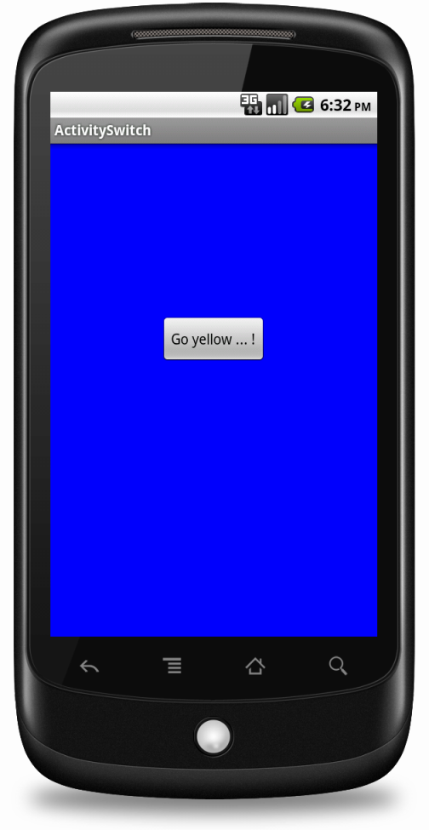
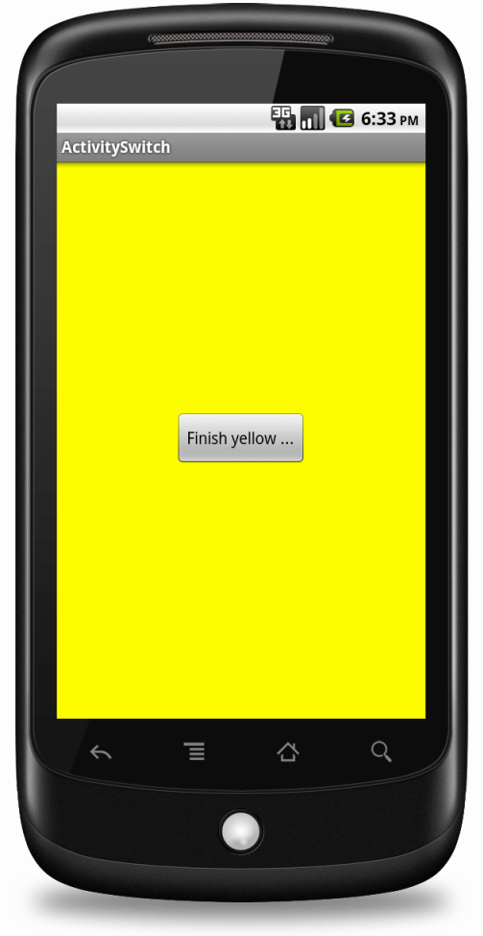
On click of button on BlueActivity, the YellowActivity will be pushed onto stack
On click of button on YellowActivity, YellowActivity will be popped out of
stack and returned
back to BlueActivity

Slide 4
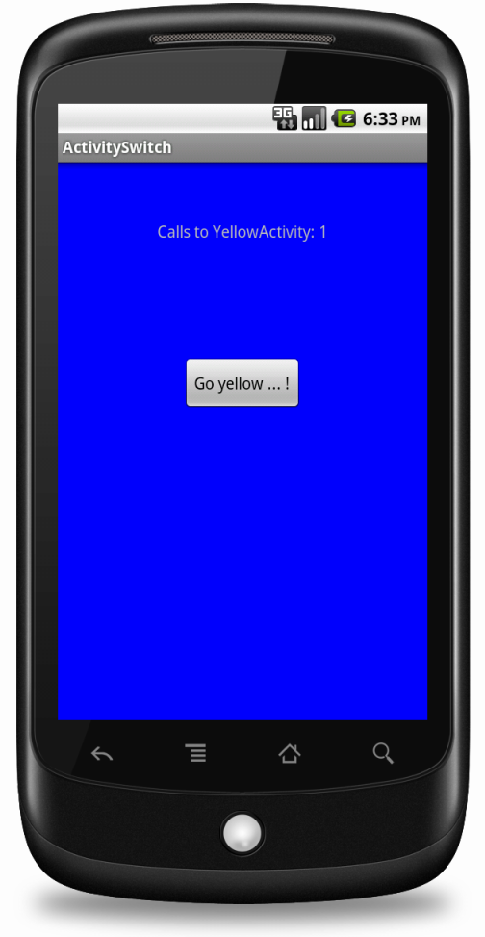
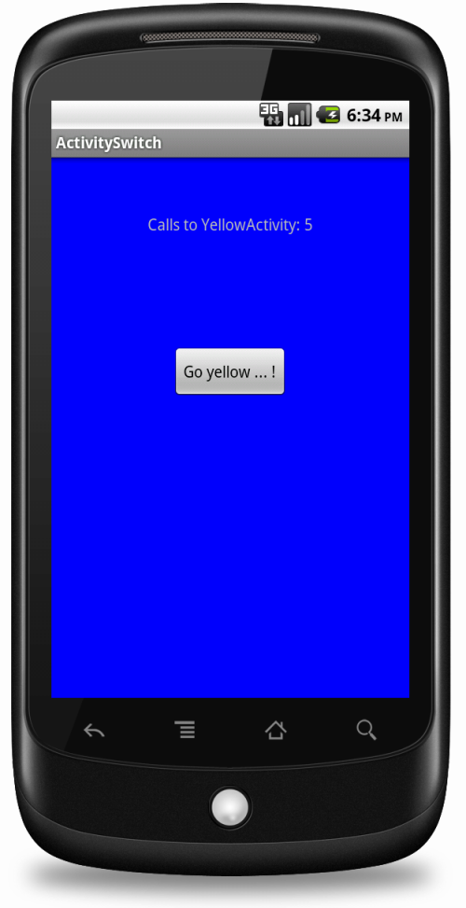
The YellowActivity keeps track of number of times the activity was called. This is returned to the BlueActivity in form of Intent which is displayed in the TextView of BlueActivity

Slide 5
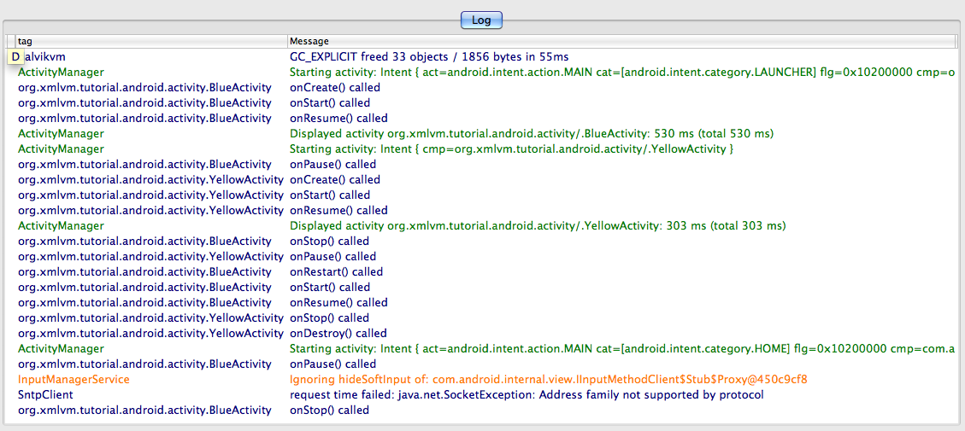
When running this application, the logging output can be observed (using DDMS) to understand activity lifecycle methods that are invoked by Android.
Called during start of BlueActivity
Called when YellowActivity is called from BlueActivity
Called when returned back to BlueActivity from YellowActivity

Slide 6
References
Activity
Activity lifecycle
Intent

Slide 7
Exercise
Add a GreenActivity that can be reached via a button from the YellowActivity. No data needs to be passed between YellowActivity and GreenActivity.

