Slide 1
Android - Activities (Implicit)
tutorial/android/activity/implicit
This tutorial is a variation of the explicit switching of activities
Activities are referenced implicitly, i.e., not by referencing their class object, but by an action
An action is essentially a string
An activity can respond to an action by defining an intent filter in AndroidManifest.xml
If several activities have the same intent filter, Android will show a so-called activity chooser
Note that this tutorial has two separate Android applications: first run ActivitySwitchImplicit and then install ActivitySwitchImplicitGreen and re-run the first app

Slide 2
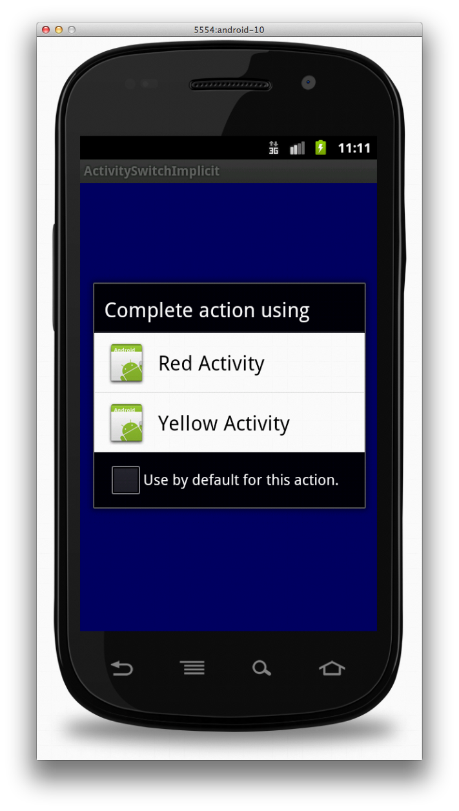
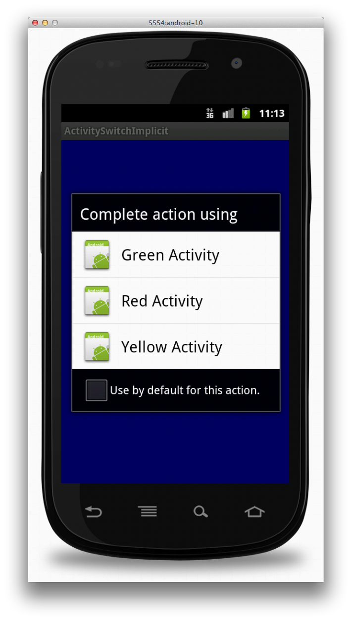
Running ActivitySwitchImplicit without installing ActivitySwitchImplicitGreen
Running ActivitySwitchImplicit after installing ActivitySwitchImplicitGreen

Slide 3
References
Activity
Activity lifecycle
Intent

Slide 4
Exercise
Add another intent filter to YellowActivity for an action called ACTION_BRIGHT_COLOR. Add another button to BlueActivity with the title "Choose bright color" and sends the implicit action ACTION_BRIGHT_COLOR.

