Slide 1
Android - Map
tutorial/android/map
This application is uses Google API to display map of San Francisco
Google API offers its own MapActivity and the application has to be derived from it
Every application that uses Google Maps API has to
Register with Google
Obtain a Map API Key
Include the key in android:apiKey attribute of the layout resource
MapView
acts as a wrapper around the Google Maps API to manipulate and work with Google Maps data
setBuiltInZoomControls()
Used to retrieve the built in ZoomControls object from MapView

Slide 2
GeoPoint
Represents a pair of latitude and longitude
MapController
Used to set view location and zooming
In AndroidManifest.xml
Permissions have to be declared :
INTERNET
To access internet and retrieve Gogle Maps tiles
ACCESS_FINE_LOCATION
Reference the Map API via <uses-library>
<uses-library android:name="com.google.android.maps"/>
Because we are using Google Maps library

Slide 3
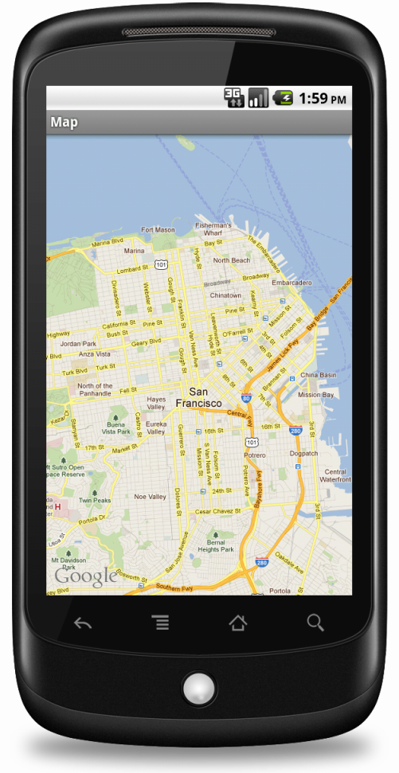
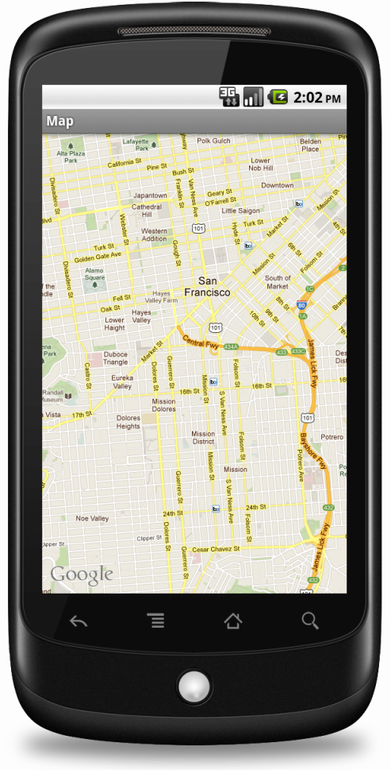

Slide 4
References:
Maps API key
GeoPoint
Location and Maps
MapView
MapController

Slide 5
Exercise
Change the hardcoded langitude/latitude coordinates so that the map shows downtown Manhattan in New York City.
Also show a pin at those coordinates
(hint: http://developer.android.com/resources/tutorials/views/hello-mapview.html)

