Slide 1
Android - List
tutorial/android/navigation/list
Application to demonstrate ListActivity that displays items as a vertical list
List item can be an arbitrary view (here, TextView)
The main activity is derived from ListActivity
ArrayAdapter can be used to fill the ListActivity with values
The ArrayAdapter needs
Resource ID for a layout file containing a TextView
Objects - String array with values to be shown
getListView()
Used to retrieve the ListView

Slide 2
A click listener is set which will be invoked when an item is selected
onItemClick()
Callback invoked when item is selected
onItemClick(AdapterView<?> parent,
View view,
int position,
long id)
AdapterView where the click happened
View within the AdapterView that was clicked
Row ID of the item that was clicked
Position of the view in the adapter

Slide 3
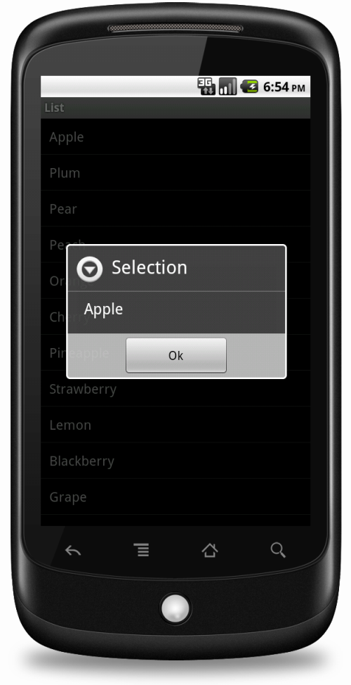
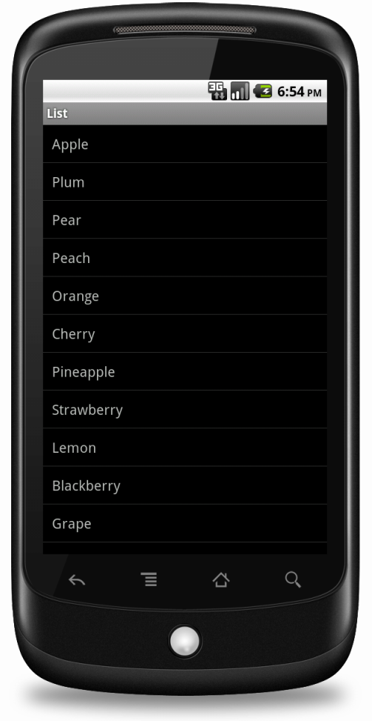
A list item here, is a TextView showing one of several fruit names hardcoded into the application
Whenever an item of the ListActivity is selected, an AlertDialog is shown with the item that was selected

Slide 4
References
ListActivity
ListView
ArrayAdapter
AlertDialog

Slide 5
Exercise
Nothing to do!

