Slide 1
Android - TabBar
tutorial/android/navigation/tabbar
Application to demonstrate the use of a TabBar which allows to select from a variety of options
The main activity is derived from base class TabActivity
Each tab has an Activity associated with it
For each tab a helper Activity is called
Displays the Tab that was selected in the TextView of the main view
TabHost.getTabHost()
Used to retrieve the container for tabbed window view
Holds 2 children:
Set of tab labels
User clicks on these to select a tab
FrameLayout object
displays contents of that page

Slide 2
Fluent-interface
Each method returns reference to an object
Allows concatenation of several method invocations into one "sentence"
E.g.: object.function1().function2().function3()
Each tab requires:
Tag of the tab - newTabSpec()
An indicator consisting of a label and an icon - setIndicator()
The content to be shown when the tab is selected - setContent() - specified via an Intent
Individual tabs are added to the TabBar using addTab()

Slide 3
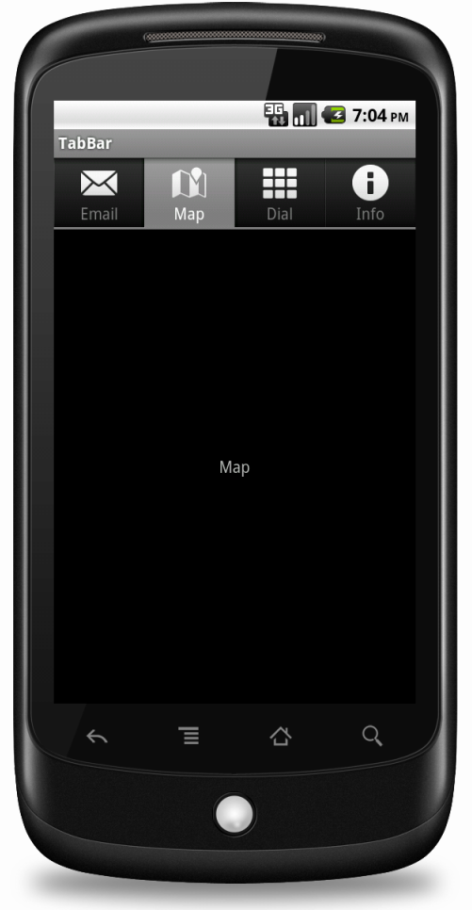
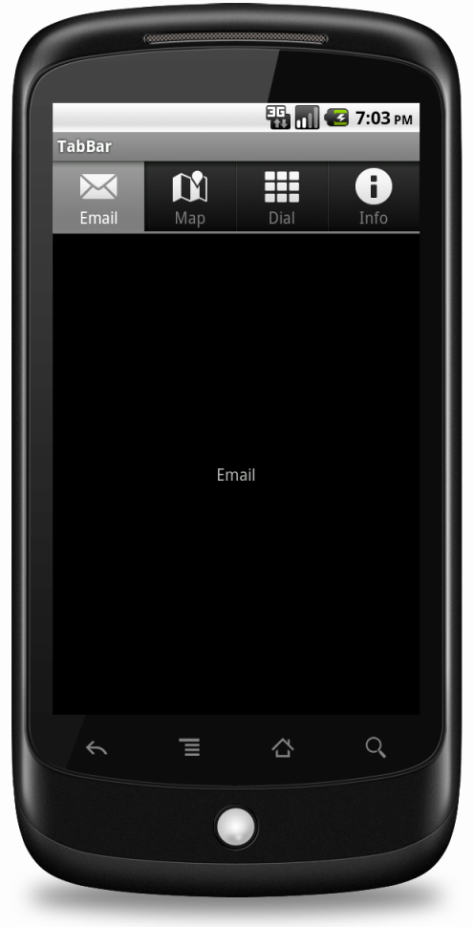
There are 4 tabs : "Email" "Map "Dial" "Info"
System icons are used for each tab
On click of any tab, the tab that was selected is displayed in the TextView of the main view

Slide 4
References
TabActivity
Resources
TabHost
FrameLayout
Intent

Slide 5
Exercise
Add another tab to the application. The label of the tab should be “Hello” and when selected, the main view of the tab should show the label “Hello World”.

