Slide 1
Android - MultiTouch
Demonstrates multi-touch on Android devices
A circle is shown where the finger touches
If there are multiple touches, multiple circles are shown
The circle follows the finger when the finger is dragged over
An anonymous class derived from android.view.View is used
Override :
onDraw() - to draw circle
onTouchEvent() - to intercept touch events
A list of active touch positions is maintained
Used by onDraw() to draw circles
Updated by onTouchEvent()

Slide 2
onTouchEvent()
Called when new touch event occurs
getAction()
Get the type of the motion event
Some of the events are:
MotionEvent.ACTION_DOWN
A pressed gesture has started
MotionEvent.ACTION_POINTER_DOWN
User puts finger on screen
MotionEvent.ACTION_MOVE
User moved a finger
MotionEvent.ACTION_UP
A pressed gesture has finished
MotionEvent.ACTION_POINTER_UP
User lifted a finger
All the active touches are iterated over and added to the list except the event where user lifted his finger is ignored

Slide 3
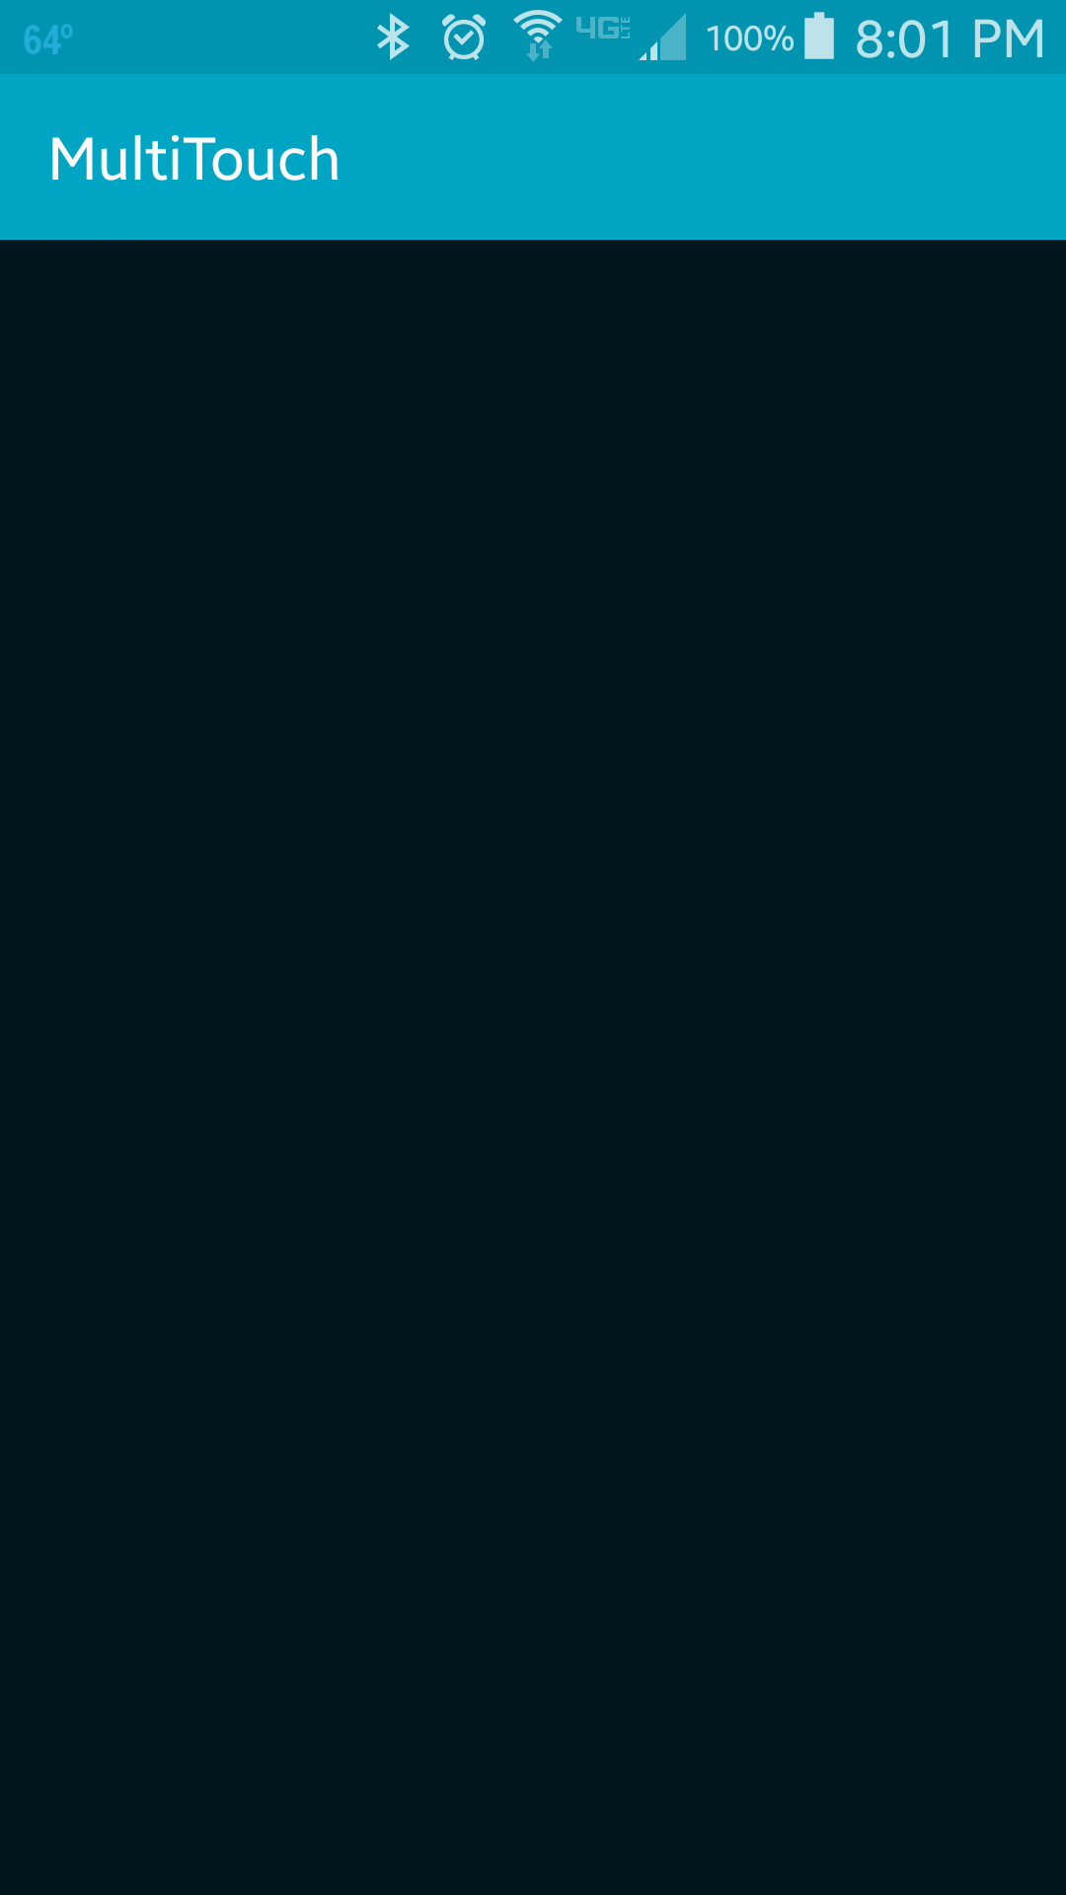
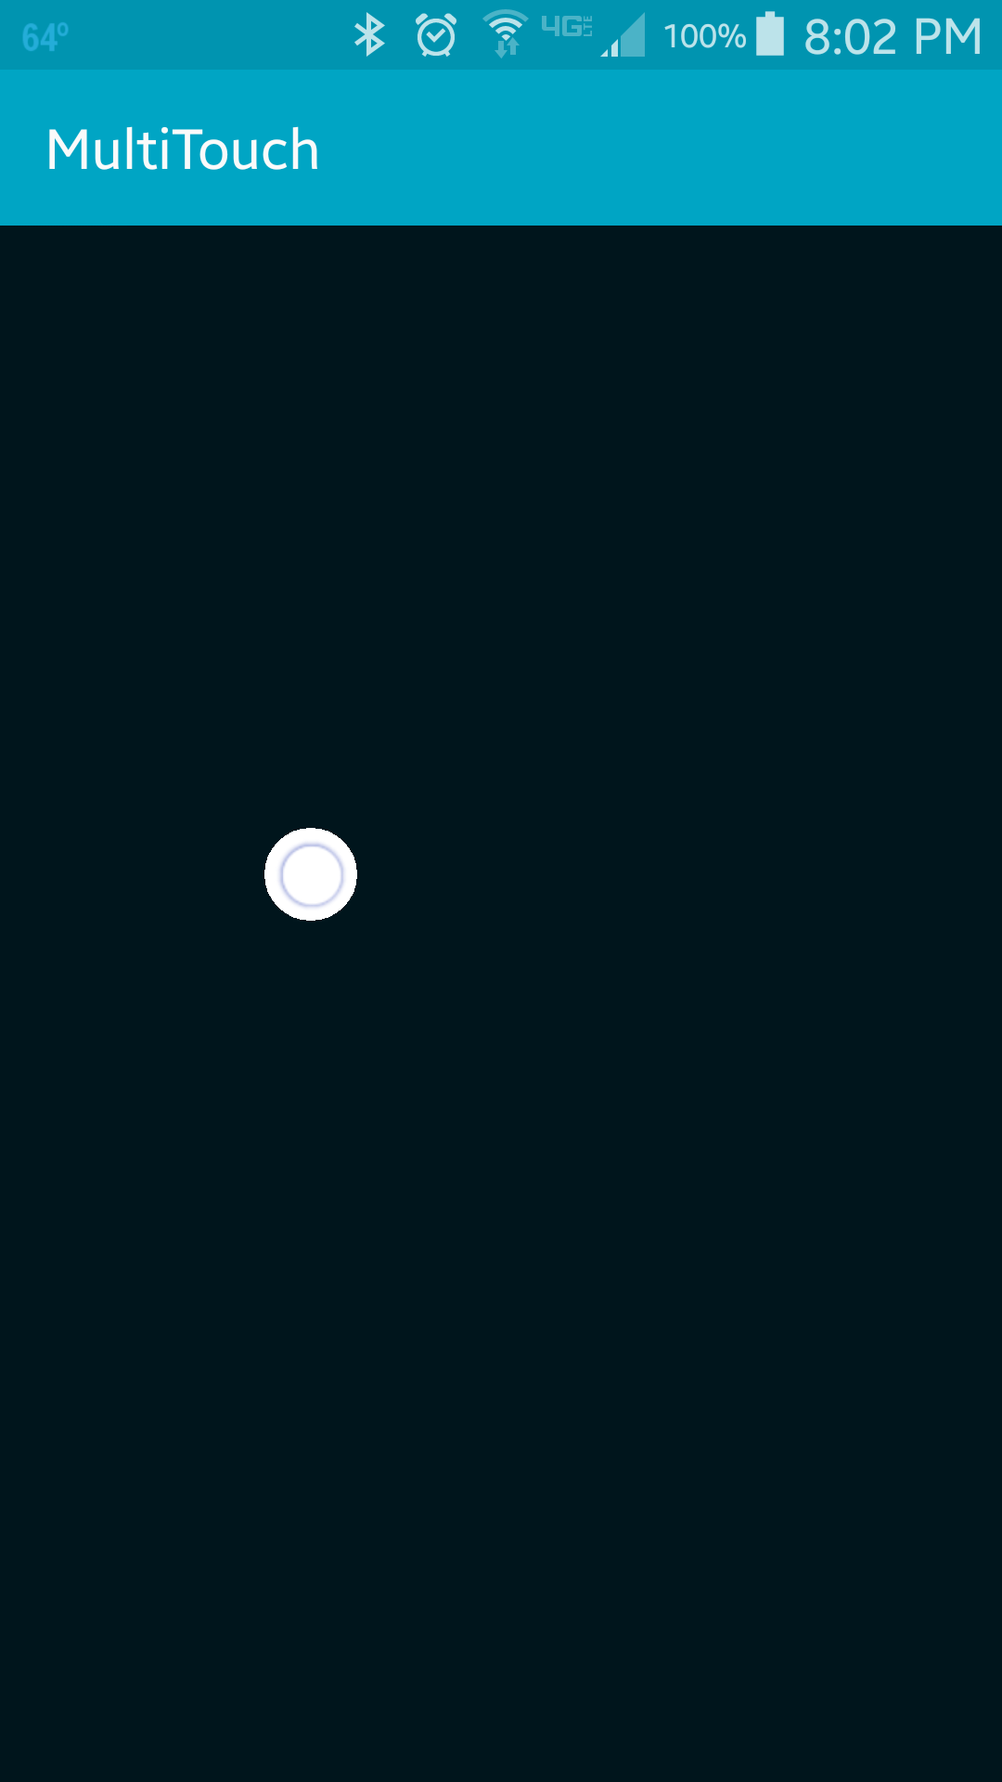
A white circle is drawn wherever the finger touches the screen
The Android emulator can only simulate one touch
Not all Android devices support multi-touch

Slide 4
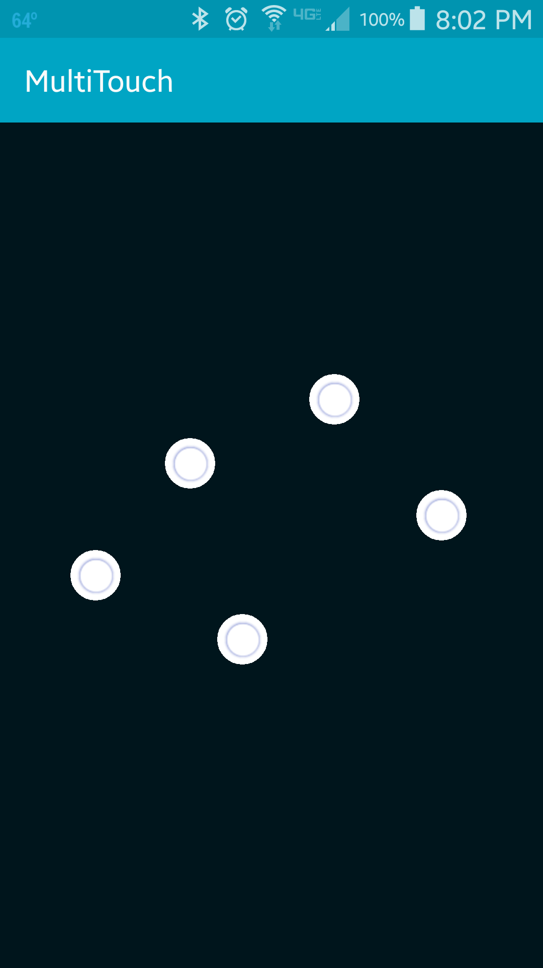
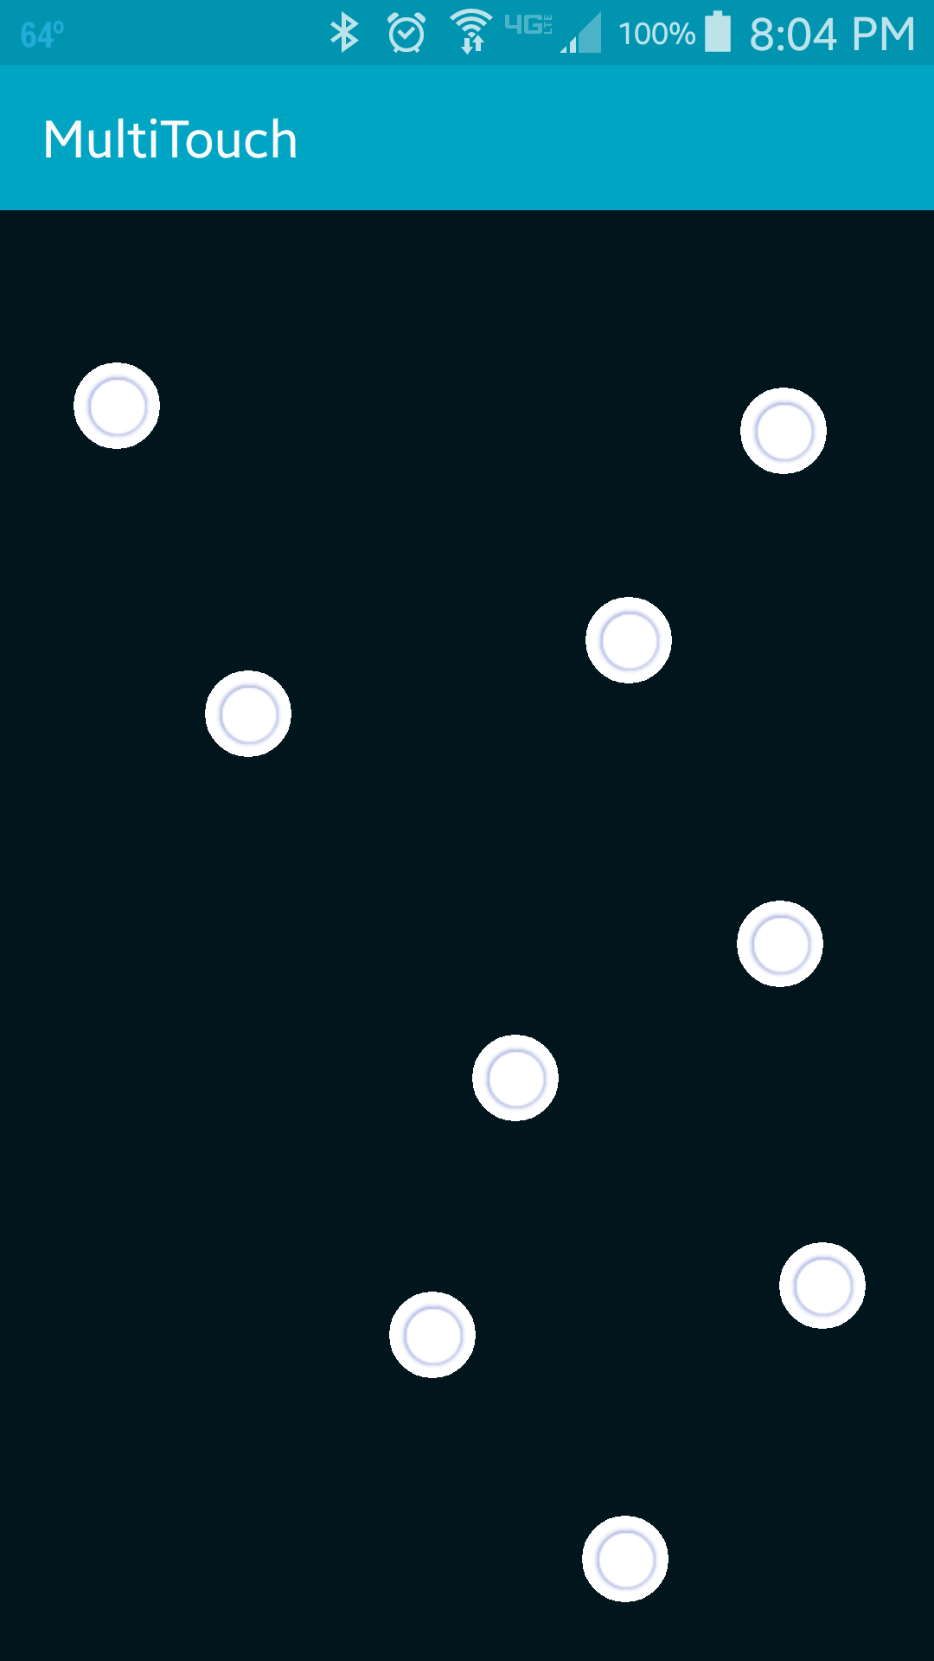

Slide 5
References
MotionEvent
Point
View

Slide 6
Exercise
Change the application so that is draws *one* rectangle that is just large enough to include all active touches. Use red as the filling color of this bounding box.

