Slide 1
Android - HelloWorld (landscape)
tutorial/android/helloworld/landscape
Simple "Hello World" similar to declarative version
Locks the orientation to landscape mode
Locking orientation is done via XML attribute in AndroidManifest.xml
XML-attribute used is :
android:screenOrientation="landscape"

Slide 2
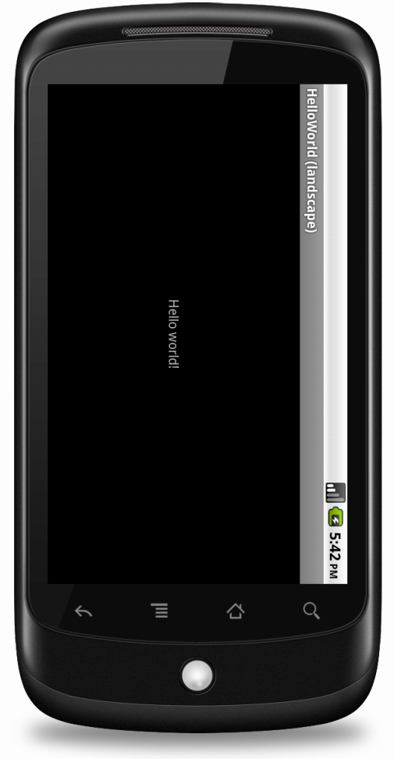
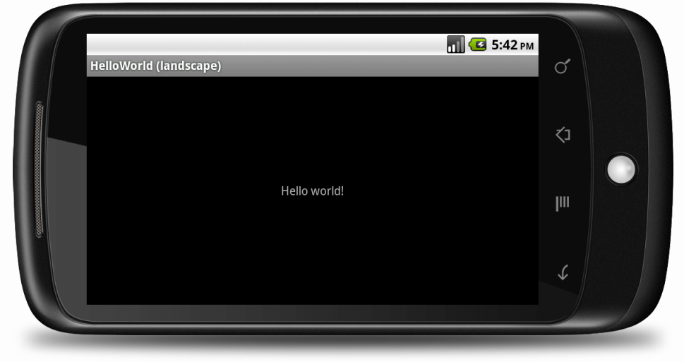
"Hello World" is displayed at the center of the screen
The orientation is locked to landscape mode
The application works when cross-compiled using XMLVM

Slide 3
References
AndroidManifest file
<activity> element

Slide 4
Exercise
Nothing to do!

