Slide 1
Android - Layout (linear)
tutorial/android/layout/linear
Shows use of LinearLayout for portrait and landscape mode
Displays six buttons arranged according to the orientation
Layout resource is referenced via identifier R.layout.main
Layout resource is picked based on screen orientation:
res/layout/main.xml - portrait mode
res/layout-land/main.xml - landscape mode
Layout resource uses:
LinearLayout on top-level of view hierarchy
Nested LinearLayouts to achieve portrait/ landscape orientation
Layout parameters in <Button> must match capabilities defined by LinearLayout
<LinearLayout>
<Button .. .... />
</LinearLayout>

Slide 2
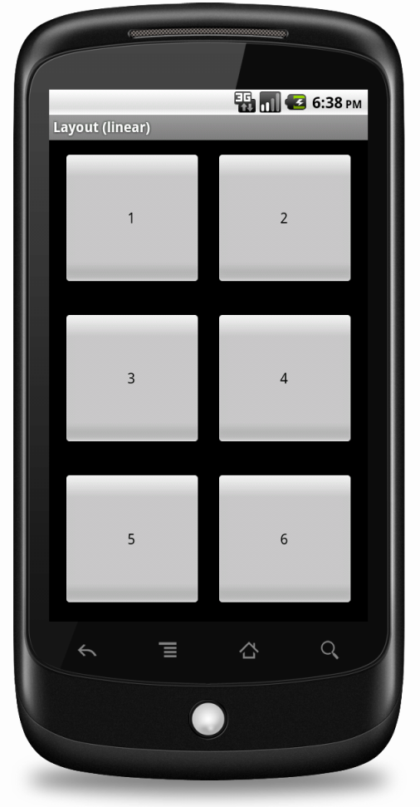
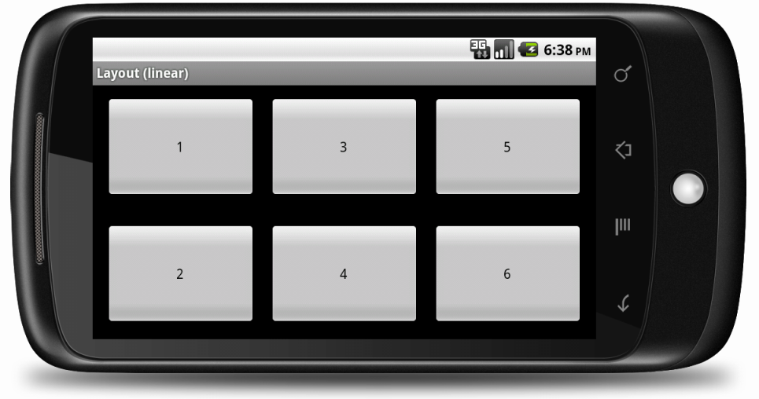
Layout resource uses
3 nested LinearLayout to achieve portrait orientation of six buttons
2 nested LinearLayout to achieve landscape orientation

Slide 3
References
Layout objects
LinearLayout
LinearLayout.LayoutParams
Button

Slide 4
Exercise
Change the application such that the positions of the buttons 1 and 6 are swapped in landscape mode (i.e., button “6” should be in the upper left corner while button “1” in the lower right corner). The position of the buttons in portrait mode should remain unchanged.

