Slide 1
Android - Menu
tutorial/android/navigation/menu
Demonstrate use of Android's menu button
The menu is displayed in the bottom half of screen when menu button is pressed
Here, menu has 3 items :
Add
Delete
Search
When specific menu is selected, the option is displayed in TextView on main view
The contents of Activity's standard options menu is initialized by overriding onCreateOptionsMenu()
onOptionsItemSelected()
called whenever the user selects an option from the menu

Slide 2
getMenuInflater()
Used to retrive the MenuInflator for the activity
MenuInflator used to instantiate menu XML files into Menu objects
res/menu/options.xml
Describes items of menu
Each item has
A resource ID associated
A label android:title="Add"
An icon: android:icon="@android:drawable/ic_menu_add

Slide 3
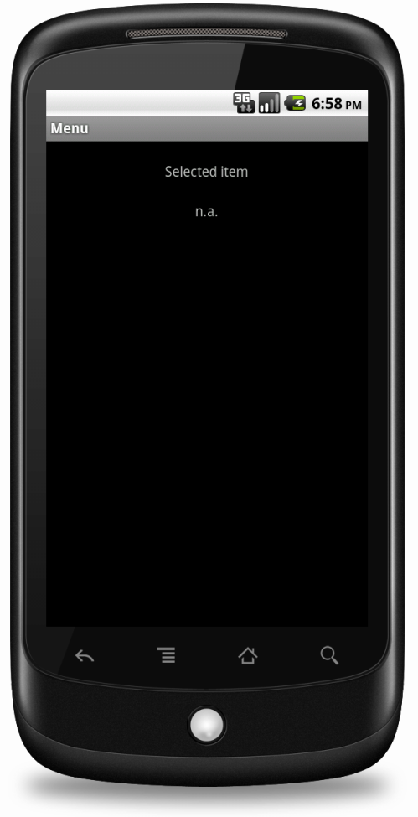
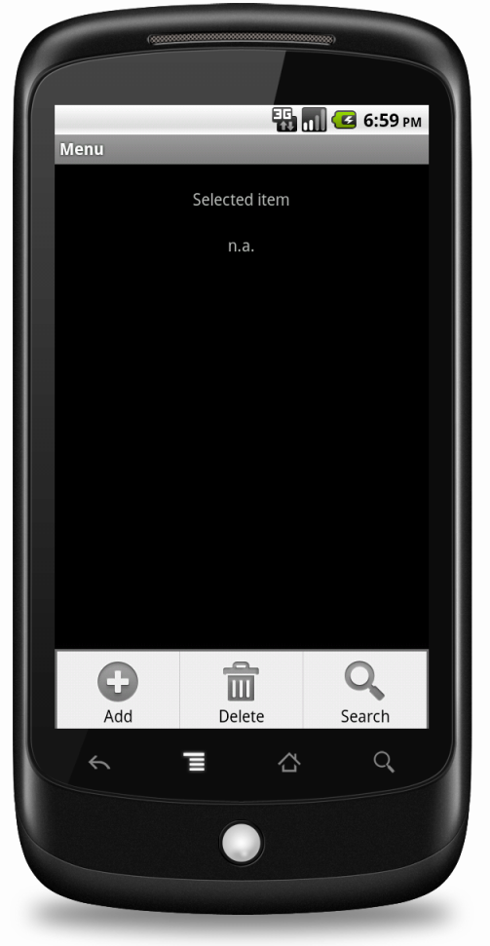
On click of Android's physical menu button, the three menu items are displayed at the bottom of the screen

Slide 4
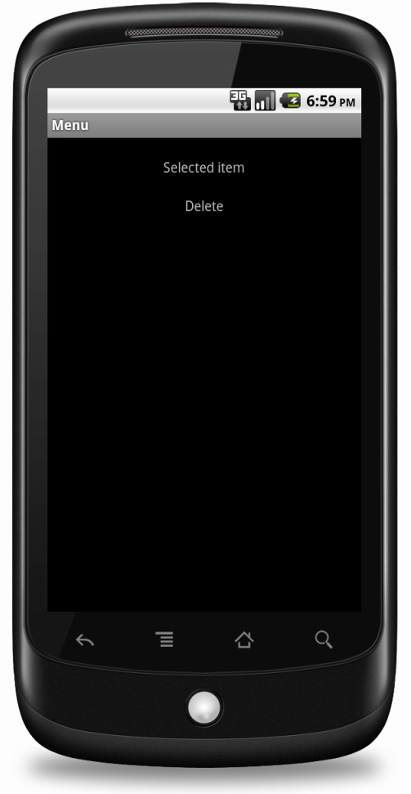
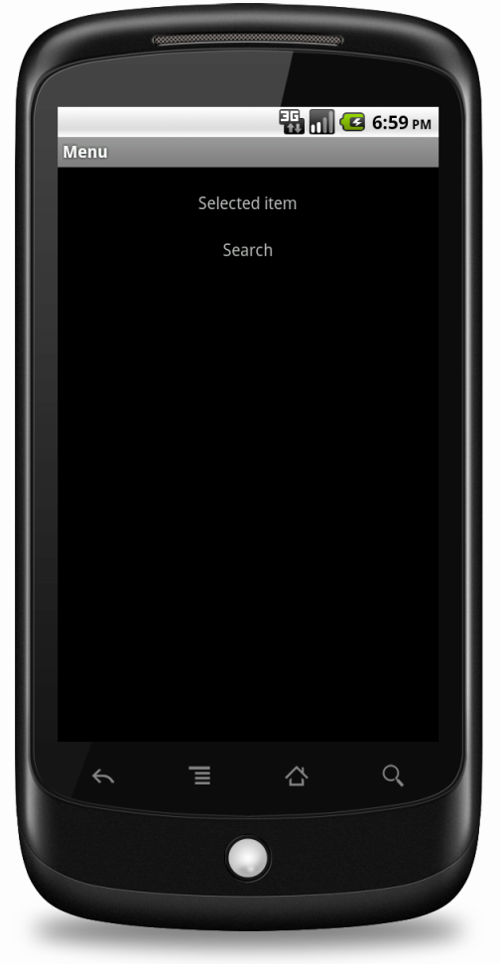
On click of any of the menu item, the selected menu item is displayed in the TextView of the main view

Slide 5
References
Menu
Creating menus
Menu resource
MenuInflator
Activity

Slide 6
Exercise
Add another menu option called “About”

