Slide 1
Android - GPS
tutorial/android/sensor/gps
This application allows the user to see their current location based on latitude and longitude
The latitude and longitude gets updated on change of location
LocationListener is used as callback whenever there are location events
The permission android.permission.ACCESS_FINE_LOCATION has to be declared in AndroidManifest.xml
LocationManager is used to access the GPS information on the device
The location information can be obtained in 3 ways :
NEWORK_PROVIDER
GPS_PROVIDER (used in the example)
PASSIVE_PROVIDER
Override onLocationChanged()
Called when the location has changed
To update the change in latitude and longitude

Slide 2
The other callback methods are:
onProviderDisabled()
Called when the provide is disabled by the user
onProviderEnabled()
Called when the provider is enabled by the user
onStatusChanged()
Called when the provider status changes
It may take a while for GPS information to be obtained
Good practice to display the last known location whenever available
getLastKnownLocation()
Gets the last known location
Returns Location object from which longitude and latitude from previous session can be obtained using getLongitude() and getLatitude()

Slide 3
Using the "geo fix" command in the emulator console
To send mock location data from the command line.
Launch your application in the Android emulator and open a terminal/console in your SDK's /tools directory.
Connect to the emulator console. Use the command: telnet localhost <console-port> telnet localhost 5554
Send the location data: geo fix longitude latitude altitude
This command accepts a longitude and latitude in decimal degrees, and an optional altitude in meters. For example: geo fix -121.45356 46.51119 4392

Slide 4
Three ways to emulate GPS using DDMS
Switch to the DDMS (Dalvik Debug Monitor Service) perspective.
Using the Manual tab under Location Controls, manually send individual longitude/latitude coordinates to the device.
Use a GPX file describing a route for playback to the device.
Use a KML file describing individual place marks for sequenced playback to the device.

Slide 5
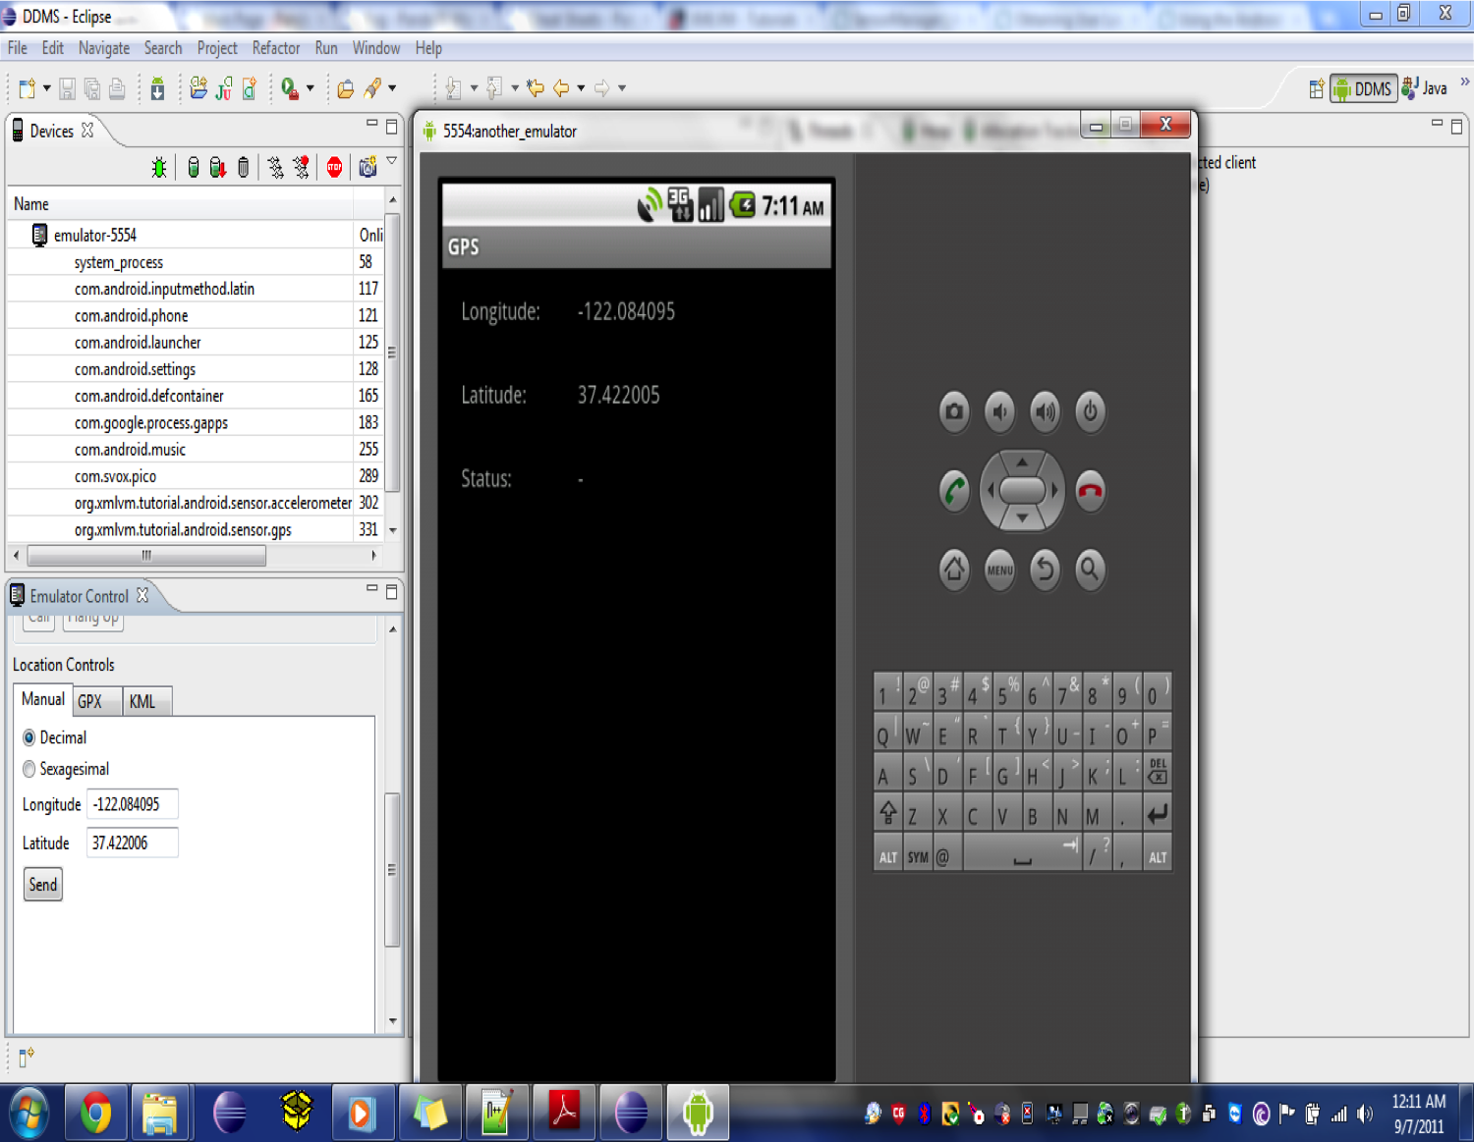

Slide 6
Reference
LocationManager
LocationListener

Slide 7
Exercise
Add another label that displays the accuracy of the Location object.

