Slide 1
Android - Gyroscope
Application to demonstrate access to gyroscope on Android device
Main activity implements the interface android.hardware.SensorEventListener
Gyroscope is not supported on all devices
SensorManager.getDefaultSensor (Sensor.TYPE_GYROSCOPE)- retrieves the default Sensor for the gyroscope.
Whenever there is change is sensor event, onSensorChanged() callback is called with the SensorEvent object
SensorEvent object contains an array of angular speed along x, y and z axis
It is good practice to unregister the sensor when not in use using unregisterListener()

Slide 2
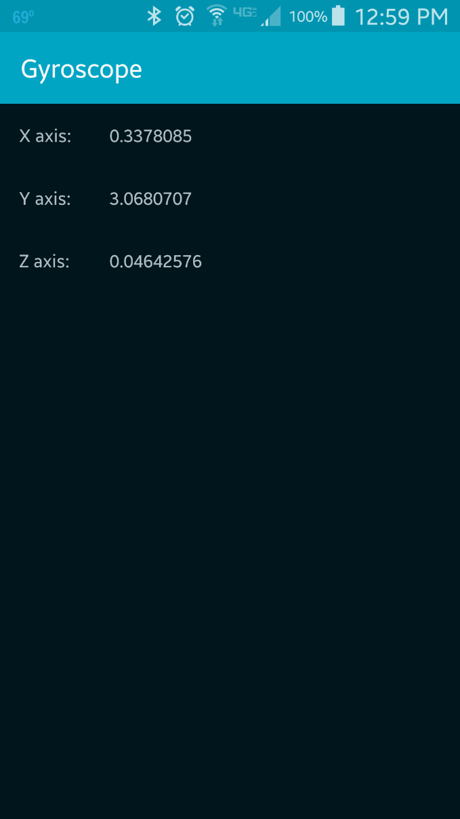

Slide 3
Reference
SensorEvent
SensorEventListener
SensorManager
Sensor

Slide 4
Exercise
Nothing to do!

