Slide 1
DTMF

Slide 2
What is DTMF
Dual-tone multi-frequency signalling (DTMF) is used for telecommunication signalling over analog telephone lines in the voice-frequency band between telephone handsets and other communications devices and switching centre.
The version of DTMF that is used for tone dialling is known as Touch-Tone.

Slide 3
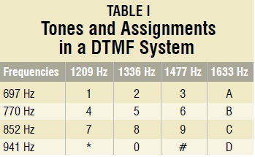
DTMF Frequencies

Slide 4
Stuff Required
The following things are required:
MT8870
Atmega16
Phone jack
L293D

Slide 5
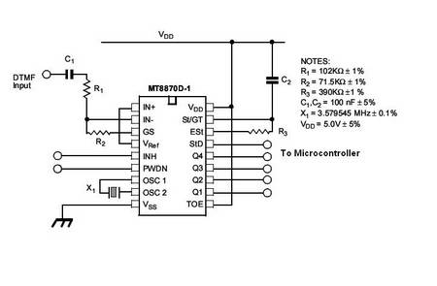
Circuit Diagram

Slide 6
In this pin 15 (std pin) is to be kept not connected. INH and PWDN pins should also be ground. R2 can have bigger value till 110kohms.
Pins 11 to 14 are connected to input pins of microcontroller.
Connect L293D to output pins microcontroller and its output pins to motors.

Slide 7
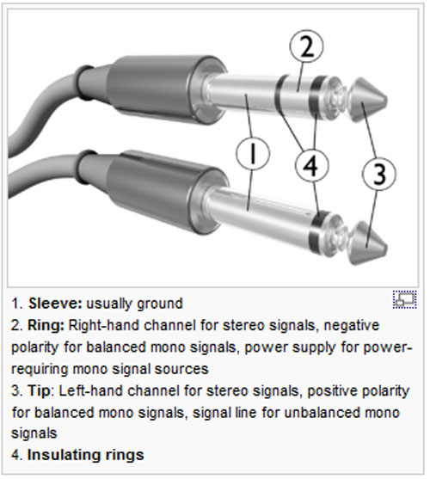
Audio Jack

Slide 8
Tip should be connected to dtmf input.
Sleeve-ring should be ground.
You need to short ring and sleeve

