Slide 1



Slide 2

Pulse Width Modultaion

Slide 3
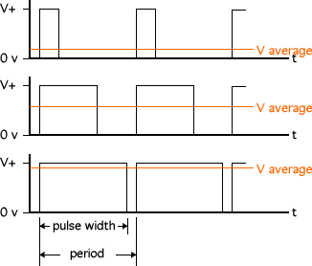
PWM – Pulse width modulation
Generating a pulse whose duration can be altered

Slide 4
Back to PWM
Need
Uses:
Motor Speed Control
Intensity Control

Slide 5
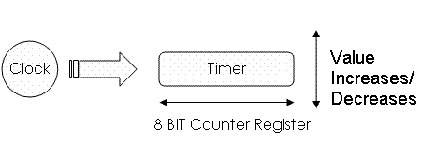

Timers in Microcontroller
Timer is basically a register i.e. a storage unit that keeps times.

Slide 6
Timers in Microcontroller(Cont.)
In Atmega16 there are 2 types of timers-
• 8 bit timer ( range 0-255)
• 16 bit timer (range 0-65535 )
Atmega16 has one 16 bit and two 8 bit timers.
16 bit timer- Timer1 (Called as Timer1A and Timer1B)
8 bit timers – Timer0
- Timer2

Slide 7
Timer Registers
TCCR = Timer/Counter Control Register.
It sets up the timer.
TCNT = Timer Counter.
It keeps the count of the clock cycles as shown previously.
It has the actual timer count.
OCR = Compare Value.
As soon as TCNT becomes equal to OCR, the output becomes low.

Slide 8
Clock Prescaling
Gives options to use clock frequency lesser than what crystal provides.
Possible options in Atmega16 for Timer0 & Timer1
Fclk/1
Fclk/8
Fclk/64
Fclk/256
Fclk/1024

Slide 9
Deciding the count for 1ms of time
An interrupt can be generated when on comparing OCR value to TCNT, they’re found equal.
Assume a clock of frequency 16 Mhz.
What is the OCR value needed to figure out that 1 millisec of time has elapsed?

Slide 10
Deciding the count for 1ms of time
CPU Clock frequency 16 MHz
For OCR1A = 250,
When TCNT1 == OCR1A, one millisec time has elapsed
TCNT1
The Timer/Counter1
(Increments 1 for every cycle i.e. in 1/250000 secs)
Clock prescaling by 64
(16Mhz/64 = 250 K

Slide 11
Other Important register for using timers for PWM
ICR = Top Value.
This stores the top value up to which timer can count. It becomes zero after reaching TOP value.
The PWM output is connected to the ENABLE pin of the motor driver.

Slide 12
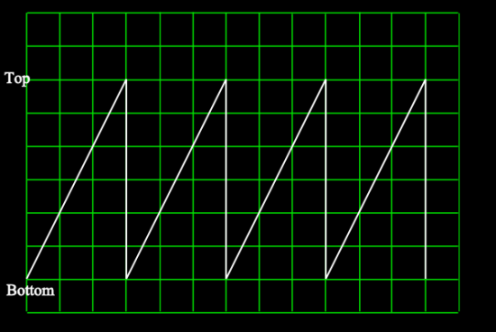
How is PWM achieved using timers?
Consider a graph of TCNT register value plotted against time

Slide 13
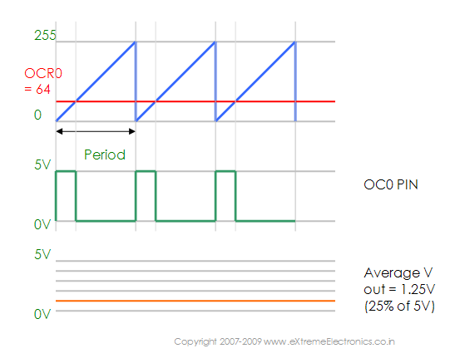
PWM output

Slide 14
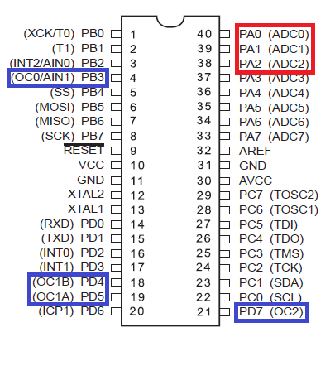
Output pins for PWM in atmega
In Atmega16 four pins
are allocated for PWM
namely-
•OC0
•OC1A
•OC1B
•OC2

Slide 15
What will we be using and why?
Number of PWM output pins required for our usage?
Which of the 2 – Timer0, Timer1, Timer2?

Slide 16
PWM initialisation
void pwm1_init(void)
{
PWM1A_DIR=1;
PWM1B_DIR=1;
TCCR1B = 0x00; //stop
TCNT1H = 0x00; //setup
TCNT1L = 0x00;
OCR1AH = 0x00;
OCR1AL = 0x00;
OCR1BH = 0x00;
OCR1BL = 0x00;
ICR1H = 0x01;
ICR1L = 0x8F; //0x018F = 399
TCCR1A = 0xA2;
TCCR1B = 0x19; //start Timer
}

Slide 17
PWM functions in sra.c
//Set PWM1A
void set_pwm1a(int a)
{
OCR1A=a;
}
//SET PWM1B
void set_pwm1b(int b)
{
OCR1B=b;
}

