Slide 1
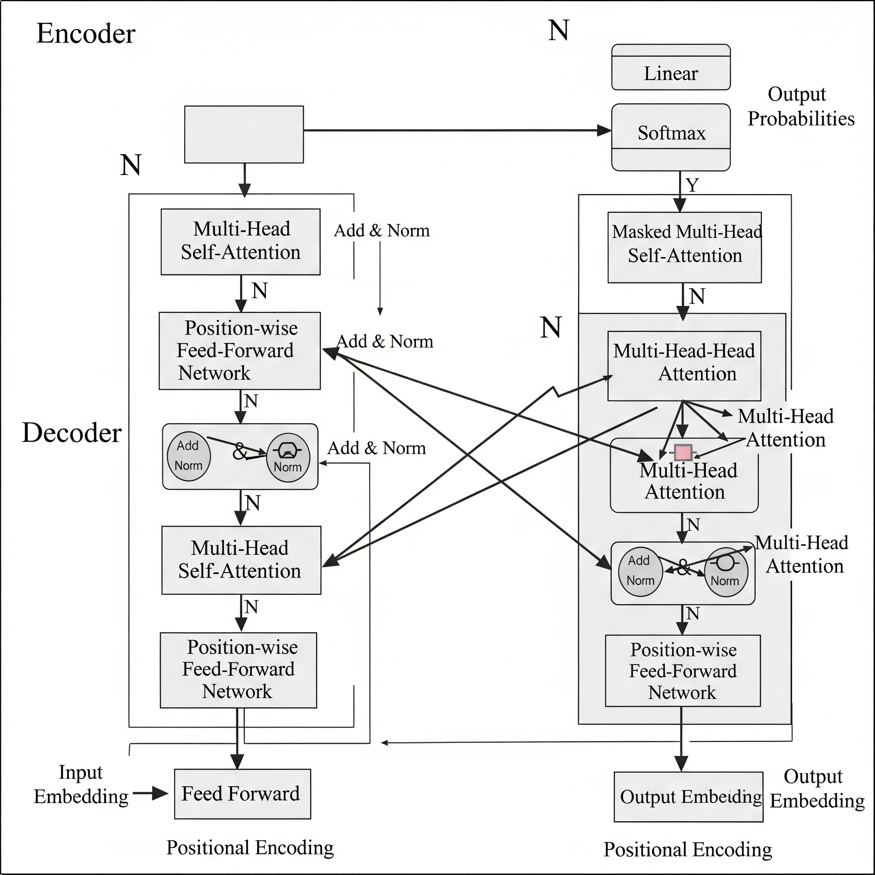
Transformers in Deep Learning
Attention mechanisms are fundamental to the Transformer model
Transformers utilize an encoder-decoder architecture effectively
They enable powerful sequence-to-sequence modeling capabilities
Positional encodings capture the important word order information

