Slide 1
Classification of Flowers
(Using Deep Learning)
Members:-
1 . Ameya khedkar
2 . Ajinkya deshpande
3 . Mandar patil
Notes:
Nahi soory tu adjust kar tab tak mein cnn mein copy karke image dalta

Slide 2
Problem statement
To identify and differentiate between 5 different types of flower from its image using convolution neural networks
Given an image of flower classify it into its proper class
Using CNN.
Try to understand how Convolution, Pooling layers extract features from images .

Slide 3
Technology stack( for flower-image detection)
Programming language:-python
Python libraries used:-
1.numpy ( for data wrangling)
2.matplotlib (graphs)
3.os , shutil and random (for creating and copying and removing directory and other stuff)
4.Google colab authentication ( for unzipping file for further data wrangling )
Framework used:-
1.Google colab:- for writing code
2.Tensorflow : - keras API
Dataset:- flower recognition using CNN keras from kaggle
Notes:
Ha theke na

Slide 4
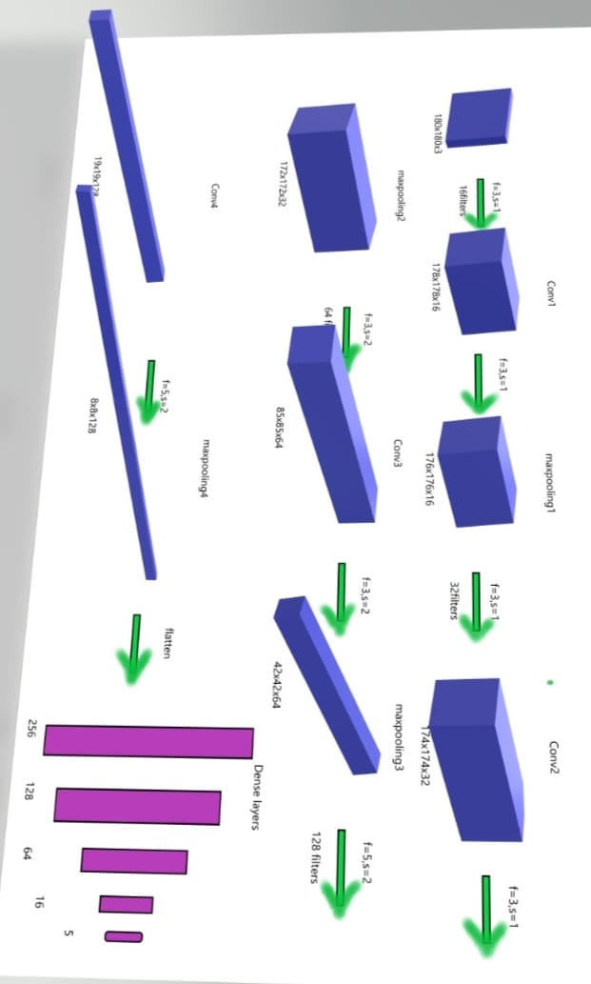
Neural network visualization

Slide 5
Results and conclusion(CNN)
Results:-
After 80 epochs
1.Testing accuracy comes out to be 83%.
2.training data accuracy was 84% .
3.Further iterations did not show changes in accuracies.
Conclusion:-
After 80 epoches ,parameters were updated satisfactorily.
To extract features from images we require convolution layers and huge number of parameters.

Slide 6
Few things which are imp in project(CNN)
Images need to be processed and augmented before feeding into network to obtaining better accuracy
Large number of neurons need to be utilised to extract proper features from images.
After specific number of epochs model starts overfitting resulting in poor validation and test accuracy.
Random and shuffled data opts for better accuracy on test set

Slide 7
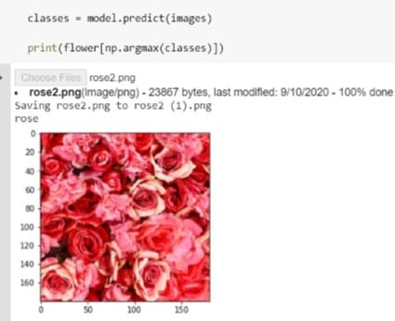
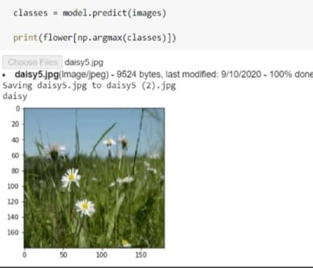
SOME TESTED IMAGES

Slide 8
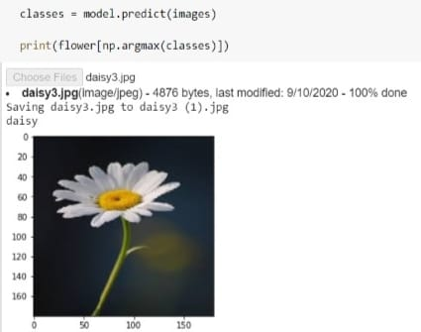
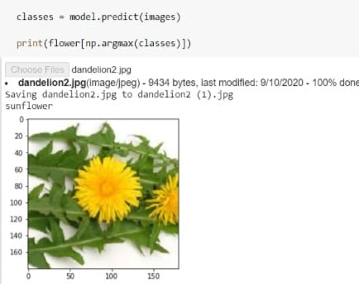
SOME TESTED IMAGES

