Slide 1
Sentiment analysis project
(Using Deep Learning)
Members:-
Ameya khedkar
Ajinkya deshpande
Mandar patil

Slide 2
Problem statement
To analyse the sentiment of text using recurrent neural networks
Given a message decide whether it is positive, negative or neutral.
To extract sentiments from word and establish relations between them using deep recurrent network model.

Slide 3
Technology stack( for text sentiment analysis)
Programming language used :-
Python
Framework used:-
1.Google Colab
2.Tensorflow:-
keras API
Python libraries used:-
1.numpy ( for data wrangling)
2.matplotlib (graphs)
3.pandas( for dataframe generation)
4. Google colab authentication ( for fetching data from google data sheet)
Dataset:- twitter sentiment analysis data
Tensorflow projector (for visualization of word vector )

Slide 4
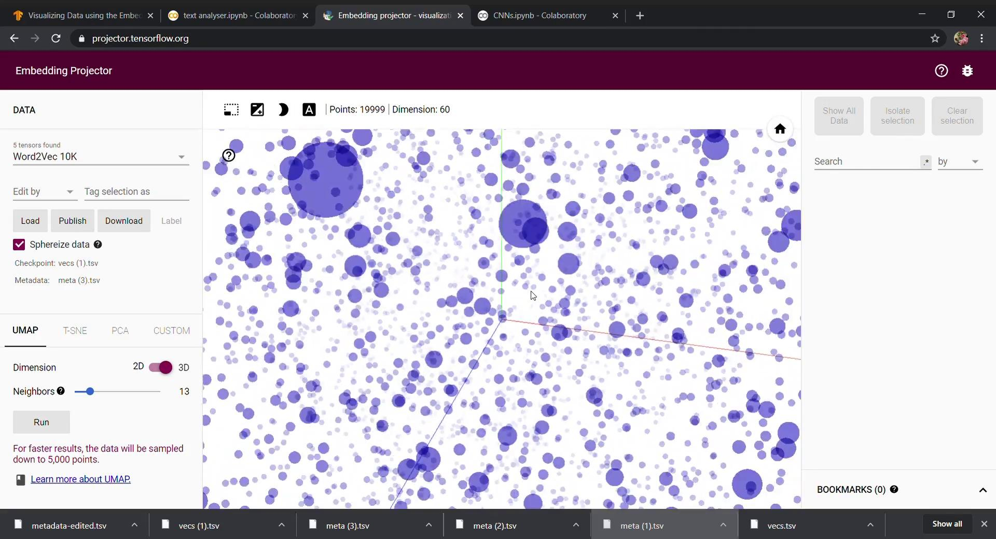
Word vector visualisation

Slide 5
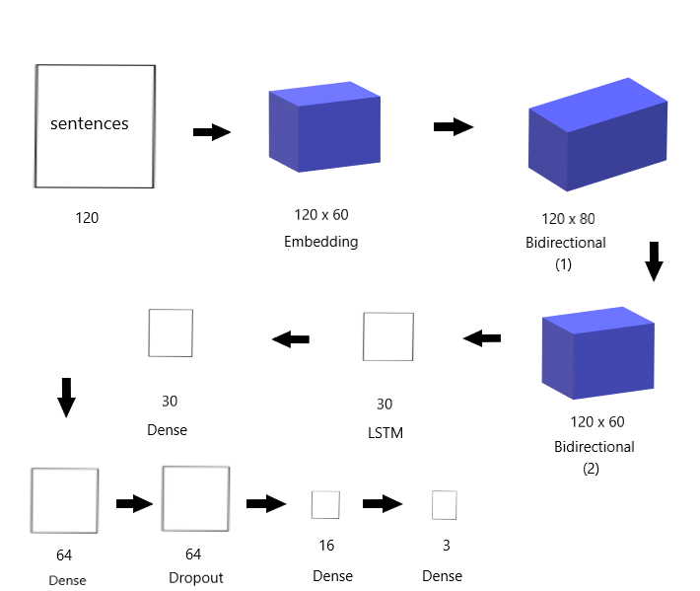
Flow of neural network
Batch Normalization
80
Notes:
Arey apan front me likha nahi title of project aur fir ha of course aaare theke rahe ga yo
Ojas se me sikhha ke presentable kaise kar na

Slide 6
Results and conclusion(RNN)
Results:-
After 10 epochs
1.Training data set output accuracy comes out to be 92% .
2.Validating data set output accuracy comes out to be 78%.
3.Testing set accuracy was 79%.
Conclusion:-
After 10 epoches ,parameters were updated satisfactorily.
To extract sentiments from words, sentences we need to vectorize them using word embeddings.

Slide 7
Few things which are imp in project(RNN)
In real world problems vocabulary size is an important parameter which affects accuracy of model ,it does not need to be size of complete words in dataset but some of effective words should be included.
Also, accuracy and loss function is noisy if batch size is not tuned properly.
After specific number of epochs model starts overfitting resulting in poor validation and test accuracy.
Random and shuffled data opts for better accuracy on test set
Model overfits so requires regularization and less parameters

Slide 8
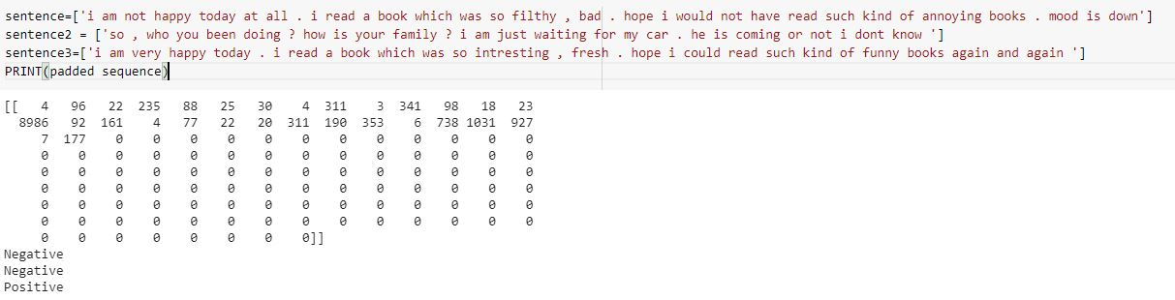
Some tested sentences with their sequence
Notes:
Tu hai kya ameya
??okay fir aur koi kam

