Slide 1
Implement a floating-point adder/subtractor in Verilog using IEEE 754 conventions
Name: Nitin Kumar
Enrollment Number: 21116065
Email: n_kumar1@ece.iitr.ac.in
Name: Yawalkar Ajinkya Ganpati
Enrollment Number: 21116108
Email: y_aganpati@ece.iitr.ac.in
Name: Bhukya Nikhil
Enrollment Number: 21116030
Email: b_nikhil@ece.iitr.ac.in
Name: Tadiparthi Sai Harshitha
Enrollment Number: 21116094
Email: t_sharshitha@ece.iitr.ac.in

Slide 2
Outline
Objective
What are single precision floating point numbers?
Flowchart of implementation
Details about the code
Edge cases in detail
Simulation results of in Xilinx Vivado
Challenges faced and your solutions
Lessons learnt during Project implementation
Conclusion/Summary
References

Slide 3
Objective
The objective of this project is to implement an adder/subtractor for two 32-bit single-precision floating-point numbers using Verilog HDL. The project aims to achieve the following:
Design and implement a 32-bit single-precision floating-point adder/subtractor using Verilog HDL.
Verify the functionality of the design by simulating the adder/subtractor using testbench files.
Document the design, simulation, synthesis, and implementation process in a detailed PowerPoint presentation.

Slide 4
What are single precision floating point numbers?
Called "floating-point" because the decimal point can "float" around depending on the size of the number.
Useful when dealing with very large or very small numbers, or when representing numbers with decimal points.
Uses 32 bits to represent a number. These 32 bits are divided into three parts:
a sign bit, 8bit exponent, and 23bit mantissa.
Mantissa controls precision; Exponent controls range
For single precision system:
Range : 10^-38 to 10^38
Precision up to 7 significant digits
X XXXXXXXX XXXXXXXXXXXXXXXXXXXXXXXXX
Sign Exponent Mantissa
[31] [30:23] [22:0]

Slide 5
Special Cases:
Special Values: IEEE has reserved some values that are ambiguous.
Zero – Zero is a special value denoted with an exponent and mantissa of 0. -0 and +0 are distinct values.
Denormal(underflow) –
Smaller than the smallest number that can be represented using 32 bits bit width. If the exponent is all zeros, but the mantissa is not then the value is a denormalized number. This means this number does not have an assumed leading one in significand.
Infinity(overflow) –
Larger than the largest number that can be represented using 32 bits bit width. The values +infinity(s=0) and –infinity(s=1) are denoted with an exponent of all ones and a mantissa of all zeros.
NaN(exception) – NAN is used to represent a value that is an error. This is represented when exponent field is all ones and nonzero mantissa.
*(s is sign bit)

Slide 6
Detailed steps of Project implementation
Compare and assign block :
If the exponent of a is greater than the exponent of b, then a is assigned as the larger number else b is assigned as the larger number.
Separate the sign, exponent and mantissa bits :
components of the floating-point numbers are separated and stored in separate registers to facilitate ease in further calculations.
Calculation of exponent difference and shifting of mantissa :
Considering ‘a’ has been assigned as the larger number, we subtract exponent of ‘b’ from ‘a’ and then shift the mantissa of ‘b’ to right by the difference.
Addition/Subtraction of mantissa :
If the sign bits of both the numbers are same, then we add the mantissa bits otherwise we subtract them.
Normalization Block :
If a carry is generated after the addition of mantissa bits, then we increment exponent by 1 per left shift of binary. If there is no non-zero bit in significand, then shift binary point to right until 1 in significand, and decrement exponent by 1 per shift.
Generating Output:
Merge the sign, exponent, mantissa bits and give output as a 32bit single precision floating point number.

Slide 7
Flow Chart
2 inputs a, b
32 bits each taken
Separate sign, exponent and mantissa bits
Compare exponents and assign
Operation on mantissas
Same signs addition
Opposite signs subtraction
Shift mantissa of b to right by x
Calculate exponent difference(x)
Normalization
Increase exponent of result by 1 per right shift of mantissa
yes
Carry?
no
Decrease exponent of result by 1 per left shift of mantissa until nonzero bit in significand

Slide 8
Details about the code
module Adder_Subtractor(a,b,res,underflow,overflow,exception);
input [31:0]a;
input [31:0]b;
output reg [31:0] res;
output reg underflow;
output reg overflow;
output reg exception;
reg [23:0] mant_a, mant_b;
reg [23:0] mant_temp;
reg [22:0] mant;
reg [7:0] exp;
reg sign;
reg [7:0] exp_a,exp_b,exp_temp,exp_diff;
reg sign_a,sign_b,sign_temp;
reg [32:0] temp;
reg carry;
reg compare;
reg [7:0] exp_adjust;
if (a[30:23] >= b[30:23])
compare = 1’b1;
else
compare = 1’b0;
if (compare)
mant_a = {1'b1,a[22:0]};
exp_a = a[30:23];
sign_a = a[31];
mant_b = {1'b1,b[22:0]};
exp_b = b[30:23];
sign_b = b[31];
else
mant_a = {1'b1,b[22:0]};
exp_a = b[30:23];
sign_a = b[31];
mant_b = {1'b1,a[22:0]};
exp_b = a[30:23];
sign_b = a[31];
if ((mant_a!=23'b0 & exp_a==8'b1)|(mant_b!=23'b0 & exp_b==8'b1))
assign exception = 1’b1;
else
assign exception = 1'b0;

Slide 9
if (exception)
assign underflow = 1'b0;
assign overflow = 1’b0;
assign res = 32’b0;
else if (!exception)
exp_diff = exp_a - exp_b;
mant_b = (mant_b >> exp_diff);
{carry,mant_temp} = (sign_a ~^ sign_b)? mant_a + mant_b : mant_a - mant_b ;
exp_adjust = exp_a;
if(carry)
mant_temp = mant_temp>>1;
exp_adjust = exp_adjust + 1'b1;
else
while(!mant_temp[23])
mant_temp = mant_temp<<1;
exp_adjust = exp_adjust-1'b1;
sign = sign_a;
mant = mant_temp[22:0];
exp = exp_adjust;
//overflow(infinity check)
if (mant==23'b0 & exp==8'b1)
begin
assign overflow = 1'b1;
end
else
begin
assign overflow = 1'b0;
end
//underflow(denormal check)
if (mant!=23'b0 & exp==8'b0)
begin
assign underflow = 1'b1;
end
else
begin
assign underflow = 1'b0;
end
res = {sign,exp,mant};

Slide 10
Edge cases in detail
Check inputs a and b
For normal inputs
If either of them is NaN
If either of them is Infinity
Check result
Exponent all 1’s & mantissa==0
Exponent all 0’s
Exception is raised
Overflow is raised
Result is infinity
Mantissa!=0
Mantissa==0
No operation is performed
Result is set to infinity (same sign as a)
Result is denormal
Result is zero
overflow flag set to 1
Set underflow flag to 1
Result is set to 0

Slide 11
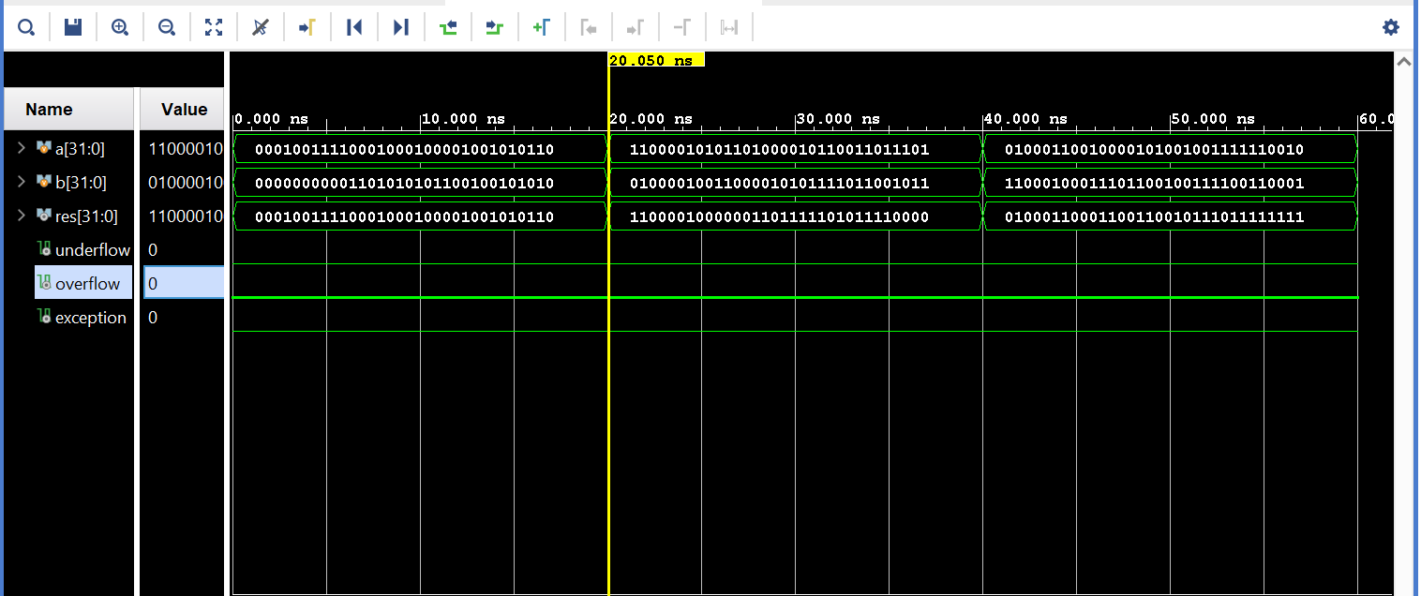
Simulation results in Xilinx Vivado

Slide 12
Challenges faced
Challenges:
Understanding the floating-point format: The project involved working with single precision floating point numbers, which can be a complex format to understand and work with.
Debugging Verilog code: Debugging the Verilog code can be a challenging task, especially when working with complex modules that have multiple inputs and outputs.
Testing the design: Verifying that the design works as intended can be a difficult task, especially when dealing with floating point arithmetic.

Slide 13
Solutions to these Challenges
Solutions:
Understanding the floating-point format:
>>Studied the IEEE 754 standard conventions that defines the floating-point format.
>>Reviewed some example implementations to understand the format and how to work with
it in Verilog.
2. Debugging Verilog code:
>>Simulated testbenches to verify the functionality of the design, observing the output waveform.
3.Testing the design:
>>Tested the design with a variety of inputs, edge cases, and error conditions.
>>Used formal verification tools to prove the correctness of the design.

Slide 14
Lessons learnt during Project implementation
Planning and organization
Collaboration is important:
Documentation is crucial:
Developing complex Verilog code challenging
patience and perseverance is the key
Having clear objectives and goals, defining a timeline and identifying required resources
Proper documentation of the project so that it would serve as a reference to others interested in same topic.
Seeking suggestions help improve the quality to meet the required standards
Using comments for more readable, understandable code for future maintenance and debugging

Slide 15
Conclusion/Summary
In conclusion, this project aimed to design and implement a 32-bit single-precision floating-point adder/subtractor using Verilog HDL.
Throughout the project, we have accomplished the following:
Designed a floating-point adder/subtractor using Verilog HDL based on IEEE 754 standard.
Gained a deeper understanding of Verilog HDL language and the design process for implementing adder/subtractor circuits for floating-point numbers.
Verified the design using simulation tools and evaluated its functionality.
Documented the design, simulation, synthesis, and implementation process in a detailed PowerPoint presentation.

Slide 16
References
International Research Journal of Engineering and Technology (IRJET)
Design and Simulation of 32-Bit Floating Point Arithmetic Logic Unit using Verilog HDL
Design Of 32-Bit Floating-Point Addition And Subtraction Units Based On IEEE 754 Standard
International Journal of Advanced Research in Electrical, Electronics and Instrumentation Engineering
Design of Floating Point Adder/Subtractor and Floating-Point Multiplier for FFT Architecture Using VHDL
IEEE Standard 754 Floating Point Numbers
https://www.geeksforgeeks.org/ieee-standard-754-floating-point-numbers/

Slide 17
Thank you !

