Slide 1

TEAM WWCD · Thapar Institute of Engineering and Technology
Udyam Express
A small business discovers, buys, verifies and tracks its Accel Business bundle in one sitting: on a phone, in its own language.
▶ Demo video (≤3 min)
GitHub: AjinkyaHon9504/Airtel_sync_aj
Airtel SYNC 2026 · Enterprise Track A: Project Udyam Digital
Notes:
Udyam Express: one-sitting digital onboarding for Accel Business SMB customers. Demo video and code linked on this slide.

Slide 2

93 of every 100 interested businesses are never switched on
Accel's Apr–Jun 2026 data (5,000 SMB leads): the demand exists; the sales journey loses it.
17.6 days
3.0
lead → live today
times each customer chases status
₹15,053
9.6% vs 2.0%
spent to win one customer
activation with vs without GSTIN
48 of 368 activations were sold in breach of catalogue rules (tier, size, GST, dependencies). Micro retail is 55% of leads but converts at 4.1% with ₹20k acquisition cost per ₹2.5k/month customer: field sales can't serve it profitably.
Steepest leak: needs assessed → quote accepted (only 44% pass)
52% of the 4,632 drops are process friction, which a digital journey removes → the feature that fixes each
827 no time for / no visit
→ Self-serve advisor
385 quote slow or complex
→ Instant OneBill
273 paperwork, signatory away
→ Smart KYC + e-sign
139 install delay, no fibre
→ AirFiber + tracker
805 unreachable after 3 calls
→ WhatsApp-first contact
Udyam Express · Team WWCD · 2

Slide 3
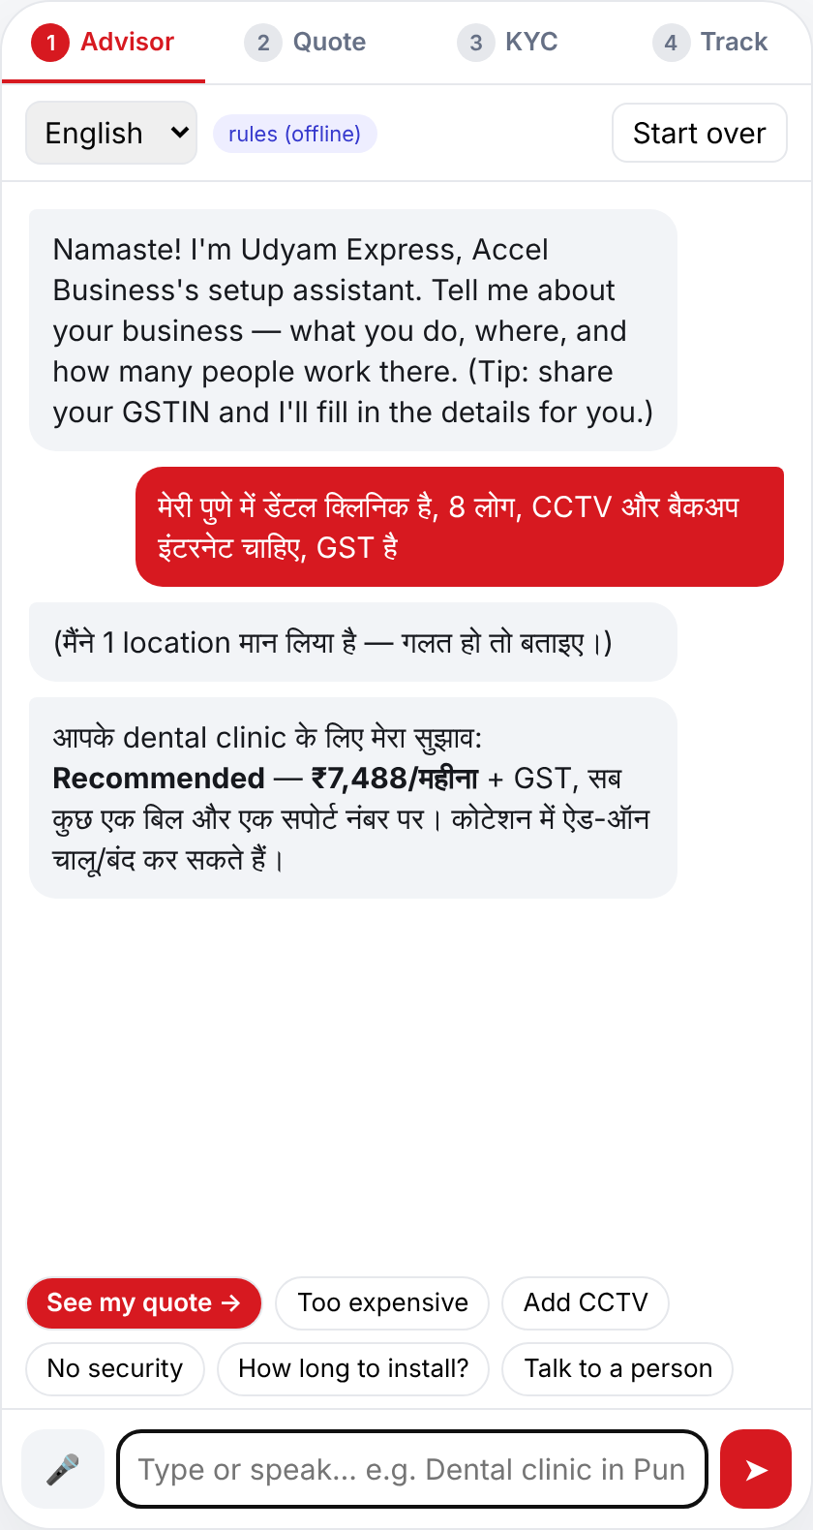
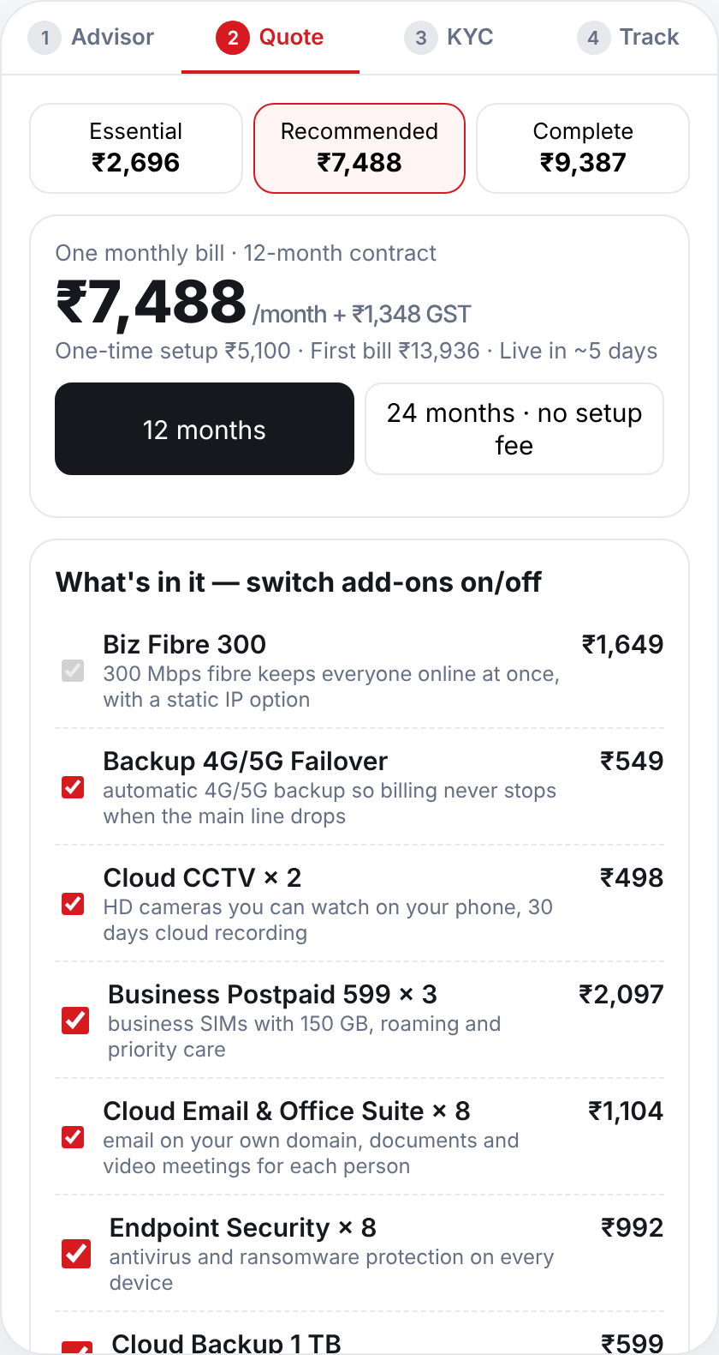
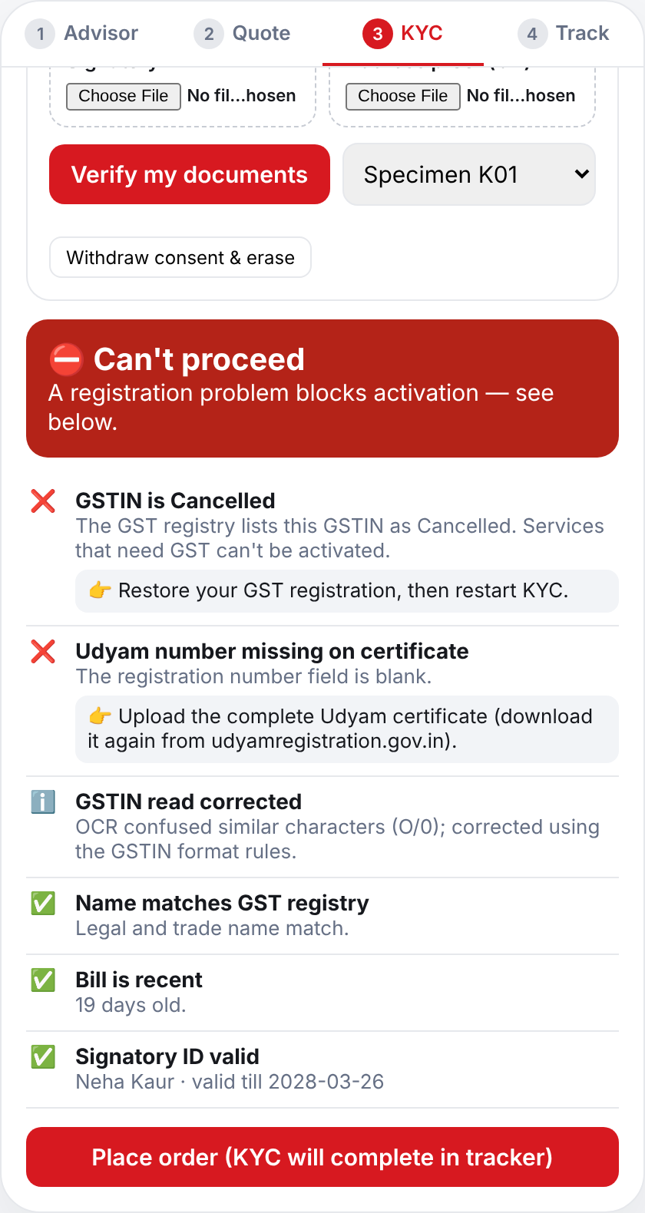
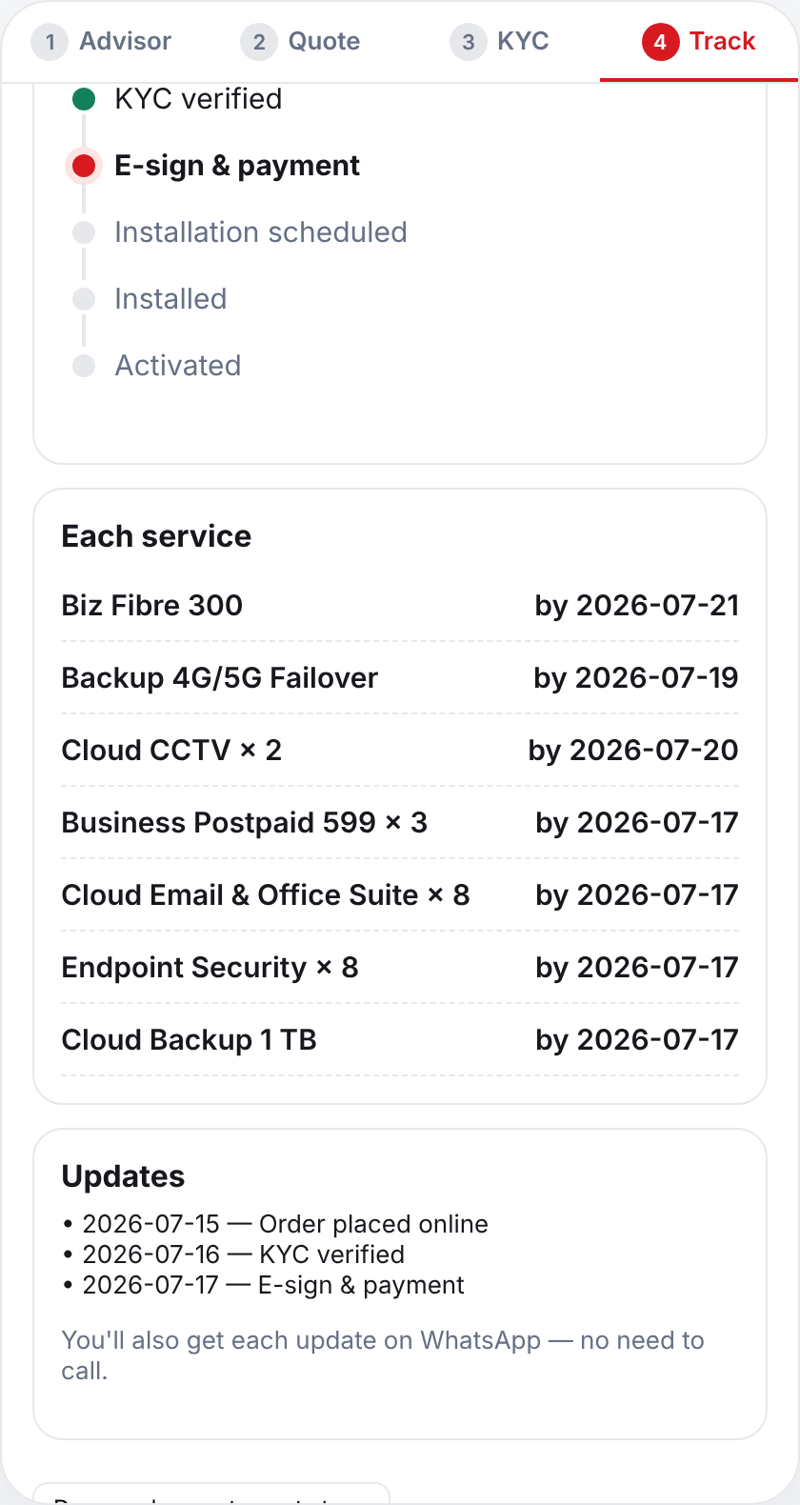
Built and working: from hello to a verified order in one sitting
Every screen below is the running prototype (phone-first web app; the same API serves WhatsApp and a partner tablet).
1 · Discover
2 · OneBill
3 · Verify
4 · Track
Chat or speak in Hindi, English or Hinglish (+6 languages via Gemini). One message or a GSTIN fills the profile.
Essential / Recommended / Complete on one monthly line. Add-ons toggle and re-price live; blocked items say why.
Consent first, then OCR on our server + GST/Udyam registry checks: 4 clear verdicts, each with a fix.
Six stages and an ETA per product from install days, with WhatsApp updates instead of chase calls.
The AI talks, the rules engine decides. Products, eligibility and every ₹ come only from the catalogue; the LLM never sees documents.
Udyam Express · Team WWCD · 3

Slide 4
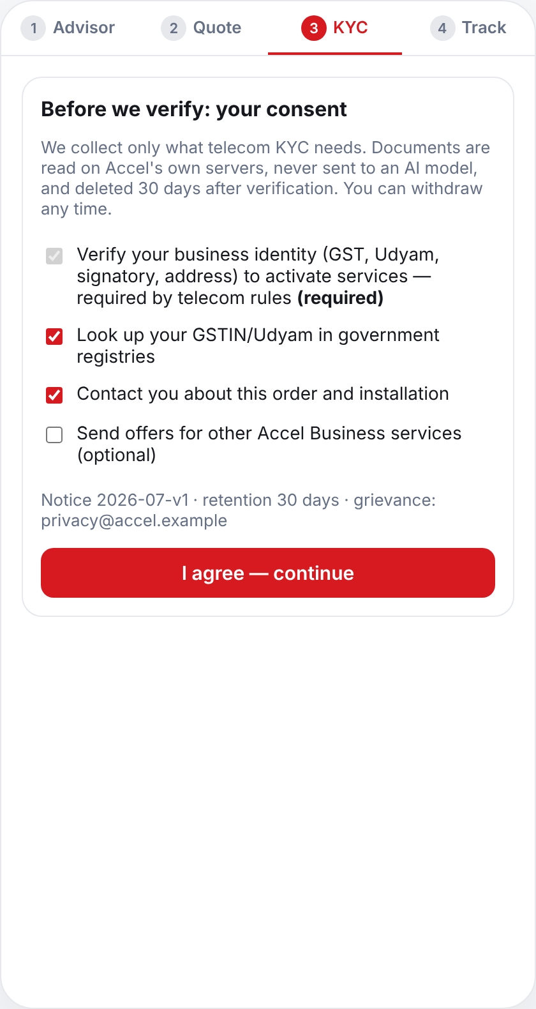
Smart KYC: all 12 specimen applicants judged correctly
On-server OCR (deskew, blur gate, GSTIN repair + checksum) → GST & Udyam registries → name, date and signatory checks.
Applicant | What we found | Verdict
K01 | GSTIN cancelled in registry + Udyam number blank | Rejected
K07 | Legal name edited ('Shri' vs 'Neelgiri Physio Clinic') | Manual review
K04 | GST certificate blurred (sharpness 1 vs ≥60): no guessing | Needs action
K05 | Udyam certificate missing: fetch from registry | Needs action
K06 | GSTIN check digit fails (one digit altered) | Needs action
K11 | Electricity bill 257 days old (limit 90) | Needs action
K02 · K08 · K10 | Tilted scan straightened; O/0, I/T, J/I OCR misreads repaired via checksum | Verified
K03 · K09 · K12 | Clean | Verified
4 verdicts, not 2
Verified → e-sign now
Needs action → owner fixes in-app
Manual review → specialist in 4 h
Rejected → registry problem
DPDP Act 2023 by design
• Consent per purpose before upload; hash-chained ledger; 1-tap withdraw & erase
• Documents never sent to an AI model
• Aadhaar / PAN redacted from chat; IDs masked in UI & logs
• Images purged after verdict (≤30 days in prod)
Udyam Express · Team WWCD · 4

Slide 5
Who first, with what bundle, through which channel
Bundles are the advisor's live output for a typical business (catalogue midpoint, ex-GST). Priority = digital fit × economics.
# | Segment (share of leads) | Today: conversion · median bundle · churn · cost/activation | Recommended bundle (typical business) | ₹/month · term | Channel
1 | Professional offices (25%) clinic, CA firm, 10 staff | 11.1% · ₹6,575 · 13.8% · ₹10.7k 86% have GSTIN → instant KYC | Fibre 300 + 4G/5G failover + 4 business SIMs + email, security & backup for 10 | ₹8,213 · 12 mo | Self-serve web/voice
2 | Micro retail (55%) kirana, salon, pharmacy | 4.1% · ₹2,470 · 22.7% · ₹20.0k very price-sensitive | Fibre 100 (AirFiber if no fibre) + UPI billing tablet + 2 SIMs; Essential from ₹1,848 | ₹2,546 · 12 mo | WhatsApp + partner-assisted
3 | Multi-site (15%) restaurant chain, 5 outlets | 11.0% · ₹28,080 · 10.8% · ₹15.6k | Fibre 300 + failover + POS per outlet, 20 cloud CCTV, 10 SIMs, one bill; SD-WAN in Complete | ₹26,705 · 24 mo | Advisor qualifies → field rep
4 | Manufacturers (5%) auto-parts unit, 45 staff | 12.8% · ₹15,910 · 8.1% · ₹15.3k | 20 Mbps leased line (99.5% SLA) + 8 machine-monitoring IoT kits + SIMs, email & security | ₹26,444 · 24 mo | Field sales + site survey
Field force & partners: the digital journey feeds them, it doesn't replace them
Partners get warm leads
Chats the bot can't close (tier-3 towns, >10 sites, custom needs) arrive with the chat summary, ranked by win-back score; commission on close.
Assisted mode
Same app on a partner's tablet for owners who prefer a person: KYC done on the spot, partner credited.
Reps focus on big tickets
Multi-site and factories (fastest payback) go to field sales pre-qualified; reps keep credit for advisor-sourced deals.
Udyam Express · Team WWCD · 5

Slide 6
Five metrics, conservative targets: the 5,000 leads replayed
Each drop reason is won back only by the feature that removes it, at cautious 10–40% rates (code: app/backoffice.py · impact()).
Metric that matters | Today | Replayed | Pilot target
Lead → activation | 7.36% | 13.0% | ≥ 12%
Days lead → live | 17.6 | 7.3 | ≤ 8
Cost per activation | ₹15,053 | ₹8,447 | ≤ ₹9,000
Status chase calls / customer | 3.0 | tracker | ≤ 1.0
6-month churn | 15.2% | — | ≤ 12%
Extra activations per quarter, by feature
Why these are reachable: quote, KYC and e-sign happen in one sitting, so only install time is left (AirFiber 2 days, fibre 5, leased line 21). In the data churn rises with chase calls (1 call → 5.9%, 5 calls → 27.9%); the tracker removes the calls.
+283
≈ ₹9.4 Cr
48 → 0
activations a quarter (1.8×)
added ARR run-rate after year 1
rule-breaking sales
Udyam Express · Team WWCD · 6
₹9.4 Cr = 283 × 4 quarters × ₹6,900 median bundle × 12 months. Cost model: −30% field effort on self-served sources, +₹40/lead platform cost (AI, OCR, hosting).

Slide 7
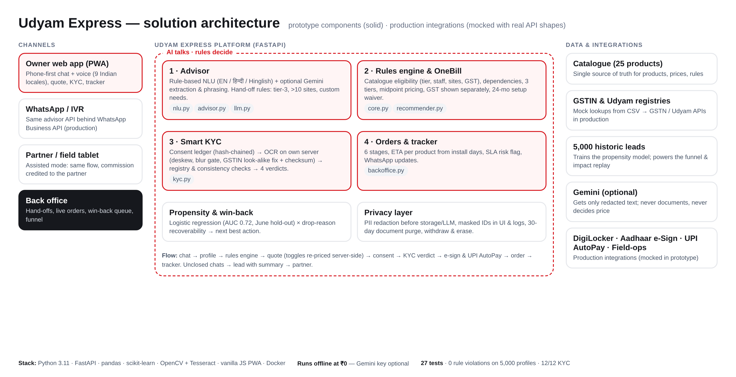
Built to ship: architecture, evidence, rollout and risks
Runs offline at ₹0 (Gemini optional); registries, DigiLocker, e-Sign and UPI AutoPay sit behind production-shaped interfaces.
Phase | Rollout plan
Weeks 0–8 | Pilot: professional offices in Pune, Delhi, Jaipur, Kochi; web + WhatsApp; 20 partners
Weeks 9–16 | Micro retail via WhatsApp + partner-assisted mode; 6 more Indian languages live
Months 5–12 | All tier-1/2 cities; multi-site and factories qualified by advisor for field sales
Risk | Mitigation
Install capacity | Launch gated on crews; AirFiber (2 days) absorbs fibre backlog; SLA alerts
Channel conflict | Partners get leads + commission; reps keep credit
Wrong advice / AI error | LLM can't set products or prices; numbers checked; hand-off rules
KYC fraud | Registry + checksum + edit detection → manual review queue
Evidence (run pytest / tests/bench_public.py)
27
automated tests
0
rule breaks across 5,000 profiles × 3 tiers
12/12
KYC specimen verdicts
75%
of 268 unseen scenarios written by other teams
0.72
AUC lead score, June hold-out (2.2× lift)
Udyam Express · Team WWCD · 7

