Slide 1

By (Team 8) - Gauravi Chaudhari
Ajinkya Kunjir
Priyal Shrotriya

Slide 2
Introduction
World’s largest home improvement retailer in the United States
The Home Depot is ranked #21 on FORTUNE’s MOST ADMIRED list
Typical products that customers see on the shelves are tools, equipment, and supplies for decorating, small building jobs, plumbing and gardening

Slide 3
Goal
To suggest promotional offers and campaigns for a new product by analyzing the trends and insights of the existing promotions of the retail store.
Home Depot is planning to launch a new toolkit product line. Which will be based on outdoor activities. For example, a tool kit for camping and Hiking.

Slide 4
Dataset
Entity : Contains the four major entity types of various products
Product Category : Contains the various categories of products
Product SubCategory : Contains the sub categories
Product: Contains the various products of our retail store
Customer: Has the existing customers information
SalesOrderDetails : Contains the products sold with its associated costs
SalesOrderHeader : Contains the shipping and billing information of the products sold
Promotions : Contains the discount,type and promotions offered by the retail store company
Marketing_ways : Contains digital marketing types and their timeframe

Slide 5
Platform - AWS
Amazon S3 bucket - To store csv files
Amazon Redshift database - Target database for integrating data to display on BI tool
Tableau- To create dashboards for displaying the trends and insights of the data

Slide 6
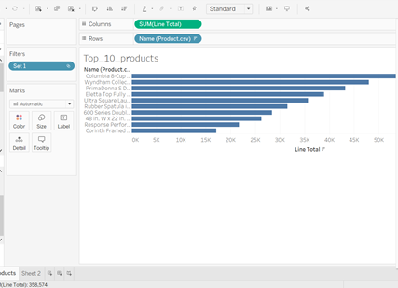
Part I
Analysis - Bar Chart

Slide 7
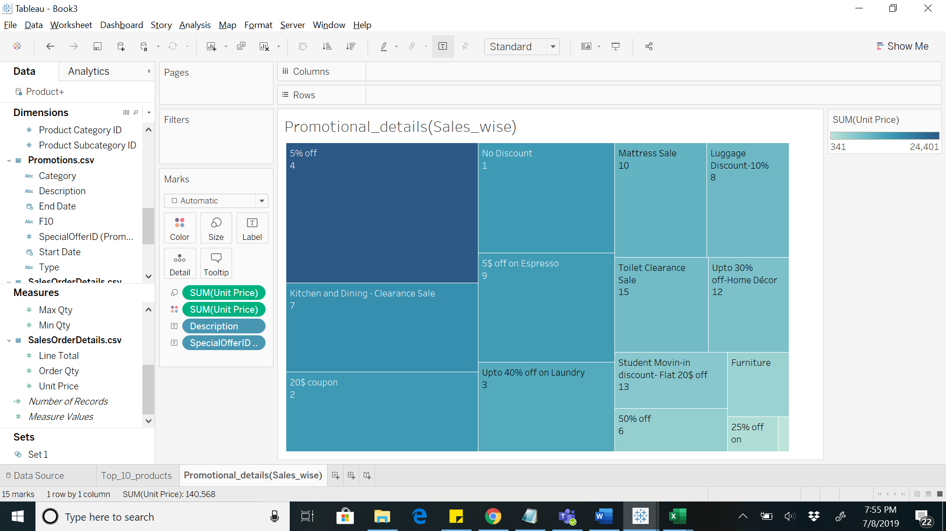
Analysis - HeatMap

Slide 8
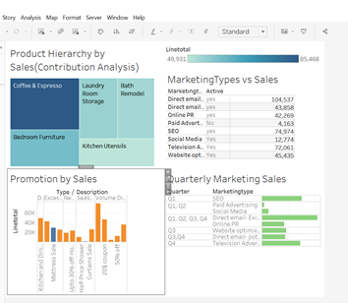
Marketing Analysis
Based on the effective marketing ways in the respective quarters gives us the analysis of which marketing ways we can move forward for our new product.

Slide 9
Future Scope
We can also do predictive analysis on marketing as a future scope: For e.g., If the base product has 1000 units for X$ each as a selling price,
Considering the ideal situation of selling all the units, we can calculate the predictive profit for Q3(Summer Sports quarter) of this product (Hiking and camping tool kit) by subtracting the Cost price, promotional offer and the cost for marketing in that quarter from selling price.

Slide 10
Part - II
Spotify Dataset
Analyzed the Spotify(Team9) data based on profit and leads associated with various campaigns lead by Spotify as follows:
Profit made by various types of subscriptions.
Profit made by each campaign in a state.
Leads by campaign type.
Profit gained by each subscription.

Slide 11
Instructions
If you want to access our dataset, we share the following things you to access our data:
1. Host Name: info7374clusterassignment1.cf3cwiqaf3ud.us-east-1.redshift.amazonaws.com
2. Port Number:5439
3. Database Name: info7374dbassignment1
4. Table Names: Entity,ProductCategory,ProductSubCategory,Product,Promotions,Customers,SalesOrderDetails,SalesOrderHeader
5. UserName: pramod
6. Password: Pramod@123

