Slide 1

GUESS ME
Project By:-
Ajinkya Muley {BT22CSE155}
Devkumar Aghera {BT22CSE157}
Swagat Khodkumbhe{BT22CSE197}
Aahil Parkar {BT22CSE218}
Guidance By:-
Dr.Jagdish Chakole

Slide 2
About ‘Guess Me’
Explore the world of words with Guess Me, a word guessing game that challenges players to guess words displaying their initial letter only. The players can choose the length of the word ranging from an easy 4-letter word to a difficult 10-letter word!!!
The game is build and programmed using C language and is inspired from the popular game Wordle. It is user friendly and is surely going to be a favourite amongst players testing their dictionary skills and improving them day by day in a fun and exciting way and stretch your critical thinking and IQ to a new level.
Relax, train your brain and improve your vocabulary with Guess Me!!
2

Slide 3

Progression of ‘Guess Me’
4 letter word to guess for!
6 letter word to guess for!
8 letter word
to guess for!
10 letter word to guess for!
START
Level 4
Level 5
Level 6
Level 7
Level 8
Level 9
Level 10
5 letter word to guess for!
7 letter word to guess for!
9 letter word to guess for!
Easy
Moderate
Difficult
Very Difficult
3

Slide 4




How to Play?
First of all, note your gamer ID.
Enter the number of letters of the word you desire to guess.
The first letter will be shown to you. You will be given 8 chances for easy, 6 chances for medium and 5 chances for hard difficulty.
Now, you can start guessing the word
Even if atleast one letter is at the same position as the desired word that you guess, it will be displayed along with the score and the number of chances remaining.
If not, the same word with the number of blanks will be displayed and a chance will be deducted.
You will be rewarded a point on guessing each letter accurately.
4

Slide 5
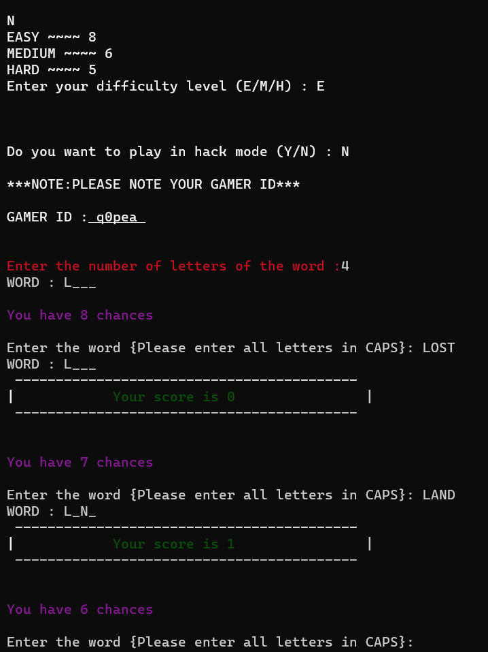

For e.g., you desired to guess a 4 letter word and the correct word is LUNE and you guessed LOST, then you get O points and the same word is displayed again. Now you entered LAND, you are rewarded a point and L_ N_ is displayed.
Once you guess the whole word properly, you will be given an option to either continue or to end the game.
If you lose, then you will be booted out of the game. If you wish to try again then you can do so by again opening the game..
5

Slide 6


Salient Features
Ease of Play
Competitive Skills
Variety of Choices
An entertaining game with simple rules and exciting challenges
Compete with other players and know where you stand from our leaderboard!
Choose from a 4-letter word way up till a 10-letter word!!!
1
3
5
2
4
6
Mind Challenging
Vocab Development
For all Ages
Seems simple initially but as you progress you feel the thrill!!
Enhance your vocabulary by learning new words on the go!!!
From youngsters to elders, all can enjoy Guess Me!
6

Slide 7
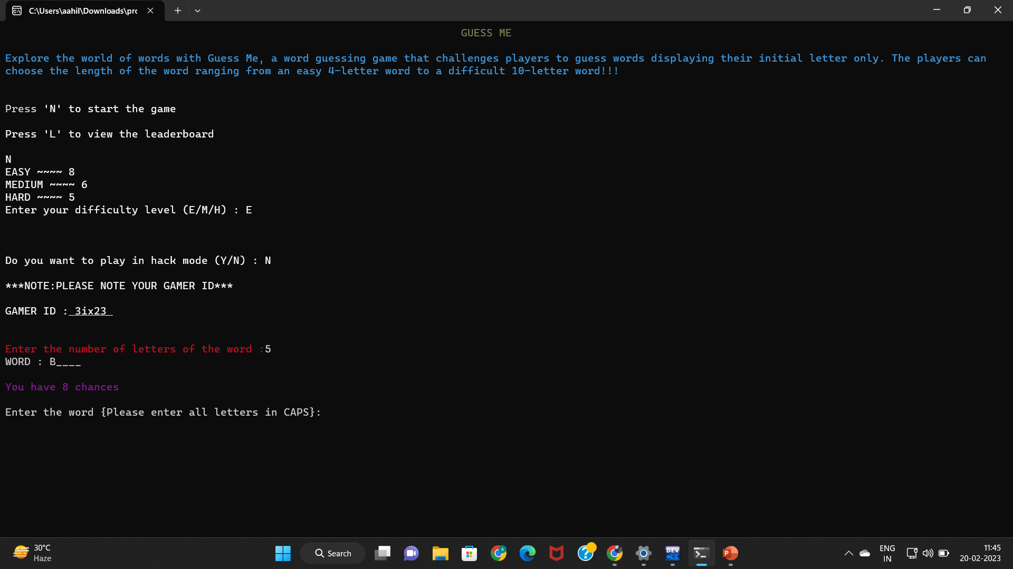

7

Slide 8

So, what are you waiting for lets start playing!!!
We promise you’ll leave each game feeling accomplished, smarter and more at peace!
The Guess Me journey is satisfying, challenging and a world of exploration you want to put down!!!
8

Slide 9


Thank You!!!
9

