Slide 1
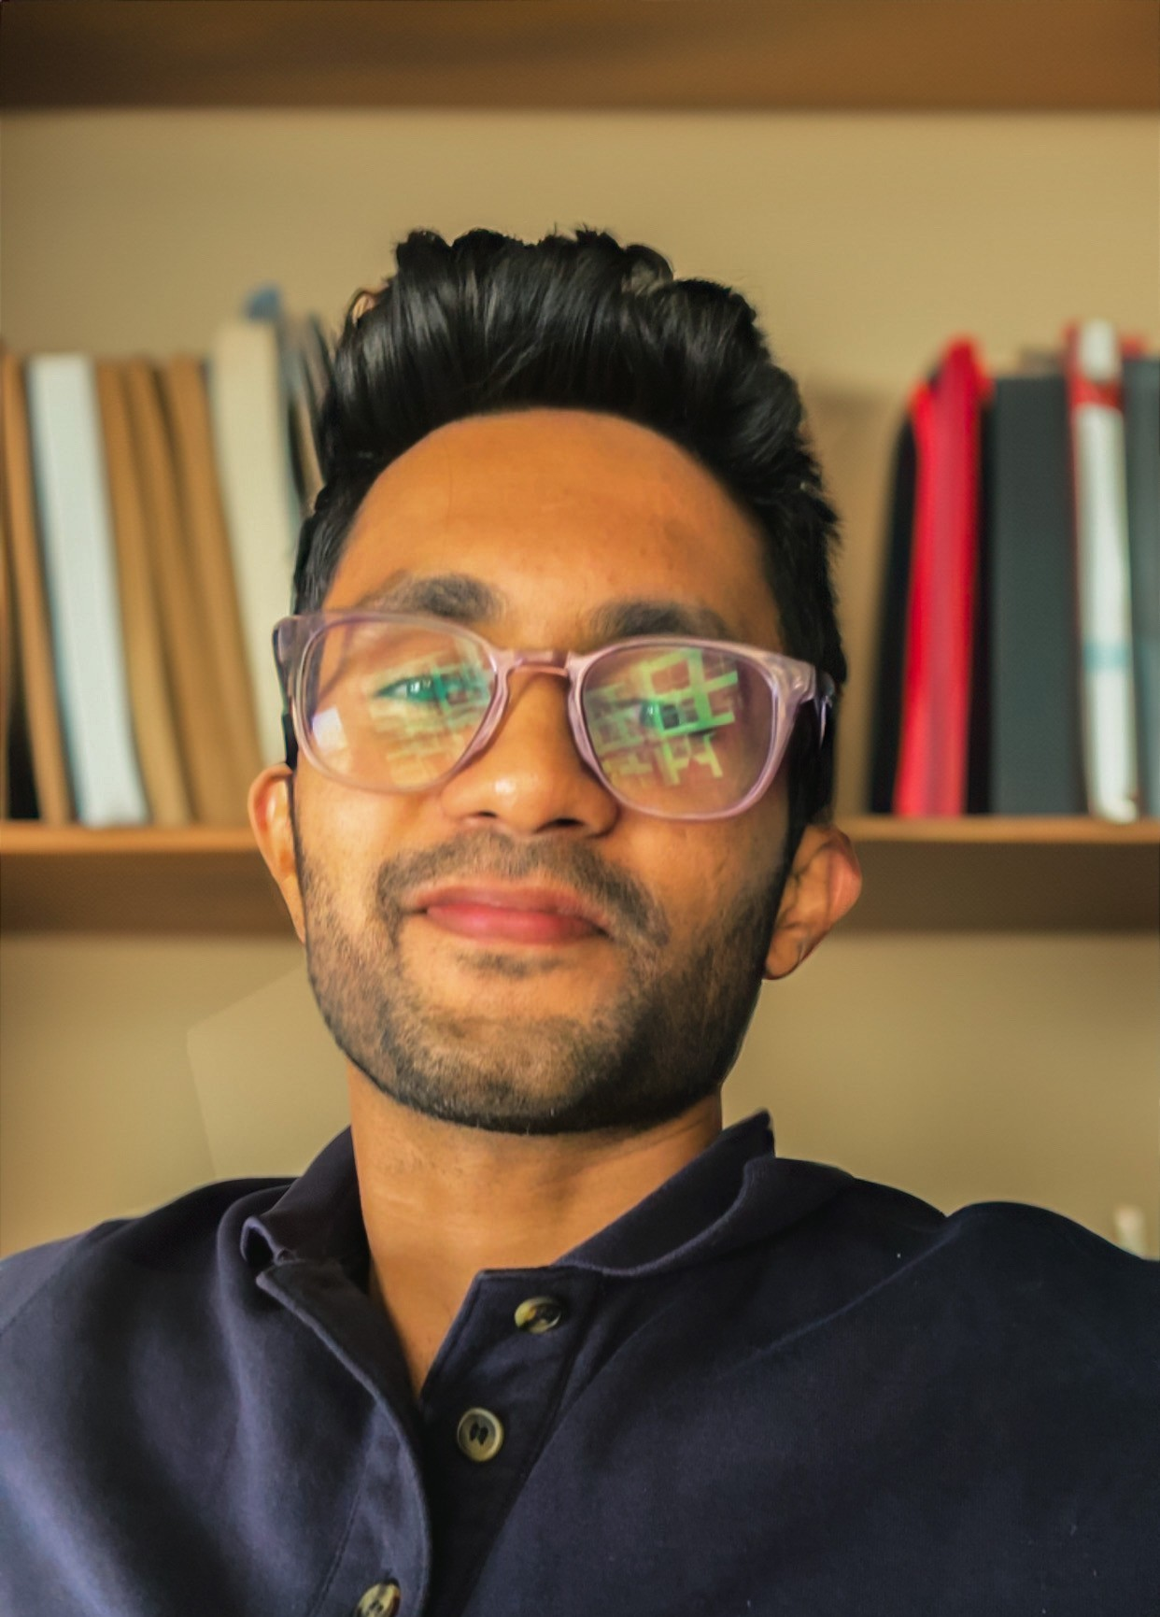

Ajinkya Pawale
Senior Consultant
AI & Data
Tel : 763-306-4790
Email ajinkya.pawale@ey.com
Background
Experience
Ajinkya joined the AI & Data Practice of EY Charlotte in January 2026. He brings extensive experience in AI/ML engineering, GenAI solutions, and data pipeline development. Prior to EY, he worked as an AI Engineer at Elevance Health and as a Data Engineer at Course5 Intelligence.
Ajinkya holds the following qualifications:
Master of Science in Data Science, Indiana University Bloomington
Bachelor of Science in Computer Science, Mumbai University
Generative AI
Led end-to-end GenAI solution for automated call summarization using OpenAI GPT models, architecting Langchain-based orchestration that achieved 55% faster response times across 350+ agents
Augmented call wrap-up API with RAG pipelines and autonomous agent workflows for validation, achieving 85% higher summary quality scores and cutting post-call correction time by two-thirds
Fine-tuned open-source LLMs (Llama) using LoRA on healthcare call transcript corpora for domain-adapted summarization, building evaluation pipelines to benchmark summarization accuracy and clinical terminology coverage against baseline GPT outputs
Architected multi-agent GPT-4.1-based document compliance system for 50+ L&D team members, reducing manual review time by 80% for large-scale training materials
Machine Learning & Predictive Analytics
Enhanced data retrieval for Inpatient Claims using PySpark, achieving 75% reduction in extraction time; enriched ML model inputs with 20+ derived features using PyTorch
Developed neural network and Bayesian optimization (BOHB) models using TensorFlow and PyTorch, boosting model efficiency by 12% and enabling early identification of at-risk students
Conducted statistical analysis in R, pandas, scikit-learn, demonstrating re-identification risks with 20% improvement in predictive accuracy
Data Engineering & Optimization
Spearheaded automation of data pipelines in Airflow, integrating ETL, modeling, and post-processing, saving 4 hours of manual work per production run
Designed Kinesis Consumer Application for live call transcript processing with Redis cache, enhancing data retrieval speed by 40%
Migrated project data from on-premise to AWS EMR cluster, improving processing speed, scalability, and reliability
Implemented data validation tool detecting production data drift, saving nearly two full days of workload monthly
Analytics & Monitoring
Established 20+ crucial alerts and dashboards in Datadog and Splunk to monitor system health, accuracy, and performance
Performed statistical analysis on 100,000+ data entries across six sources; utilized Tableau visualizations reducing manual analysis time by 50%
Created analytics framework using pymongo to query data lake, generating insights across 250+ product categories
Testing & Quality Assurance
Orchestrated pytest framework covering 50+ test scenarios, reducing manual testing time by 3 hours per week
Executed load and stress tests using LoadRunner, coordinated API-based regression testing across feature cycles
Skills
Healthcare, E-commerce, Retail Banking
Machine Learning, Generative AI, LLM Fine-Tuning, Predictive Analytics, Deep Learning, NLP
Data Engineering, Cloud Architecture, MLOps
Programming and tools:
Python, PySpark, R, SQL, PyTorch, TensorFlow
Langchain, LlamaIndex, OpenAI and Anthropic APIs, Hugging Face
AWS (S3, EC2, Lambda, EMR), Kubernetes, Docker, Airflow
Databases: PostgreSQL, MongoDB, Hadoop, Hive, Qdrant

