Slide 1
Recommender Systems
AJINTH CHRISTUDAS , DEC 17
Data Science Immersive

Slide 2
Recommender System?
What is a Recommender System?
Application that serves content (movies, restaurants, ads, products) to users based on user profiles & preferences
Application that is able to predict the users behavior towards a content prior to experiencing a content
Examples
Netflix, Amazon, LinkedIn, Facebook , YouTube

Slide 3
Need for Recommender Systems (Business)
Why the need for Recommender System?
From the Business perspective it is a part of the Customer Relationship Management (CRM)
Maintaining a good CRM model helps drive business and sales
Better personalization → Better Recommendation → Better Sales
Examples
Amazon → 35% increase in Sales based on recommendations
Netflix → 40% increase in movie selection based on recommendations
Facebook → 90% increase in user interaction via personalization

Slide 4
Need for Recommender Systems (Users)
Most users are Lazy, and like the content to be pushed to them rather having to search for content they may like
Easier when someone else makes the decision for you

Slide 5
Data
Raw Data
1.5 million users
4.5 million reviews across all business, all states
Pre-Processing
Extracted reviews pertaining to one state (South Carolina)
1500 users
9000 reviews
Extracted only restaurant categories

Slide 6
Common Approaches
Popularity Based Model
Collaborative Filtering Model
Item – Item filtering Model
User – User filtering Model
Content Based Filtering Model
-------------------------------------------------------------------------------------
Hybrid Model (Combination of collaborative & content models)
Knowledge Based Filtering Model

Slide 7
Collaborative Filtering Model
Item – Item filtering Model
For any given restaurant find similar restaurants using similarity metrics
Recommend restaurants that are similar to restaurants that the user already likes, but is yet to rate/visit
E.g. “Little Donkey” is similar to “Life Alive”.
Sally liked “Life Alive”, hence she is going to like “Little Donkey”
Sally gets recommended “Little Donkey” restaurant
 | Little Donkey | Life Alive | Thelonious Monkfish | Craigie on Main
Chris | 5 | 3 | X | X
Alice | 4 | 4 | X | 4
Sally | X | 4 | 5 | X
Bob | 4 | X | 4 | 4
Jason | 3 | 3 | X | X
Max | 2 | 5 | X | 4
User – Item Matrix

Slide 8
Collaborative Filtering Model
User – User filtering Model
For a given user find similar users using similarity metrics
Recommend restaurant to users who are similar to each other
E.g. “Alice” and “Sally” are very similar users
“Alice” liked “Little Donkey”, hence it gets recommended to “Sally”
“Sally Like “Thelonious Monkfish”, hence it gets recommended to “Alice”
 | Little Donkey | Life Alive | Thelonious Monkfish | Craigie on Main
Chris | 5 | 3 | X | X
Alice | 4 | 4 | X | 4
Sally | X | 4 | 5 | X
Bob | 4 | X | 4 | 4
Jason | 3 | 3 | X | X
Max | 2 | 5 | X | 4

Slide 9
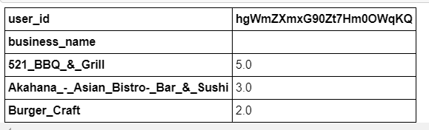
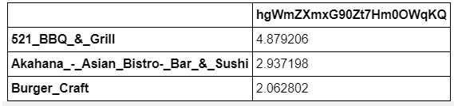
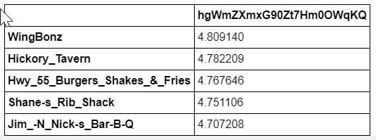
RESULTS - COLLABORATIVE filtering Model
Actual Predictions
Predicted Ratings (Actual)
Predictions are pretty good
Average accuracy was anywhere between 0.6 and 0.9
The metric used was Root Mean Square error (RMSE) and Mean Absolute Error (MAE)
Recommendations

Slide 10
Collaborative Filtering Model
PROS
CONS
Easy to implement
Not required to know the attributes of the restaurants. E.g. Service, Lighting, Menu
Dependency on prior user ratings to get the desired recommendations
Cold Start Problem
Sparse Data Matrix
Performance dependent on the number of users and number of ratings (critical mass)

Slide 11
Content BASED Filtering MODEL
 | Parking | Lighting | Music | User | Rating
Little Donkey | 1 | 0 | 1 | Chris | 4
Life Alive | 1 | 0 | 1 | Alice | 3
Thelonious Monkfish | 0 | 0 | 1 | Bob | 2
Craigie on Main | 0 | 1 | 1 | Sally | 3
Content based filtering model is dependent on the attributes of the restaurants
Prior user ratings not needed to make recommendations or predictions
Item profile is built by comparing restaurant attributes.
Based on similarities between item attributes Alice is recommended “Craigie on Main” and Sally is recommended “Life Alive”
 | Parking | Lighting | Music | User | Rating
Little Donkey | 0.5 | 0 | 0.75 | Chris | 4
Life Alive | .35 | 0 | .85 | Alice | 3
Thelonious Monkfish | 0 | 0 | .5 | Bob | 2
Craigie on Main | 0 | .45 | 0.55 | Sally | 3

Slide 12
Content Based filtering Model
Pros
Cons
Helps ease out the Cold Start problem to a certain extent
Prior rating from users not needed to make predictions or recommendations
Research says that the content based model is more accurate than the collaborative model (That was not the case in my model!)
Sometimes collecting item attributes can be an hassle
Requires some level of parsing user reviews to generate the attributes of the restaurants

Slide 13
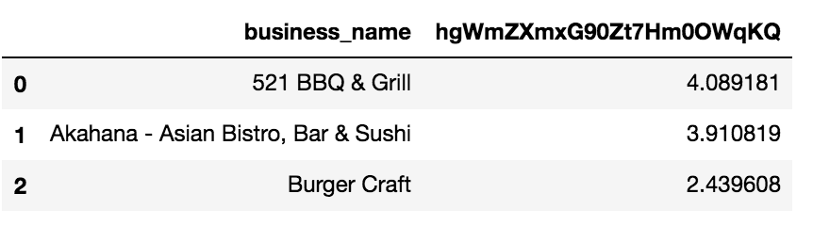
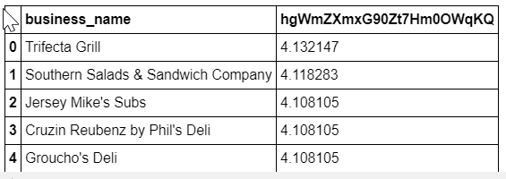
RESULTS - Content Based filtering Model
Actual Predictions
Predicted Ratings (Actual)
Predictions are very erratic and does not seem to perform as well as the collaborative model
Average accuracy was anywhere between 0.8 and 1.2
The metric used was Root Mean Square error (RMSE) and Mean Absolute Error (MAE)
Recommendations

Slide 14
Conclusion
Time to reflect!
Collaborative and Content based models are one the two basic models for recommender systems
Traditionally Content based models are better performing and more accurate than the collaborative models

Slide 15
Next Steps
Short Term:
Use text reviews from the users, generate more accurate attributes and aggregate into the content based model
Implement a web interface for the Recommender System, using flask (python libraries)
Long Term:
Implement a Hybrid model (combination of collaborative and content based model)

Slide 16
Challenges and Lessons Learnt
Data Acquisition (JSON v/s SQL)
Data Import into a local MySQL instance
Data Aggregation (Combining Reviews, Users, Businesses and Categories)
Building the model (lots of outside research, ton of youtube videos)
Still not a perfect model ☹ (Welcome to Data Science!)
Model Validation
Experience of working through an end to end Data Science life cycle

Slide 17
Technical Details
Dataset
https://www.yelp.com/dataset/
Technology and Techniques
MySQL
Python
pymysql
sklearn
Cosine Similarity
SVD
K Nearest Neighbor
Github:
https://github.com/Ajinth/Yelp_Recommender

Slide 18
Questions

