Slide 1
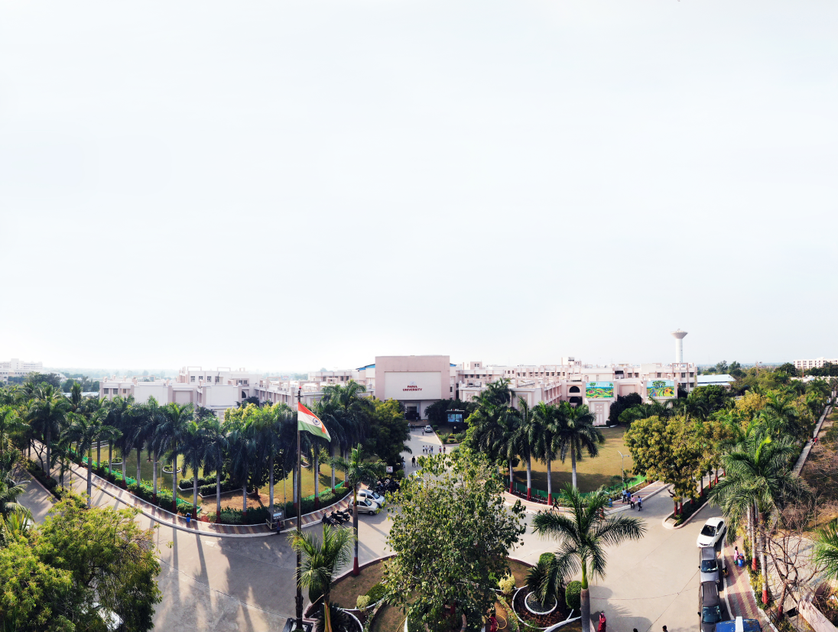



Content Management System
Unit – 1
Prof. Sohil Parmar

Slide 2
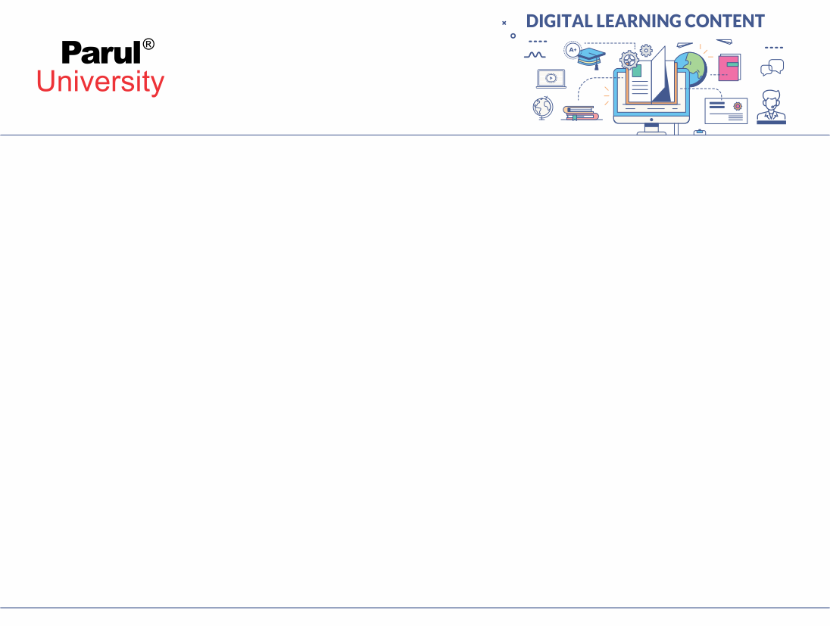

Unit – 1
CMS Introduction & configuration

Slide 3
Define -data
In a PHP-based Content Management System (CMS), data refers to all the information that the system stores, manages, and retrieves using PHP scripts.
This data is usually saved in a database (like MySQL) and can include:
- User information – username, email, password
- Content – pages, posts, articles, images
- Settings – website configuration, themes, plugins
- Metadata – timestamps, author names, categories, tags
- Media files – images, documents, videos (stored as file paths)

Slide 4
information Method & POST Method
Information in a CMS refers to all the organized and meaningful data that the system manages, stores, processes, and displays to users.
It includes any content that is created, edited, published, or viewed within the CMS.
Examples of Information in a CMS
Web pages and articles - Images, videos, audio files
User profiles and permissions - Menus, links, and navigation structure
Metadata (title, keywords, description, tags)
Comments and feedback - Website settings and configuration details

Slide 5
content Method & POST Method
Content in a CMS refers to all the digital material created, stored, edited, and published through the system.
It is the main information displayed on the website and can be managed without needing technical coding knowledge.
Types of Content in a CMS
Text – articles, blogs, pages, news
Images – photos, banners, icons - Links and menus
Videos and audio - Forms, comments, and feedback
Documents – PDFs, files - Metadata – title, tags, description

Slide 6
Introduction to Content Management System (CMS) Method & POST Method
A Content Management System (CMS) is a software application that helps users create, manage, organize, and publish digital content on websites without needing technical programming knowledge.
It provides an easy-to-use interface where users can add or edit web pages, images, videos, and other content.
CMS separates content from design, allowing website owners to update information easily without changing the underlying code.
It also supports multiple users, workflows, templates, themes, and plugins to extend website functionality.

Slide 7
Continue…
Method & POST Method
Key Features of CMS
Easy content creation and editing
User-friendly interface
Templates and themes for design
Plugins/extensions for additional features
Content storage and organization
User roles and permissions
Search and navigation tools
Examples of CMS WordPress , Joomla , Drupal , Magento (for e-commerce)

Slide 8
Continue… Method & POST Meth
od
Why CMS is Important?
Saves time and cost.
No need for programming knowledge.
Allows multiple users to work on the website.
Easy maintenance and updates.
Flexible and scalable for any size of website.
Applications of CMS
Business websites Blogs and news portals E-commerce sites
Educational websites Government portals Portfolio and personal sites

Slide 9
Comparison of CMS and website builder Method & POST Meth
od
Basis | CMS (Content Management System) | Website Builder
Definition | A software platform used to create, manage, and modify website content, often requiring some technical knowledge. | A simple drag-and-drop tool designed for quickly creating websites without any technical skills.
Technical Knowledge Required | Moderate – basic HTML/CSS may be helpful but not compulsory. | Very low – no coding needed; designed for beginners.
Flexibility & Customization | Very high. Users can install themes, plugins, edit code, and create custom features. | Limited. Customization depends on pre-built templates and available design blocks.
Control Over Website | Full control over design, functionality, and hosting. | Limited control; platform controls hosting, security, and features.

Slide 10
Continue.... Method & POST Meth
od
Basis | CMS (Content Management System) | Website Builder
Hosting | Self-hosted (WordPress.org, Joomla, Drupal) or hosted options available. | Fully hosted (Wix, Squarespace, Weebly). No external hosting needed.
Plugins/Extensions | Thousands of plugins/extensions available for extra functionality. | Limited extension marketplace; mostly built-in features only.
Ease of Use | Moderately easy; learning curve exists. | Very easy; beginner-friendly drag-and-drop interface.
Cost | Software may be free, but hosting, domain, and premium plugins/themes cost extra. | Usually subscription-based with monthly/annual plans.

Slide 11
Continue.... Method & POST Meth
od
Basis | CMS (Content Management System) | Website Builder
Scalability | Highly scalable; can support small blogs to enterprise-level websites. | Limited scalability; suitable for small and medium websites.
Security | User is responsible for updates, backups, and security (in self-hosted CMS). | Platform provider handles security, updates, and backups.
Examples | WordPress, Joomla, Drupal, Magento. | Wix, Squarespace, Weebly, Shopify (for e-commerce).
CMS is best for: Large websites , Websites needing advanced features , Developers, businesses, and customizable solutions
Website Builders are ideal for: Beginners , Small business websites , People needing quick, simple, ready-made sites

Slide 12
Introduction to dynamic web pages Method & POST Method
A dynamic web page is a type of web page whose content changes automatically based on user interaction, time, database data, or other real-time factors.
Unlike static web pages, which always display the same content, dynamic pages can display different information each time they are loaded.
Dynamic web pages are generated using server-side scripting languages such as PHP, ASP.NET, Python, Node.js, or client-side scripting such as JavaScript.

Slide 13
Continue… Method & POST Method
Key Characteristics of Dynamic Web Pages
1. Content changes based on input or conditions
Example: Login systems, search results, user profiles.
2. Connected with a database
They fetch, insert, update, and display data dynamically.
3. Use of scripting languages
Client-side: JavaScript
Server-side: PHP, Python, ASP.NET, Ruby
Interactive and user-friendly
Forms, dropdowns, auto-update content, etc.

Slide 14
Continue… Method & POST Method
Difference Between Static and Dynamic Web Pages
Static: Same content every time; built using HTML only.
Dynamic: Content changes; uses scripting + database.

Slide 15
Downloading Joomla Method & POST M
ethod
Joomla is a popular open-source Content Management System (CMS) used to build dynamic and powerful websites.
To start using Joomla, you must download, install, and configure it on your server or local machine.
Step 1: Visit the Official Joomla Website
Go to the official Joomla download page:
https://downloads.joomla.org
Step 2: Choose the Latest Joomla Version
Select the latest stable version (e.g., Joomla 5.x or 4.x).

Slide 16
Continue… Method & POST M
ethod
Step 3: Download the ZIP Package
Click on the “Download” button to get the compressed .zip file.
Step 4: Save the File
Save the downloaded Joomla package to your computer.

Slide 17
Installing Joomla Method & POST Method
Step 1: Install XAMPP or WAMP
XAMPP → Apache + PHP + MySQL
Start Apache and MySQL services.
Step 2: Copy Joomla Files
Extract the downloaded ZIP folder.
Copy the extracted Joomla folder into:
htdocs (for XAMPP)
www (for WAMP)

Slide 18
Continue… Method & POST Method
Step 3: Create a Database
Open browser → go to http://localhost/phpmyadmin
Click New
Create database name (example: joomla_db)
Step 4: Run the Joomla Installer
Open browser → http://localhost/joomla
Step 5: Joomla Installation Steps
1. Site Configuration Site Name, Description , Admin email , Admin username + password Click Next.

Slide 19
Continue… Method & POST Method
2. Database Configuration Database Type: MySQLi , Host Name: localhost , Username: root (default for local XAMPP/WAMP) , Password: (leave blank for local) , Database Name: joomla_db Click Next
3. Finalization Joomla will install the required tables. After completion → click Remove Installation Folder (mandatory).
Step 6: Login to Joomla Admin Panel
Go to: http://localhost/joomla/administrator Enter the admin username & password. Your Joomla site is ready!

Slide 20
Continue… Method & POST Method
Installing Joomla on a Web Server (Hosting)
Step 1: Upload Joomla File
Login to hosting account (cPanel)
Go to File Manager
Upload Joomla ZIP into public_html
Extract the ZIP file
Step 2: Create a Database
Open MySQL Database Wizard
Create: Database , Database User , Assign ALL PRIVILEGES

Slide 21
Continue… Method & POST Method
Step 3: Run Installation
Open domain in browser: https://yourdomain.com Follow the same installation process as localhost.

Slide 22
Joomla Administration Method & POST Metho
d
Joomla Administration refers to the backend control panel where website administrators manage the entire Joomla website.
It provides tools to control content, users, extensions, templates, configuration, and overall site functionality.
The administration panel is accessible at:
http://yourdomain.com/administrator(or http://localhost/joomla/administrator in local setups)
After logging in with the administrator username and password, you enter the Joomla Admin Dashboard.

Slide 23
Continue… Method & POST Me
tho
d
1. Content Management
This section helps to manage all website content:
Articles: Create, edit, delete content pages
Categories: Organize articles into groups
Media Manager: Upload images, videos, documents
Featured Articles: Select articles to display on homepage
2. User Management
Used for controlling access to the site:
Add, edit, delete users

Slide 24
Continue… Method & POST Metho
d
Assign user groups (Author, Editor, Manager, Admin, etc.)
Set permissions using Access Control Levels (ACL)
Joomla has a strong and flexible permission system.
3. Menu Management
Menus control navigation of the website:
Create menus (Main Menu, Footer Menu, etc.)
Add menu items (links to articles, categories, components)
Control menu hierarchy (parent & child items)

Slide 25
Continue… Method & POST Metho
d
4. Extension Management
Extensions add extra features to Joomla.
Types of Extensions:
Components – main functional units (e.g., Contacts, Banners, Joomla Articles)
Modules – small blocks displayed on the pages (e.g., menu module)
Plugins – event-driven features (e.g., login plugin)
Templates – design/layout of the website
The Extension Manager allows: Install / uninstall extensions , Update extensions , Enable / disable plug-ins

Slide 26
Continue… Method & POST Metho
d
5. Template Management
Templates control the look and feel of both the frontend and backend.
You can: Install templates
Customize template styles
Change layout positions
Assign templates to specific pages
6. Global Configuration
This is one of the most important panels.
Here the administrator can configure site-wide settings:

Slide 27
Continue… Method & POST Metho
d
Site name, metadata, offline mode
Server settings (cache, sessions, error reporting)
SEO settings (URLs, metadata options)
Database settings
Mail server configuration
7. System Maintenance
This includes: Clear cache , Global check-in , Backup and restore , View system information , Update Joomla core

Slide 28
importing templates Method & POST Metho
d
A template in Joomla controls the overall look, layout, and design of the website.
Importing or installing a new template allows you to change your site’s appearance without modifying the content.
Joomla supports two ways to import templates:
Uploading a template package (.zip)
Installing from a directory or URL

Slide 29
Continue... Method & POST Metho
d
Uploading a template package (.zip)
Step 1: Download the Template
Visit a trusted Joomla template provider (e.g., JoomShaper, JoomlArt, TemplateMonster).
Download the template package in .zip format.
Do NOT extract it.
Step 2: Open Joomla Administrator Panel
Go to: http://yourdomain.com/administrator
Login with admin username and password.

Slide 30
Continue... Method & POST Metho
d
Step 3: Go to Extensions → Manage → Install
You will see three installation options:
Upload Package File
Install from Folder
Install from URL
Step 4: Upload Template (.zip) File
Click Upload Package File
Select the downloaded template .zip file
Click Upload & Install
Joomla will automatically extract and install the template.

Slide 31
Continue... Method & POST Metho
d
Step 5: Set Template as Default
After installation:
Go to Extensions → Templates → Styles
Select your newly installed template
Click Default (star icon)
Now the new template becomes the default for your site.

Slide 32
Continue... Method & POST Metho
d
Installing from a directory or URL
Install From URL.
Paste the direct URL of the template package and click Install.

Slide 33
Continue... Method & POST Metho
d
Managing and Customizing Templates
After importing:
Open Extensions → Templates → Styles
Choose template → click Customize
Edit template settings (colors, fonts, layout)
Modify template files using Template File Editor
Assign templates to specific menu items

Slide 34
Configuring templates Method & POST Metho
d
Step 1: Open Template Manager
Login to Joomla Administrator Panel
Go to Extensions → Templates → Styles
this page displays all installed templates for frontend and backend.
Step 2: Select the Template to Configure
Click on the template name under Styles.
This opens the Template Settings Panel.
Step 3: Customize Template Options
Different templates provide different configuration options, such as:

Slide 35
Continue... Method & POST Metho
d
a) Layout Settings
Choose layout style
Select number of columns
Adjust module positions
Enable/disable sections
b) Color & Theme Settings
Change colors
Modify background
elect typography styles (fonts, sizes) , Apply light/dark modes

Slide 36
Continue... Method & POST
Metho
d
c) Logo & Branding
Upload site logo , Set favicon , Add header image , Adjust logo size and position
d) Menu & Navigation
Configure main menu , Choose menu position , Enable sticky/fixed menu ,Add mega menu options (if supported)
e) Module Positioning
Templates can be applied to: Entire website , Specific menu items (e.g., homepage only)
Extensions → Templates → Styles → Template → Menu Assignment

Slide 37
Continue... Method & POST Metho
d
Step 5: Save the Configuration
Click Save or Save & Close to apply changes.
Template File Editor
Under Templates → Templates → (Template Name)
You can edit:
HTML files , CSS files , JavaScript files , Layout overrides , Custom code

Slide 38
Create Store Database Method & POST Metho
d
Joomla does not require you to manually create a separate database for a store.
You install Joomla first, then use an e-commerce extension to set up the store database tables within Joomla’s existing database.
1. Prerequisites
Joomla installed on localhost (XAMPP/WAMP) or on a web server.
An administrator account for Joomla backend.
A chosen Joomla e-commerce extension (e.g., VirtueMart, J2Store, HikaShop).

Slide 39
Continue... Method & POST Metho
d
2. Install an E-commerce Extension
Download the extension from the official site.
Login to Joomla Administrator Panel:
http://yourdomain.com/administrator
Navigate to: Extensions → Manage → Install
Upload the extension .zip file → Click Upload & Install
This process automatically creates the required tables for products, customers, orders, and payments in the Joomla database.

Slide 40
Continue... Method & POST Metho
d
3. Configure the Store Database
Once the extension is installed:
Go to the extension panel: Components → [Extension Name] (e.g., VirtueMart)
Configure the following:
a) Products Add product categories , Add products with price, stock, Upload images
b) Customers Add customer details (optional for admin) Customer registration handled automatically during checkout

Slide 41
Continue... Method & POST Metho
d
c) Orders Orders are stored automatically in the database , dmin can view, edit, or delete orders
d) Payments & Shipping Configure payment gateways (PayPal, Stripe, COD, etc.) , Configure shipping methods All data is stored in Joomla’s MySQL database tables created by the extension.
4. Example of Store Database Tables Created by Extensions
After installing an e-commerce extension like VirtueMart, the Joomla database will contain tables like:

Slide 42
Continue... Method & POST Metho
d
#__ is the prefix defined during Joomla installation (default: jos_)
Table Name | Description
#__virtuemart_products | Stores product information
#__virtuemart_categories | Stores product categories
#__virtuemart_orders | Stores customer orders
#__virtuemart_order_items | Stores products in each orde
#__virtuemart_customers | Stores customer details
#__virtuemart_payment_methods | Stores payment method details
#__virtuemart_shipment_methods | Stores shipping details

Slide 43
Continue... Method & POST Metho
d
5. Benefits of Using Joomla Extensions for Store Database
No need to manually create database tables.
Handles all relationships between customers, products, and orders.
Provides a user-friendly interface to manage the store.
Supports secure checkout, inventory management, and reporting.

Slide 44
set up Wizard Method & POST Metho
d
The Set Up Wizard is a step-by-step interface that appears during Joomla installation or extension setup.
It helps administrators configure site name, admin credentials, database settings, template, and sample data quickly and accurately.
Using the wizard reduces errors, is beginner-friendly, and ensures the website or extension is ready for use immediately.
Many e-commerce extensions also provide a setup wizard to configure store details, payment, shipping, and products.

Slide 45
Continue... Method & POST Metho
d
Advantages of Using Set Up Wizard
Beginner-friendly; no need to manually configure complex settings.
Reduces installation errors.
Quick setup for templates, extensions, and databases.
Ensures proper configuration for security and performance.
Can install sample data for testing or learning.

Slide 46
Admin panel Method & POST Metho
d
The Joomla Admin Panel (also called Joomla Backend) is the control center of a Joomla website where administrators can manage, configure, and maintain the site.
It allows full control over content, users, menus, templates, extensions, and system settings.
You can access it at:
http://yourdomain.com/administrator OR
http://localhost/joomla/administrator

Slide 47
Continue... Method & POST Metho
d
Components of Joomla Admin Panel
A. Dashboard
Displays site statistics (articles, users, latest activity)
Provides quick icons for frequently used tasks
Shows system messages, updates, and notifications
B. Content
Articles: Create, edit, delete web pages or posts
Categories: Organize articles into groups
Media Manager: Upload/manage images, videos, and documents
Featured Articles: Select content for homepage display

Slide 48
Continue... Method & POST Metho
d
C. Users
Manage registered users
Create/edit/delete users
Assign roles (Author, Editor, Manager, Administrator)
Configure Access Control Levels (ACL)
D. Menus
Create navigation menus
Add menu items linking to articles, categories, or components
Organize menu hierarchy (parent/child)

Slide 49


www.paruluniversity.ac.in

