Slide 1
Project 2 - Data acquisition and data wrangling
SUBMITTED BY- AJIT KUMAR

Slide 2
About the project
To perform Data acquisition and apply different methods for Data Wrangling on 3 given csv datasets.
Tools used – Python.
Python libraries imported – Pandas , Numpy , Seaborn ,Matplotlib and Scipy.

Slide 3
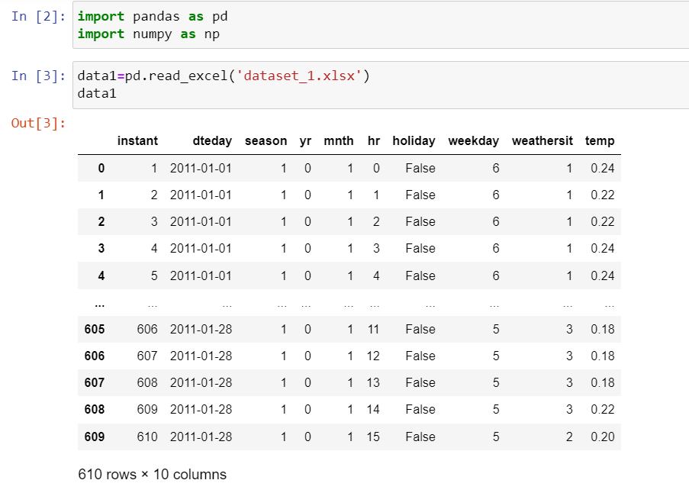
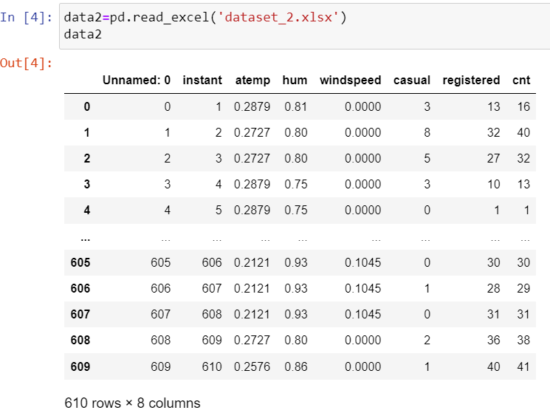
Importing datasets
Dataset 1
Dataset 2

Slide 4
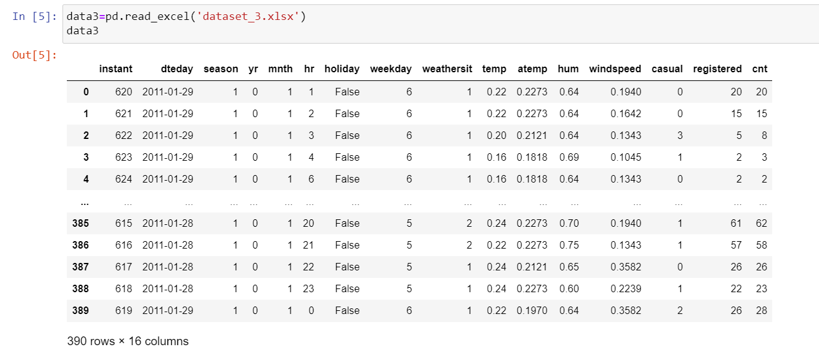
Importing dataset
Dataset 3

Slide 5
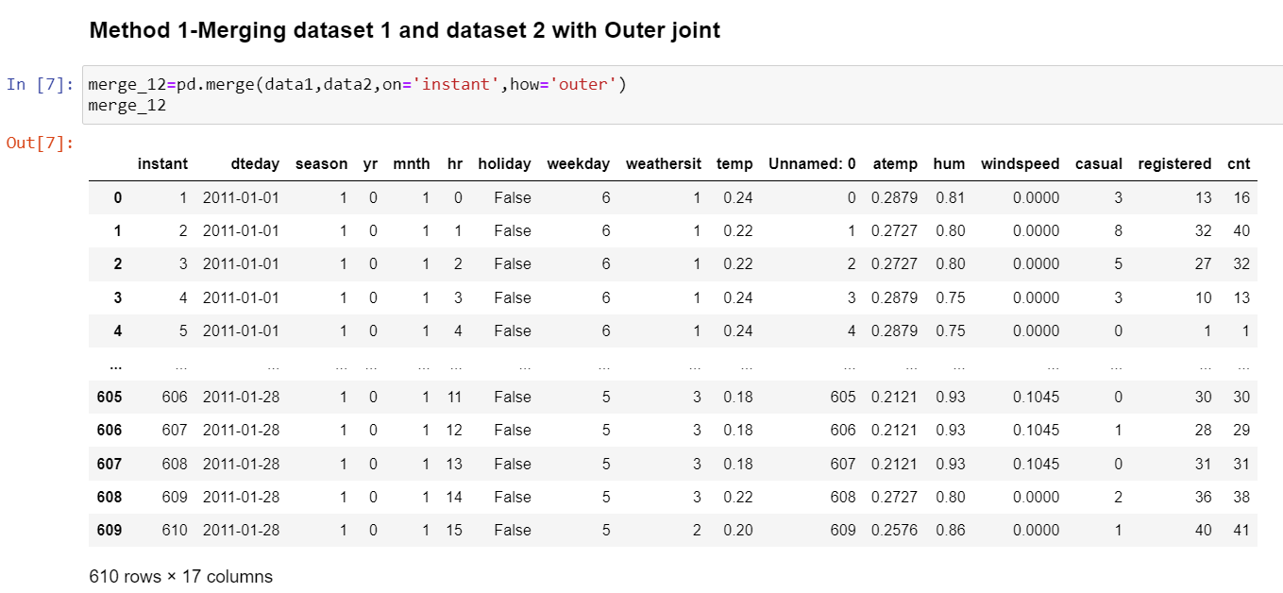
Merging dataset 1 & 2
Merged with Outer joint with “Instant” as common ID.
All columns from both datasets are available.

Slide 6
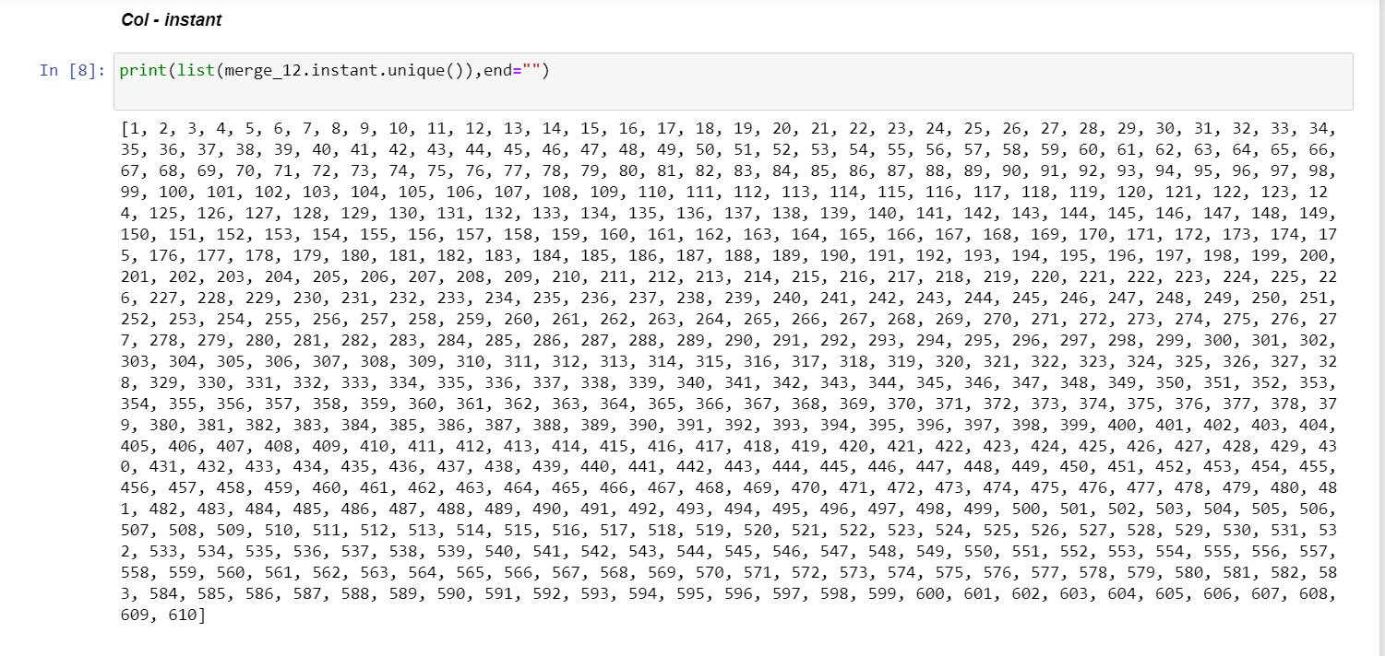
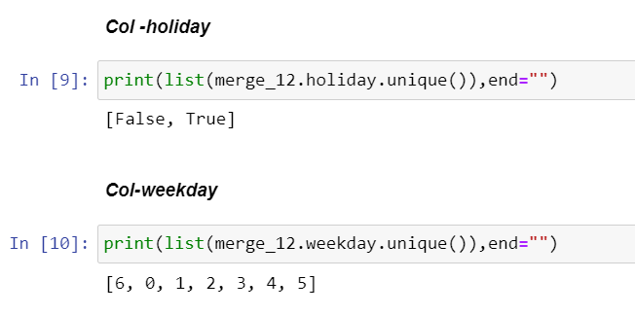
Checking unique number for merged dataset 1&2

Slide 7
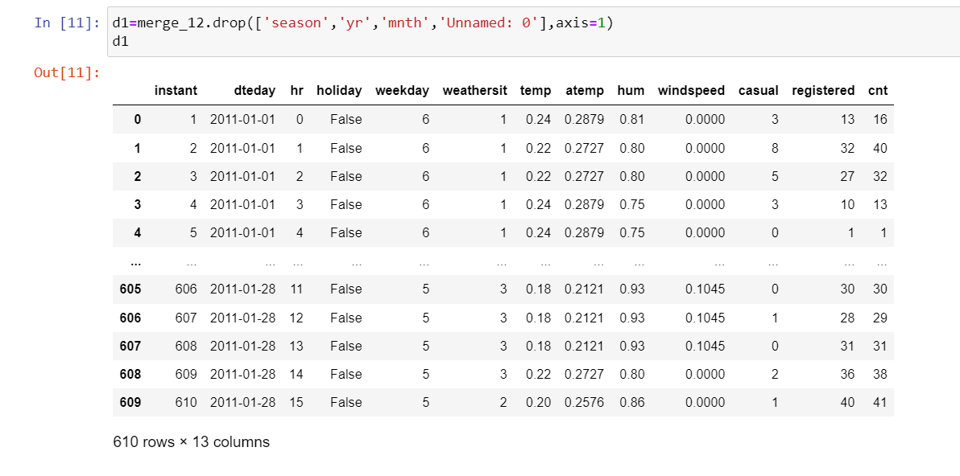
Removing unnecessary columns from merged dataset
Identifying columns which have less or no impact on overall datasets and removing it.
For ex. Season , yr ,mnth,Unnmaed columns in merged datasets can be removed.

Slide 8
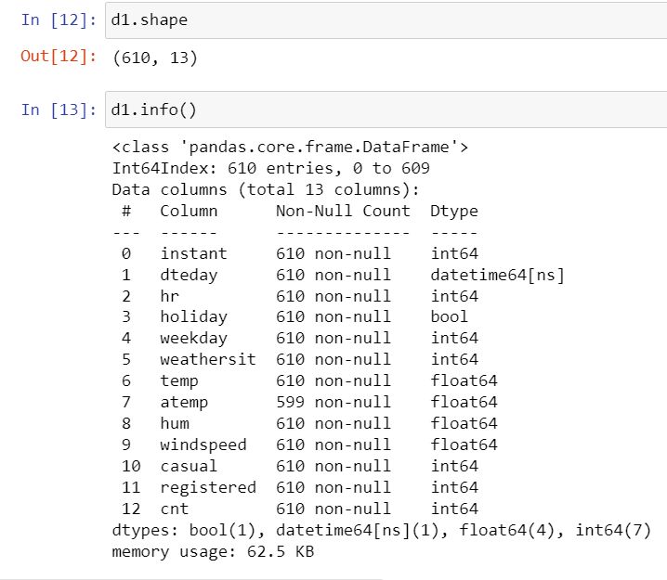
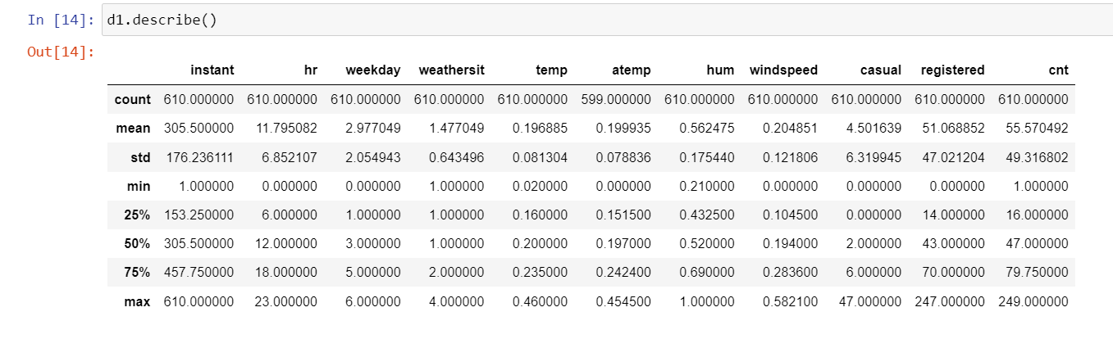
Checking datatype and summary

Slide 9
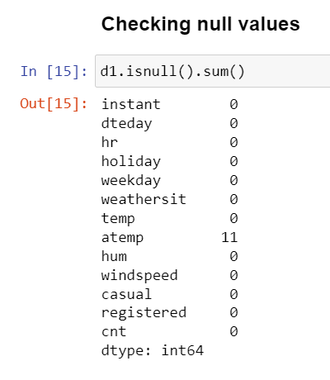
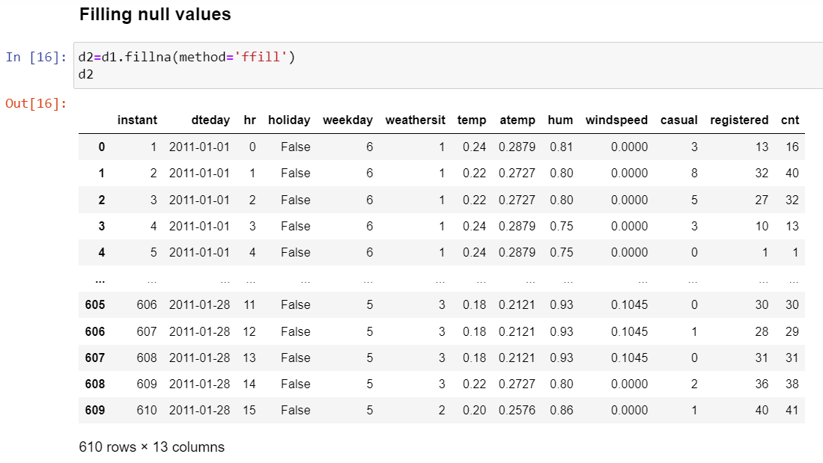
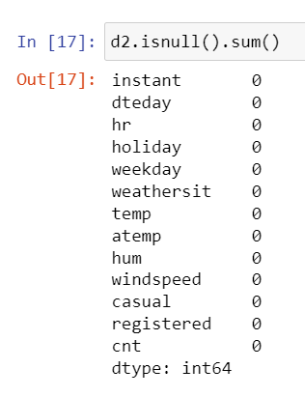
Treating null values
Checking Null values
Filling Null values using Front Fill method.
No Null values afterwards

Slide 10
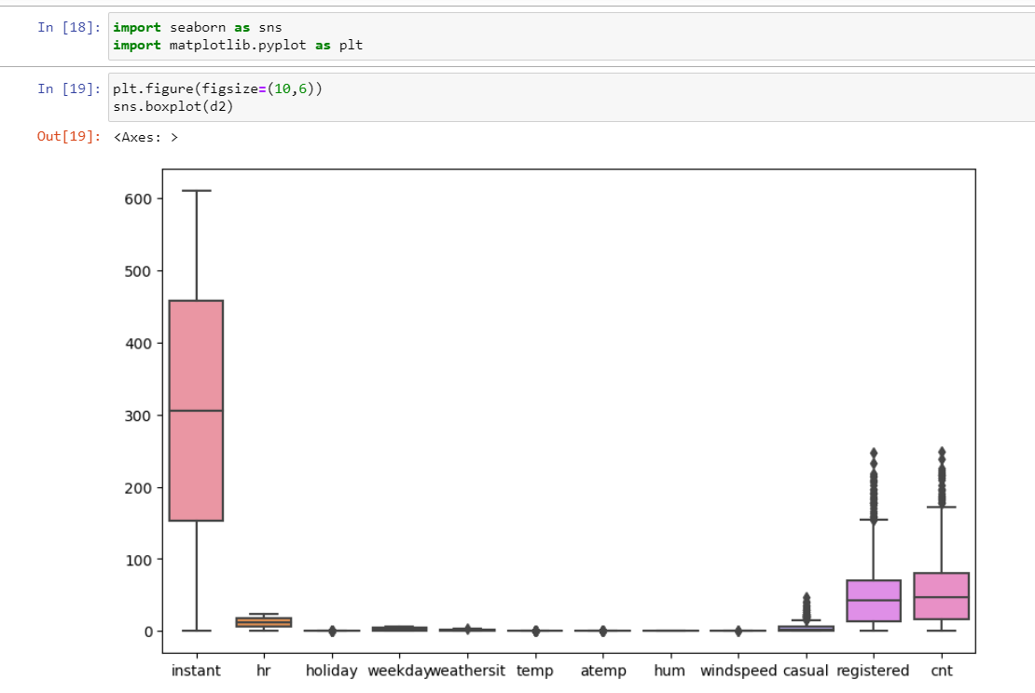
Checking outliers using boxplot

Slide 11
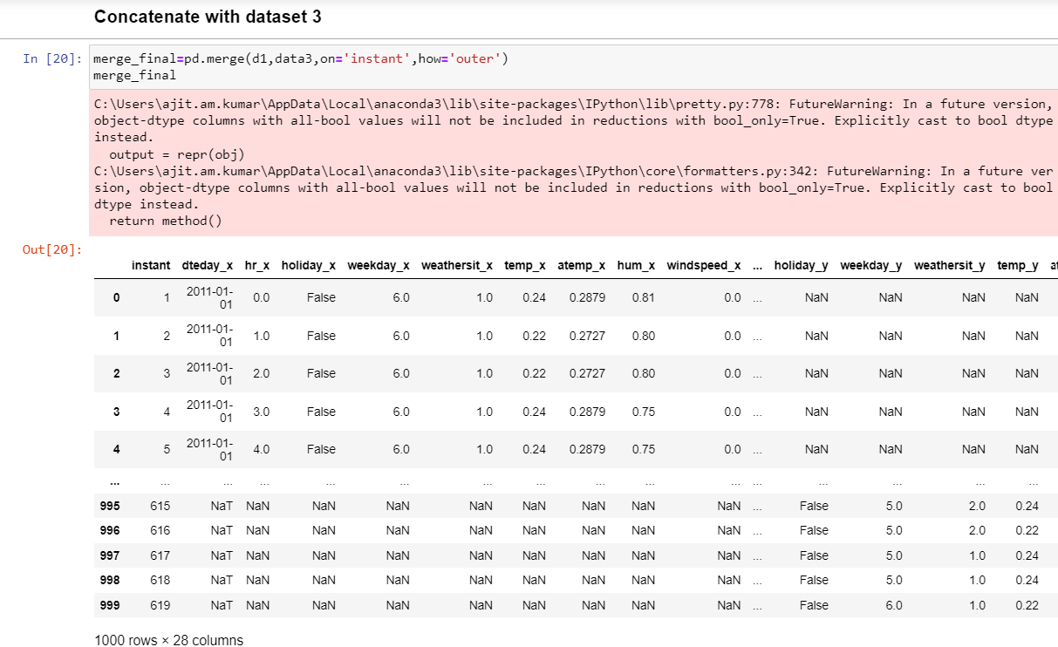
Concatenate dataset 3 with merged dataset 1 & 2

Slide 12
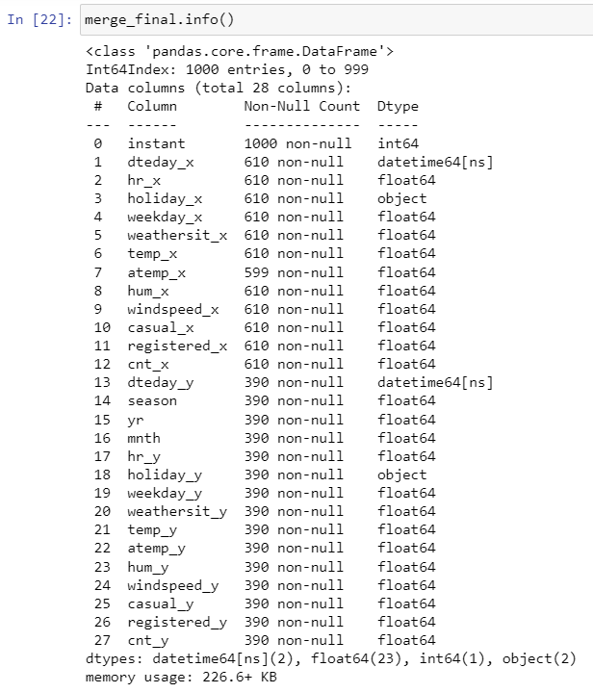
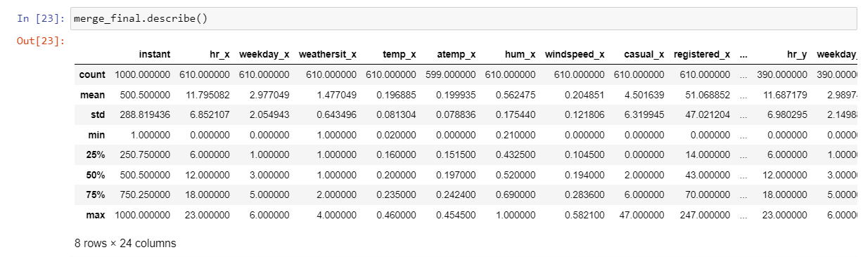
Checking datatype summary of merged dataset 1,2 & 3

Slide 13
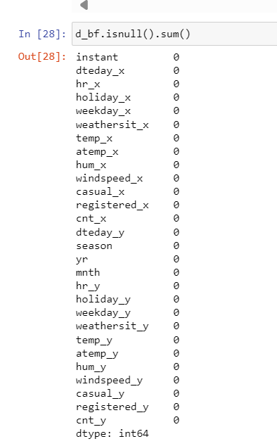
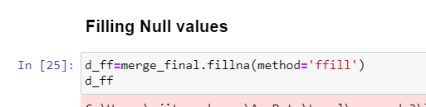
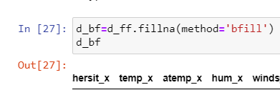
Treating missing values of merged datasets 1,2,3
No null values after Front & Backfill treatment
Filling null values using Front Fill method
Filling null values using Back Fill method

Slide 14
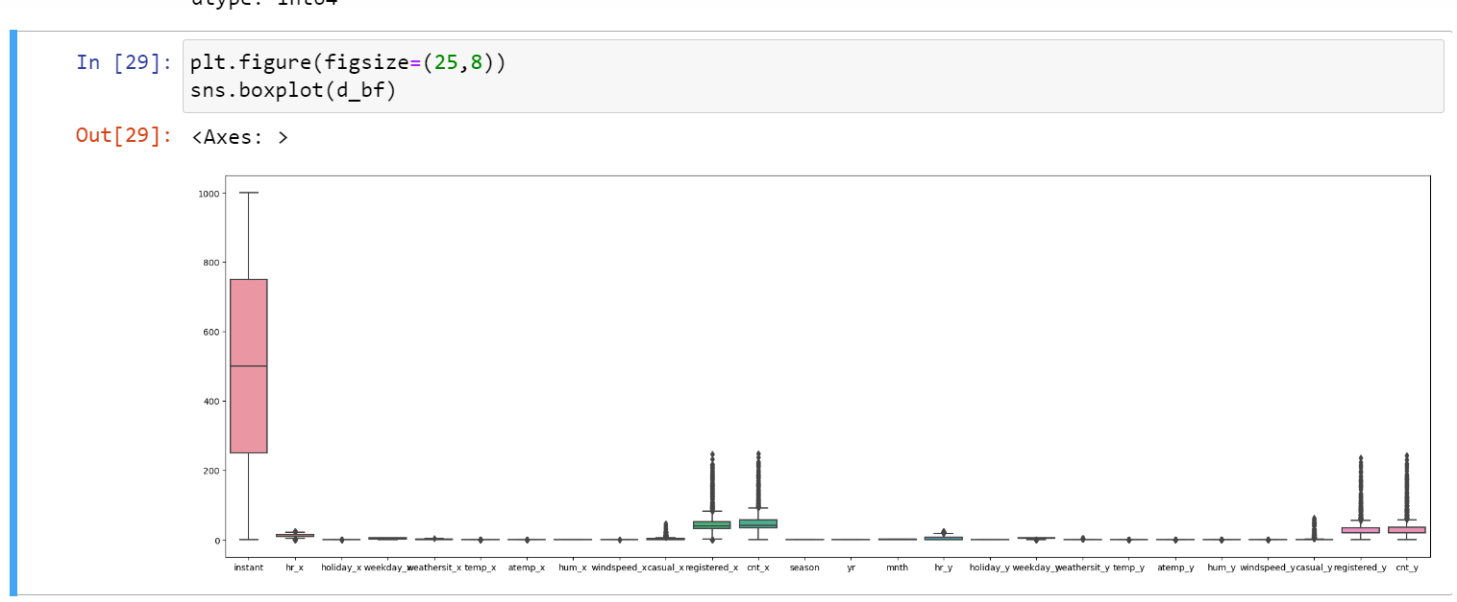
Checking outliers using boxplot

Slide 15
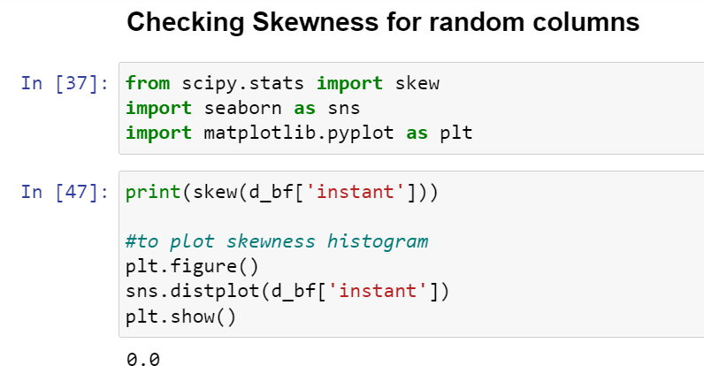
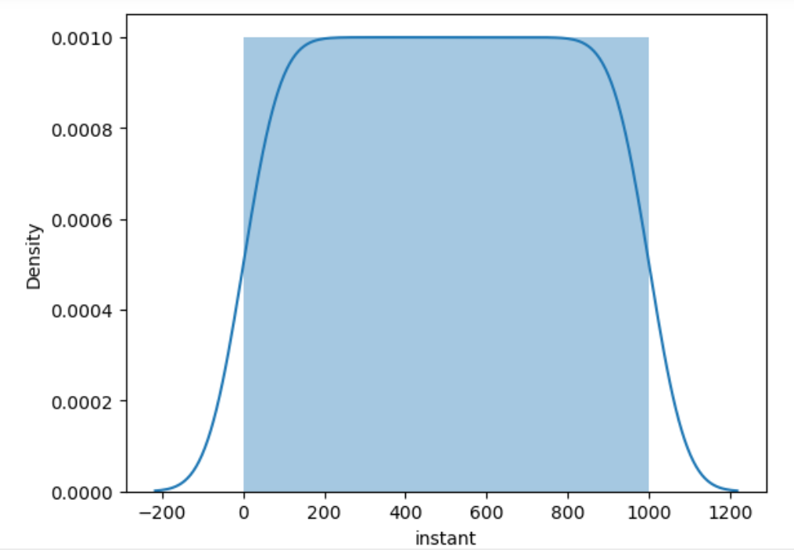
Checking skewness using distplot
Normal distribution

Slide 16
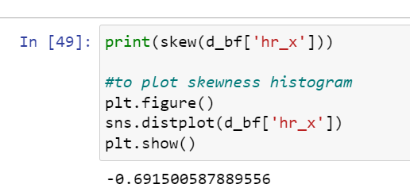
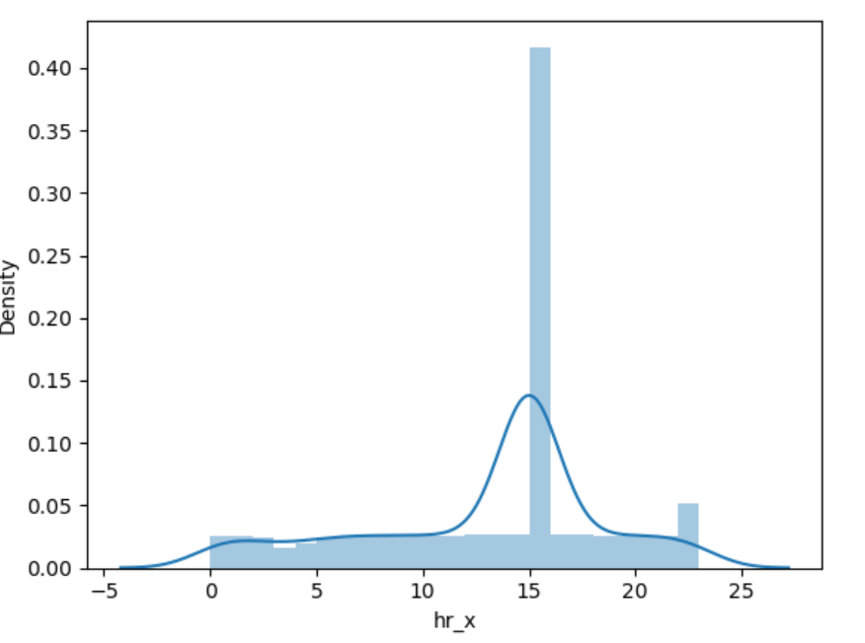
Checking skewness using distplot
Negative skewed distribution

Slide 17
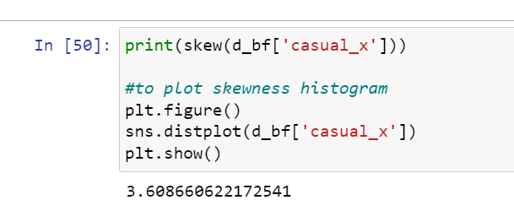
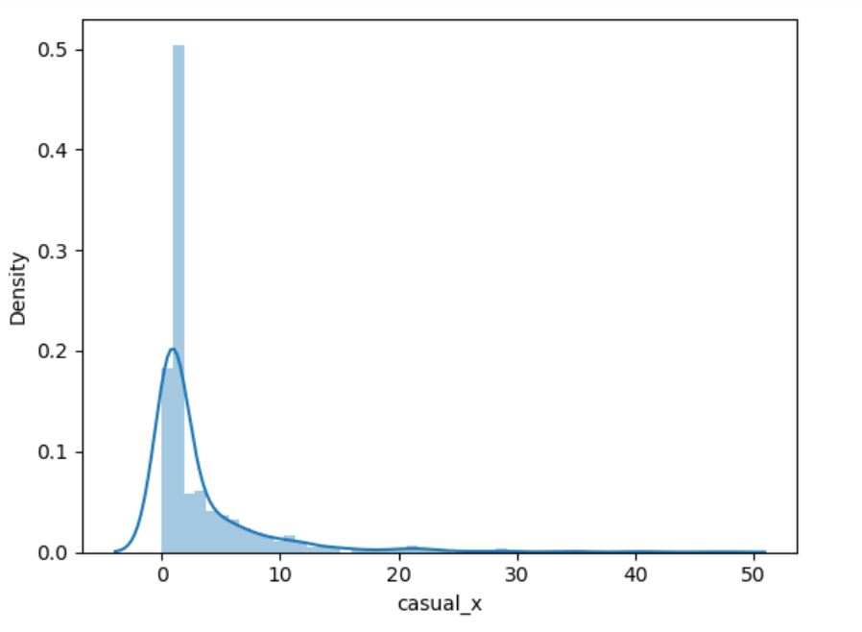
Checking skewness using distplot
Positive skewed distribution

Slide 18
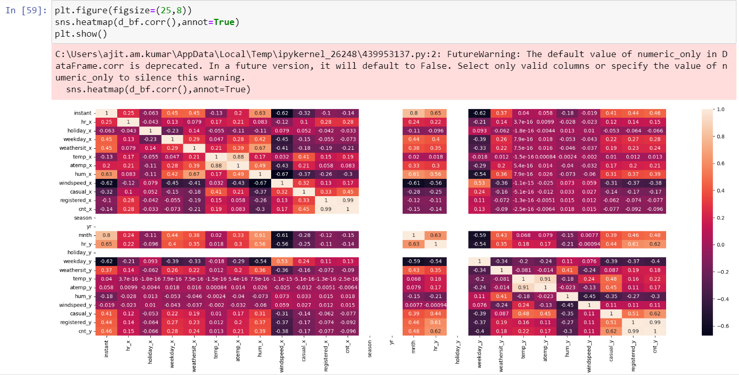
Plotting heatmap to check correlation

Slide 19
Thank you !

