Slide 1
Project - A SIMPLE CALCULATOR USING Python TKINTER LIBRARY
SUBMITTED BY- AJIT KUMAR

Slide 2
About the project
To create a simple GUI calculator using the Python Tkinter library.
Tools used – Microsoft Virtual Studio Code.
Calculator operations includes basic arithmetic equation evaluation such as addition , subtraction , multiplication and division.
Includes digits buttons from 0-9 and basic operators.

Slide 3
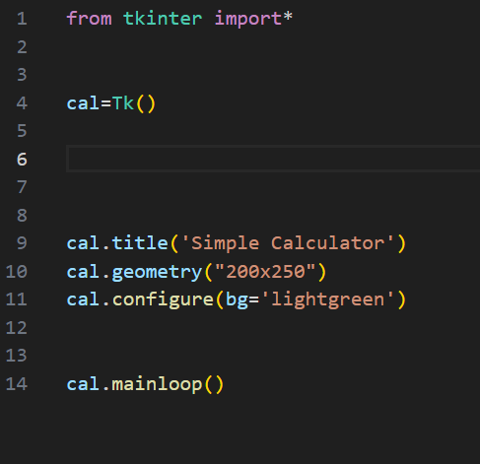
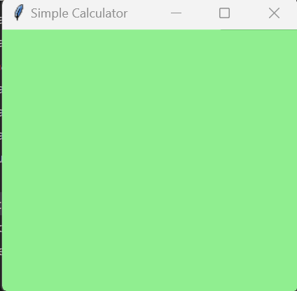
Creating Basic GUI
Code
GUI output

Slide 4
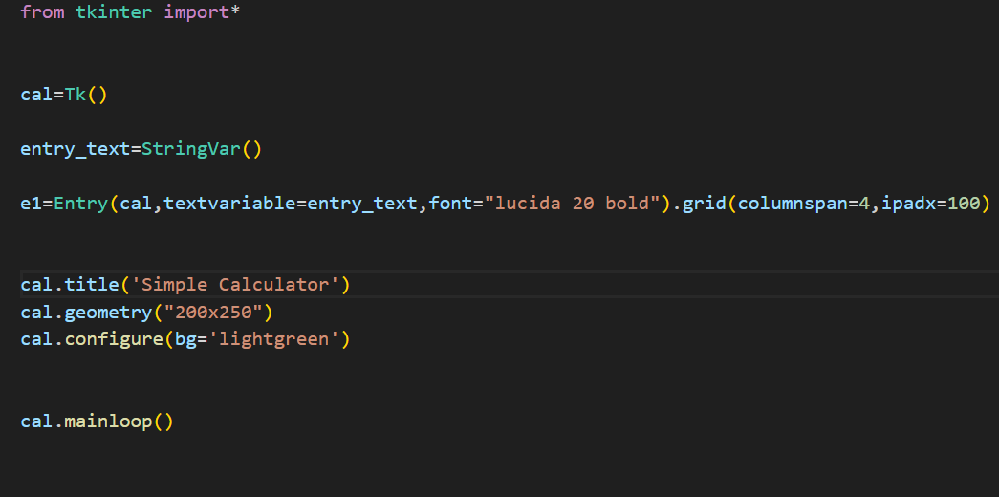
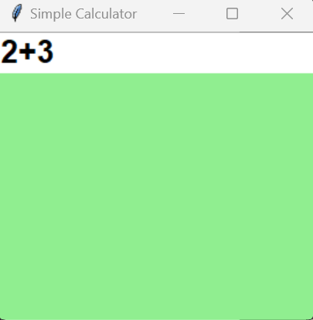
Creating entry widget
Code
GUI output

Slide 5
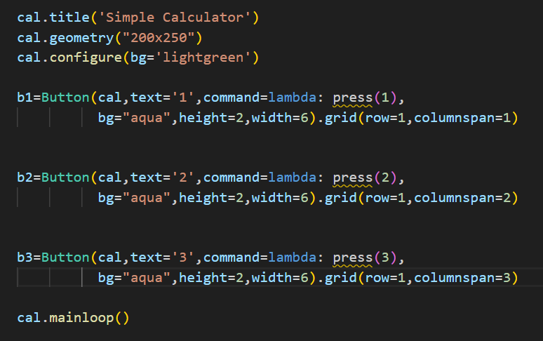
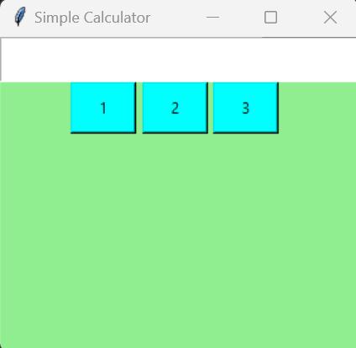
Adding button widgets
Code
GUI output

Slide 6
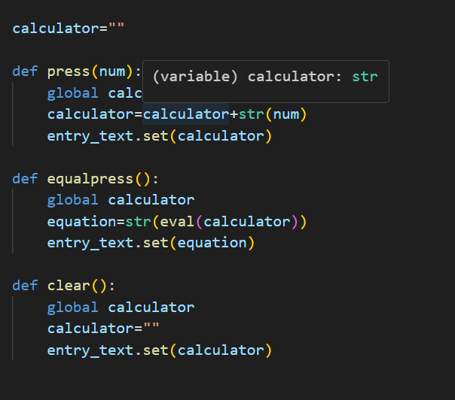
Creating functions for button widgets operability
Code
Defining global expression as calculator =“”
User defined function def press (num) to put the user defined numbers value in the entry widget
def equalpress( ) to evaluate the equation put in entry widget
def clear( ) to clear the equation available in entry widget for next equation.

Slide 7
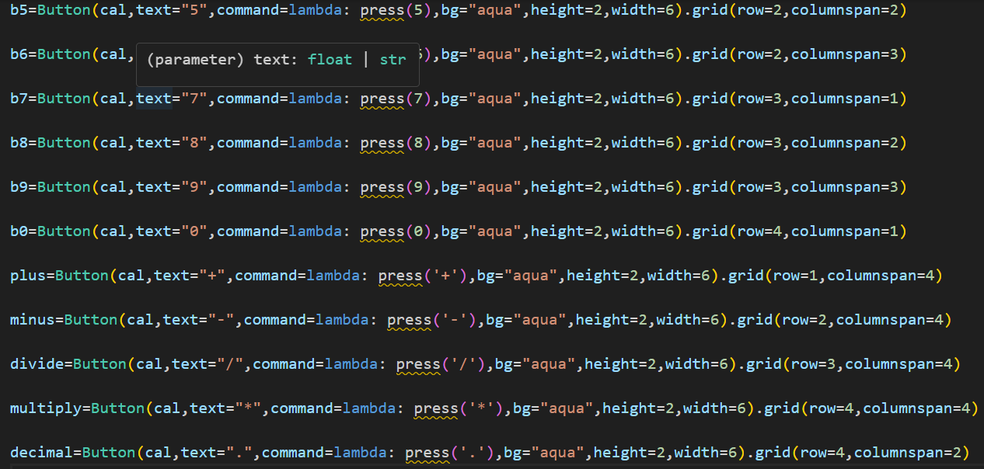
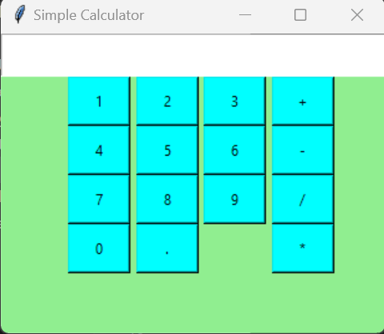
Adding all button widgets
Code
GUI output

Slide 8
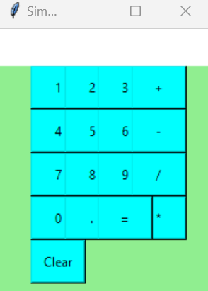
Final Output

Slide 9
Thank you !

