Slide 1

INDUSTRY INTERNSHIP
Ajit A Bijapur
Intern at Spookfish Innovations Bangalore
(20-01-2020 to 31-05-2020)

Slide 2
Contents
Inspection Bot
a)Introduction
b)Methodology
c)Results
Barcode Decoder
a)Introduction
b)working process
c)hardware implementation
d) Results
3. Programmable logic controller (PLC)
4. Digital I/O cards

Slide 3
INSPECTION BOT:Introduction
Many accidents have happened owing to the crack and the corrosion of pipelines. We will have severe damages if fluid leaks from the pipeline and explodes.
It is very difficult to inspect the pipelines because they are buried under the ground. Therefore, we are hoping a method of inspection method with a simple four bar mechanism from the inside of the pipelines without digging the ground.
So we proposed a new design in inspecting pipelines.
Problem statement
We need to construct and design a 4 wheeled trolley to carry the camera for the inspection application it should move vertical and horizontal .

Slide 4
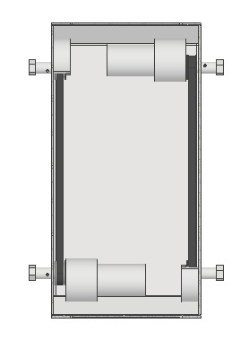
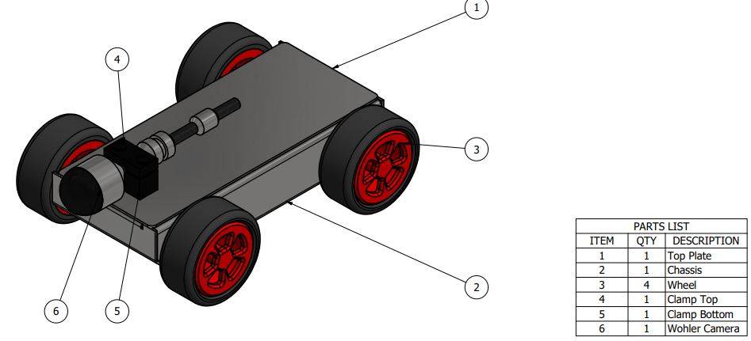
INSPECTION BOT:Methodology
Design and development of inspection robot using CAD software.
Fabrication of CAD models by means of manufacturing equipments.
Assembling all the fabricated parts.
Fixing a camera, motors, and mounting the circuit board onto the robot.
Making it to robot ,inside a pipe by means of a remote to capture the video image in a monitor.
Final design:-

Slide 5

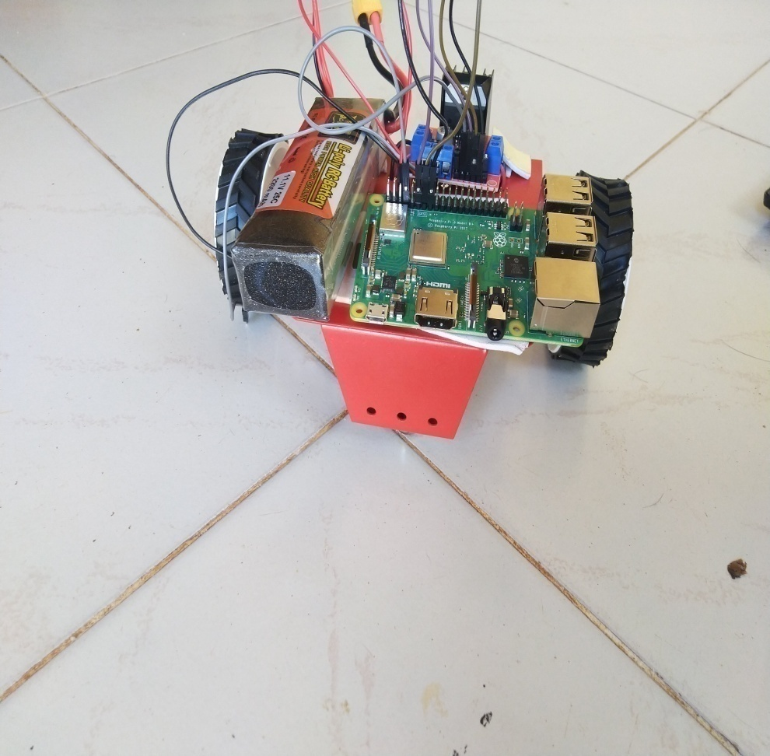
INSPECTION BOT:Results
fig 3.Web page GUI
Fig 4.Prototype of the inspection bot

Slide 6
PHARMA BARCODE DECODER:Introduction
What is Barcode Decoder?
A barcode reader (or barcode scanner) is an electronic device for reading printed barcodes.
Like a flatbed scanner, it consists of a light source, a lens and a light sensor translating optical impulses into electrical ones.
Additionally, nearly all barcode readers contain decoder circuitry analyzing the barcodes image data provided by the sensor and sending the barcodes content to the scanners output port.
Types of barcode decoder:-
Pen-type readers
Laser scanners
CCD readers (also known as LED scanners)
Camera-based readers

Slide 7
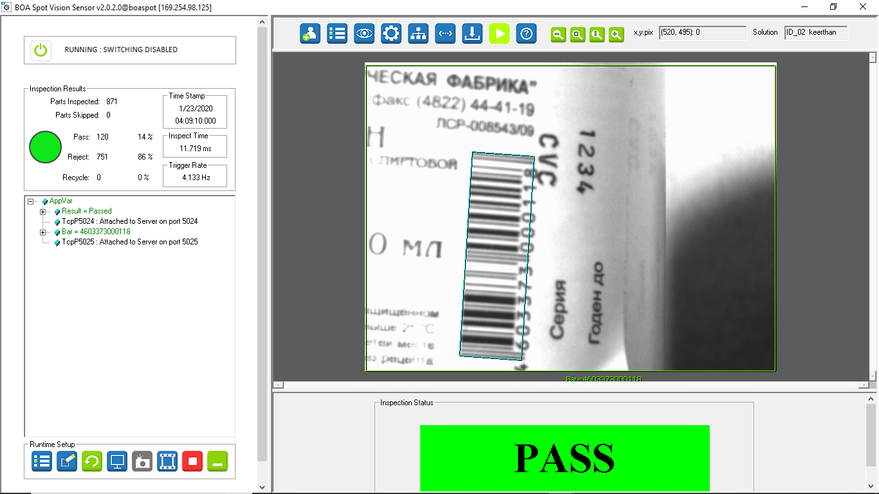
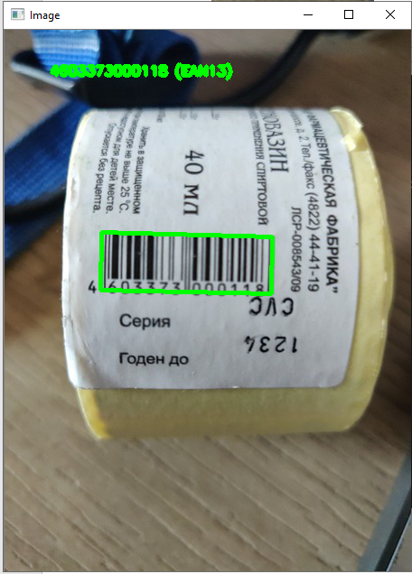
PHARMA BARCODE DECODER: Working methodology
Working:-
.
A bar code consists of a series of parallel, adjacent bars and spaces. Symbologies are used to encode small strings of character data into a printed symbol.
A bar code reader decodes a bar code by scanning a light source across the bar code and measuring the intensity of light reflected back by the white spaces
The pattern of reflected light is detected with a photodiode which produces an electronic signal that exactly matches the printed bar code pattern. This signal is then decoded back to the original data by electronic circuit.

Slide 8
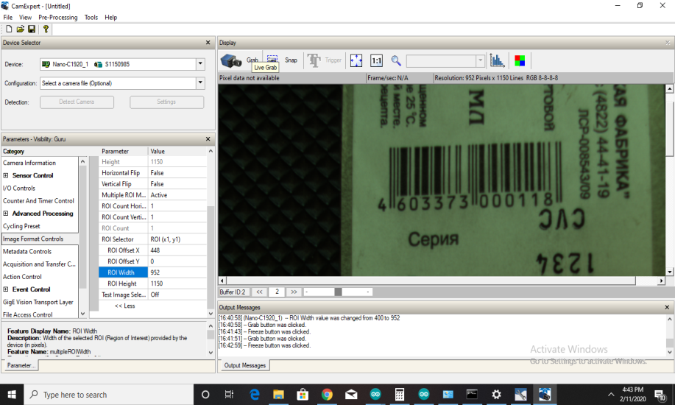
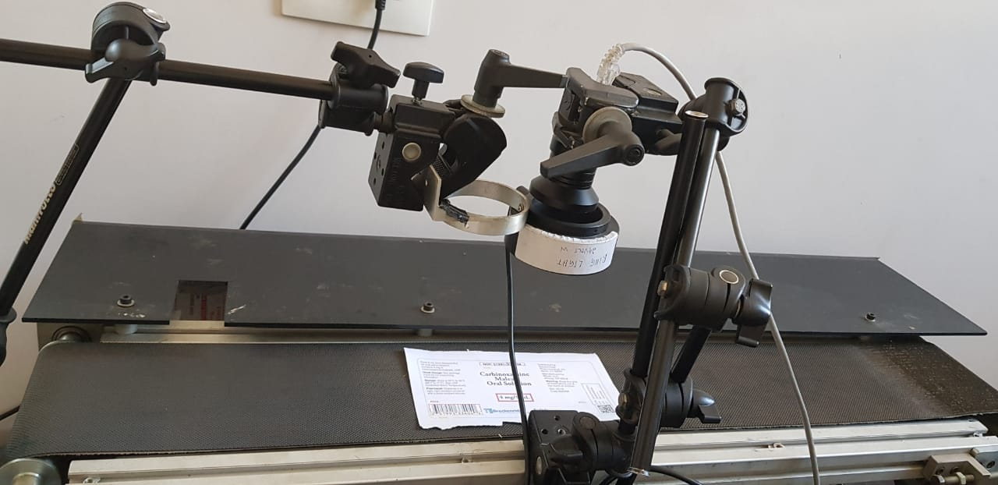
PHARMA BARCODE DECODER: Hardware Implementation
So started to rotate the stepper motor in forward and backward direction by giving 400 steps per revolution with speed of 9.5m/sec And with this speed we are able grab the image of barcode by hardware trigger with delay of 100ms as shown below in fig
a)For example in 1sec if we grab 10 images of barcode by hardware trigger around 4-5 images are in frame of view rest are not an images of barcode or not in frame of view
b)for point A to B to A it will take time around 1.12sec as show in below figure
.
Conveyer setup
reading barcode from a hardware trigger

Slide 9
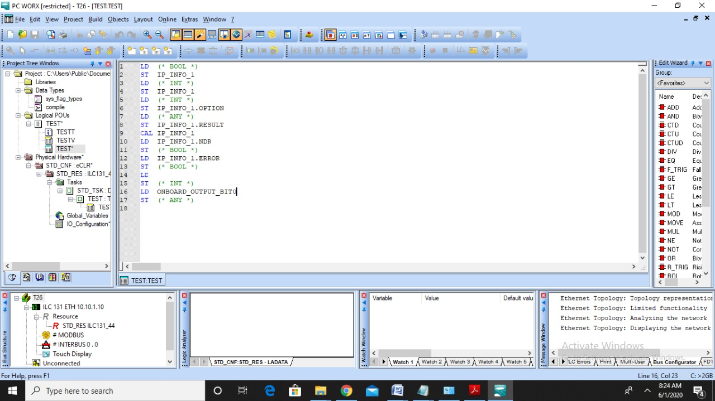
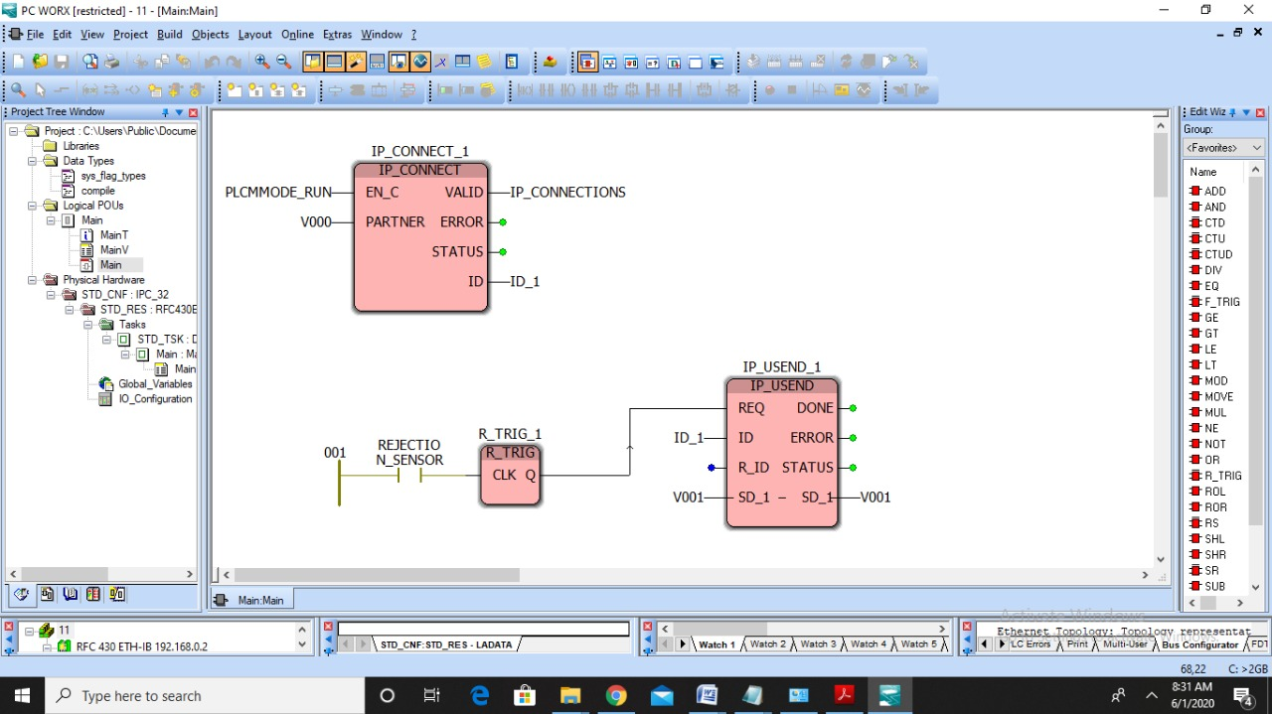
Programmable logic controller (PLC)
PC Worx is a programming platform where we can code for any PLC.
To work on a software called “PC worx” which is used to code using text language(ex Instruction list, structure tex) or graphical coding(ex ladder logic, Function Block Diagram).
The PLC we implemented this was on ILC 131 ETH, which has 8 input bits and 4 output bits, the communication happens over the Ethernet. So Netnames+ software tells us the IP address for the connected PLC.
Explored how to write the instruction list programming and the ladder logic
.

Slide 10
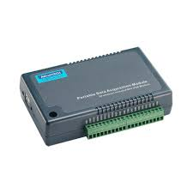
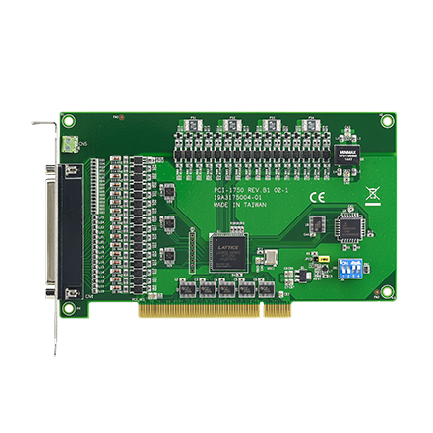
Digital I/O cards
I/O cards are the right answer to the need to acquire digital and analogical inputs and outputs from a PC in an industrial environment.
We need to understand how IO Cards are better than PLC.?
Suppose if you want to activate 24v industrial I/O signals to integrate PLC, you could set up a high level communications path from your PC to intelligence in a PLC based control system, passing messages back and forth, the PLC activating the plant signals.
USB-4750
PCI-1750

Slide 11
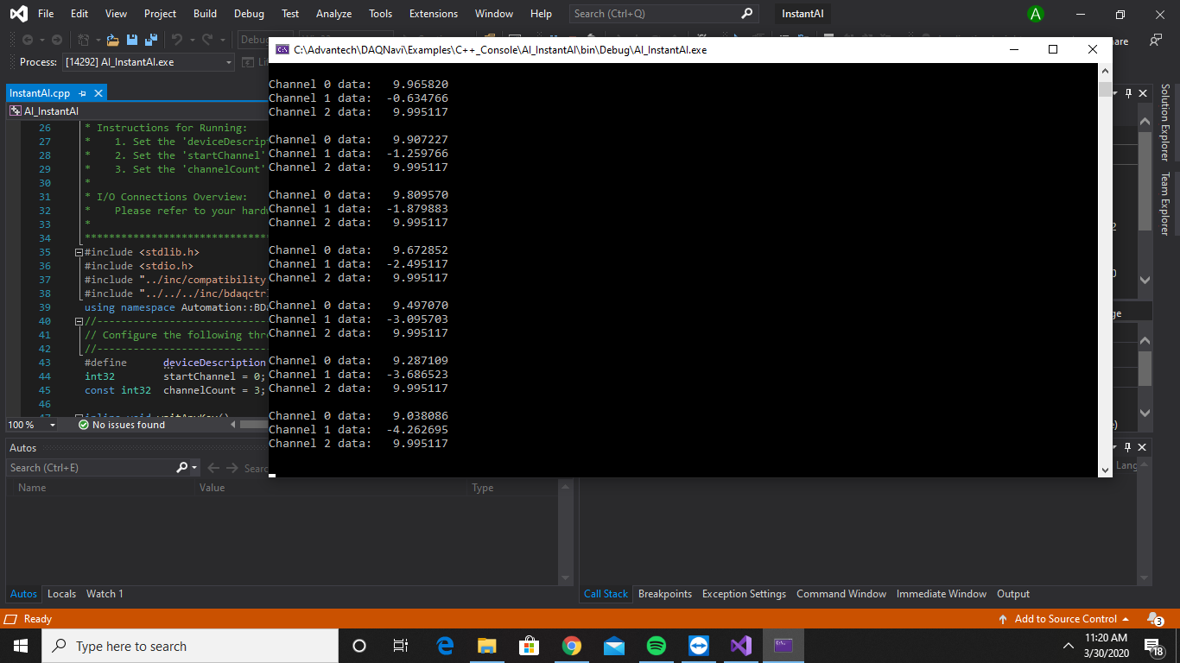
Digital I/O cards
Insert Daq device,then power on PC
.
Install driver of advantech Daq device
Mention the suitable device name
output

Slide 12
THANK YOU

