Slide 1

P peline
The Data
Byte 1
© Jennifer Mankoff
The Data Pipeline; HCII; Spring 2014

Slide 2
Let’s look at Byte1
Display RSS data provided by Yahoo Pipes
Learning goals:
A first experience with Python
Learning how to acquire data from an external source
Data formats we will use: RSS format
Technologies: Forms & Dynamic HTML & Yahoo! Pipes
Setting up a question and deciding what data helps to answer the question.

Slide 3
Demo
Yahoo Pipes End:
http://pipes.yahoo.com/pipes/
Google Appspot End:
http://jmankoff-byte1.appspot.com/

Slide 4
What can you do with Pipes?
starts with a blog feed
Run links through the BackType API to see who has posted the link to Twitter
Use the Twitter API to see how many followers each person who tweeted the link has
Format it as RSS “username (num of followers): Tweet text”
(Dawn Foster: http://gigaom.com/2010/10/29/using-apis-not-quite-as-hard-as-it-looks/)

Slide 5
What can you do with Python?
Pretty it up http://jianf-byte1.appspot.com/
Calculate something: http://halkutka-byte1.appspot.com/search
Visualize something:
http://psureshk-byte1.appspot.com/search

Slide 6
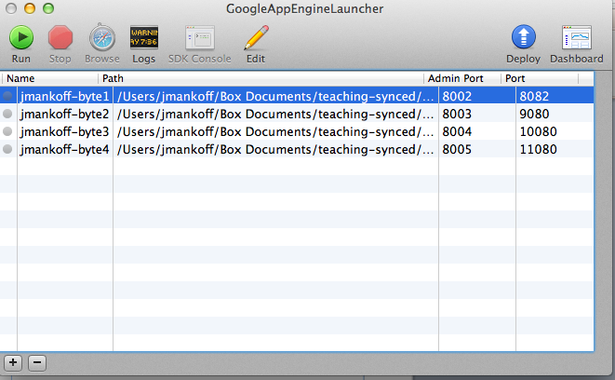
How does Appspot work?

Slide 7
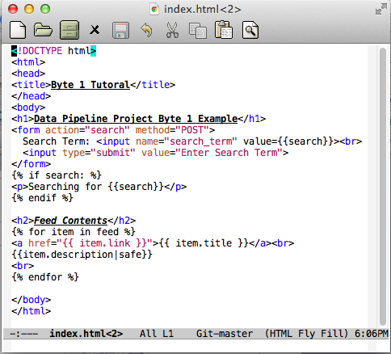
HTML

Slide 8
HTML
{{<name>}} is replaced with the value of that variable in your python code

Slide 9
HTML
{% %} executes logic (and may also refer to variables). Here we have an if then statement

Slide 10
Dynamic HTML
And this is a for loop that will generate multiple copies of the html inside of it, one for each item in the feed variable

Slide 11
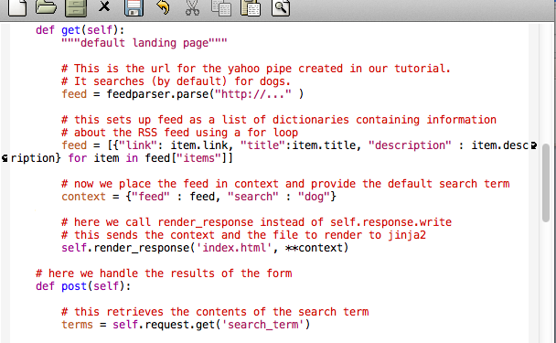
Meanwhile in Main.py…
… very similar to get
Notes:
Meanwhile

Slide 12
Main.py
This statement will download the contents of the RSS feed using the feedparser library, which returns a python dictionary object containing the key information
… very similar to get

Slide 13
Main.py
This is a type of for loop that can be used in python to efficiently construct a list (in this case a list of dictionaries that we construct which are designed specifically to pass only necessary information the loop in index.html).
… very similar to get

Slide 14
Main.py
We add that list to the context variable and then pass it to a special function (render_response), which invokes the dynamic code in index.html and renders the results to the user.
… very similar to get

Slide 15
Hints and Requests
Be sure to follow the tutorial step by step.
You will need to create accounts and specific things in Google and Yahoo! Pipes in order to complete this assignment.
Leave enough time to work out the kinks – even with a tutorial and source code you will run into some.
Questions and answers are most welcome as comments on the tutorial so we all benefit.
Notes:
----- Meeting Notes (1/14/14 10:13) -----
make sure comments are enabled
make sure th search works with spaces

