Slide 1
Robot Framework Training
By Jayson Panganiban

Slide 2
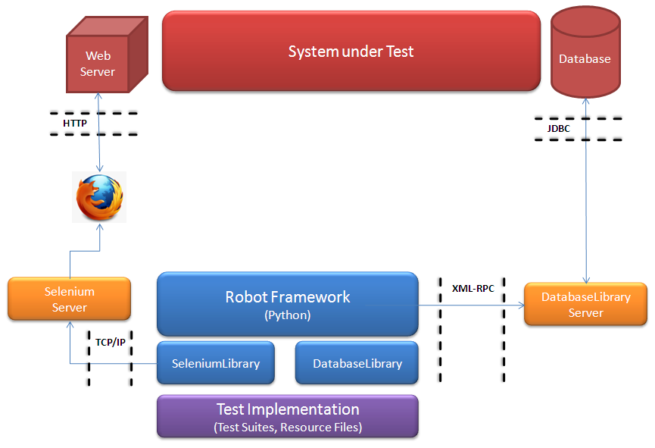
Testing Architecture

Slide 3
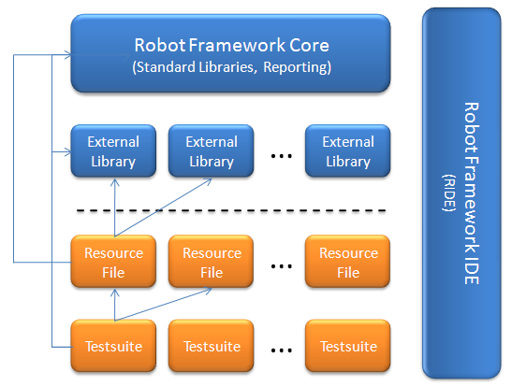
Robot Framework Overview

Slide 4

Test Creation
[Documentation]
Used for specifying a test case documentation.
[Tags]
Used for tagging test cases.
[Setup], [Teardown]
Specify test setup and teardown.
[Template]
Specifies the template keyword to use. The test itself will contain only data to use as arguments to that keyword.
[Timeout]
Used for setting a test case timeout. Timeouts are discussed in their own section.

Slide 5
Naming - High Level Guidelines
Test suite naming
Suite names should be as describing as possible.
Names can be relatively long, but over 40 characters starts to be too much.
Remember that suite names are created automatically from file/directory names. Extensions are stripped, underscores are converted to spaces and, if name is all lower case, words are capitalized. For example login_tests.txt -> Login Tests and DHCP_and_DNS -> DHCP and DNS.
Test case naming
Test names should be describing similarly as suite names.
If a suite contains many similar tests, and the suite itself is well named, test names can be shorter.
Name is exactly what you specify in the test case file without any conversion.
*** Test Cases ***
Verify That Login With Empty Username And Password Should Fail
Verify That Login With Invalid Username And Invalid Password Should Fail

Slide 6
Naming - High Level Guidelines
Keyword naming
Keyword names should be describing and clear.
Should explain what the keyword does, not how it does it.
Very different abstraction levels (e.g. Input Text or User logs into system).
*** Keywords ***
Login With Valid Credentials
Setup and Teardown Naming
Possibly use an existing keyword.
More abstract names acceptable if a setup/teardown contain unrelated steps.
Listing steps in name is duplication and a maintenance problem (e.g. Login to system, add user, activate alarms and check balance).
May need to use something generic like Initialize system.
BuiltIn keyword Run Keywords can work well if you have keywords for all lower level steps ready.
For example | Run Keywords | Login to system | Add user | Activate alarms |.

Slide 7
Variables
Encapsulate long and/or complicated values
Pass information from command line
Pass information between keywords
Variable naming
Clear but not too long names
Recommended to list also variables that are set dynamically in the variable table
Set typically using Set Global/Suite/Test Variable keywords
The initial value should explain where/how the real value is set
Use case consistently
Use snake case for compound words
Lower case with local variables and test variable available inside certain test or keyword
Upper case with others (global and suite)

Slide 8



Variables - Priorities
Variable from the command line
Highest priority of all variables that can be set before the actual test execution starts
Overrides possible variables created in variable tables
--variable option
Variable table in a test case file
Available for all the test cases in that file
Can be used in setting table
Imported resource and variable files
Lowest priority
File imported first are taken into use
Variables set during test execution
Sets during test execution either using return values from keywords or using Set Test/Suite/Global Variable keywords always override possible existing variables in the scope where they are set
Built-in variables
${TEMPDIR} and ${TEST_NAME} have the highest priority of all variables cannot be overridden but can be reset during execution

Slide 9
Variables - Scope
Global Scope
Normally set from the command line with –variable and –variablefile options
Can be created using Set Global Variable
Built in variables are global
Recommended to use CAPITAL letters
Test Suite Scope
Available anywhere in the test suite where they are defined or imported
Not recursive, which means that variables available in a higher-level test suite are not available in lower-level suites.
Test Case Scope
Visible in test case an in all user keywords
Can be created using “Set Test Variable”
Local Scope
Test cases and user keywords have a local variable scope that is not seen by other tests or keywords.
Can be created using return values from executed keywords and user keywords also get them as arguments.

Slide 10

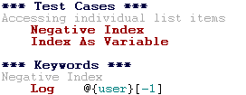

Variables – Scalar, List, Dictionary
Scalar Variables
List Variables
Dictionary Variables

Slide 11
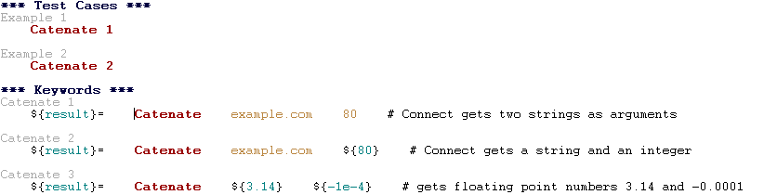
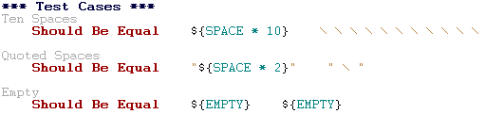
Built-in Variables – Number, Space, Empty
Number
Space and empty variables

Slide 12
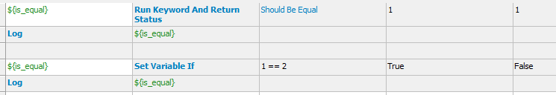
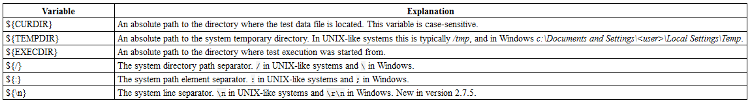
Built-in Variables – Boolean and OS
Boolean
Operating System

Slide 13


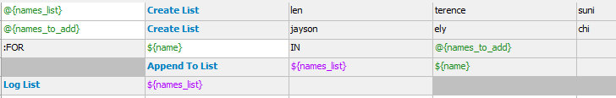
For Loop
In Range
Exiting
Thru Elements

Slide 14
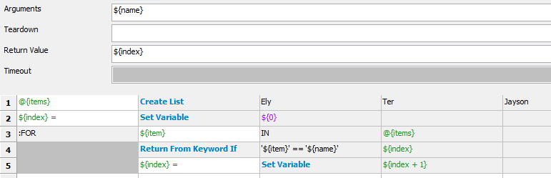
For Loop
Thru Dictionary
Finding Index

Slide 15
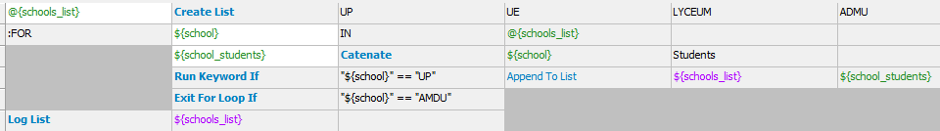
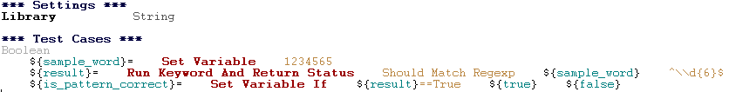
Conditional Execution
Run Keyword If and Run Keyword Unless
Execute a named keyword only if a certain expression is true or false, respectively. They are ideally suited to creating simple if/else constructs. For an example, see the documentation of the former.
Set Variable If
Can be used to set variables dynamically based on a given expression.

Slide 16
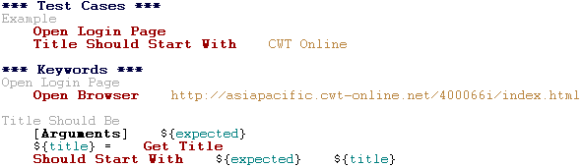
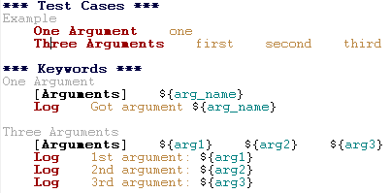
User Keywords
Basic Syntax
Keyword Positional Arguments

Slide 17
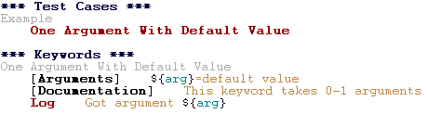
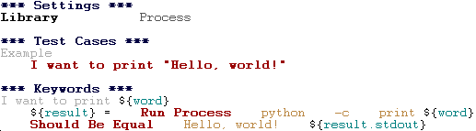
User Keywords
Default values with user keywords
Embedding arguments into keyword name

Slide 18
Passing and Returning Value
Common approach is to return values from keywords, assign them to variables and then pass them as arguments to other keywords
Clear and easy to follow approach
Looks like programming
Alternative approach is using Set Test Variable keyword
No need to have any programming style in test case level
More complex to follow, reusing keywords harder
Avoid below test case level

Slide 19
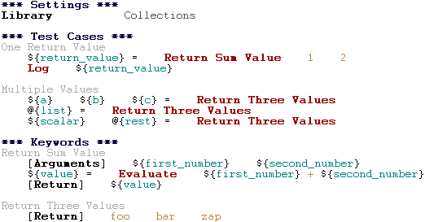
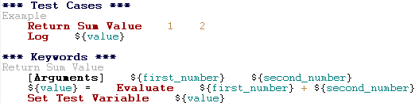
Return Setting and Set Test Variable
Using Return Setting
Using Set Test Variable

Slide 20
Using Wait – Avoid Sleeping
Sleeping is very fragile
Instead of sleep, use keyword that polls has certain action occurred
Should have a maximum time to wait
Keyword names often starts with Wait Until ...
Possible to wrap other keywords inside BuiltIn keyword Wait Until Keyword Succeeds
Sometimes sleeping is easiest solution
Always use with care and never in user keywords that are used often by tests or other keywords
Can be useful in debugging to stop execution
Although Dialogs Library often works better for that purpose

Slide 21
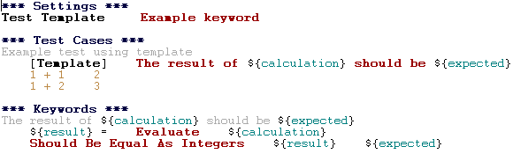
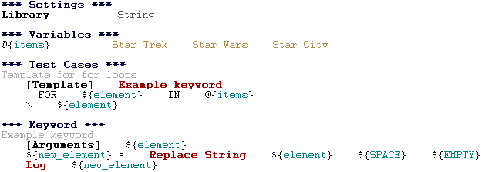
Test Templates
Templates with embedded arguments
Templates with for loops

Slide 22
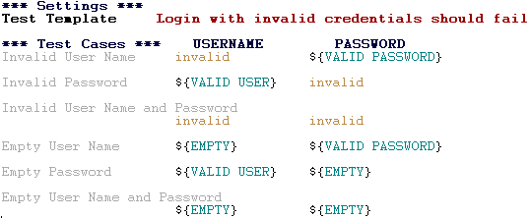
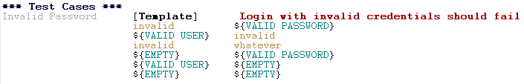
Data-driven style
The above example has six separate tests, one for each invalid user/password combination, and the example below illustrates how to have only one test with all the combinations. When using test templates, all the rounds in a test are executed even if there are failures, so there is no real functional difference between these two styles. In the above example separate combinations are named so it is easier to see what they test, but having potentially large number of these tests may mess-up statistics. Which style to use depends on the context and personal preferences.

Slide 23
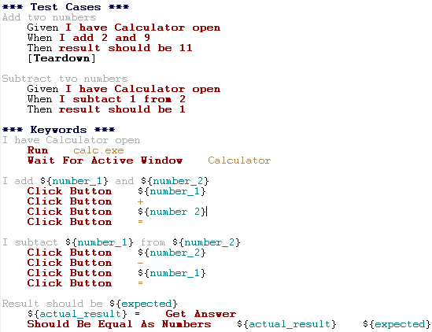
Behavior-driven development style

Slide 24
Execution Flow
Suite Setup
Executed before its tests and child suites. If the suite setup passes, test execution continues normally. If it fails, all the test cases the suite and its child suites contain are marked failed. The tests and possible suite setups and teardowns in the child test suites are not executed.
Suite Teardown
Executed after all its test cases and child suites. Suite teardowns are executed regardless of the test status and even if the matching suite setup fails. If the suite teardown fails, all tests in the suite are marked failed afterwards in reports and logs.
Test Setup
Executed before the keywords of the test case. If the setup fails, the keywords are not executed. The main use for test setups is setting up the environment for that particular test case.
Test Teardown
Executed after the test case has been executed. It is executed regardless of the test status and also if test setup has failed.
Keyword Teardown
User keywords cannot have setups, but they can have teardowns that work exactly like other teardowns. Keyword teardowns are run after the keyword is executed otherwise, regardless the status, and they are executed fully even if some of their keywords fail.

Slide 25
Execution – Handling Failure
Run Keyword And Ignore Error and Run Keyword And Expect Error
Handle failures so that test execution is not terminated immediately. Though, using these keywords for this purpose often adds extra complexity to test cases, so the following features are worth considering to make continuing after failures easier.
Run Keyword And Continue on Failure
Allows converting any failure into a continuable failure. These failures are handled by the framework exactly the same way as continuable failures originating from library keywords.
Execution continues on teardowns automatically
To make it sure that all the cleanup activities are taken care of, the continue on failure mode is automatically on in test and suite teardowns. In practice this means that in teardowns all the keywords in all levels are always executed.
Stopping when first test case fails
If option --exitonfailure is used, test execution stops immediately if any critical test fails. Also the remaining tests are marked as failed.
Handling teardowns
It is also possible to skip teardowns when execution is stopped by using --skipteardownonexit option. This can be useful if, for example, clean-up tasks take a lot of time.

Slide 26
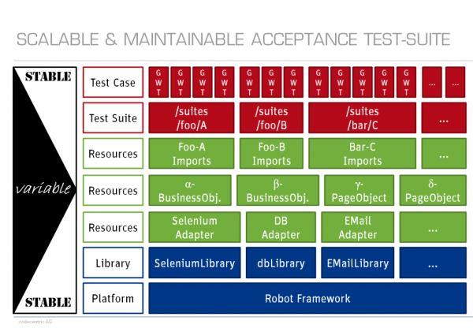
Scalable and Maintainable Acceptance Test Suite

