Slide 1
Problem Statement:
The process of reading input file -> processing data -> storing it takes time and hence for real time data, some data may get truncated.
Input Files
Output Files
Batch Process
Bottleneck areas
Database

Slide 2
Problem Analysis:
The data structure must be chosen best suited for real time solution.
Database for storing data must be chosen properly.
Requirements to achieve this
CRUD operations should be fast
Traversal should be fast
Data structure Specific requirement
Should be First in First Out hence ordered
Should be thread safe
Database specific requirement
Should be distributed
Should be concurrent
Should have correct data means no override.

Slide 3
Data Structure and Database candidate:
Consideration:-
Unstructured data
Huge data
Dynamic Schema
No SQL stands out on all front
Out of selection process
Array:- Not auto scalable
Stack:- LIFO and not FIFO
Hash Map:- does not maintain order , collision resolution is high, painful for huge data
Hash Table:- does not maintain order, painful for huge data
Hash Set:- does not maintain order, internally uses Hash map.
Flat file:- Painfully slow
List:- Slower than Queue if FIFO is required
JSON:- Internally it stores as map + overhead
__________________________________ Selection
Queue:- Follows FIFO principal. Faster than others above. Pop/push time takes O(1) Tree and graph:- Good for having a hierarchy
Data Structure
Database
Which No SQL?
Graph Databases:- Good for storing graph-oriented data structures.(Recommendation engines)
Wide column data stores:- Good for Search engines and web app
Document Stores:- content management and monitoring web
Key-Value (KV) Stores:-Good for clickstream data and application logs

Slide 4
Final selection and Reason:
Data Structure
For our application we need to retrieve data in minimum time in a FIFO approach.
We do not want to lose any data, and all this should happen in real time.
We also need to have key value paired data for indexing the value Based on our current requirement we select Queue as the data structure.
Database
Our data base should be as per the work that we are doing with the data stored.
Here the data requires constant monitoring for Clicks, impression by consumer to register the usage of ads.
And to perform content management from source to destination.
Hence, Document stores NoSQL database would be best suited for our purpose

Slide 5
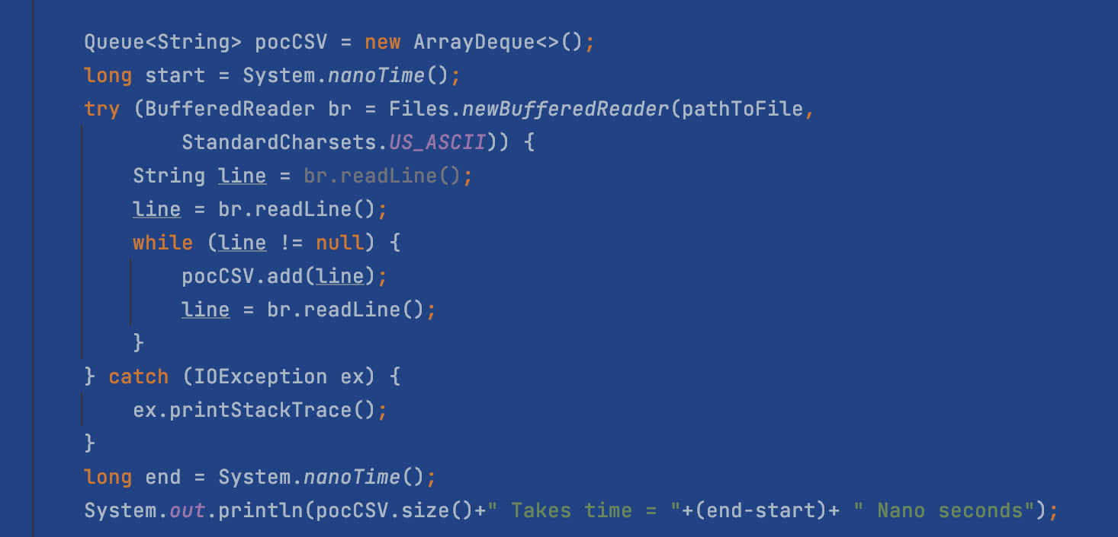
A Small implementation:

