Slide 1
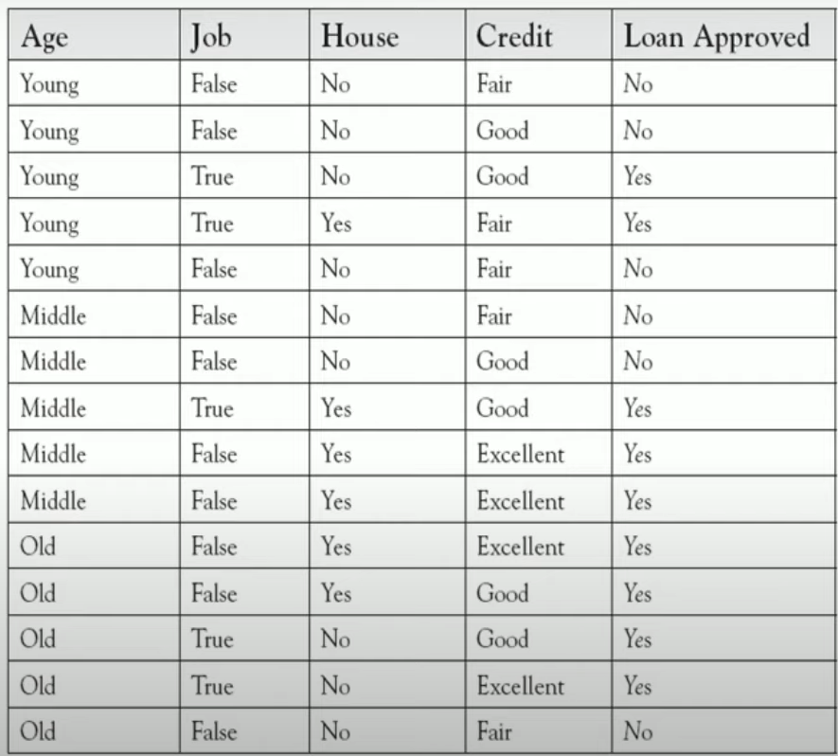
Gini(S) = 1 - Σ(p_i)^2
Gini for age:
Gini(Age=young)=1-((2/5)²+ (3/5)²=0.48
Gini(Age=middle)=1-((3/5)²+ (2/5)²=0.48
Gini(Age=old)=1-((4/5)²+ (1/5)²=0.32
Weighted Gini Impurity = (Proportion_1 * Gini Impurity_1) + (Proportion_2 * Gini Impurity_2) + ... + (Proportion n * Gini Impurity_n)
Weighted average =0.48*(5/15)+0.48*(5/15)+0.32*(5/15)= 0.42
Gini for Job:
Gini(job=False)=1-((4/10)²+ (6/10)²=0.48
Gini(job=True)=1-((5/5)²+ (0/5)²=0
Weighted average =0.48*(10/15)+0=0.32
Gini for House:
Gini(house=No)=1-((3/9)²+ (6/9)²=0.44
Gini(house=Yes)=1-((6/6)²+ (0/6)²=0
Weighted average =0.44*(9/15)+0=0.26
Gini for credit:
Gini(credit=Fair)=1-((1/5)²+ (4/5)²=0.32
Gini(credit=Good)=1-((4/6)²+ (2/6)²=0.44
Weighted average =0.32*(5/15)+0.44*(6/15)+0=0.28
Gini(credit=excellent)=1-((4/4)²+ (0/4)²=0

Slide 2
House=Yes
Gini(yes=Age=young)=1-((1/1)²+ (0/1)²=0
Gini(yes=Age=middle)=1-((3/3)²+ (0/3)²=0
Gini(yes=Age=old)=1-((2/2)²+ (0/2)²=0
Weighted average=0
HOUSE
Gini(yes=job=true)=1-((2/2)²+ (0/2)²=0
Gini(yes=job=false)=1-((4/4)²+ (0/4)²=0
Weighted average=0
Gini(yes=credit=fair)=1-((1/1)²+ (0/1)²=0
Gini(yes=credit=good)=1-((2/2)²+ (0/2)²=0
Gini(yes=credit=excellent)=1-((2/3)²+ (0/3)²=0
weighted average=0
House=No
Gini(No=Age=young)=1-((1/4)²+ (3/4)²=0.37
Gini(No=Age=middle)=1-((0/2)²+ (2/2)²=0
Gini(No=Age=old)=1-((2/3)²+ (1/3)²=0.4
Weighted average=0.37*(4/9)+0+0.4*(3/9)=0.29
NO
YES
Gini(No=job=True)=1-((3/3)²+ (0/3)²=0
Gini(No=job=False)=1-((0/6)²+ (6/6)²=0
Weighted average=0

Slide 3
Gini(No=credit=fair)=1-((4/4)²+ (0/4)²=0
Gini(No=credit=good)=1-((2/4)²+ (2/4)²=0.5
Gini(No=credit=excellent)=1-((1/1)²=0
weighted average=0*(4/9)+0.5*(4/9)+0*(1/9)=0.22
HOUSE
yes
No
yes
JOB
False
True
NO
YES

Slide 4
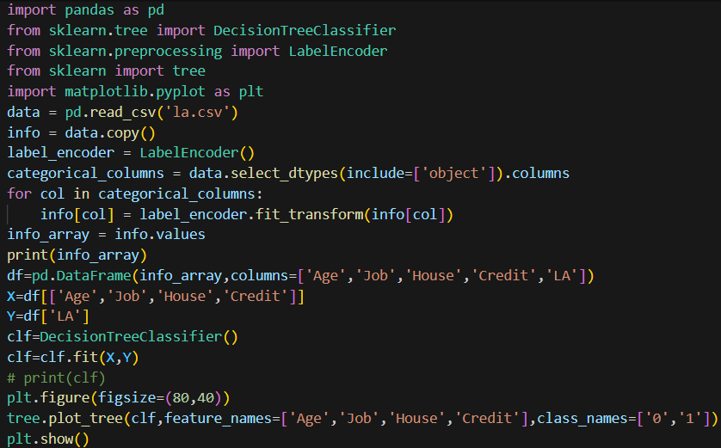
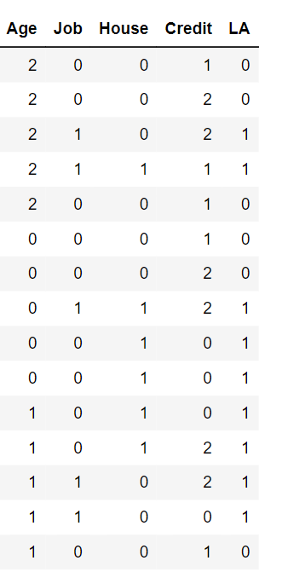
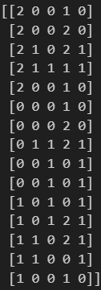
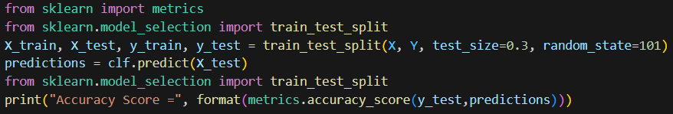
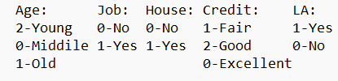

Slide 5
