Slide 1
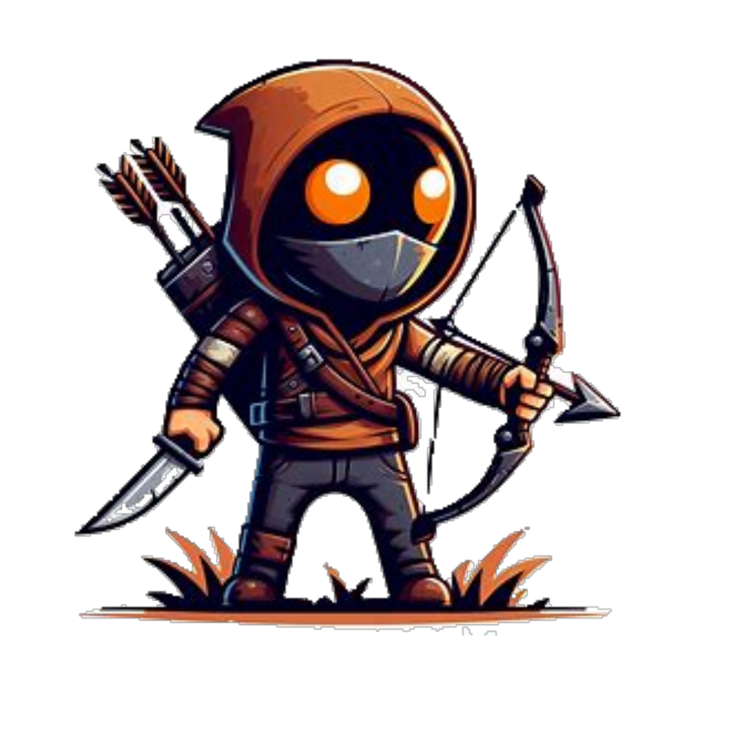
THE SAVIOUR
“Light In Despair”

Slide 2
Problem statements implemented:
1) 4 directional “W A S D” keys for movement
2) Blocks
3) Story mode
4) Survival
5) Obstacle course
Our moto is to ignite a spark in the users learning ability and add value to his/her life through a game which helps them learn coding concepts in a steady but powerful manner. This approach will help to develop a hunger in the user’s mind to come up with innovative ideas instead of whiling away time in unproductive tasks. We aim to integrate the power of gamification to reinforce the concept into the user’s mind.
Brief overview of the game's purpose: Our game aims to teach coding concepts in a fun and engaging way, helping players develop and sharpen their logical skills that can benefit them in various aspects of life.
AIM: "Learn Coding Concepts Through Adventure"

Slide 3
THE SAVIOUR
Welcome to "The Saviour" an adventure game where you step into the shoes of our hero, Simon, the savior of a kingdom. As the game begins, you find yourself amidst chaos, tasked with protecting the city from a dragon that has invaded the jungle.
In "The Saviour" Simon must go through various obstacles and challenges to reach the dragon's lair. Along the way, he encounters wild animals and must utilize his weapons—a bow and arrows, as well as a sword to defeat them.
Simon can collect fruits scattered along his path to replenish his health. However, he must also be cautious, as his health decreases gradually while walking and diminishes rapidly when sprinting.
The game presents players with choices, including selecting the best path at nodes encountered during the journey. These decisions, guided by clues from NPC’s, significantly impact Simon's progress.
As Simon progresses by killing the wild animals, he earns rewarding updates to his weapons, such as increased arrow capacity and sharper sword blades.
In "The Saviour" Simon's success also relies on managing his health, making strategic decisions, and being good at combat skills. Failure to defeat creatures or failure to achieve goals results in a loss of health and eventually leads to loss of one of Simon's three lives.
Throughout the game, players encounter checkpoints that serve as respawning points, allowing them to continue their journey from checkpoints if they lose a life.
The ultimate objective of "The Saviour" is for Simon to defeat the dragon, thereby saving the city from further destruction. Only by successfully defeating the dragon can players emerge victorious and restore peace to the habitants.

Slide 4
Game Overview:
Description of the game's setting and story: In a world, players take on the role of a hero on a mission to save the kingdom. Along the way, the hero will encounter challenges that require the use of coding concepts to overcome. After completing a level, the game provides a summary of the coding concept used and how it was applied in the level. This reinforces the concept in the user's mind, making the learning experience more engaging and leaning towards edutainment.
Example/Use case (The use case is in text format as it is to establish a “Proof of Concept” ):
The basic coding terminologies and methods:
Loops: The respawn feature based on checkpoints is an application of loops.
Conditional Statement: (the if and else conditions) player will get health increment only if he collects fruits, like wise player will get updates of weapons only if he kill the animals else nothing.
Functions:(set of reusable instructions) the functional buttons like sprint, use arrow or sword.
If topic is to understand Classes and Objects, below is our high-level design:
1)Give a brief introduction to what are classes and objects (giving a gist of the topic)
2)We will consider real world entities like the Hero and NPC
Class Definition:
In our game, we have a class called 'Character' that serves as the blueprint for both the hero and NPCs. This class defines properties such as 'health', 'strength', and 'speed', as well as methods like 'move' and 'attack'.

Slide 5
Objects:
The hero is an object created from the 'Character' class. It has specific values for properties like 'health', 'strength', and 'speed', and can perform actions like moving and attacking.
Similarly, an NPC (Non-Player Character) is another object created from the same 'Character' class, but with different values for its properties. NPCs have their own health, strength, and speed values, and can also perform actions like moving and attacking.
3) Reinforcing topic by comparison:
By comparing the hero and NPC, we can see that they are both instances of the 'Character' class, but with different values for their properties. This demonstrates how classes and objects allow us to create multiple similar entities in our game.
Summary:
In this way we will be able to break down complex coding concepts into a simpler and interactive way of learning. This building of logic will eventually translate into code, as logic is the heart and soul of the code. Coding (in any programming language) is just a tool to help you build products but the logic behind the code will help the user to write code in any language if he/she knows the syntax. We want to discourage the “Old School” fashion of rote learning and want to encourage a logical mindset for problem solving.

Slide 6

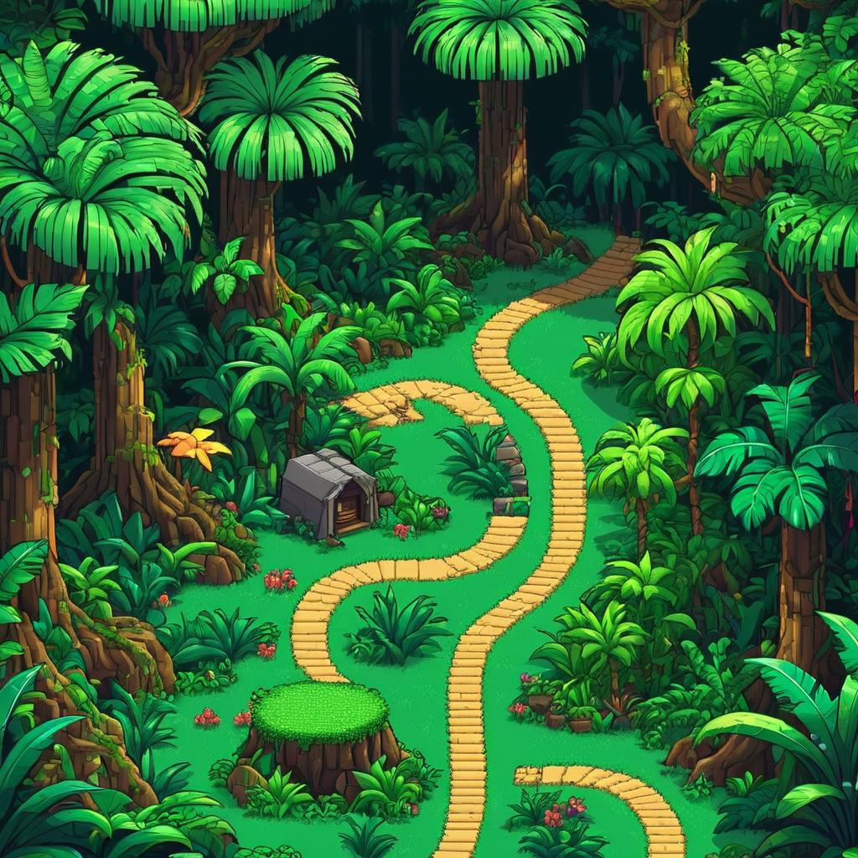



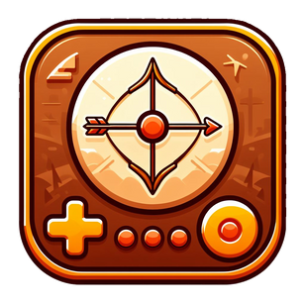

Slide 7


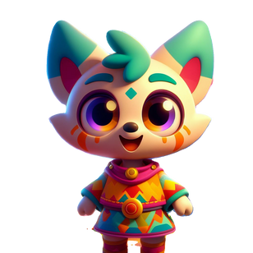
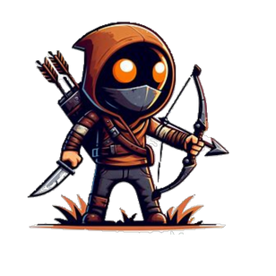
Hi Simon,
a great trouble
has come on us

Slide 8
A dragon has attacked our city and has destroyed it

Slide 9
I could help you.
Where is the Dragon????

Slide 10
I overheard some survivors mentioning a cave in the mountains to the north

Slide 11
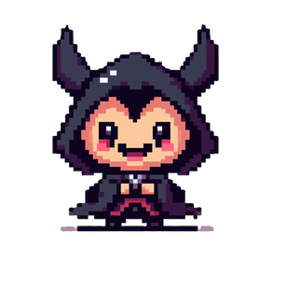
STOP!!!
Where are you headed.......
Mr Simon

Slide 12
You better not get in my way DEMON!

Slide 13
COMBAT MODE

