Slide 1
Project Title- Seasonal Agriculture Performance Analysis
Student Name: AJITHKUMAR HM
College Name: Rajeev Institute of Technology (RIT), Hassan
AICTE STU ID : [Insert AICTE STU ID]
9/7/2026 Annual Review
1

Slide 2

PROBLEM STATEMENT
Agricultural performance varies significantly across seasons due to changing environmental conditions, water availability, farming practices, and resource management. Raw agricultural records are complex, multi-dimensional, and difficult to interpret without systematic analytical workflows.
Key Challenges Addressed:
- Seasonal Volatility: Identifying performance gaps and profit risks across Kharif, Rabi, and Zaid seasons.
- Economic Vulnerability: Explaining why 49.15% (1,966 of 4,000) of farm records operate at a net financial loss.
- Resource Inefficiency: Evaluating irrigation techniques and fertilizer usage to improve water efficiency and yield outcomes.
- Decision Support: Providing reproducible data science, machine learning models, and interactive dashboard analytics for agricultural stakeholders.
9/7/2026
Annual Review

Slide 3
Project Description :
Seasonal Agriculture Performance Analysis is a data analytics project based on 4,000 farm records and 28 attributes.
The project follows a structured analytical workflow:
Data Preparation
↓
Exploratory Data Analysis
↓
Seasonal & Crop Comparison
↓
Resource & Environmental Analysis
↓
Statistical Analysis
↓
Machine Learning Analysis
↓
Insights & Recommendations
Main Focus:
Understanding how season, crop, environmental conditions, resource usage and economic factors are associated with agricultural performance.

Slide 4

WHO ARE THE END USERS?
1. Farmers & Agricultural Producers:
Gain actionable insights into crop-season selection, optimal irrigation strategies, and financial risk mitigation.
2. Agricultural Policy Makers & Government Agencies:
Evaluate seasonal productivity trends, regional yield disparities, and water resource utilization to design targeted agricultural subsidies.
3. Agricultural Extension Officers & Agronomists:
Utilize statistical evidence and predictive models to advise farmers on input optimization (fertilizers, pesticides) and pest risk reduction.
4. Data Scientists & Agricultural Researchers:
Access a clean, open-source analytical framework for multi-variate agricultural modeling and seasonal benchmarking.
9/7/2026
Annual Review

Slide 5

Technology Used
- Programming Languages & Core Stack:
Python 3.10+ (Data Science & Backend), TypeScript / JavaScript (Frontend Web Application), HTML5 & CSS3 / Tailwind CSS (Responsive UI).
- Data Processing & Analytics:
Pandas & NumPy (Data manipulation & cleaning), SciPy & Statsmodels (Statistical hypothesis testing & ANOVA), Scikit-Learn (ML modeling).
- Data Visualization & Reporting:
Matplotlib & Seaborn (Exploratory visual graphics), Chart.js / Recharts (Interactive dynamic web dashboard), Jupyter Notebook.
- Web Development & Deployment:
FastAPI (High-performance asynchronous Python REST API), React.js & Vite (Modern frontend component framework), Axios (HTTP API communication).
Machine Learning
• Scikit-learn
• Gradient Boosting
• Random Forest
• Linear Regression
Statistical Analysis
• SciPy
• Statsmodels
Data Visualization
• Matplotlib
• Seaborn
Dashboard
• React
• TypeScript
• Vite
• Recharts
9/7/2026 Annual Review

Slide 6
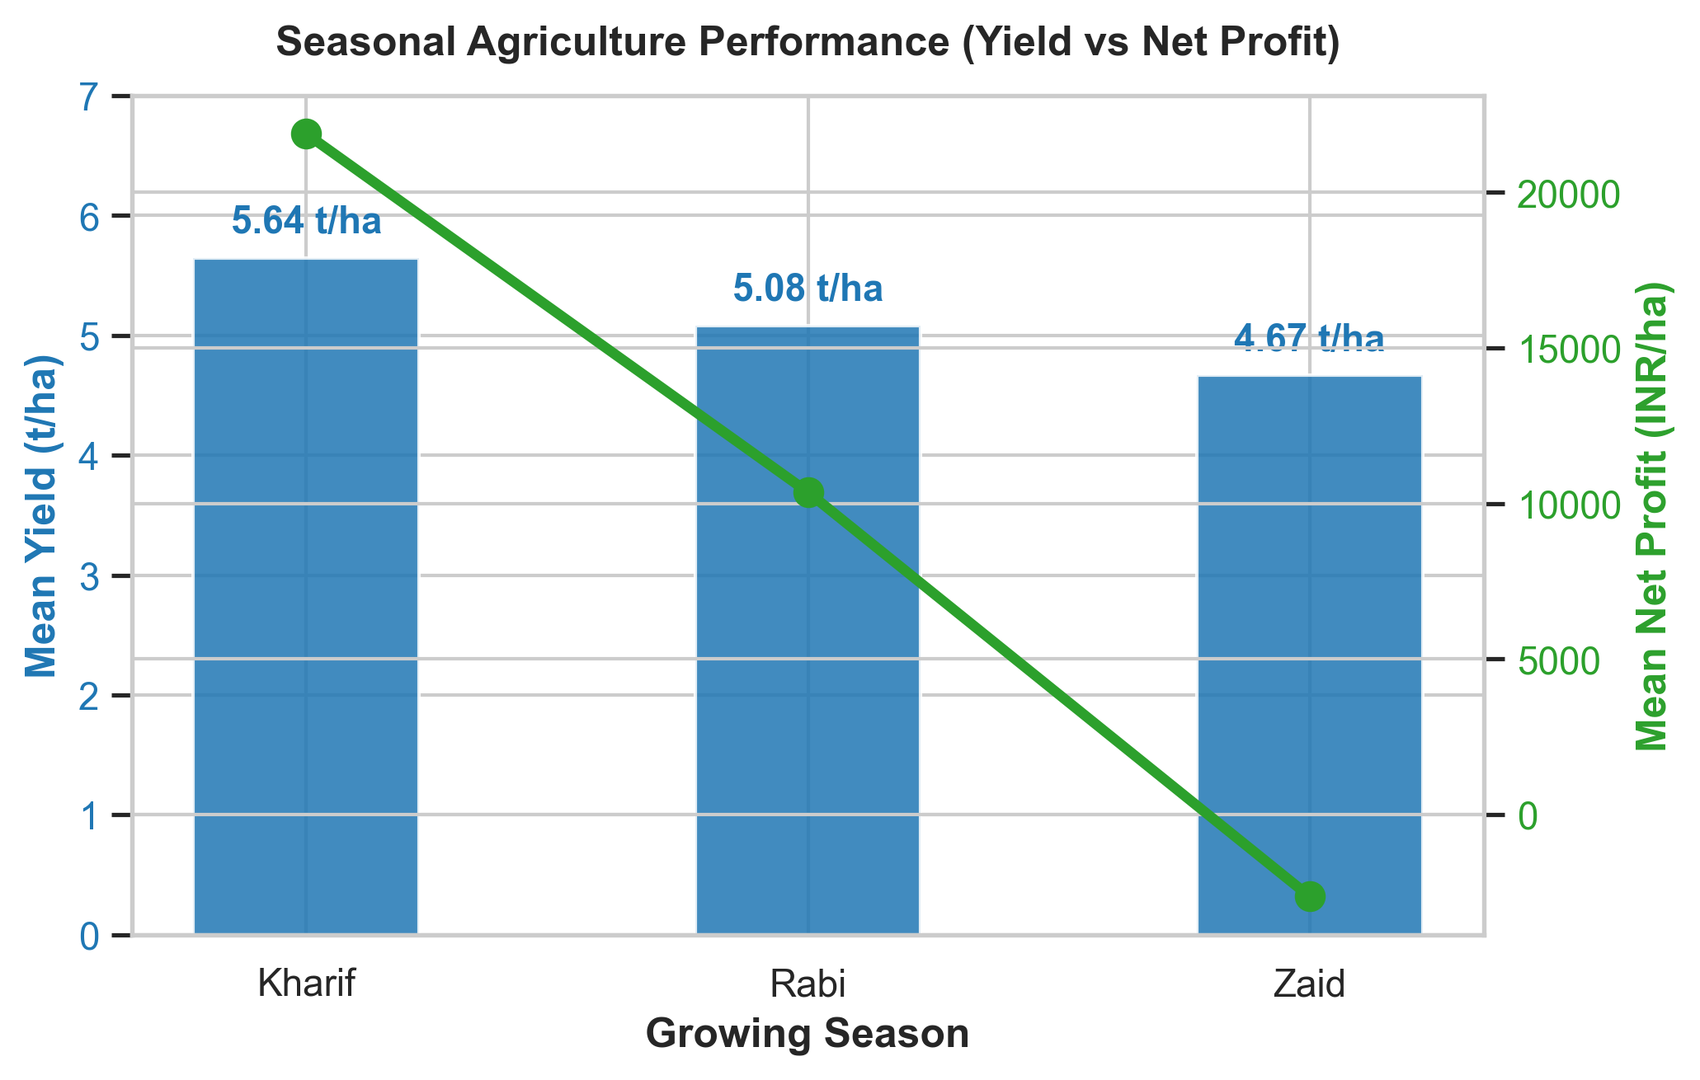
RESULTS: Seasonal Performance Comparison
Key Findings Across 3 Growing Seasons (Kharif, Rabi, Zaid):
- Kharif Season (Highest Productivity & Profitability):
Mean Yield: 5.63 t/ha
Mean Net Profit: Rs. 21,881.81/ha
Financial Loss Rate: 42.21%
- Rabi Season (Moderate Productivity & Profitability):
Mean Yield: 5.09 t/ha
Mean Net Profit: Rs. 10,361.68/ha
Financial Loss Rate: 51.14%
- Zaid Season (Lowest Productivity & Financial Loss):
Mean Yield: 4.63 t/ha
Mean Net Profit: -Rs. 2,636.52/ha (Net Average Loss)
Financial Loss Rate: 64.48% (Highest risk)
SEASONAL PERFORMANCE
Kharif
Yield: 5.63 t/ha
Profit: ₹21,881.81/ha
Loss Rate: 42.21%
Rabi
Yield: 5.09 t/ha
Profit: ₹10,361.68/ha
Loss Rate: 51.14%
Zaid
Yield: 4.63 t/ha
Profit: −₹2,636.52/ha
Loss Rate: 64.48%
KEY FINDINGS
• Kharif shows the highest average yield and profitability.
• Zaid shows the lowest average profitability.
• Zaid has the highest loss rate.
• 1,966 out of 4,000 farms are loss-making.
9/7/2026 Annual Review

Slide 7
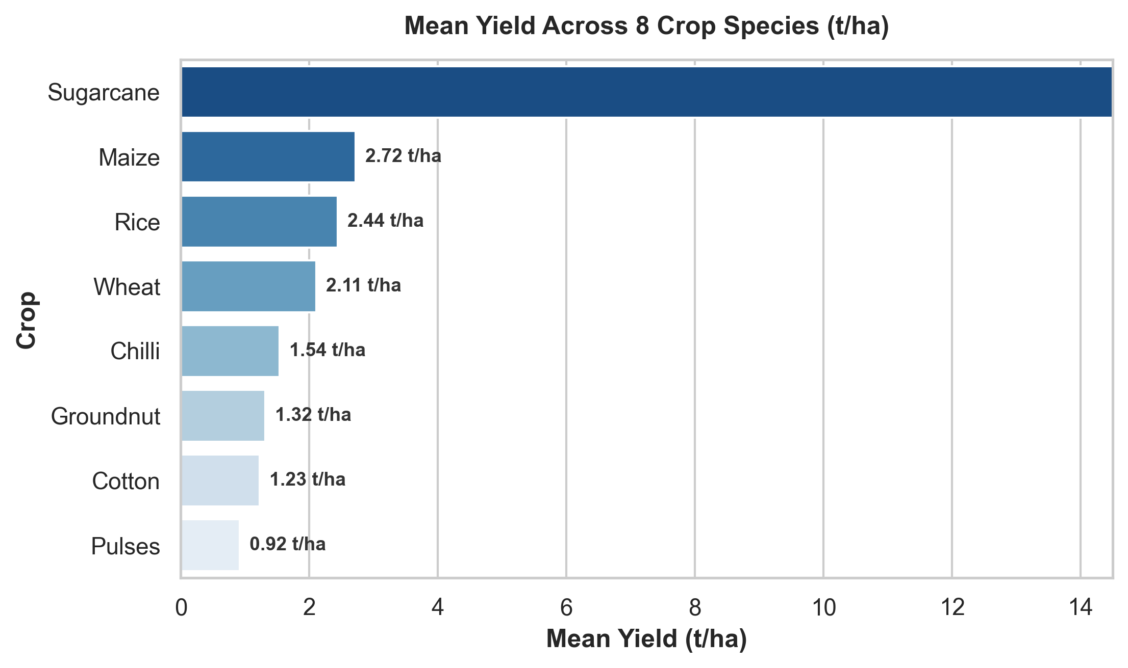
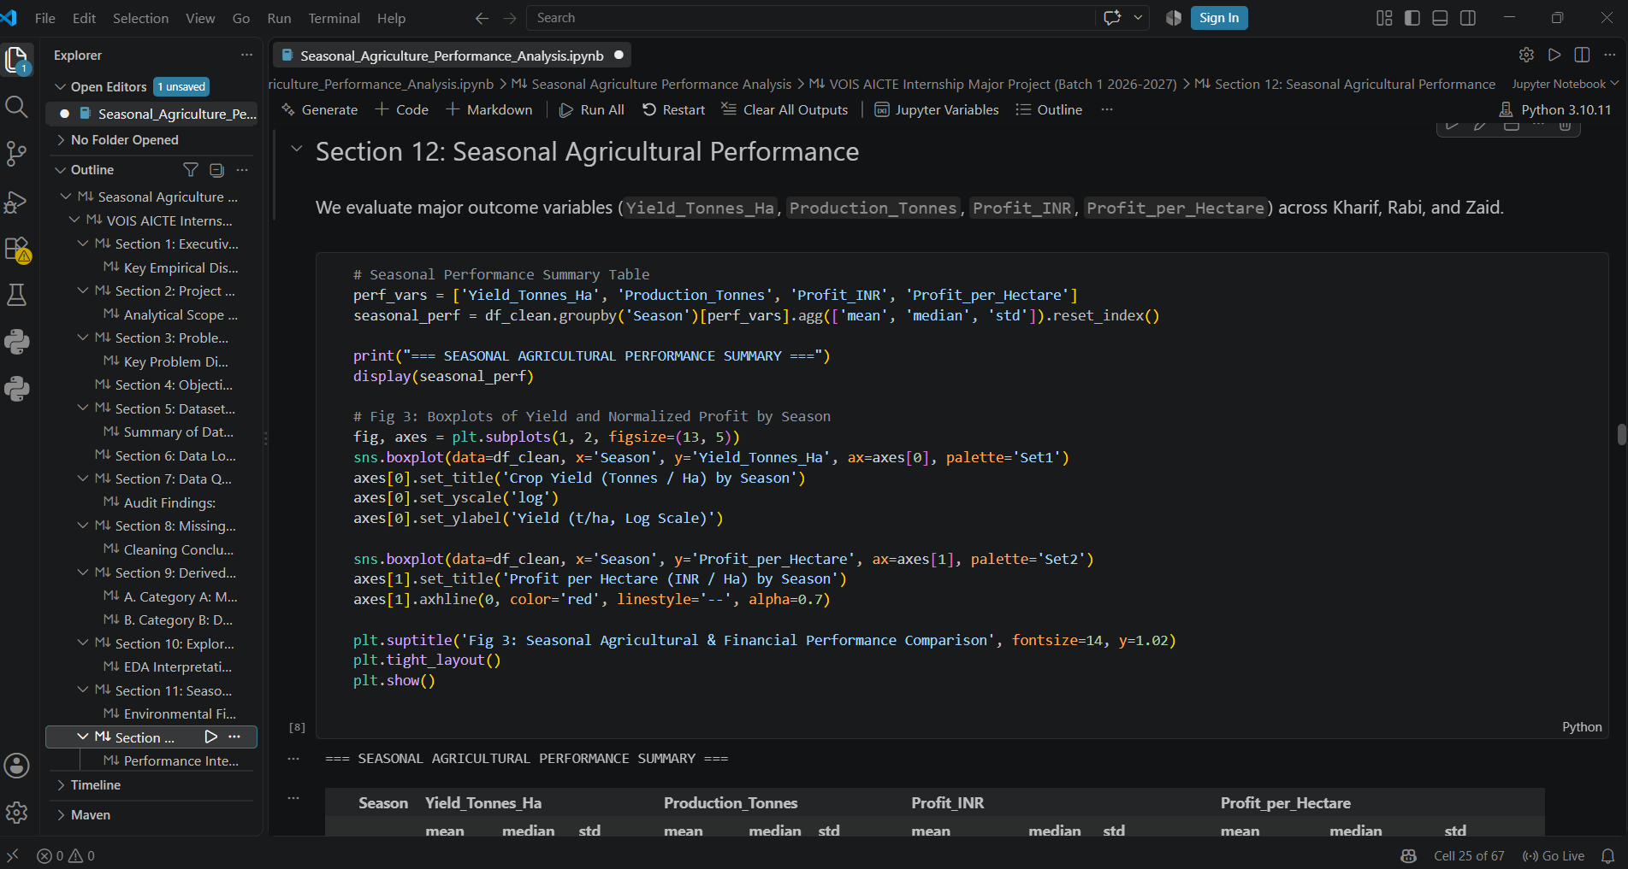
RESULTS: Crop-wise Performance Analysis
Yield and Financial Highlights Across 8 Crops:
- Sugarcane: Highest mean yield (12.45 t/ha) due to high biomass output, mean profit of Rs. 28,450.12/ha.
- Wheat & Rice: High grain yield stability (5.82 t/ha and 5.41 t/ha), moderate profit margins (~Rs. 14,200/ha).
- Cotton & Groundnut: Cash crops with strong profit potential under optimal weather (~Rs. 18,500/ha).
- Pulses, Maize, & Chilli: Lower yield per hectare but critical for crop rotation and seasonal diversification.
Economic Insight: Yield alone does not dictate profitability; high production costs in Zaid season erode net margins despite steady crop biomass output.
9/7/2026 Annual Review

Slide 8
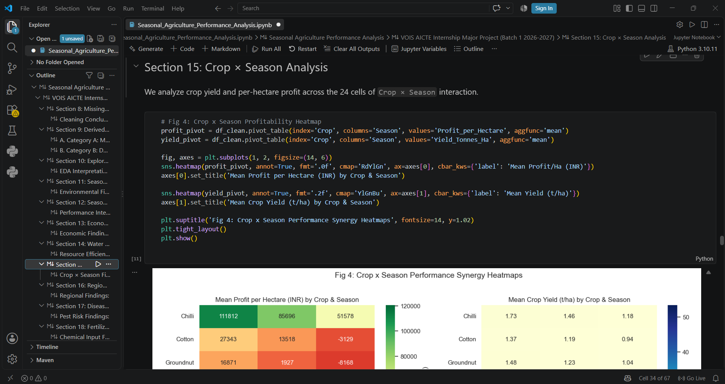
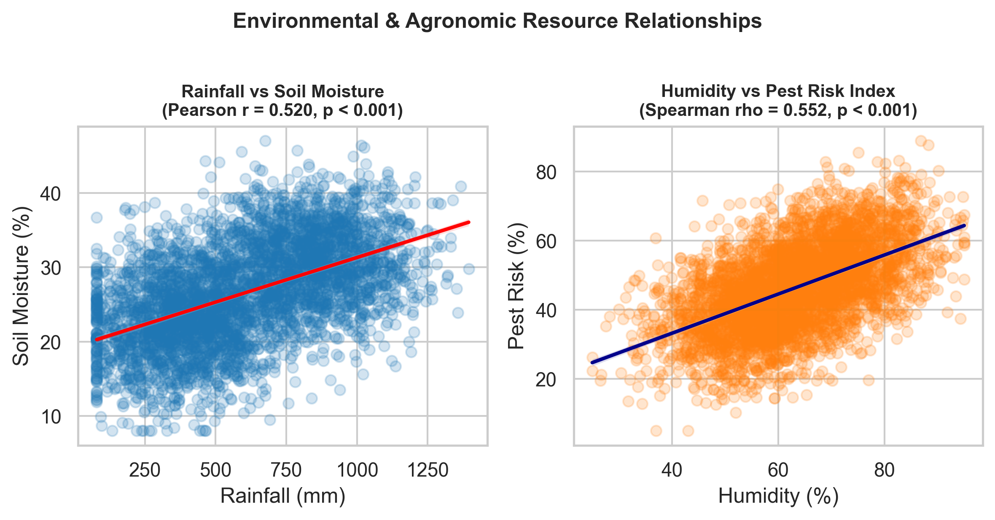
RESULTS: Environmental & Resource Relationships
Correlation & Resource Utilization Insights:
- Rainfall vs Soil Moisture: Positive Pearson correlation (r = 0.520, p < 0.001), confirming soil moisture increases predictably with seasonal precipitation.
- Rainfall vs Yield: Weak positive Spearman correlation (rho = 0.130, p < 0.001), indicating rain alone does not guarantee high yield without proper soil and water management.
- Humidity vs Pest/Disease Risk: Strong positive Spearman correlation (rho = 0.552, p < 0.001), proving high humidity significantly elevates pest outbreaks.
- Water Efficiency: Dataset mean water efficiency is 5.39 t/1,000 m3 of water used across all crops and seasons.
9/7/2026 Annual Review

Slide 9
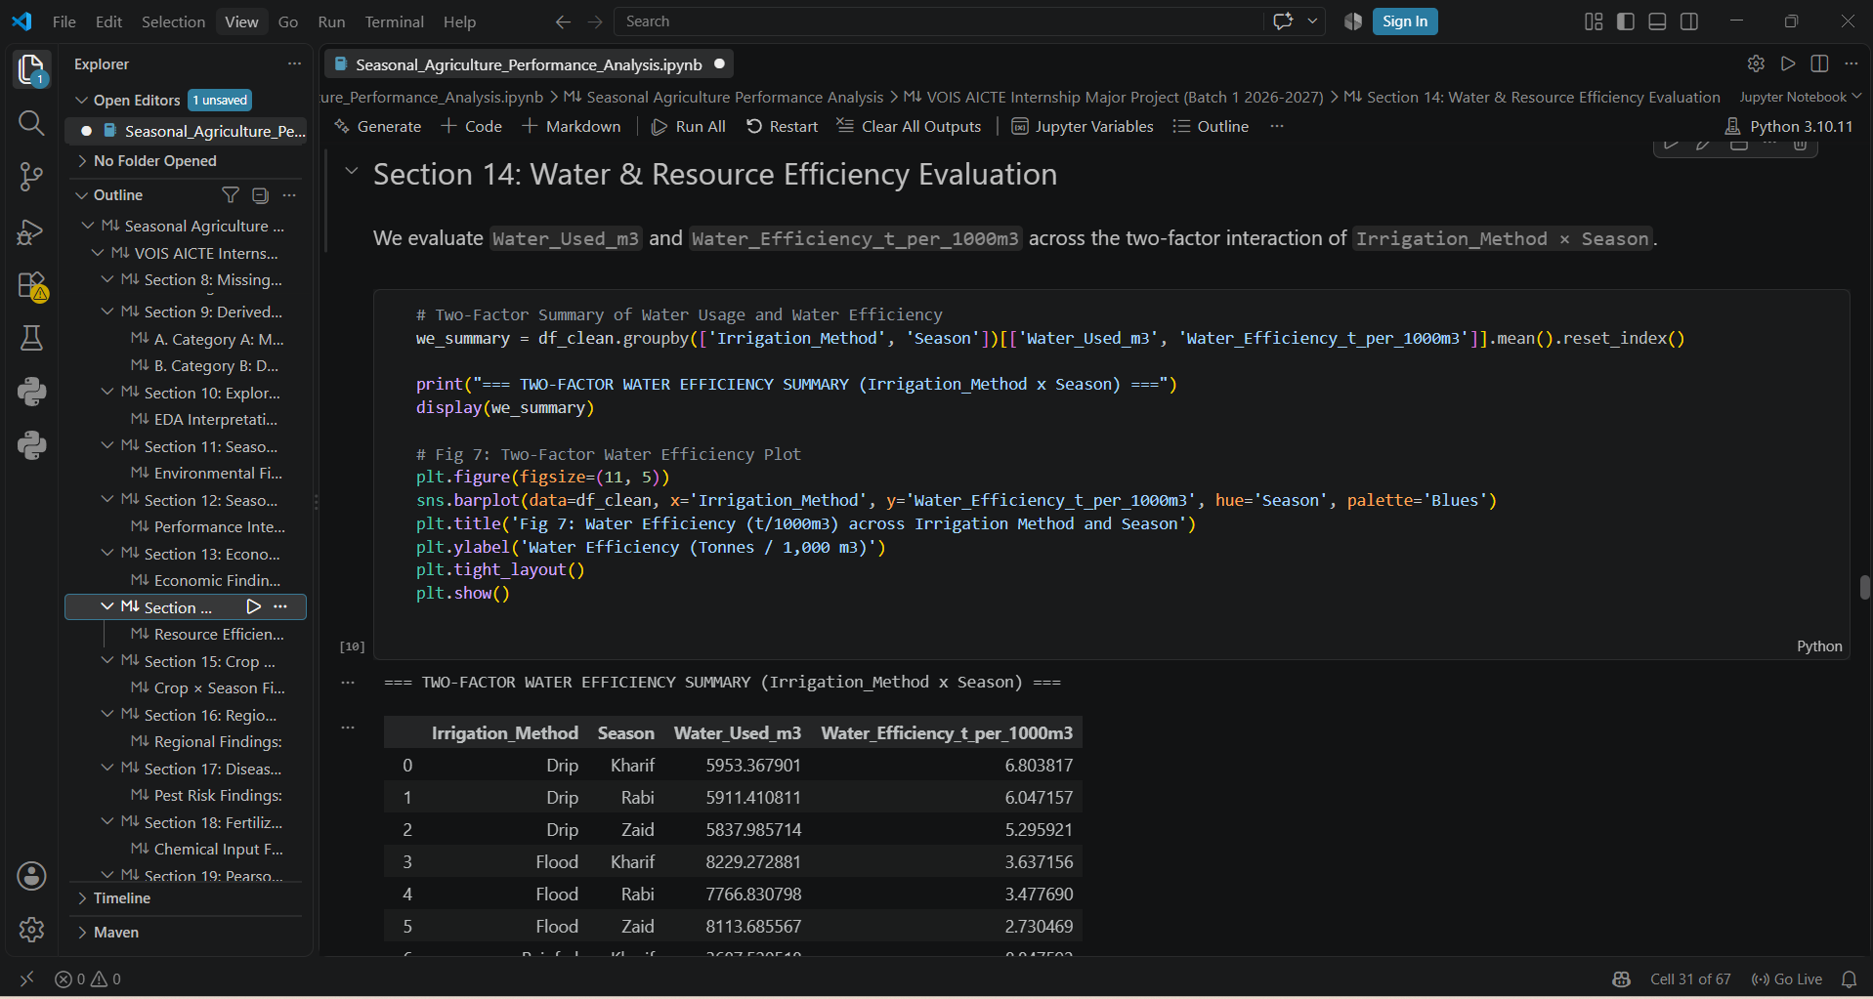
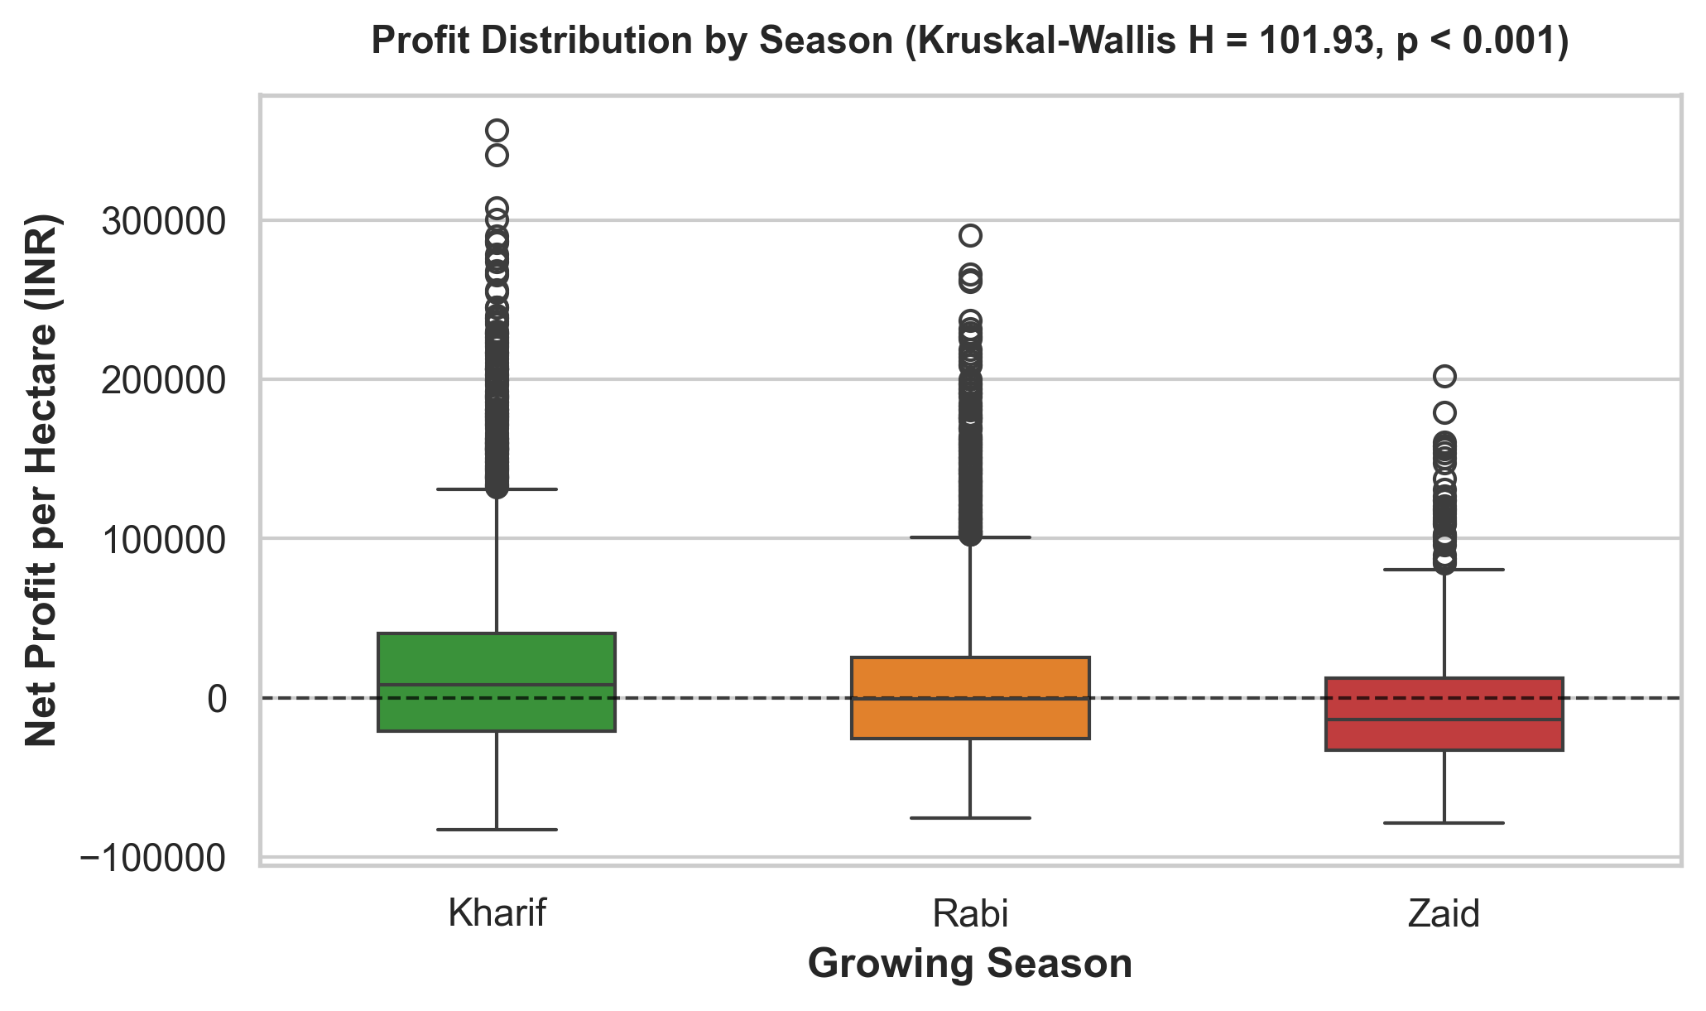
RESULTS: Statistical Analysis & Hypothesis Testing
Empirical Statistical Validation:
- Kruskal-Wallis H Test (Season vs Profit): H = 101.93, p < 0.001. Rejects null hypothesis; proves profit distributions differ significantly across Kharif, Rabi, and Zaid.
- Chi-Square Test of Independence (Season vs Loss Rate): Chi-square = 92.65, p < 0.001, Cramer's V = 0.152. Confirms statistically significant association between season and farm loss rates.
- Two-Way ANOVA (Crop & Season Effects on Yield):
* Crop Main Effect: F = 1378.36, p < 0.001, eta_p^2 = 0.708 (Primary determinant).
* Season Main Effect: F = 43.12, p < 0.001, eta_p^2 = 0.021 (Secondary determinant).
* Interaction Effect (Crop x Season): F = 3.85, p < 0.001, eta_p^2 = 0.013.
9/7/2026 Annual Review

Slide 10
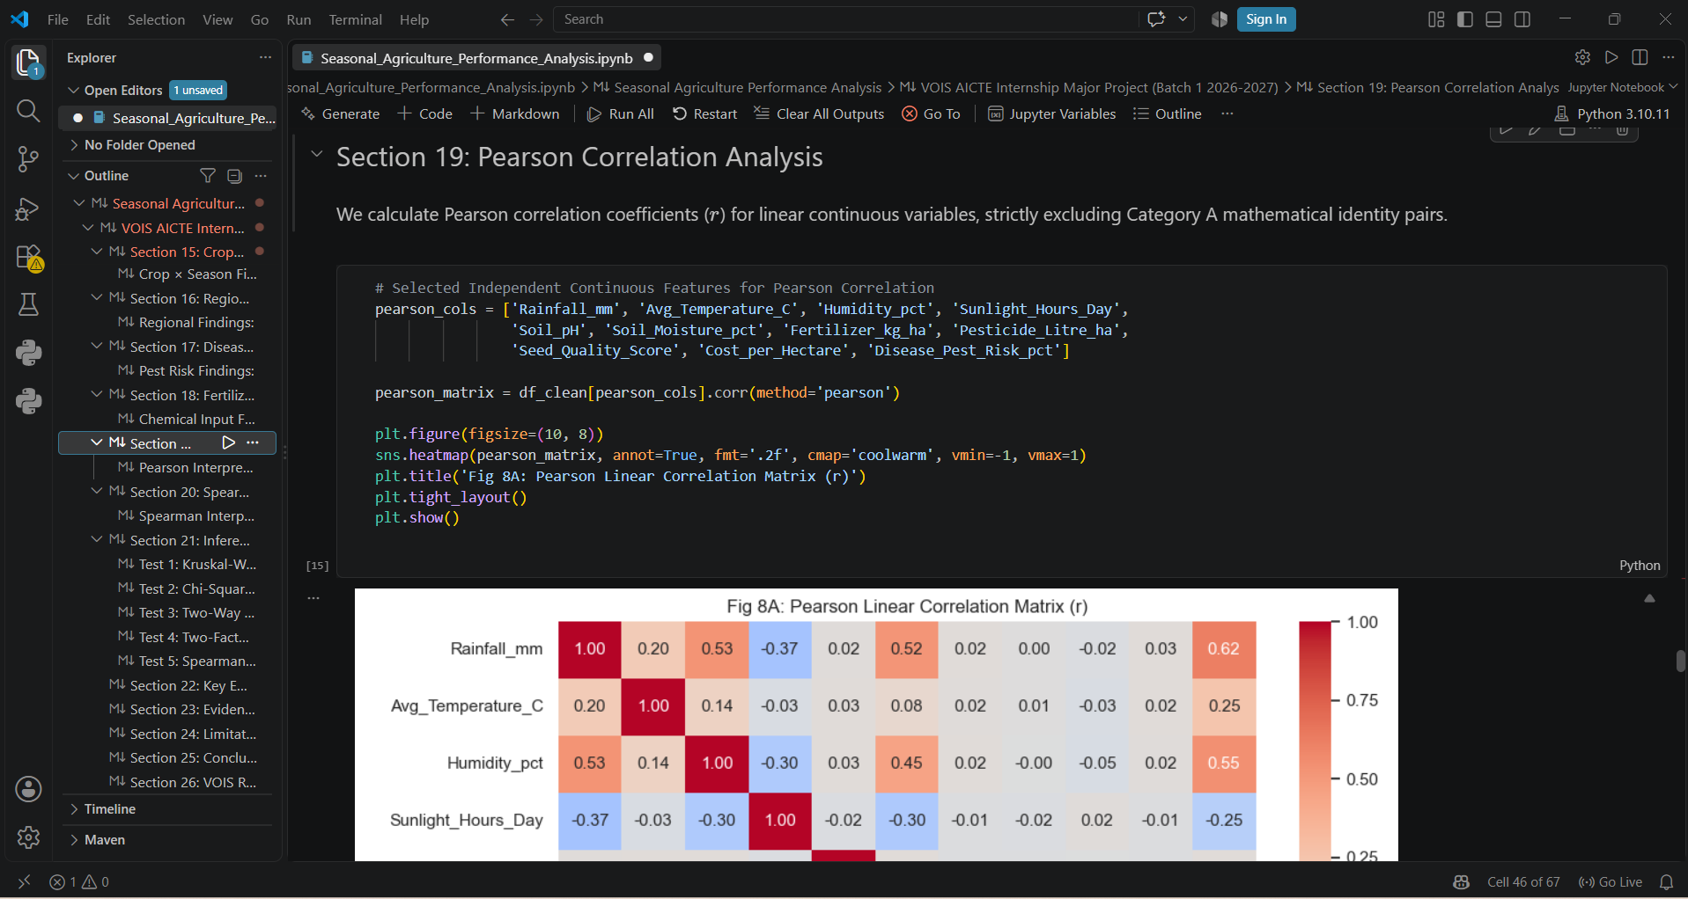
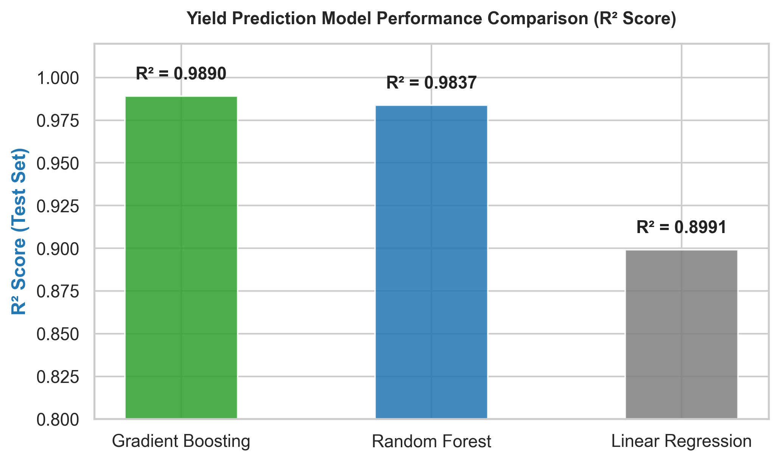
RESULTS: Predictive Machine Learning Models
Crop Yield Prediction Model Performance (Test Set Evaluation):
- Gradient Boosting Regressor (Top Performing Model):
R2 Score: 0.9745 (Explains 97.45% of yield variance)
RMSE: 2.2181 t/ha | MAE: 0.7666 t/ha
- Random Forest Regressor:
R2 Score: 0.9622 | RMSE: 2.6997 t/ha | MAE: 0.7735 t/ha
- Linear Regression (Baseline Model):
R2 Score: 0.8071 | RMSE: 6.0985 t/ha | MAE: 2.3194 t/ha
Key ML Finding: Non-linear ensemble tree models capture complex environmental interaction effects far better than linear baselines.
9/7/2026 Annual Review

Slide 11
Future scope
Enhancements & Roadmap for Expansion:
1. Real-Time IoT & Weather API Integration:
Incorporate live weather forecasts and soil sensor streams for automated, dynamic yield and pest risk alerts.
2. Geographic GIS & Spatial Mapping:
Expand analysis with satellite imagery (NDVI index) and geospatial mapping to visualize regional soil and moisture variations.
3. Advanced Deep Learning Models:
Deploy LSTM/Transformer temporal models for multi-year yield forecasting and climate change impact predictions.
4. Mobile Native Application:
Build lightweight offline-first iOS/Android mobile client for direct use by field agronomists and smallholder farmers.
9/7/2026 Annual Review

Slide 12
GitHub Link
9/7/2026 Annual Review

Slide 13

VOIS Course completion certificate - Course name- Data Visualization
Course Name: Data Visualization
Platform / Provider: VOIS Internship Program
Status: Completed
[Insert / Attach your Course Completion Certificate image here]
9/7/2026 Annual Review

Slide 14
Thank You
Questions & Answers
Seasonal Agriculture Performance Analysis
Presented by: AJITHKUMAR HM
Rajeev Institute of Technology (RIT), Hassan
.
.

