Slide 1
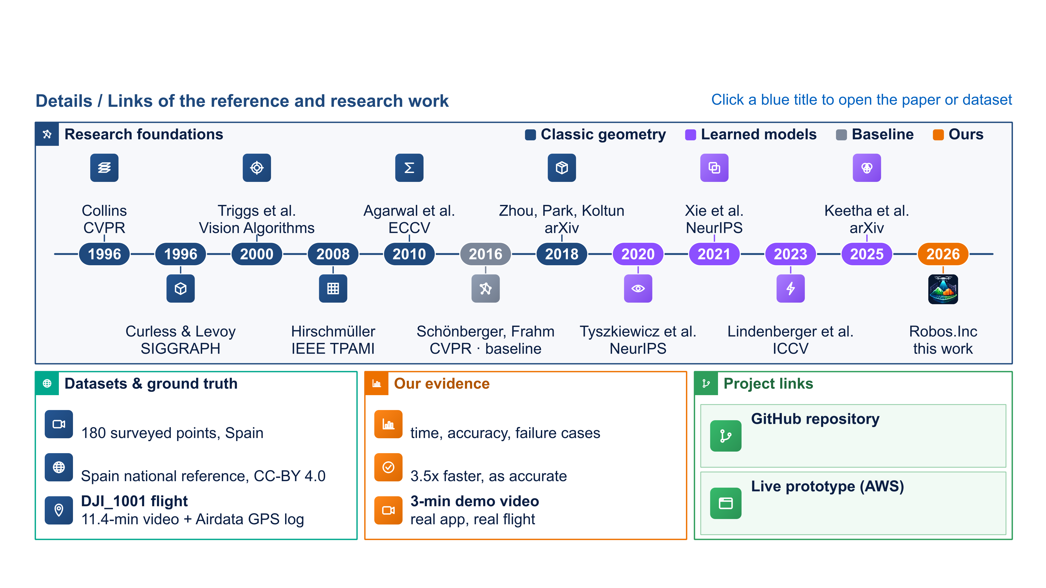
RESEARCH AND REFERENCES
Robos.Inc
Plane sweep
Bundle adjustment
BA in the large
Open3D
SegFormer
MapAnything
TSDF fusion
SGM stereo
COLMAP SfM
DISK features
LightGlue
DRISHTI-3D
PinPoint flight01 + 02
Real-flight validation
github.com/Ajith-Praveen/Drishti-3D
IGN ortho + LiDAR DTM
COLMAP, same frames
13-234-83-238.sslip.io

