Slide 1
Employee Data Analysis using Excel
STUDENT NAME: AJITH P
REGISTER NO: 312202580
DEPARTMENT: B.COM
COLLEGE: kanchi shri Krishna college of arts
and science kilambi.

Slide 2
PROJECT TITLE
Employee Performance Analysis using Excel

Slide 3


AGENDA
Problem Statement
Project Overview
End Users
Our Solution and Proposition
Dataset Description
Modelling Approach
Results and Discussion
Conclusion
3/21/2024 Annual Review

Slide 4

PROBLEM STATEMENT
Employee turnover and performance issues are critical challenges faced by organizations, impacting productivity and overall business performance.

Slide 5

PROJECT OVERVIEW
.
Clear goals make it easier to create an action plan and produce better survey results, showing employees how effective surveys can be as internal feedback tools.

Slide 6
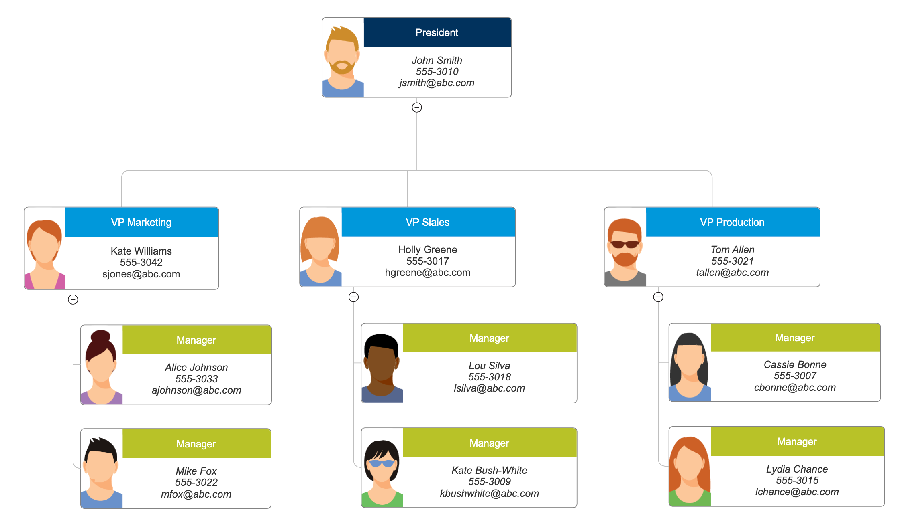

WHO ARE THE END USERS?

Slide 7

OUR SOLUTION AND ITS VALUE PROPOSITION
Conditional formattingizing-missing Filterernove Pivot summary Graph-date visualiation

Slide 8
Dataset Description
Employee - kaggle
26 features
6 features
EmpID
FirstName
Last Name
Performance Level
employee Rating
GenderCode

Slide 9

THE "WOW" IN OUR SOLUTION
=IFS( Z * 8 >= 5 , "VERY HIGH" Z * 8 >= 4 "HIGH",Z 8>=3,"MED",TRUE,"LOW")
3/21/2024 Annual Review
9

Slide 10
MODELLING
Employee data models can be used to represent employee information, such as employee numbers, and how employees are connected to customers
10

Slide 11
RESULTS
11

Slide 12
conclusion
In conclusion, this project highlights the importance of analyzing employee turnover through job satisfaction feedback to uncover underlying factors that contribute to attrition. By identifying patterns in employee dissatisfaction, organizations can gain valuable insights into the root causes of turnover. Implementing data-driven strategies based on these insights can enhance job satisfaction, improve employee retention, and ultimately reduce turnover rates, fostering a

