Slide 1
Optimising Asset Management Using One Page Asset Management Plan (AMP)
Ajith Kumar Balamurugan & Mohammed Iftekhar Aalam
Group - 2025-SP2-207
Masters in Data Science UniSA
June 17, 2025

Slide 2
Presentation Outline
1
Project Background & Problem Statement
2
Methodology & Approach
3
Justification of Techniques
4
Architecture Consistency & Design
5
Visual Walkthrough (Sample Dashboard)
6
Validation & Demo Feedback
7
Value Delivered to Secora
8
Challenges & Resolutions
9
Reflection & Learning

Slide 3
Project Background & Problem Statement
Background
Problem
Why It Matters
Secora uses the Lifecycle Management Metric (LMM) dashboard to monitor assets health.
LMM gives only portfolio-level insights.
Asset-level view needed for accurate decisions.
No drill-down into individual asset performance.
Faster, clearer, risk-based planning.
Project Background & Problem Statement
Methodology & Approach
Justification of Techniques
Architecture Consistency & Design
Visual Walkthrough (Sample Dashboard)
Value Delivered to Secora
Validation & Demo Feedback
Reflection & Learning
Challenges & Resolutions

Slide 4
Project Background & Problem Statement
Project Objectives
Enable clear asset-level insights
Create dynamic, user-friendly dashboards
Build a reusable and scalable template
Key Deliverables
3 AMP Dashboards: Drill, Crane, Truck
Supporting documents: Field Mapping table, DAX logic, Report
Demo of working AMP
Project Background & Problem Statement
Methodology & Approach
Justification of Techniques
Architecture Consistency & Design
Visual Walkthrough (Sample Dashboard)
Value Delivered to Secora
Validation & Demo Feedback
Reflection & Learning
Challenges & Resolutions

Slide 5



Methodology & Approach
Stage 1 – Data Extraction
Pulled asset-level data from LMM dashboard exports
Cleaned & structured ~40 assets × 40 fields in Excel
Stage 2 – Field Mapping & Architecture
Mapped each field to dashboard sections
Designed one page layout and defined section logic
Stage 3 – Dashboard Implementation
Built visuals, cards, and gauges in Power BI
Applied DAX for logic, summaries, and filtering
Project Background & Problem Statement
Methodology & Approach
Justification of Techniques
Architecture Consistency & Design
Visual Walkthrough (Sample Dashboard)
Value Delivered to Secora
Validation & Demo Feedback
Reflection & Learning
Challenges & Resolutions

Slide 6
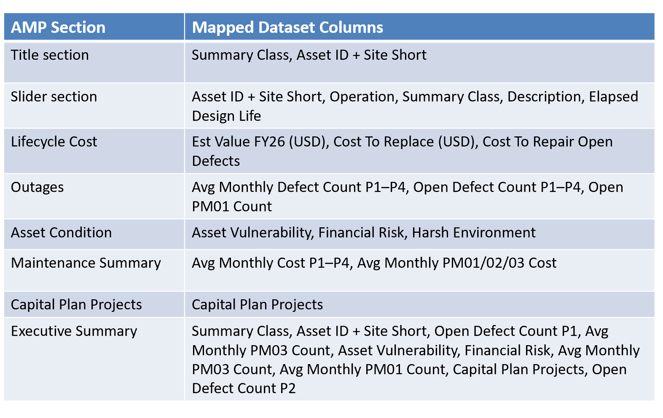
Methodology & Approach
Project Background & Problem Statement
Methodology & Approach
Justification of Techniques
Architecture Consistency & Design
Visual Walkthrough (Sample Dashboard)
Value Delivered to Secora
Validation & Demo Feedback
Reflection & Learning
Challenges & Resolutions

Slide 7



Justification of Techniques
Why Power BI?
Why One-Page Layout?
Why Reusable Architecture?
Aligned with Secora's toolset
Enables quick decision-making
Mapping table supports asset onboarding
Strong support for DAX logic & slicers
No need for multi-tab reports
Slicers + logic = minimal manual work
Project Background & Problem Statement
Methodology & Approach
Justification of Techniques
Architecture Consistency & Design
Visual Walkthrough (Sample Dashboard)
Value Delivered to Secora
Validation & Demo Feedback
Reflection & Learning
Challenges & Resolutions

Slide 8
Architecture Consistency & Design
Fixed Grid Layout
Each dashboard uses same section structure
Reusable Components
Card visuals, gauges, slicers grouped by asset type
Executive Summary Logic
DAX-based WHAT – SO WHAT – NOW WHAT messages
Filtering Across Assets
Slicers switch between Drill, Crane, Truck views
Project Background & Problem Statement
Methodology & Approach
Justification of Techniques
Architecture Consistency & Design
Visual Walkthrough (Sample Dashboard)
Value Delivered to Secora
Validation & Demo Feedback
Reflection & Learning
Challenges & Resolutions

Slide 9
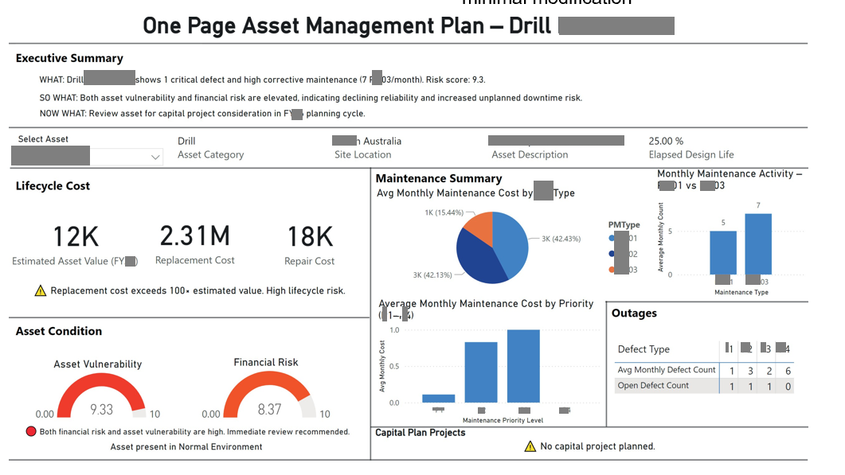

Visual Walkthrough (Sample Dashboard)
Project Background & Problem Statement
Methodology & Approach
Justification of Techniques
Architecture Consistency & Design
Visual Walkthrough (Sample Dashboard)
Value Delivered to Secora
Validation & Demo Feedback
Reflection & Learning
Challenges & Resolutions

Slide 10
Key Sections of AMP Dashboard
Dynamic Title
Asset Condition
Shows asset type + ID (e.g., Drill XXXXYY-ZZ)
Gauges for Vulnerability & Financial Risk
Slicer by Asset
Traffic light colors (Green, Yellow, Red)
Filters entire dashboard instantly
Maintenance & Outages
Lifecycle Cost
XX01 vs XX03 → Pie + Bar charts
Matrix for defect counts (X1–X4)
Estimated Value, Replace Cost, Repair Cost
Executive Summary
Auto-generated insights via DAX
Project Background & Problem Statement
Methodology & Approach
Justification of Techniques
Architecture Consistency & Design
Visual Walkthrough (Sample Dashboard)
Value Delivered to Secora
Validation & Demo Feedback
Reflection & Learning
Challenges & Resolutions

Slide 11
Validation & Demo Feedback
Internal Testing
Stakeholder Demo
Positive Feedback
Verified filtering and logic across Drill, Crane, Truck
Walkthrough with Secora team
Easy to use, good layout, insightful summaries
Liked dynamic filtering and narrative (WHAT – SO WHAT – NOW WHAT)
Project Background & Problem Statement
Methodology & Approach
Justification of Techniques
Architecture Consistency & Design
Visual Walkthrough (Sample Dashboard)
Value Delivered to Secora
Validation & Demo Feedback
Reflection & Learning
Challenges & Resolutions

Slide 12




Value Delivered to Secora
Faster Asset Review
Key metrics on a single page - no multi-tab reports
Improved Decision-Making
Highlights high XX03 cost, missing CapEx → action points
No Report Duplication
One reusable layout, filter by asset
Scalable & Aligned with Vision
Supports Secora's move toward standardised, risk-driven dashboards
Project Background & Problem Statement
Methodology & Approach
Justification of Techniques
Architecture Consistency & Design
Visual Walkthrough (Sample Dashboard)
Value Delivered to Secora
Validation & Demo Feedback
Reflection & Learning
Challenges & Resolutions

Slide 13




Challenges & Resolutions
Challenge: Unstructured LMM Data
Data locked in Power BI visuals
Resolution: Manual export, structured in Excel
Challenge: New to Power BI & DAX
Our background was in Tableau
Resolution: Self-learning, trial-and-error DAX logic building
Challenge: Layout & Design Consistency
Needed reusable grid for all assets
Resolution: Fixed visual structure, insight boxes, shared slicers
Challenge: Limited Stakeholder Availability
Scheduling delays early on
Resolution: Planned around availability, async feedback
Project Background & Problem Statement
Methodology & Approach
Justification of Techniques
Architecture Consistency & Design
Visual Walkthrough (Sample Dashboard)
Value Delivered to Secora
Validation & Demo Feedback
Reflection & Learning
Challenges & Resolutions

Slide 14
Reflection & Learning - Ajith
1
Real Client Exposure
First time handling live industry operational data.
Gained clarity on client expectations.
2
Agile Process & Planning
Managed time with 2-week sprints and task tracking.
Stayed aligned with Secora's expectations.
3
Working Style & Communication
Adapted to structured planning and corporate practices.
Became confident in seeking feedback.
Project Background & Problem Statement
Methodology & Approach
Justification of Techniques
Architecture Consistency & Design
Visual Walkthrough (Sample Dashboard)
Value Delivered to Secora
Validation & Demo Feedback
Reflection & Learning
Challenges & Resolutions

Slide 15



Reflection & Learning - Aalam
Hands-On Development
Built visuals for 3 asset types.
Applied logic for filtering and conditional cards.
Tools & Visualisation
Developed Power BI and DAX skills.
Built dynamic, reusable components.
Team Collaboration
Weekly catch-ups kept the team motivated.
Gained exposure to new team dynamics.
Project Background & Problem Statement
Methodology & Approach
Justification of Techniques
Architecture Consistency & Design
Visual Walkthrough (Sample Dashboard)
Value Delivered to Secora
Validation & Demo Feedback
Reflection & Learning
Challenges & Resolutions

Slide 16

Conclusion
Problem Addressed
LMM was portfolio-level; lacked per-asset clarity
Our AMP dashboards enable focused asset decisions
Objectives Met
Built 3 dynamic, one-page dashboards
Fully filterable, scalable, and tailored to Secora's needs
Value Delivered
Reduced reporting effort
Improved asset visibility for faster decision-making

Slide 17
Thank You
Questions?

