Slide 1
LOGIN VERIFICATION

Slide 2
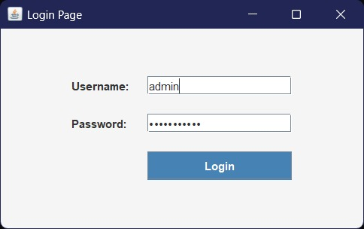

Slide 3
import javax.swing.*;
import java.awt.*;
import java.awt.event.*;
public class SimpleLogin extends JFrame {
public SimpleLogin() {
setTitle("Login Page");
setSize(300, 180);
setDefaultCloseOperation(JFrame.EXIT_ON_CLOSE);
setLocationRelativeTo(null);
Panel with simple layout
JPanel panel = new JPanel();
panel.setLayout(new GridLayout(4, 2, 5, 5));
Username
panel.add(new JLabel("Username:"));
JTextField userField = new JTextField();
panel.add(userField);
Password
panel.add(new JLabel("Password:"));
JPasswordField passField = new JPasswordField();
panel.add(passField);
Message label
JLabel message = new JLabel("", SwingConstants.CENTER);
panel.add(message);
Login button
JButton loginButton = new JButton("Login");
panel.add(loginButton);
add(panel);

Slide 4
Explicit ActionListener
loginButton.addActionListener(new ActionListener() {
@Override
public void actionPerformed(ActionEvent e) {
String username = userField.getText();
String password = new String(passField.getPassword());
if ("admin".equals(username) && "password".equals(password)) {
message.setText(“Login successful!");
message.setForeground(Color.GREEN);
} else {
message.setText(" Invalid credentials!");
message.setForeground(Color.RED);
}
}
});
setVisible(true);
}
public static void main(String[] args) {
SwingUtilities.invokeLater(SimpleLogin::new);
}
}

Slide 5
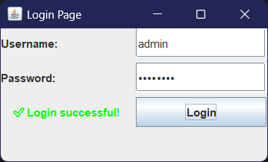

Slide 6
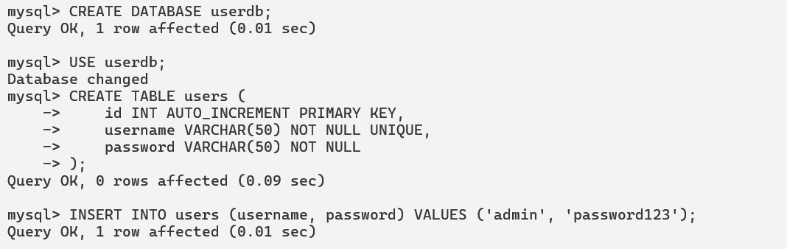

Slide 7
import javax.swing.*;
import java.awt.event.*;
import java.sql.*;
public class SimpleLogin extends JFrame implements ActionListener {
private JTextField usernameField;
private JPasswordField passwordField;
private JButton loginButton;
Database credentials
private static final String DB_URL = "jdbc:mysql://localhost:3306/userdb";
private static final String DB_USER = "root";
private static final String DB_PASS = "helia123";
public SimpleLogin() {
setTitle("Login Page");
setSize(350, 200);
setDefaultCloseOperation(JFrame.EXIT_ON_CLOSE);
setLayout(null); // Absolute positioning
setLocationRelativeTo(null); // Center the window
// Username label and field
JLabel userLabel = new JLabel("Username:");
userLabel.setBounds(30, 30, 80, 25);
add(userLabel);

Slide 8
Username field
usernameField = new JTextField();
usernameField.setBounds(120, 30, 160, 25);
add(usernameField);
Password label and field
JLabel passLabel = new JLabel("Password:");
passLabel.setBounds(30, 70, 80, 25);
add(passLabel);
passwordField = new JPasswordField();
passwordField.setBounds(120, 70, 160, 25);
add(passwordField);
Login button
loginButton = new JButton("Login");
loginButton.setBounds(120, 110, 100, 30);
loginButton.addActionListener(this);
add(loginButton);
setVisible(true); }
@Override
public void actionPerformed(ActionEvent e) {
String username = usernameField.getText();
String password = new String(passwordField.getPassword());
if (checkLogin(username, password)) {
JOptionPane.showMessageDialog(this, "Login successful! Welcome " + username);
} else {
JOptionPane.showMessageDialog(this, "Invalid username or password.");
}
}
private boolean checkLogin(String username, String password) {
boolean isValid = false;
try {
Load MySQL driver
Class.forName("com.mysql.cj.jdbc.Driver");
Connect to database
Connection conn = DriverManager.getConnection(DB_URL, DB_USER, DB_PASS);

Slide 9
String sql = "SELECT * FROM users WHERE username=? AND password=?";
PreparedStatement stmt = conn.prepareStatement(sql);
stmt.setString(1, username);
stmt.setString(2, password);
ResultSet rs = stmt.executeQuery();
if (rs.next()) {
isValid = true;
}
rs.close();
stmt.close();
conn.close();
} catch (Exception ex) {
ex.printStackTrace();
}
return isValid;
}
public static void main(String[] args) {
SwingUtilities.invokeLater(SimpleLogin::new);
}}

Slide 10
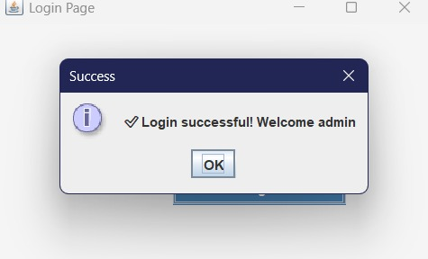

Slide 11
DATA RETRIEVAL PROBLEM

Slide 12
import javax.swing.*;
import java.awt.*;
import java.awt.event.*;
import java.sql.*;
public class StudentDetailsApp extends JFrame implements ActionListener {
private JTextField rollField = new JTextField(10);
private JTextArea resultArea = new JTextArea(5, 30);
private JButton searchBtn;
private static final String DB_URL = "jdbc:mysql://localhost:3306/testdb";
private static final String DB_USER = "root", DB_PASS = "12345";
public StudentDetailsApp() {
setTitle("Student Details Finder");
setSize(400, 300);
setDefaultCloseOperation(EXIT_ON_CLOSE);
setLocationRelativeTo(null);
searchBtn = new JButton("Search");
JPanel top = new JPanel();
top.add(new JLabel("Enter Roll No:"));
top.add(rollField);
top.add(searchBtn);

Slide 13
resultArea.setEditable(false);
add(top, BorderLayout.NORTH);
add(new JScrollPane(resultArea), BorderLayout.CENTER);
searchBtn.addActionListener(this);
}
@Override
public void actionPerformed(ActionEvent e) {
searchStudent();
}
private void searchStudent() {
String r = rollField.getText().trim();
if (r.isEmpty()){
showError("Please enter a roll number");
return;
}

Slide 14
try {
int roll = Integer.parseInt(r);
try (Connection c = DriverManager.getConnection(DB_URL, DB_USER, DB_PASS);
PreparedStatement p = c.prepareStatement("SELECT * FROM students WHERE roll_no=?")) {
p.setInt(1, roll);
ResultSet rs = p.executeQuery();
if (rs.next()) {
resultArea.setText("Roll No: " + roll +
"\nName: " + rs.getString("name") +
"\nAge: " + rs.getInt("age") +
"\nDepartment: " + rs.getString("department"));
} else resultArea.setText("No student found with Roll No: " + roll);
}
} catch (NumberFormatException ex) {
showError("Invalid Roll Number");
} catch (SQLException ex) {
showError("DB Error: " + ex.getMessage());
}
}
private void showError(String msg) {
JOptionPane.showMessageDialog(this, msg);
}
public static void main(String[] args) {
SwingUtilities.invokeLater(() -> new StudentDetailsApp().setVisible(true));
}
}

Slide 15
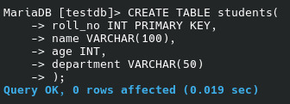

Slide 16
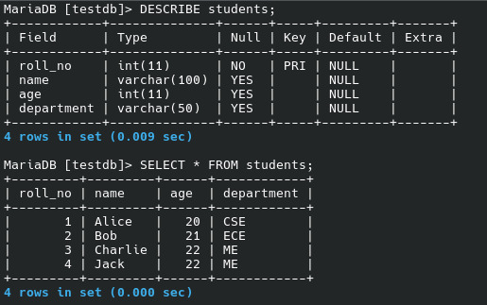

Slide 17
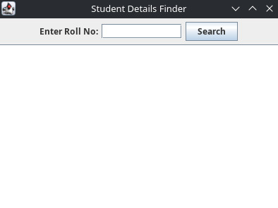
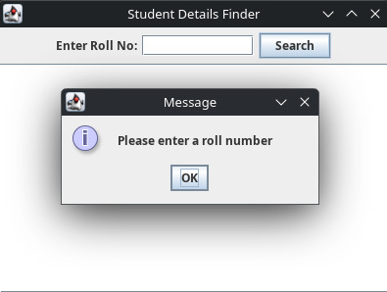
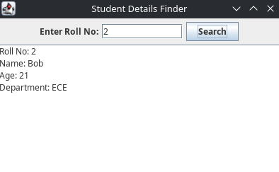

Slide 18
THANK YOU

