Slide 1
DBSCAN
DBSCAN (Density-Based Spatial Clustering of Applications with Noise) is a density-based clustering algorithm commonly used in data mining and machine learning.
It's particularly effective for discovering clusters of arbitrary shapes and handling noise points.
This algorithm views clusters as areas of high density separated by areas of low density.
Due to this rather generic view, clusters found by DBSCAN can be any shape, as opposed to k-means which assumes that clusters are convex shaped.

Slide 2
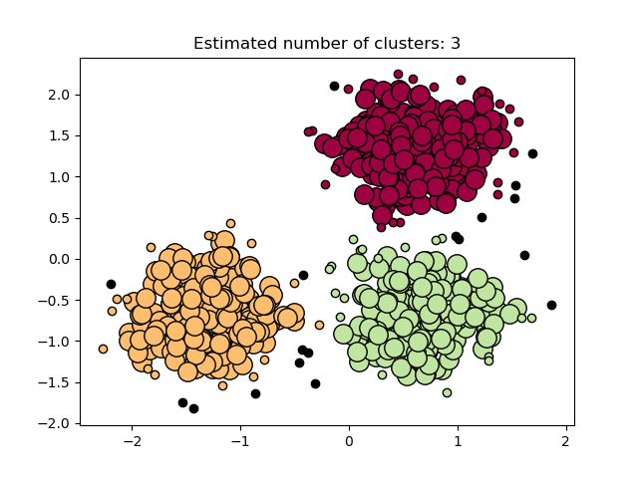
DBSCAN Diagram

Slide 3
The DBSCAN algorithm is deterministic, always generating the same clusters when given the same data in the same order.
However, the results can differ when data is provided in a different order.
First, even though the core samples will always be assigned to the same clusters, the labels of those clusters will depend on the order in which those samples are encountered in the data.
Second and more importantly, the clusters to which non-core samples are assigned can differ depending on the data order

