Slide 1
OPTICS
OPTICS (Ordering Points to Identify the Clustering Structure) is a density-based clustering algorithm.
Its a extends the concepts of DBSCAN (Density-Based Spatial Clustering of Applications with Noise).
It aims to discover clusters of varying densities and shapes in datasets.
The key difference between DBSCAN and OPTICS is that the OPTICS algorithm builds a reachability graph.
The results from OPTICS & DBSCAN method and DBSCAN are very similar, but not always identical; specifically, labeling of periphery and noise points

Slide 2
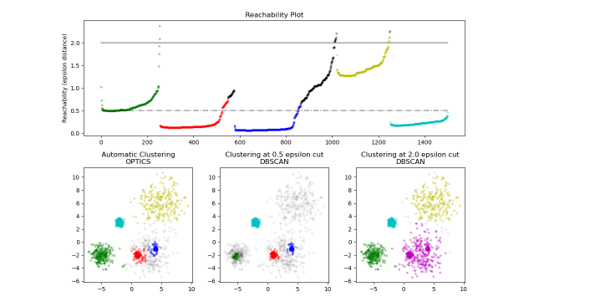
OPTICS Diagram

