Slide 1
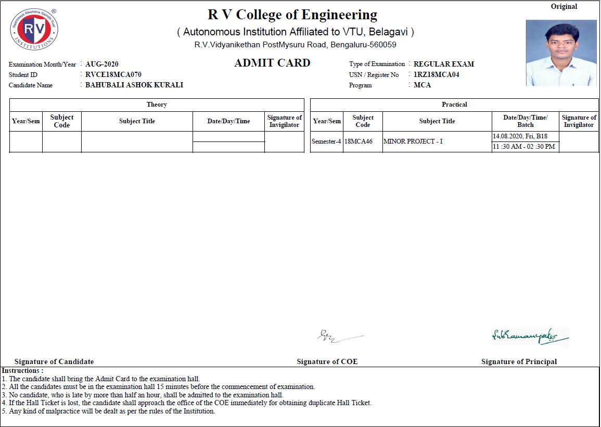
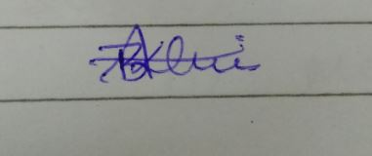

Slide 2
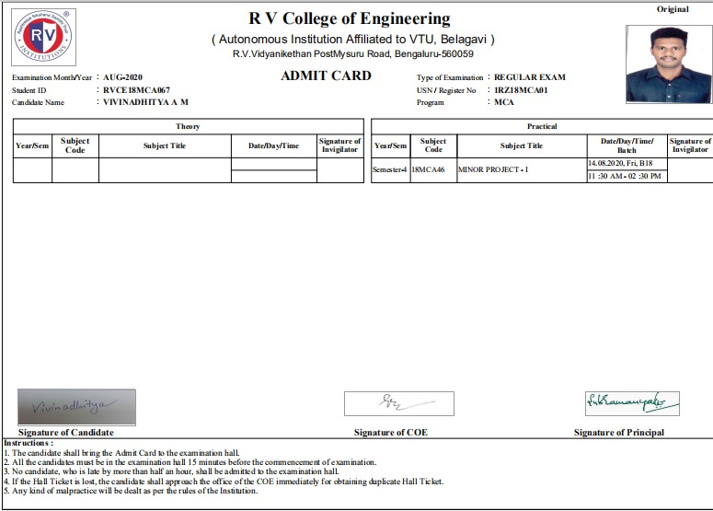

Slide 3

Go, change the world
RV College of
Engineering
Department of MCA
Android Mobile Application For Student
Activity Management System
Minor Project-1 (18MCA46)
Final Presentation
Vivin Aditya A M (1RZ18MCA01)
Bahubali Ashok Kurali (1RZ18MCA04)
Under the Guidance
of
Internal Guide Minor Project-I In charge
Dr. S S Nagamuthu Krishnan Vishal C
Associate professor Assistant professor
Dept of M.C.A Dept of M.C.A
Bangalore Bangalore
14/08/2020 Department of MCA, RVCE 1/30

Slide 4

Go, change the world
Agenda
RV College of
Engineering
Introduction
Literature Survey
Objectives of the Project Work
Hardware & Software Requirements
Functional & Non-functional Requirements
Architectural Design
System Design
Implementation (Current Status/ Main Functions)
Testing (Test Cases Based on Current Status)
Conclusions
Future Enhancements
References
14/08/2020 Department of MCA,RVCE 2 / 30

Slide 5
Go, change the world
Introduction
RV College of
Engineering
Problem Statement
Using manual system sending student academic report to their respective parents is a time consuming and release of academic student result on notice board is outdated one. To avoid all this and helping students and parents to get information quickly and from anywhere this system helps. The design of this system is android application so the user can directly use by connecting to internet. Through this application teachers can send text message to parents and students. So, the parents can know the academic state of student.
Scope of the project
The core idea of this project is to implement android based application for an advancement of the department communication between parents, counsellors and students.
The application will be used by teachers, parents and students.
Information related to student and college notifications can be easily shared with students and parents.
14/08/2020 Department of MCA,RVCE 3/30

Slide 6
Go, change the world
Introduction
RV College of
Engineering
All data related to student will be stored in firebase real-time database, and there will be a end to end encryption between parents and counsellors communication.
Counsellors can share documents (like CIE reports ) with parents of their respective students.
Alert messages like exam notifications, results, any other events news can be easily share.
Expected Outcome
Students, faculty and parents can easily communicate with each other.
The system is easy to use and safe with convenient operations.
Access to authorized person only.
14/08/2020 Department of MCA,RVCE 4/30

Slide 7
Go, change the world
Literature Survey
RV College of
Engineering
S No | Author and Paper title | Details of Publication | Summary of the Paper
1 2 | Zhi -gang YUE ,You-wei JIN , The development and design of the student management system based on the network environment Aradhana Singh , Srujana Tankala , Komal Jagtap Mobile Web Based Android Application for College Management System. | 2010 International Conference on Multimedia Communications, ISBN: 978-0-7695-4136-5 7-8 Aug. 2010 , INSPEC Accession Number: 11791652 International Journal Of Engineering And Computer Science ISSN: 2319-7242 Volume 6 Issue 2 Feb. 2017, Page No. 20206-20209 | The paper discusses the method of the management information in higher education. Add mobility and automation to the process of managing student information in an institute.
Based on the summary, discuss the need of the project topic identified
14/08/2020 Department of MCA,RVCE 5/30

Slide 8
S No | Author and Paper title | Details of Publication | Summary of the Paper
3 4 | JinMei-shan,QiuChang-li,LiJing, Android-based Attendance Management System" N.Surya, M.Soniya, M.Sathya, T.Mukesh, G.Kavitha Android Based Student- Faculty Document Sharing System | IEEE Conference on Systems, Process and Control (ICSPC 2015), 18 - 20 December 2015, Bandar Sunway, Malaysia. International Journal of Innovative Research in Science, Engineering and Technology ISSN (Online) : 2319 - 8753 ISSN (Print) : 2347 - 6710 | In this paper a method of taking attendance by employing an application running on the Android platform is proposed in this paper. This paper main aim is to replacing the current paper record system. While paper records are a traditional way of managed student data and different work, there are several drawbacks to this method.
14/08/2020 Department of MCA,RVCE 6/30

Slide 9
S No | Author and Paper title | Details of Publication | Summary of the Paper
5 | Soita Reuben Students Record Management System Project | Case Study Christian Childcare Programme Vocational Training Institute REG: S012/BICT/U002 | The main purpose of the project is to build a student database system to facilitate easy access of student’s records. The Student Database System will allow the registrar of CCP Vocational Training institute, Login to edit, update students details records.
14/08/2020 Department of MCA,RVCE 7/30

Slide 10
Go, change the world
Objectives
RV College of
Engineering
Major objectives :
The main objective of this project is to add mobility to the process of managing student information in an department
The app guarantees in protecting data of the users
students can view details and notifications anywhere at anytime.
Parents, counsellors and student can have separate discussion with chat.
14/08/2020 Department of MCA,RVCE 8/30

Slide 11
Go, change the world
Hardware & Software
Requirements
RV College of
Engineering
O/S : Linux / windows operating system.
RAM : Min 8 GB suggested
Processor : i5 and above series
Hard Drive: Min 3 GB free memory space.
Tools: Android studio and android mobile
Editor: paint/any image editor
14/08/2020 Department of MCA,RVCE 9/30

Slide 12
Go, change the world
Functional & Non-Functional Requirements
RV College of
Engineering
Non-functional requirements:
Usability
Scalability
Security
Performance
Maintainability
Functional-requirements:
User Registration
Login with registered id
Interaction with counsellors
View details of student
Notifications
14/08/2020 Department of MCA,RVCE 10/30

Slide 13
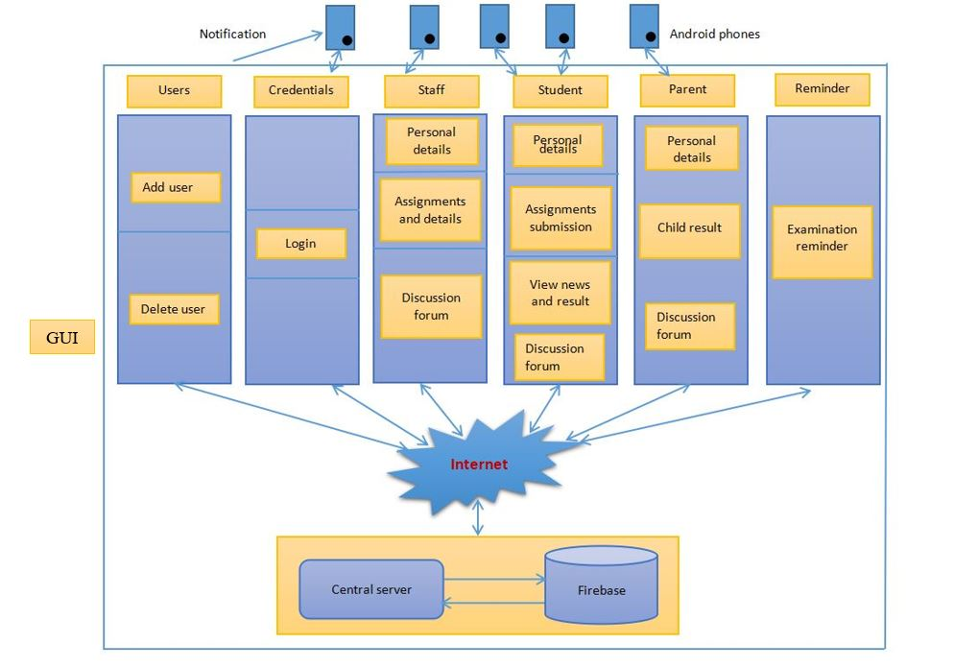
Go, change the world
Block Diagram
RV College of
Engineering
Fig 1: Block diagram
14/08/2020 Department of MCA, RVCE 11/30

Slide 14
Go, change the world
Module Specification
RV College of
Engineering
Module 1: User Module
In this module we are authenticating the users by providing username and password. If username and password is valid then they will be taken to their static screens. When they get matched with each other, system checks their status and transfer the control to respective user-interface.
Module 2: Database Module
The system uses Firebase as its real time database. This module stores information about students, and file like jpg, .doc and .pdf. For every single user it creates his own root structure and within that it creates sub-root so information related to every single user is maintained in hierarchy format.
Module 3: Staff Module
This module is designed for teachers to interact with parents and students.
Module 4: Discussion forum module
This module helps to all users to communicate with each other. They can interact within a group or in a personal chat and they can send or receive documents also.
Module 5: Assignment and notes module
Teaches can send assignments and notes files to students using this module.
Module 6: Notification and Result module
Notifications related to department are displayed in WebView. So, users can easily view.
14/08/2020 Department of MCA, RVCE 12/30

Slide 15
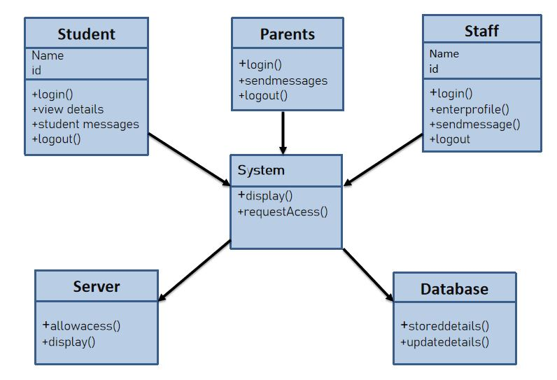
Go, change the world
Class Diagram
RV College of
Engineering
Fig 2: class diagram
14/08/2020 Department of MCA, RVCE 13/30

Slide 16
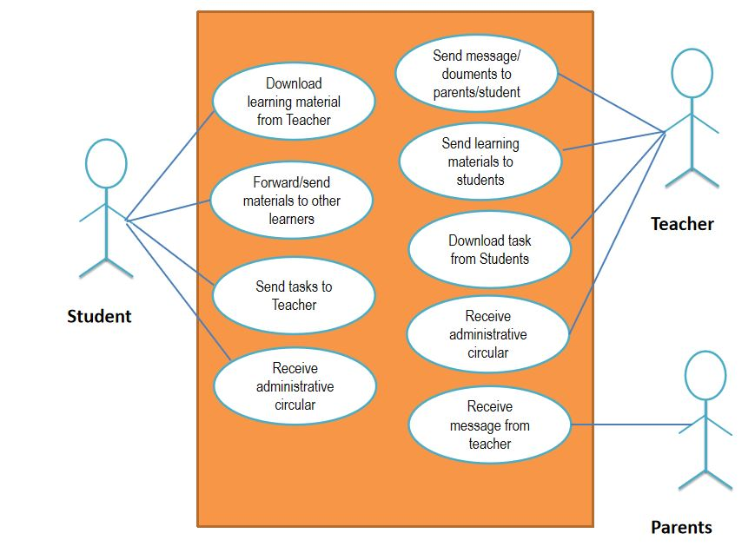
Go, change the world
Use case Diagram
RV College of
Engineering
Fig 3: Use-case diagram
14/08/2020 Department of MCA, RVCE 14/30

Slide 17
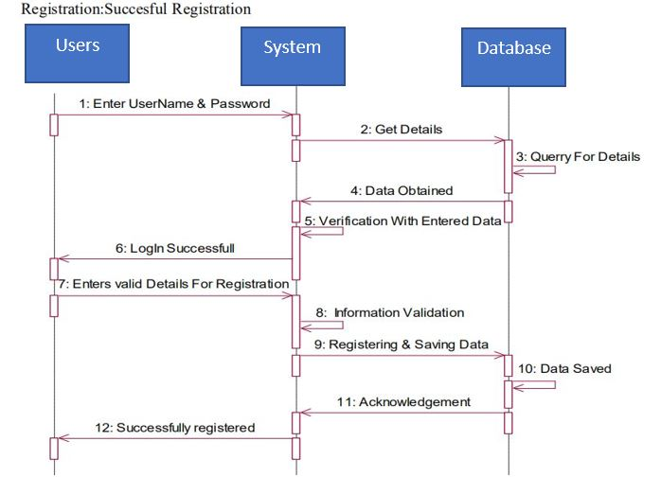
Go, change the world
Sequence Diagram
RV College of
Engineering
Fig 4: Sequence diagram
14/08/2020 Department of MCA, RVCE 15/30

Slide 18
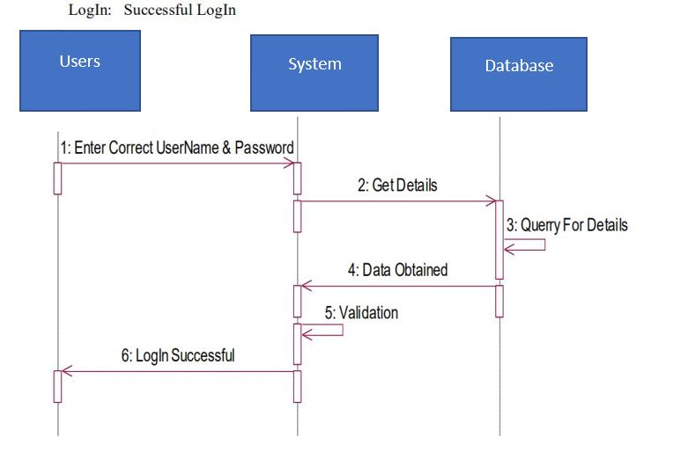
Sequence Diagram Go Change the World
14/08/2020 Department of MCA, RVCE 16/30

Slide 19
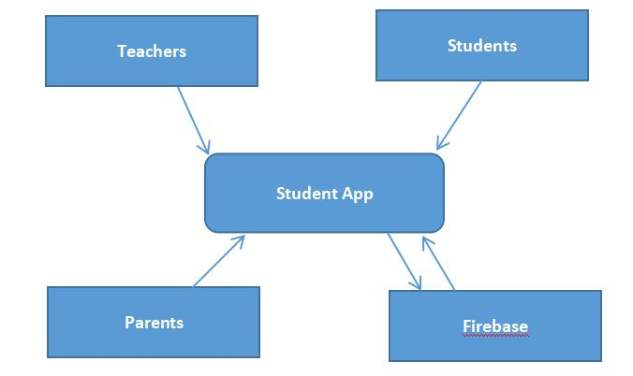
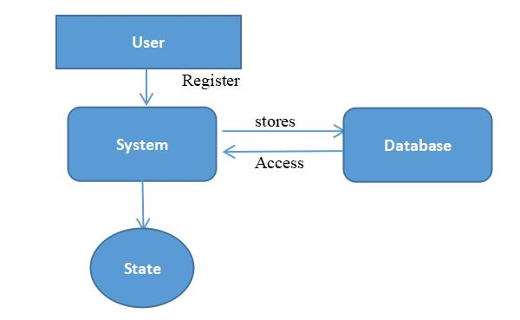
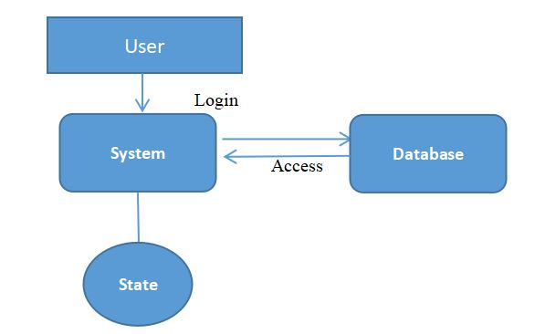
Go, change the world
Data Flow Diagram
RV College of
Engineering
DFD Level 0
DFD Level 1
DFD Level 2
Fig 5: data flow diagram
14/08/2020 Department of MCA, RVCE 17/30

Slide 20
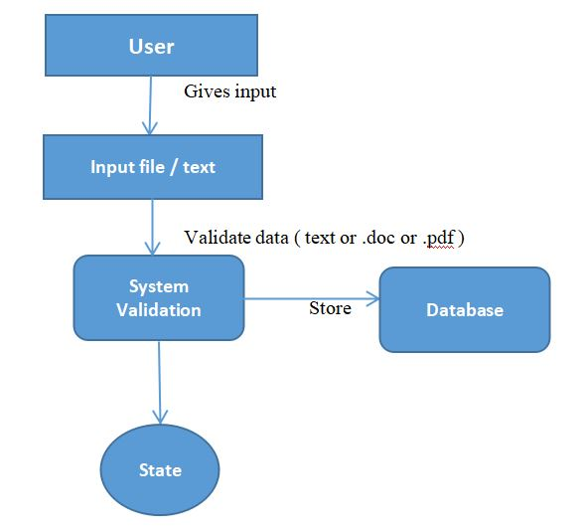
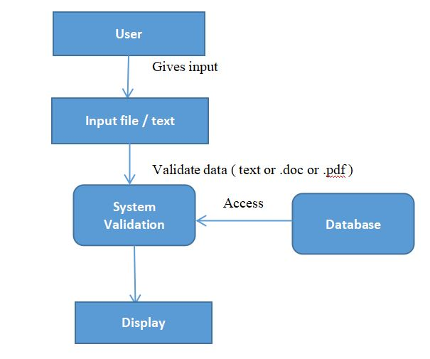
Dataflow Diagram Go Change the World
DFD Level 3
DFD Level 4
14/08/2020 Department of MCA, RVCE 18/30

Slide 21
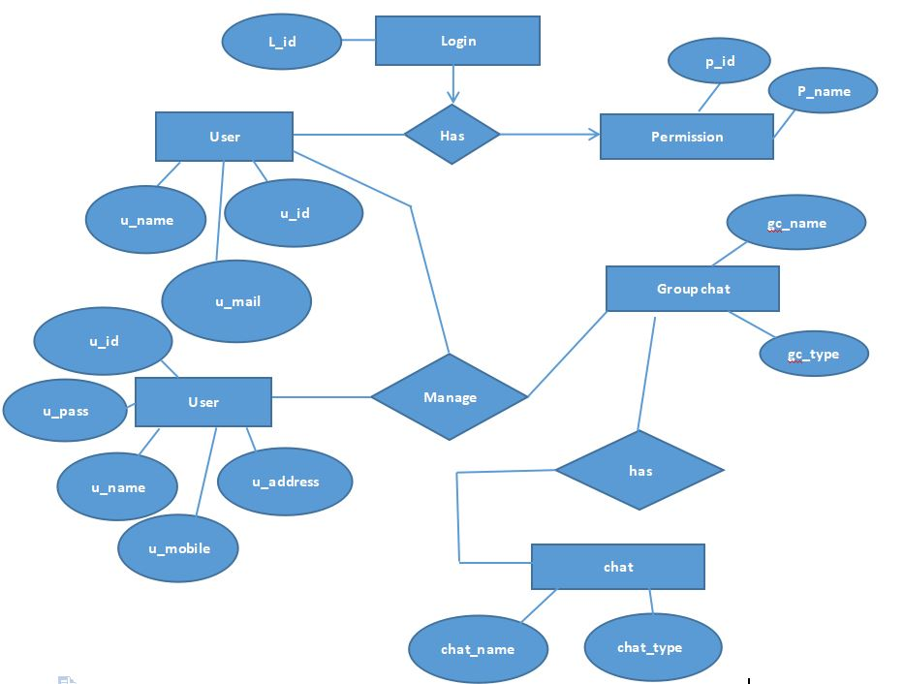
Go, change the world
ER Diagram
RV College of
Engineering
Fig 6: ER diagram
14/08/2020 Department of MCA, RVCE 19/30

Slide 22
Go, change the world
Implementation
RV College of
Engineering
All the mentioned modules are implemented
The database is created and it is storing the details of every singe user.
In the discussion forum module users can interact with personal or group chat and can share required files with each other.
14/08/2020 Department of MCA, RVCE 20/30

Slide 23
Go, change the world
Unit Testing
RV College of
Engineering
Test Case | Description | Sample Input | Expected Output | Actual Output | Result
01 | Check for valid input | Username and Password | Registration successful | Registration successful | Pass
02 | Check for invalid data | Invalid username and password | Unsuccessful registration | Unsuccessful registration | Pass
03 | Check for wrong username and correct password | Wrong username and correct password | Unsuccessful registration | Unsuccessful registration | Pass
04 | Check for correct username and wrong password | Correct username and wrong password | Unsuccessful registration | Unsuccessful registration | Pass
14/08/2020 Department of MCA, RVCE 21/30

Slide 24
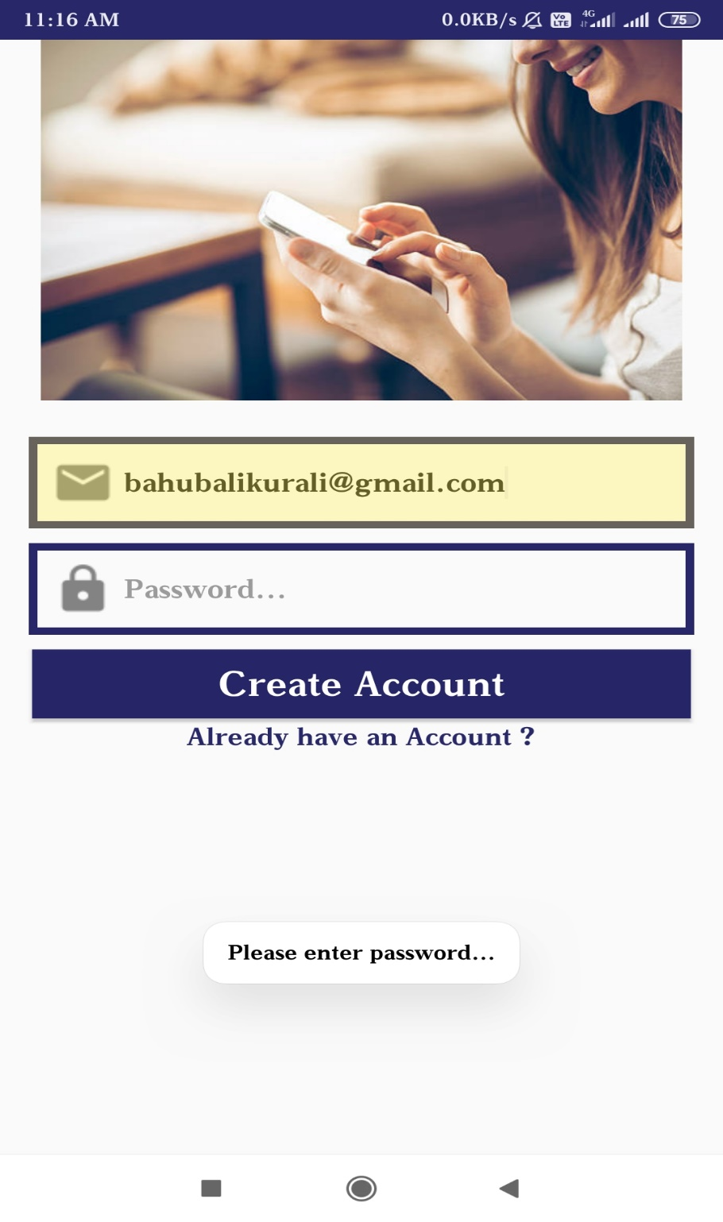
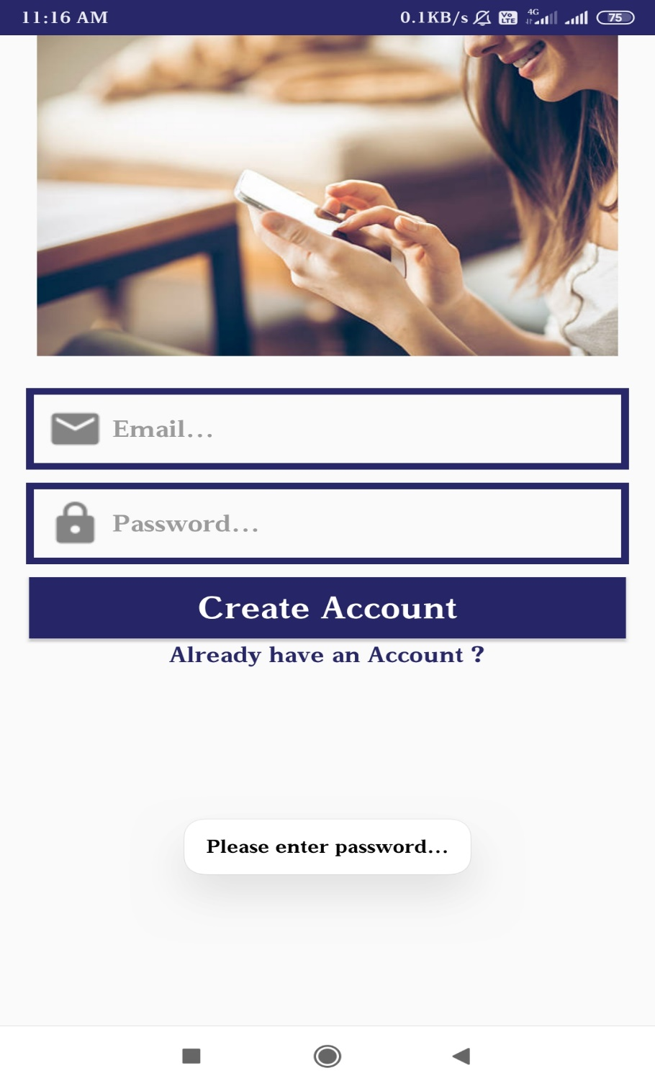
Go, change the world
Unit Testing
RV College of
Engineering
14/08/2020 Department of MCA, RVCE 22/30

Slide 25
Go, change the world
Unit Testing
RV College of
Engineering
Test Case | Description | Sample Input | Expected Output | Actual Output | Result
01 | Check for valid input | Username and Password | Login successful | Login successful | Pass
02 | Check for invalid data | Invalid username and password | Unsuccessful login | Unsuccessful login | Pass
03 | Check for wrong username and correct password | Wrong username and correct password | Unsuccessful login | Unsuccessful login | Pass
04 | Check for correct username and wrong password | Correct username and wrong password | Unsuccessful login | Unsuccessful login | Pass
05 | Check for mobile number | No input | Error message | Error message | pass
14/08/2020 Department of MCA, RVCE 23/30

Slide 26
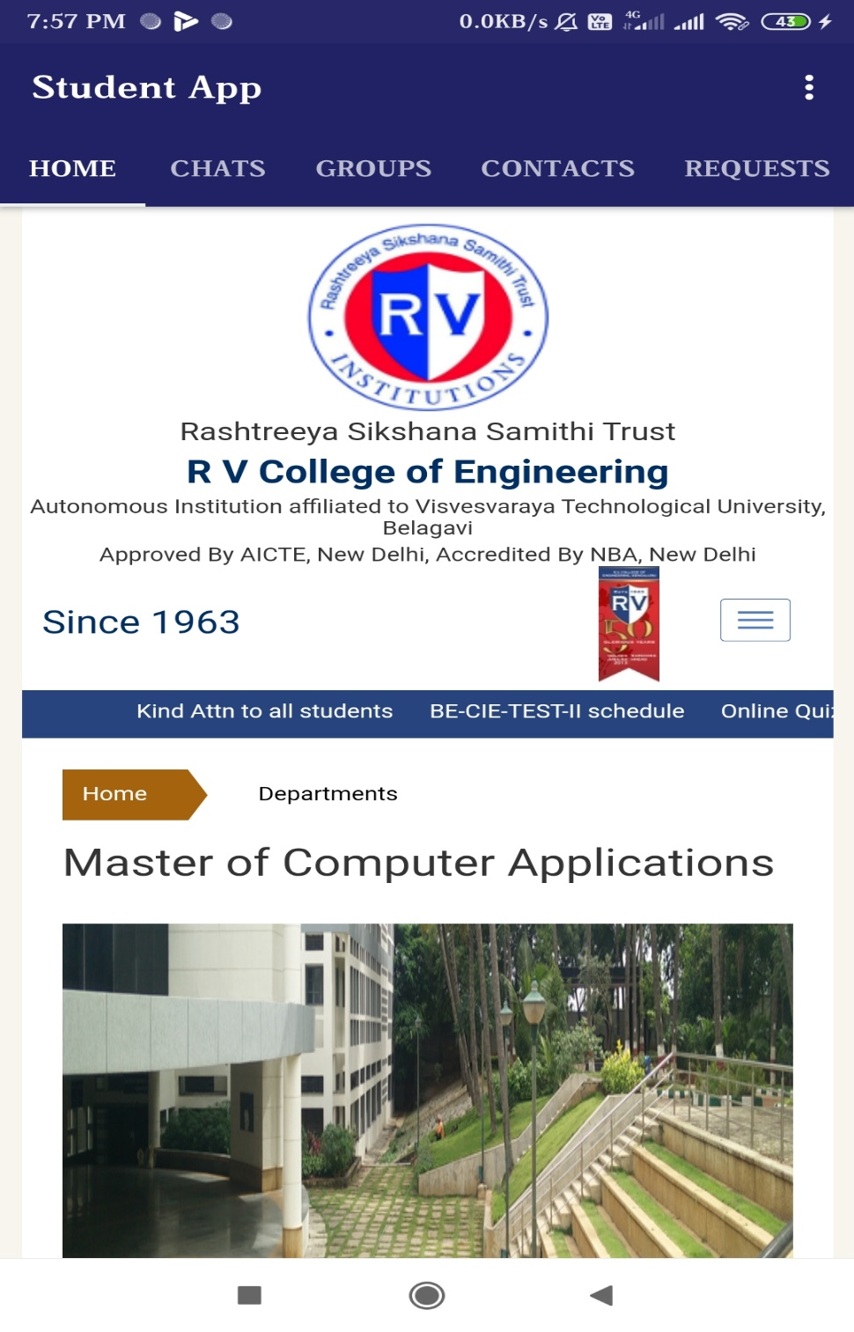
Go, change the world
Unit Testing
RV College of
Engineering
14/08/2020 Department of MCA, RVCE 24/30

Slide 27
Unit Testing Go Change the World
Test Case | Description | Sample Input | Expected Output | Actual Output | Result
01 | Check for chat tab accessible | Chat fragment | Display chat area | Display chat area | Pass
02 | Check for Group chat tab accessible | Chat fragment | Display group chat area | Display group chat area | Pass
03 | Check for send button clickable | Button click | Clickable | Clickable | Pass
04 | Check for sending message without text | No input | Please enter message | Please enter message | Pass
05 | Check for sending document | .doc / .pdf file | Message sent | Message sent | Pass
06 | Check for file upload | Click on file icon | Open dialog box | Open dialog box | Pass
14/08/2020 Department of MCA, RVCE 25/30

Slide 28
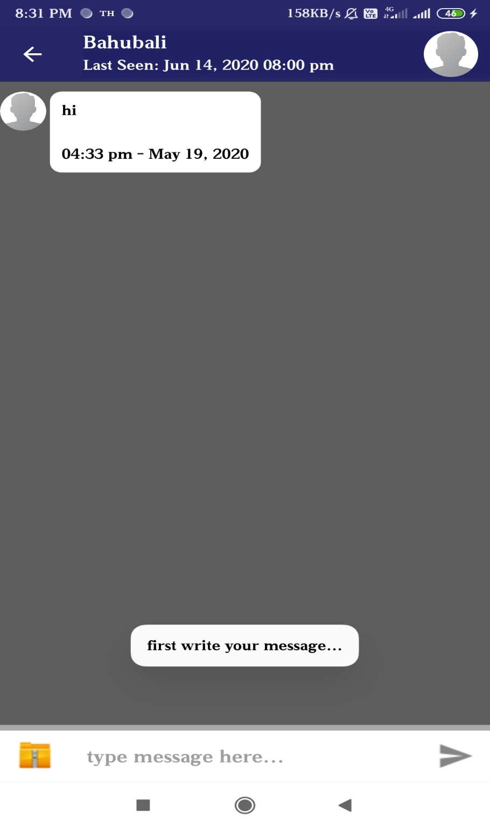
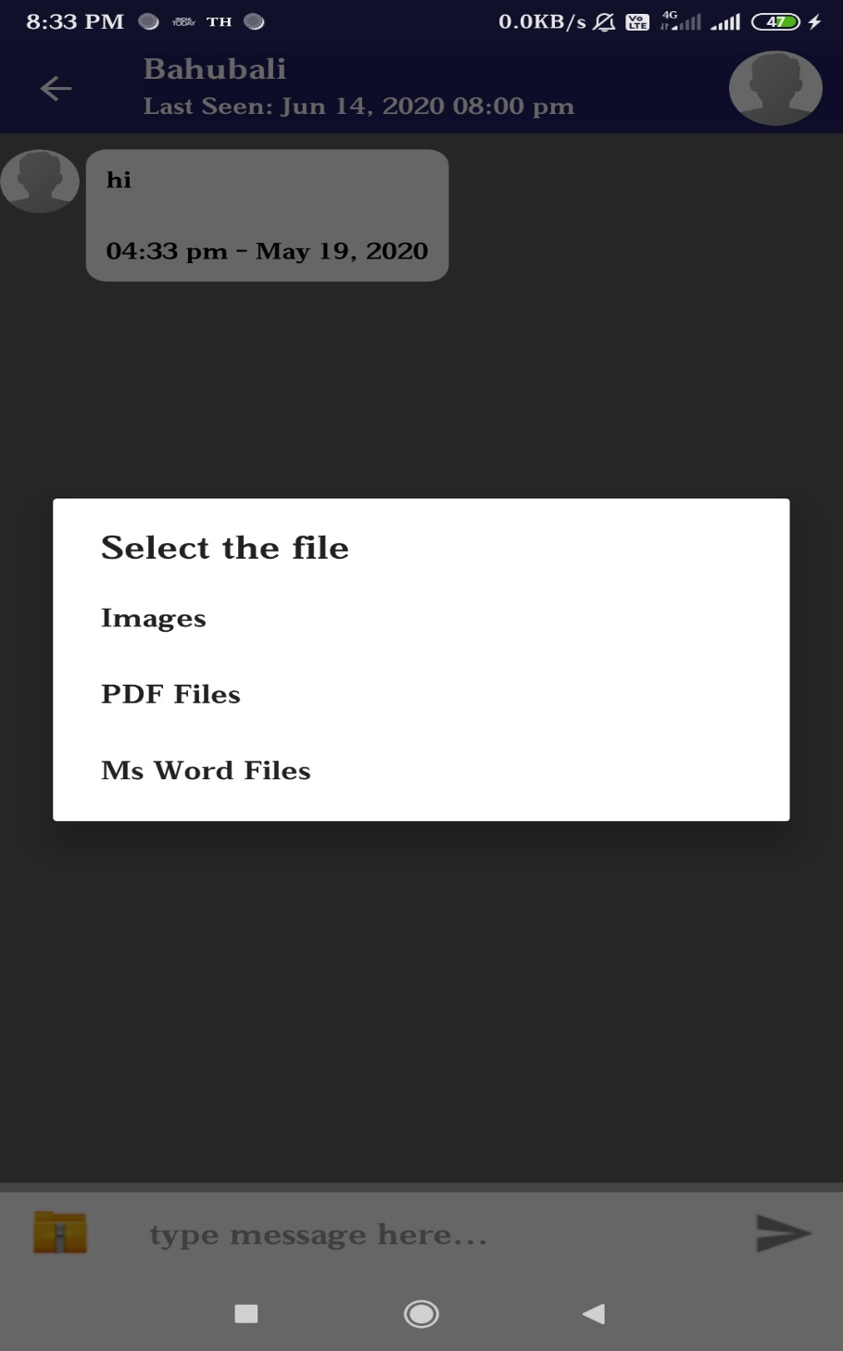
Unit Testing Go Change the World
14/08/2020 Department of MCA, RVCE 26/30

Slide 29
Go, change the world
Conclusion
RV College of
Engineering
The manual procedure is very time consuming this will reduce the manual work.
The system offers reliability, time savings and easy control. Students and their parents will also view results, and curriculum details using this application.
In the proposed system online conference (video meeting) can be included and attractive user interface
14/08/2020 Department of MCA, RVCE 27/30

Slide 30
Go, change the world
Future Enhancements
RV College of
Engineering
Allow to send video lectures
Allowing online video meeting
Placement activities can be managed
14/08/2020 Department of MCA, RVCE 28/30

Slide 31
Go, change the world
[1]https://www.researchgate.net/publication/313735671_Mobile_Web_Based_Android_Application_for_Col lege_Management_Sysytem
[2] http://www.ijecs.in/index.php/ijecs/article/view/2408
[3] https://ijcsmc.com/docs/papers/November2017/V6I11201710.pdf
[4]http://ijesc.org/upload/6cd4ed057071c927800e769330dde3e1.Android%20Application%20for%20College%20Management%20System.pdf
[5] http://www.ijcea.com/android-application-college-management-system/
References
RV College of
Engineering
14/08/2020 Department of MCA,RVCE 29/30

Slide 32
Go, change the world
RV College of
Engineering
Thank You
14/08/2020 Department of MCA,RVCE 30/30

