Slide 1

NovaRetail — Quarterly Business Review
Q2 2026 Executive Review
$1.28B
8.2%
62
Total Revenue
Fastest Regional QoQ Growth
Highest Regional NPS
EXECUTIVE SUMMARY
NovaRetail delivered strong Q2 2026 performance with $1.28B in revenue. North America remained the largest revenue region at $465M. APAC achieved the fastest quarter-over-quarter growth of 8.2% and recorded the highest NPS of 62. Latin America remains the most significant operational risk area and requires focused leadership attention.

Slide 2
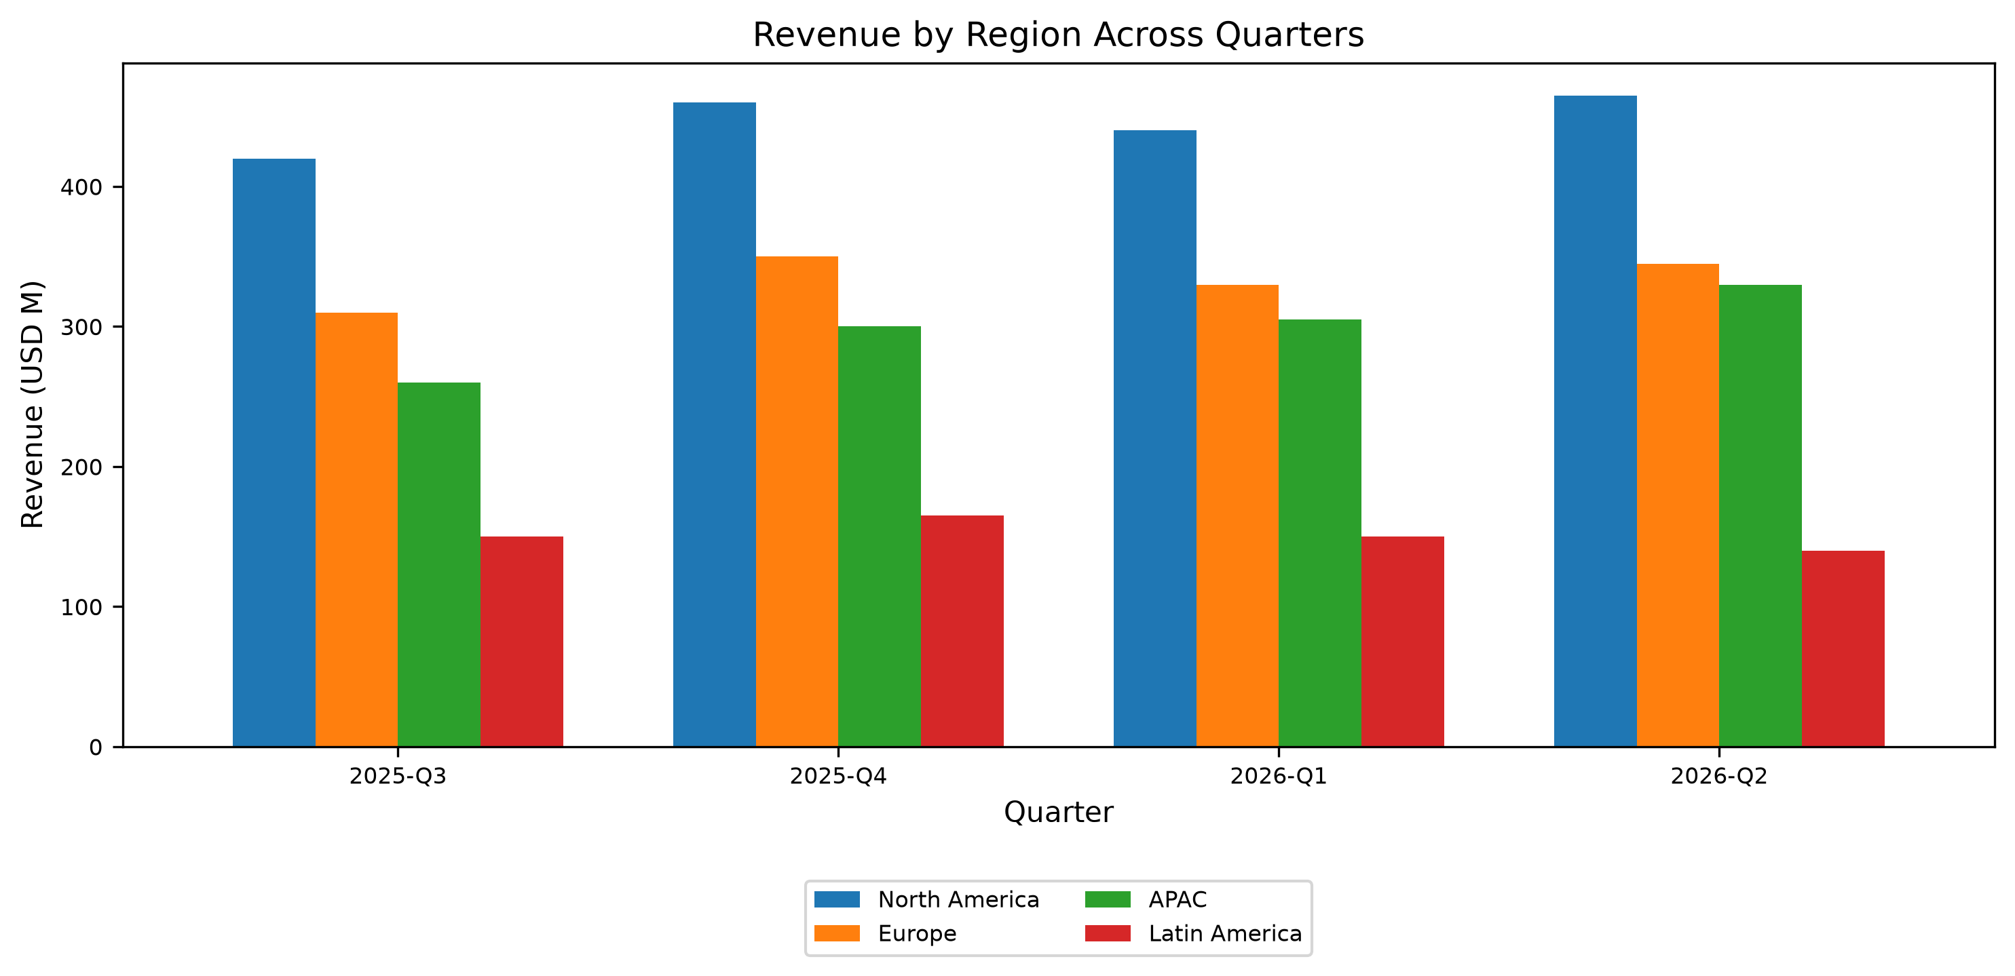

APAC Drives Q2 2026 Revenue Growth as Global Total Reaches $1.28B
- Total revenue for Q2 2026 reached $1.28B across all operational regions.
- North America generated $465M in revenue, maintaining its status as the largest revenue market.
- APAC recorded the fastest revenue growth rate with an 8.2% quarter-over-quarter increase.
- Strong sales volumes across regions supported overall quarterly commercial performance.

Slide 3
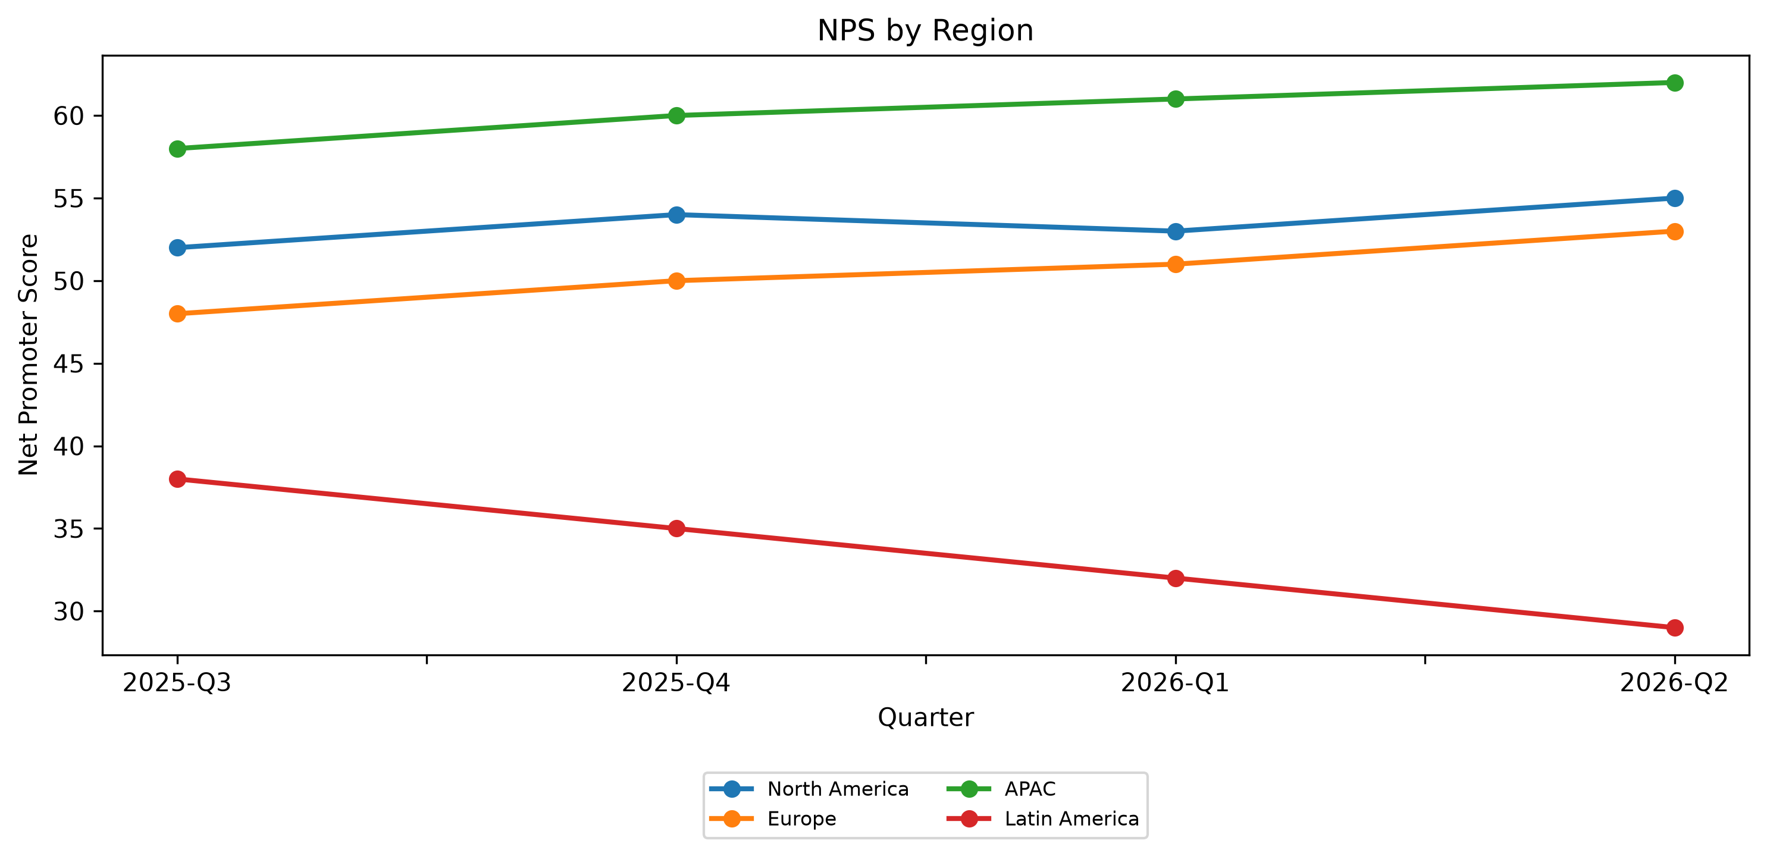

APAC Leads Customer Satisfaction Benchmarks While Latin America Lags
- APAC recorded the highest customer satisfaction scores with an NPS of 62 and a 92% CSAT rating.
- Rapid fulfillment supported high customer sentiment in APAC, where delivery averaged 2.2 days.
- Latin America registered the lowest customer satisfaction scores with an NPS of 29 and a 74% CSAT rating.
- Fulfillment bottlenecks in Latin America contributed to a 7.5-day average delivery time and 31k support tickets.

Slide 4
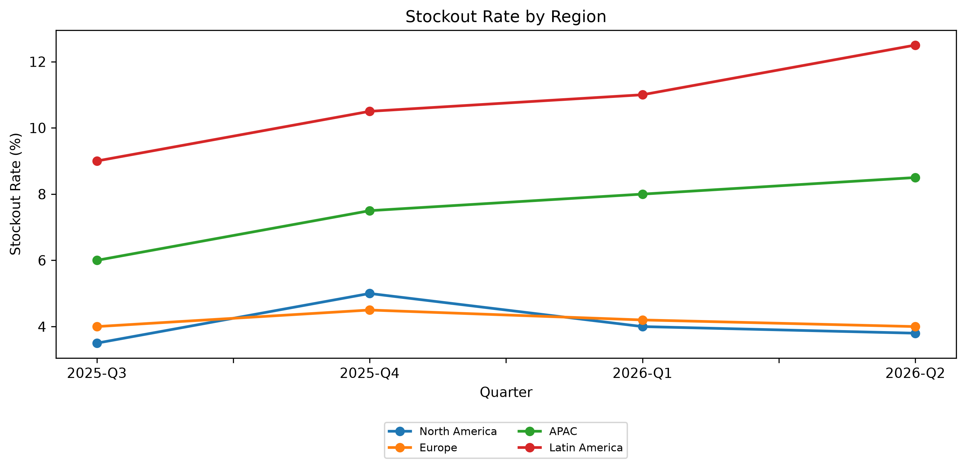

Latin America Logistics Risks Rise as APAC Nears Full Warehouse Capacity
- Latin America encountered the highest inventory risk with a peak stockout rate of 12.5%.
- Security vulnerabilities were highest in Latin America, which reported 30 fraud incidents in Q2 2026.
- Operational processing delays extended return processing times to 10 days in Latin America.
- Logistics facilities in APAC faced operational pressure, reaching 92% warehouse capacity utilization.

Slide 5

Recommended Actions & Next Steps
1. Expand warehouse capacity and logistics infrastructure in APAC to support 8.2% quarter-over-quarter growth and relieve 92% capacity utilization.
2. Optimize fulfillment operations in Latin America to reduce the 7.5-day delivery timeline and lower the 31k support ticket volume.
3. Enhance inventory tracking in Latin America to mitigate the 12.5% stockout rate and shorten 10-day return processing times.
4. Implement targeted fraud detection protocols in Latin America to address the 30 fraud incidents logged during Q2 2026.
Addressing supply chain friction in Latin America while expanding capacity in high-growth APAC will ensure NovaRetail maintains sustainable growth and service excellence.

