Slide 2
ROW Application
7

Slide 3
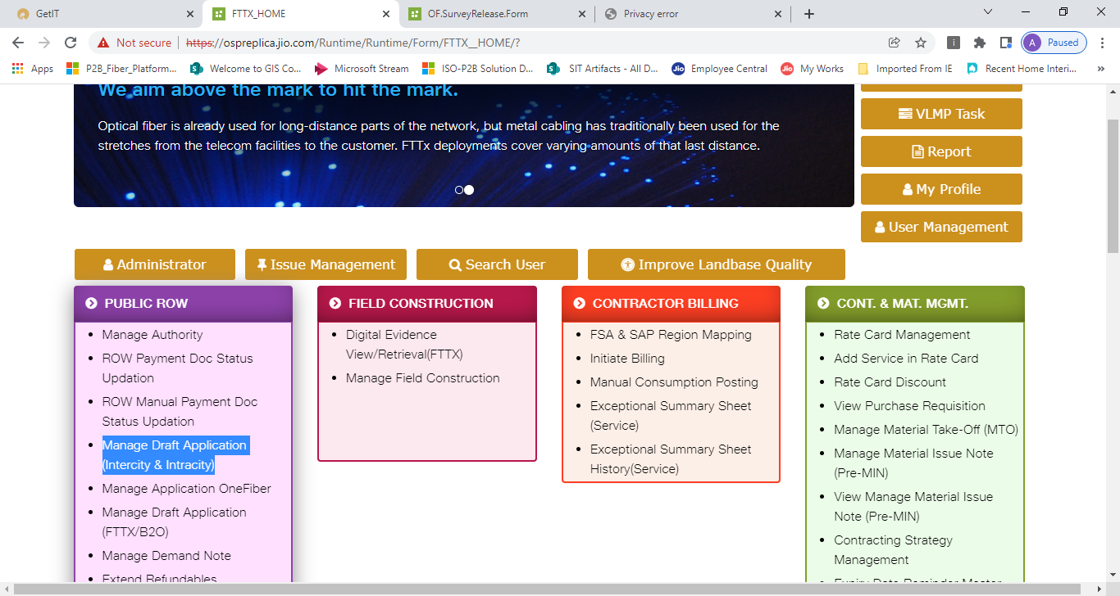
7. ROW Application
Create ROW Application
User to click on “Manage ROW Draft Application” tab on PUBLIC ROW main tile on K2 screen
Workflow | Task_Name | System | Application Type | Role | Location
ROW Application | Create ROW Application | K2,GIS | Web | ROW Executive | SHQ

Slide 4
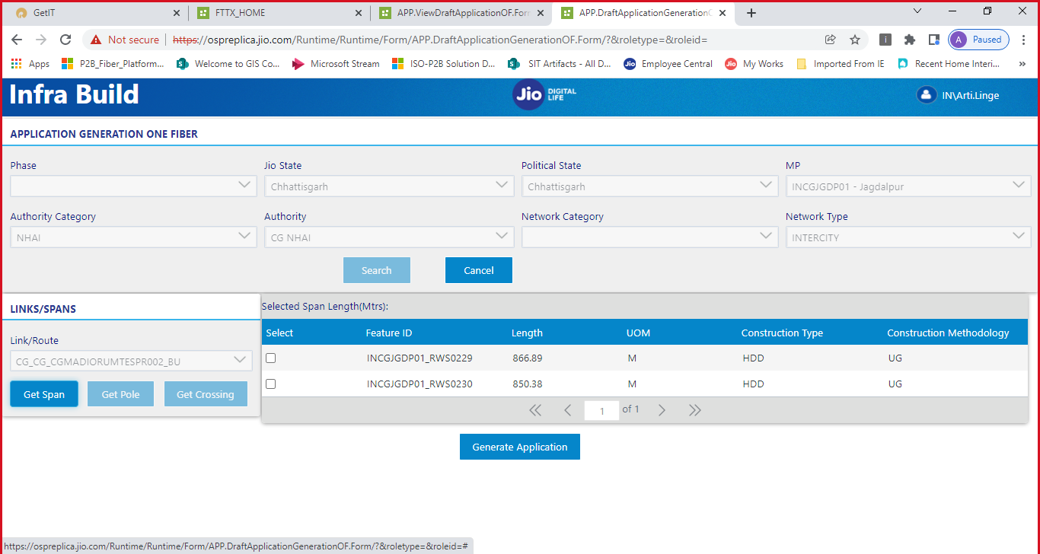
7. ROW Application (Cont’d)
Select NON DIT Draft Application
Search for Link
Click get details
SPAN, CROSSING and POLE details eligible for ROW will be displayed.
Select SPAN segment and create application

Slide 5
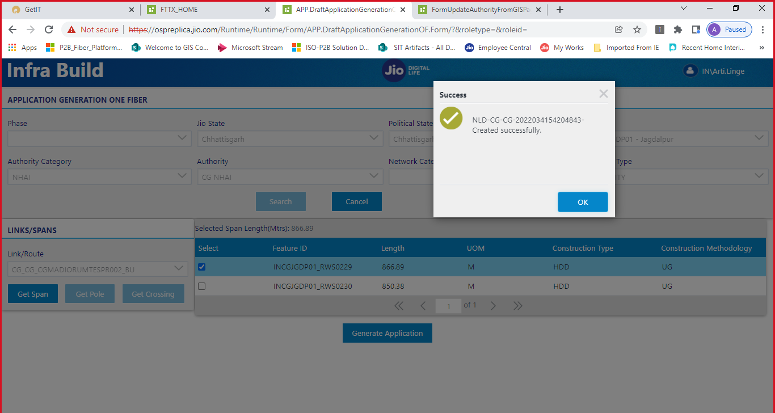
7. ROW Application (Cont’d)

Slide 6
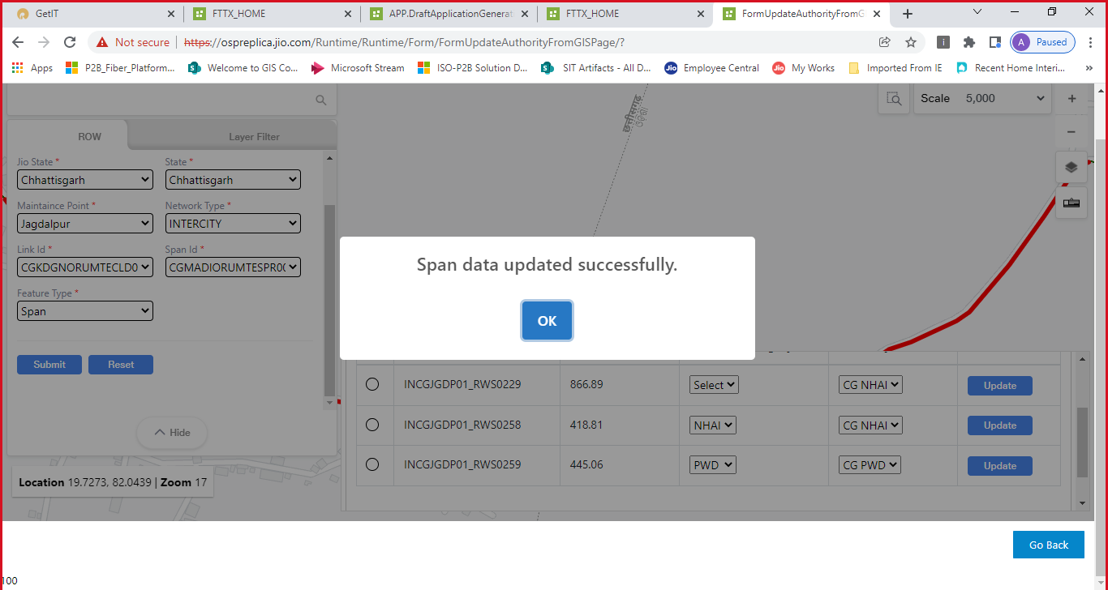
7. ROW Application (Cont’d)
SPAN split/update
User can Split Span and update another author via Update Authority page before application creation

Slide 7
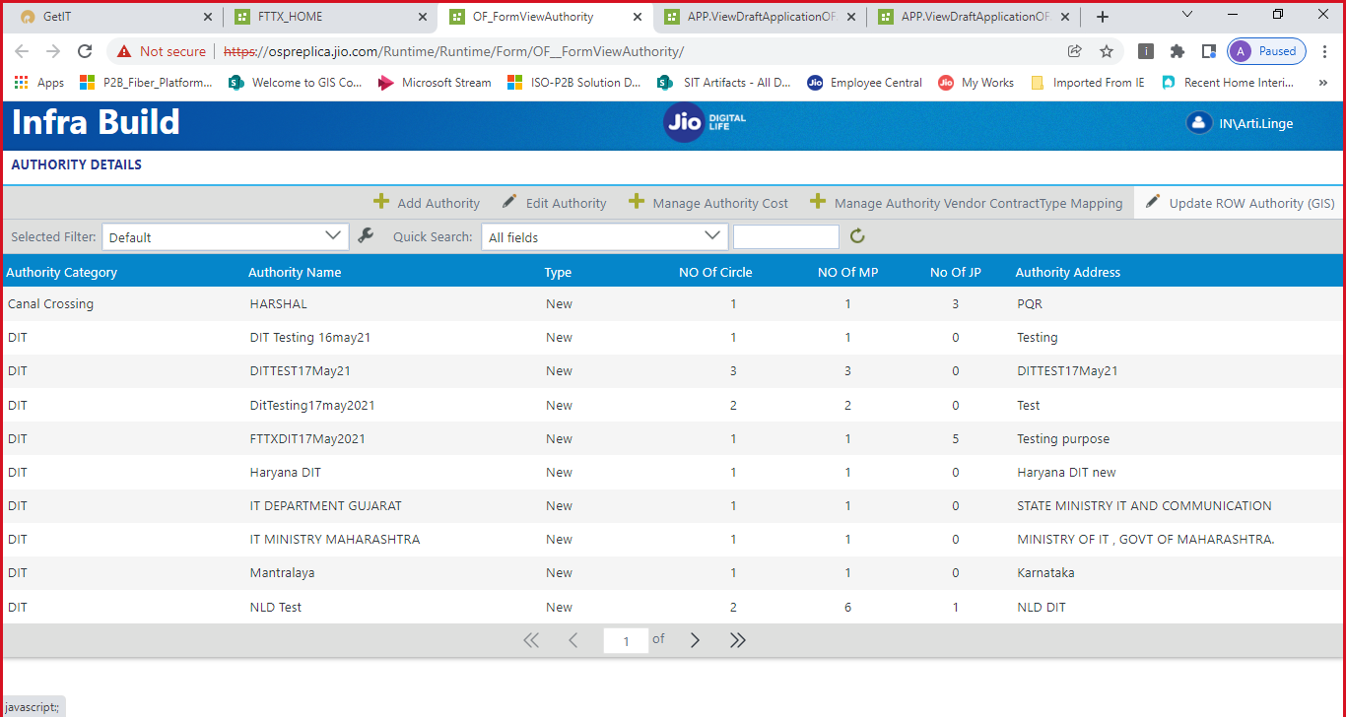
7. ROW Application (Cont’d)

Slide 8
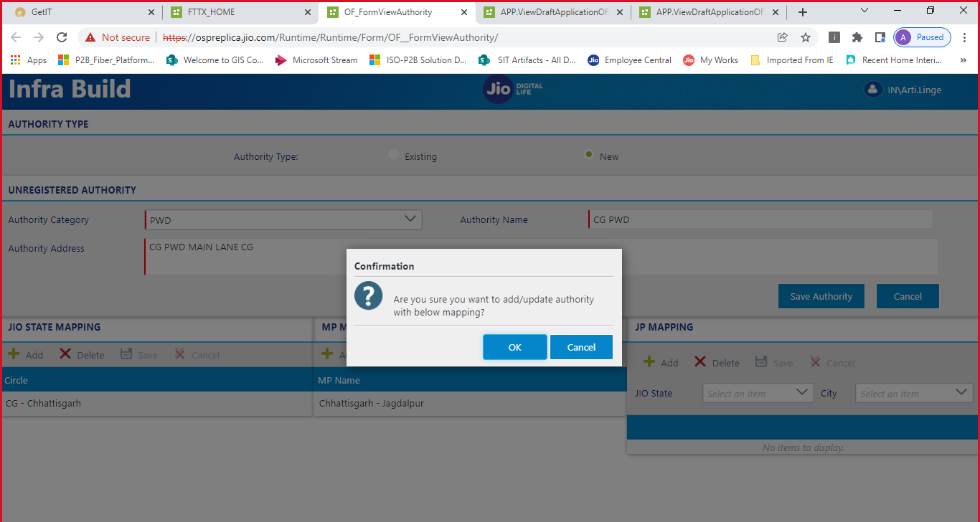
7. ROW Application (Cont’d)

Slide 9
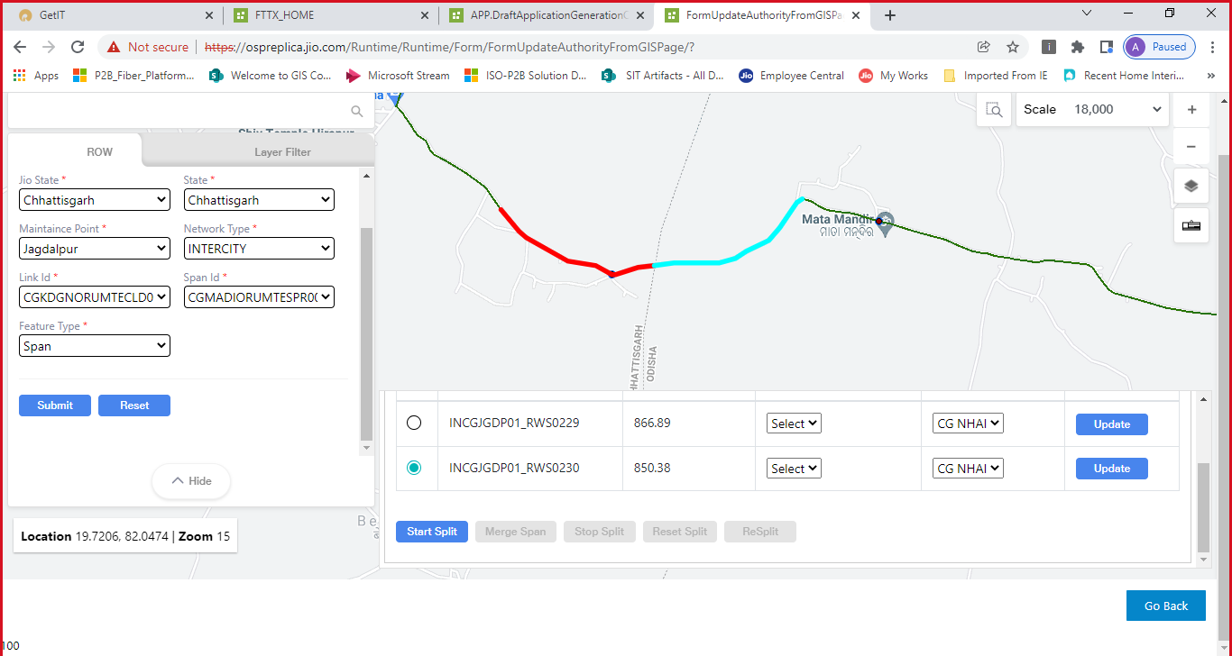
7. ROW Application (Cont’d)

Slide 10
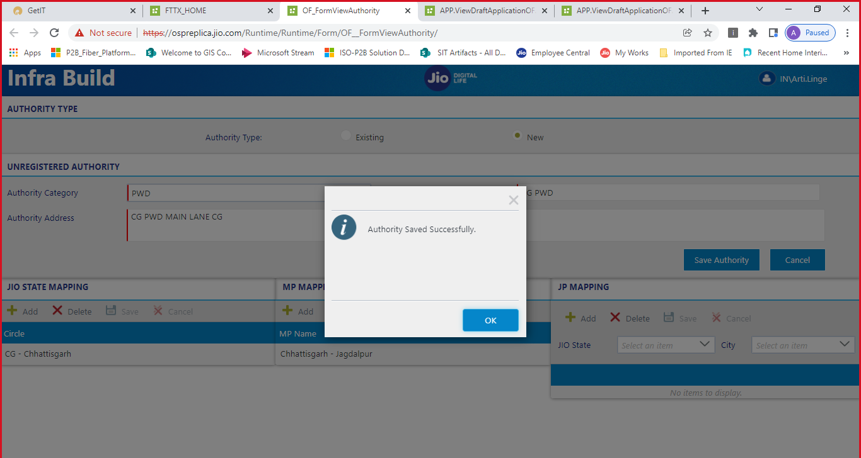
7. ROW Application (Cont’d)

Slide 11
7. ROW Application (Cont’d)

Slide 12
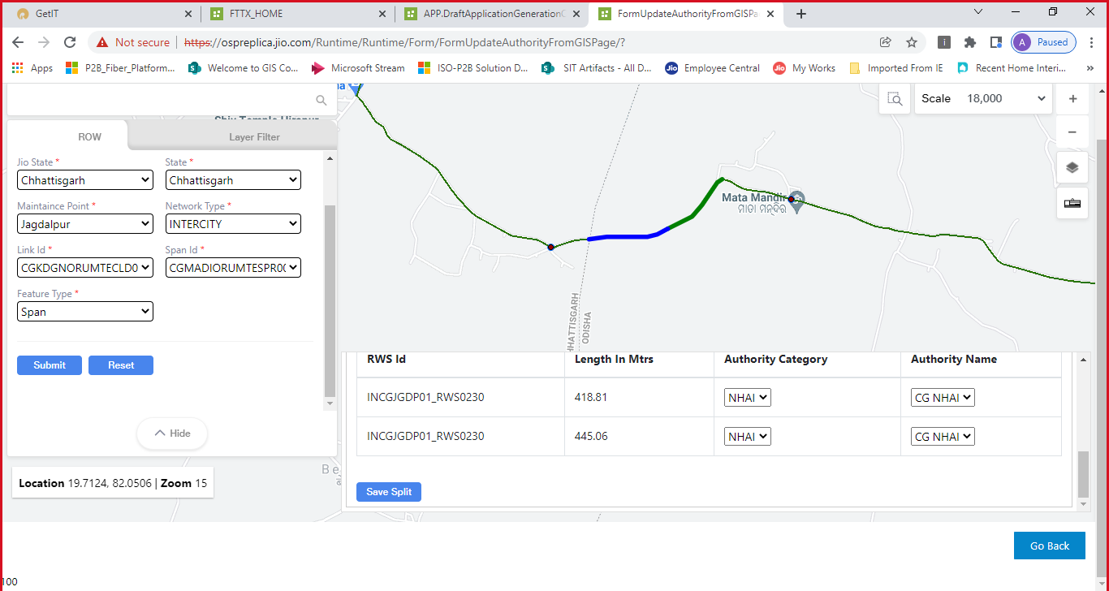
7. ROW Application (Cont’d)

Slide 13
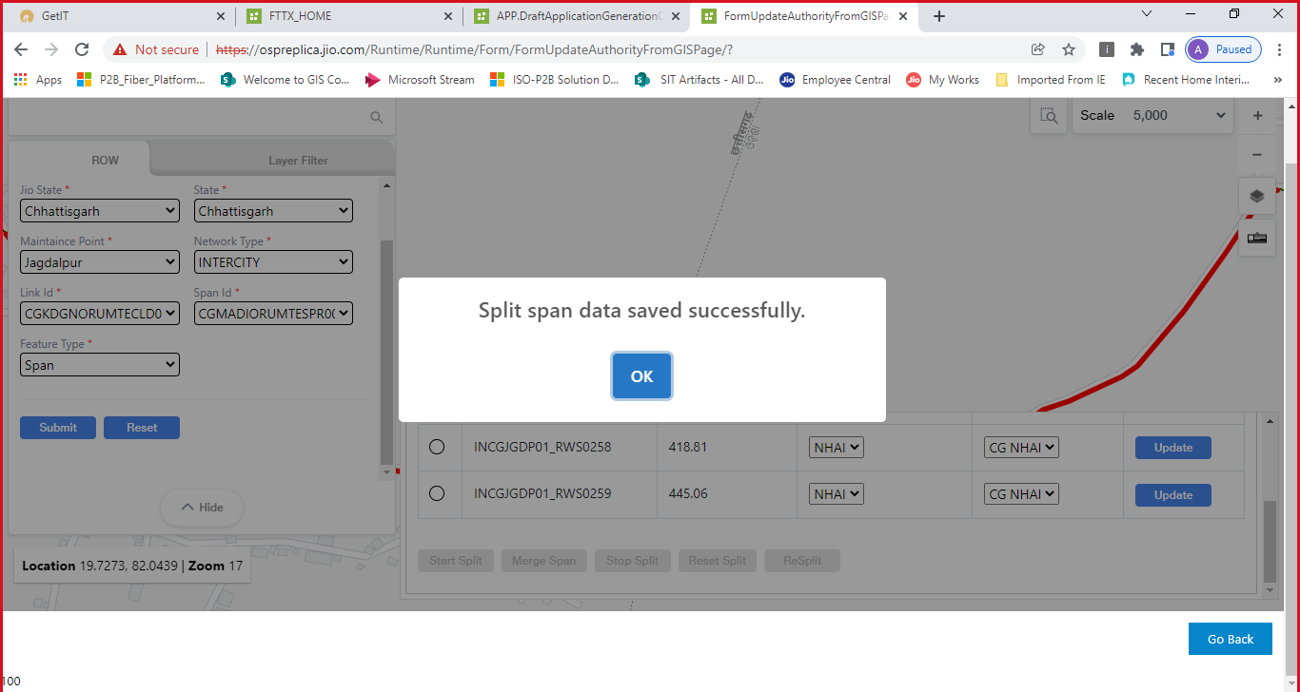
7. ROW Application (Cont’d)

Slide 14
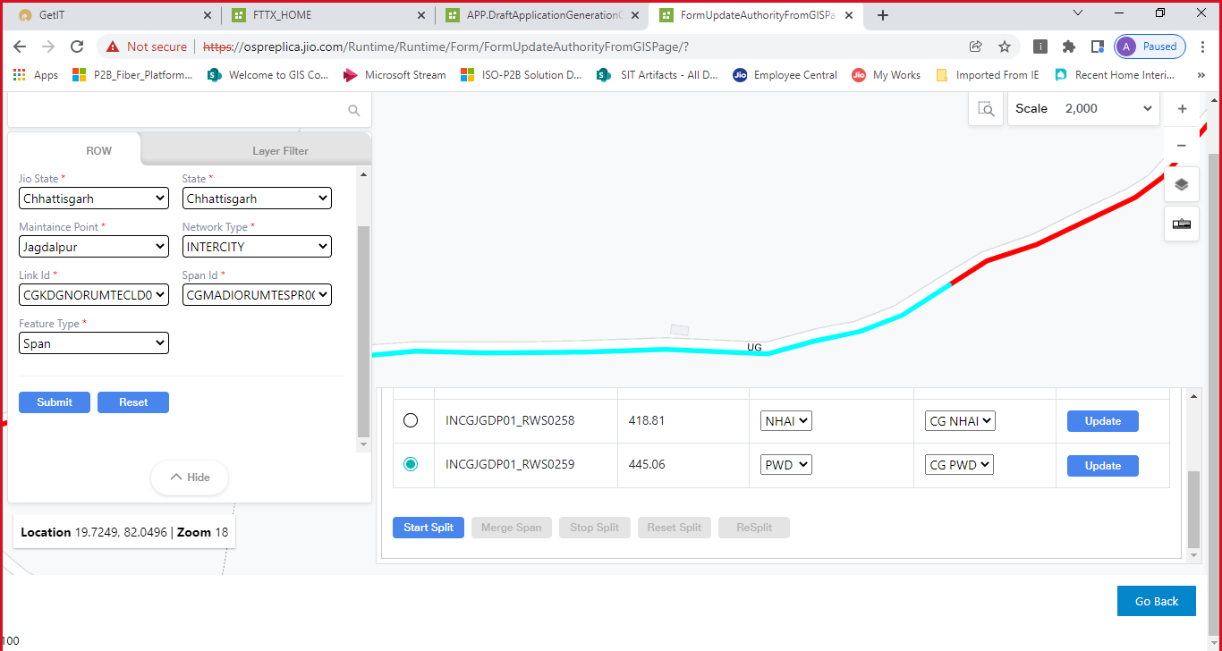
7. ROW Application (Cont’d)

Slide 15
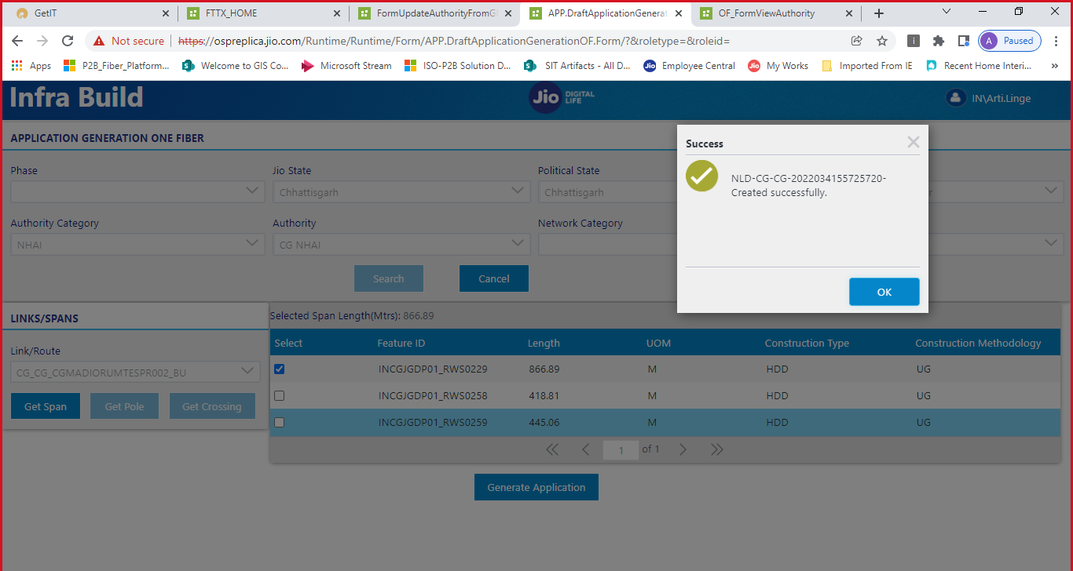
7. ROW Application (Cont’d)

Slide 16
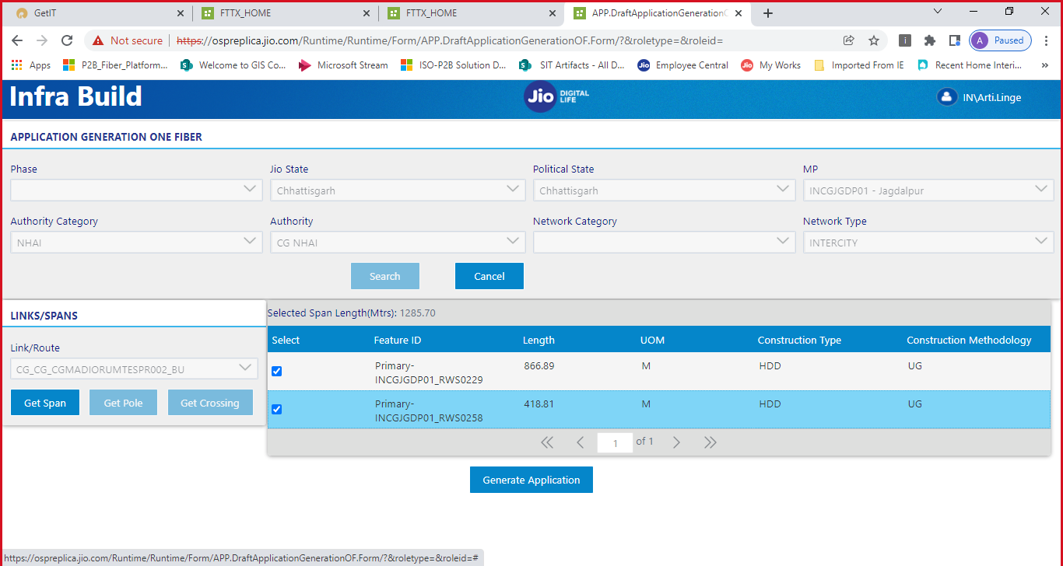
7. ROW Application (Cont’d)

Slide 17
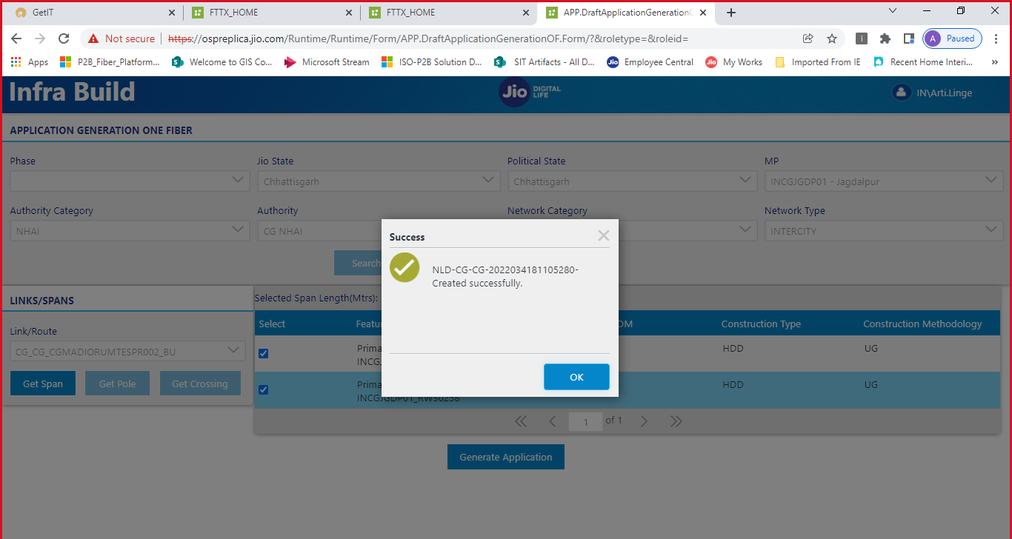
7. ROW Application (Cont’d)

Slide 18
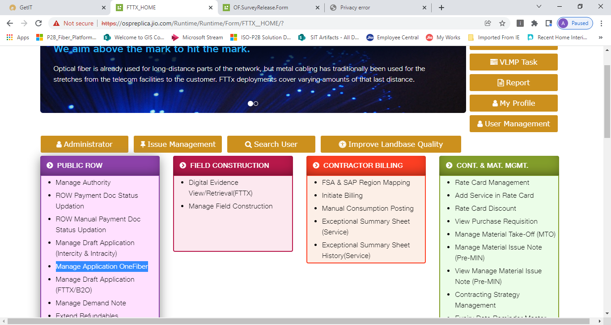
7. ROW Application (Cont’d)
Merge Application
User can merge multiple application and generate application

Slide 19
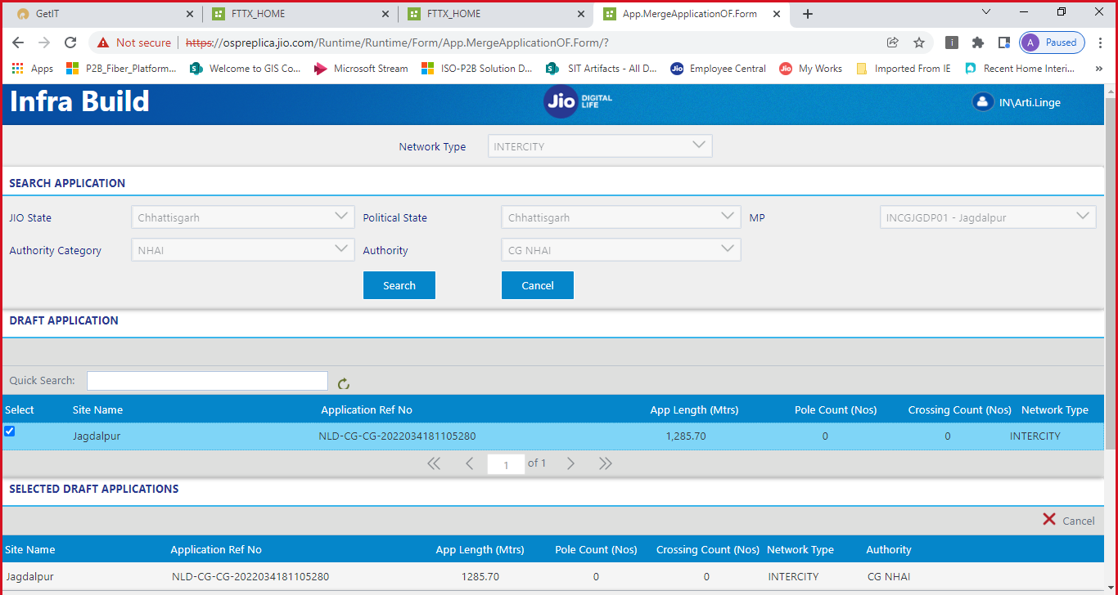
7. ROW Application (Cont’d)

Slide 20
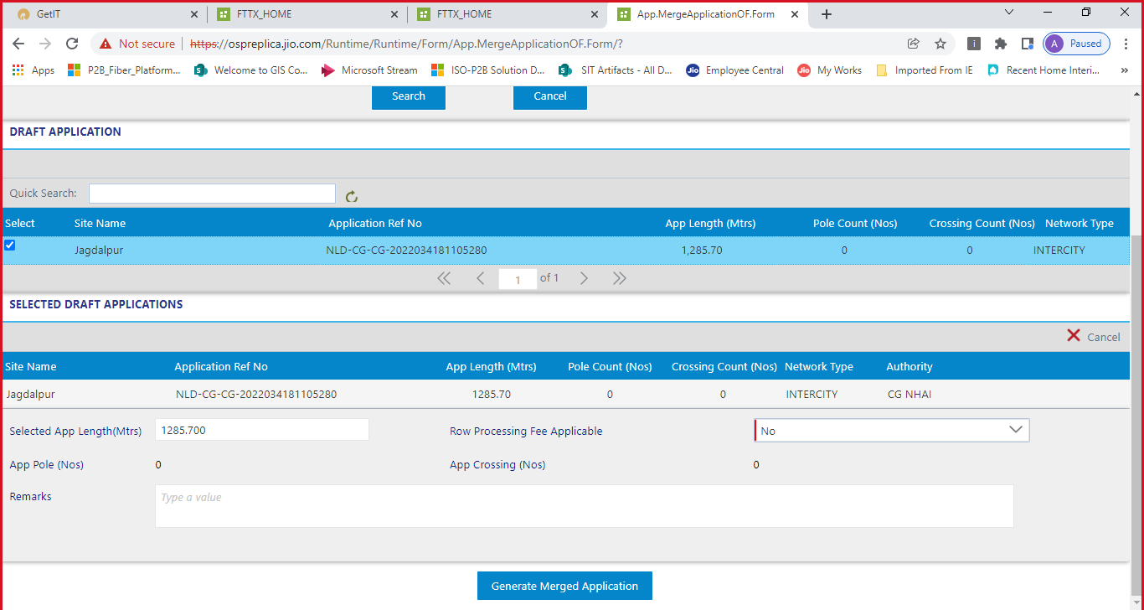
7. ROW Application (Cont’d)

Slide 21
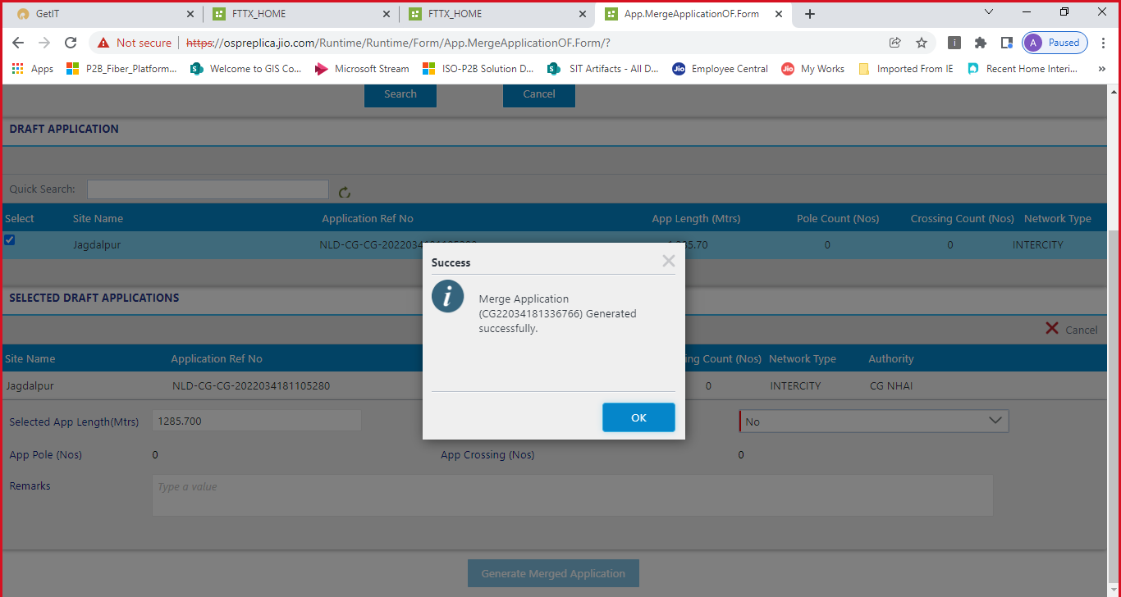
7. ROW Application (Cont’d)

Slide 22
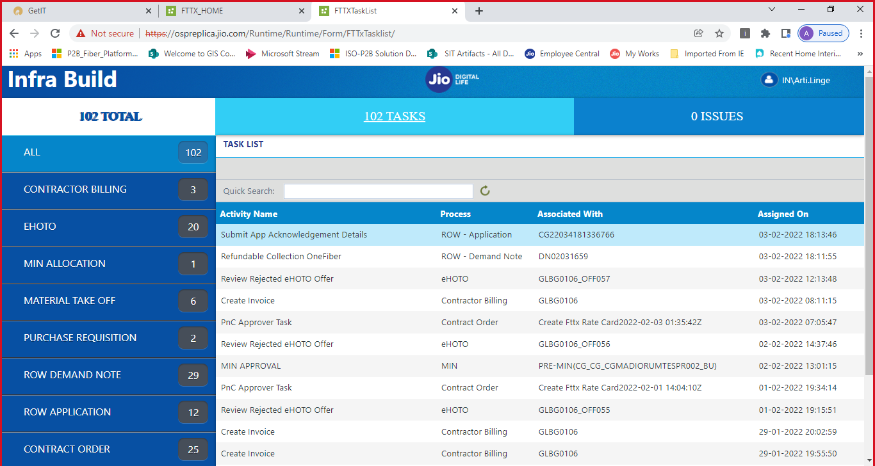
7. ROW Application (Cont’d)
Application acknowledgement
Task will be assigned to user for application submission
Workflow | Task_Name | System | Application Type | Role | Location
ROW Application | Application Acknowledgement | K2,GIS | Web | ROW Executive | SHQ
ROW Application | Capture Joint Survey Details | K2,GIS | Web | ROW Executive | SHQ
ROW Application | Capture Application Processing Fee | K2,GIS | Web | ROW Executive | SHQ

Slide 23
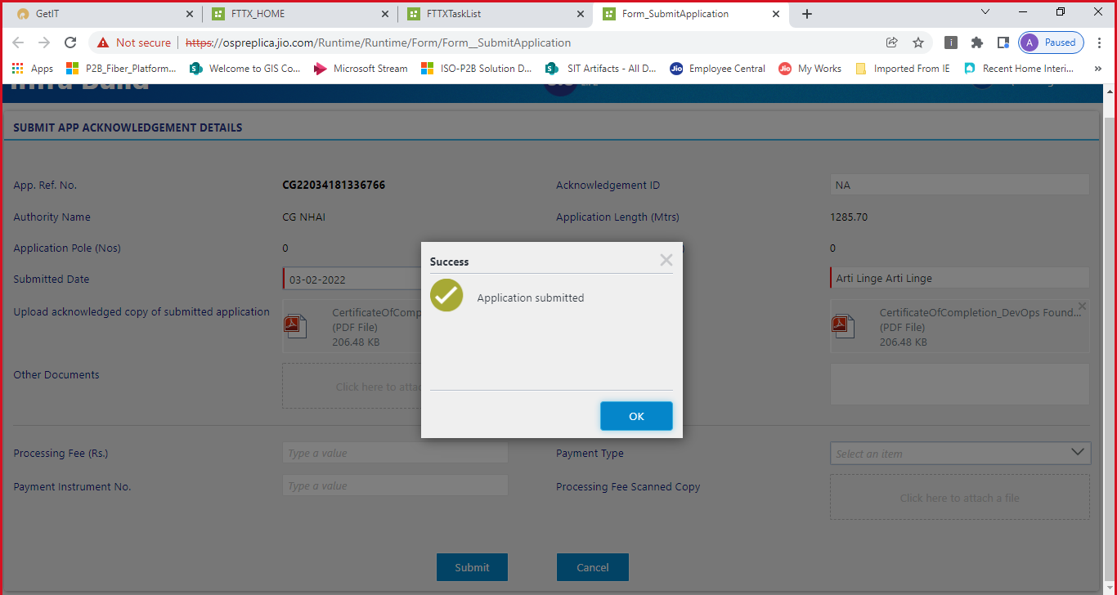
7. ROW Application (Cont’d)

Slide 24
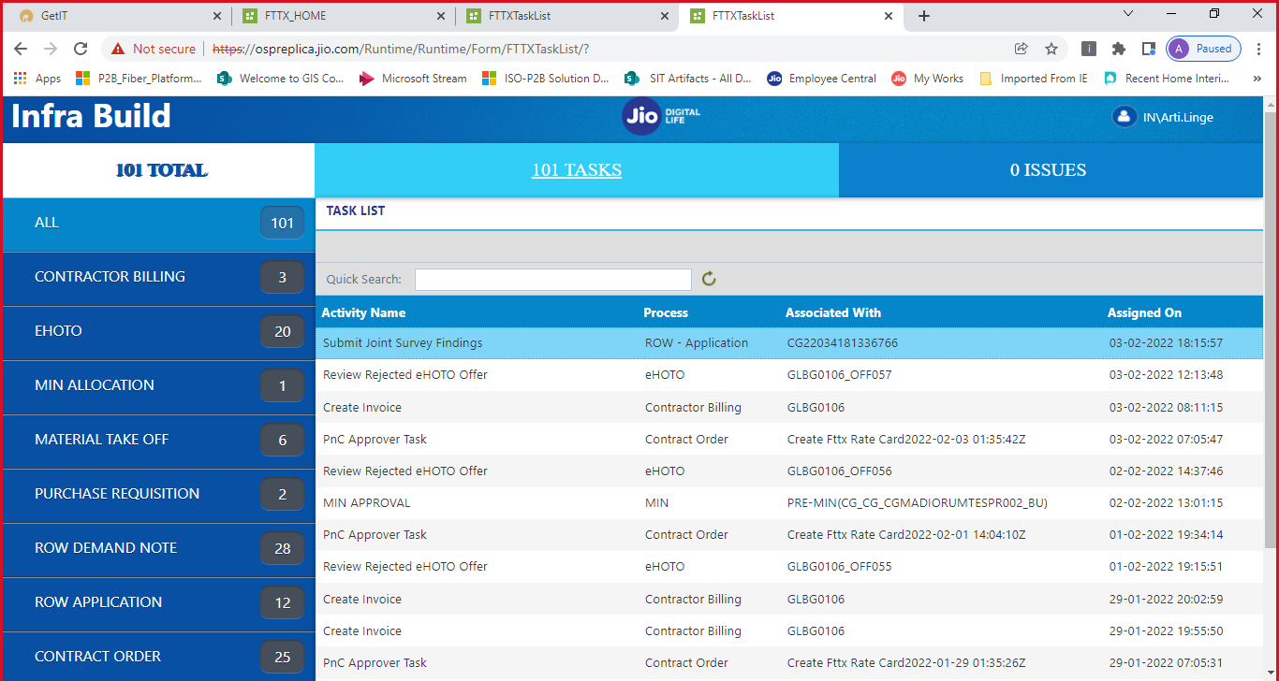
7. ROW Application (Cont’d)

Slide 25
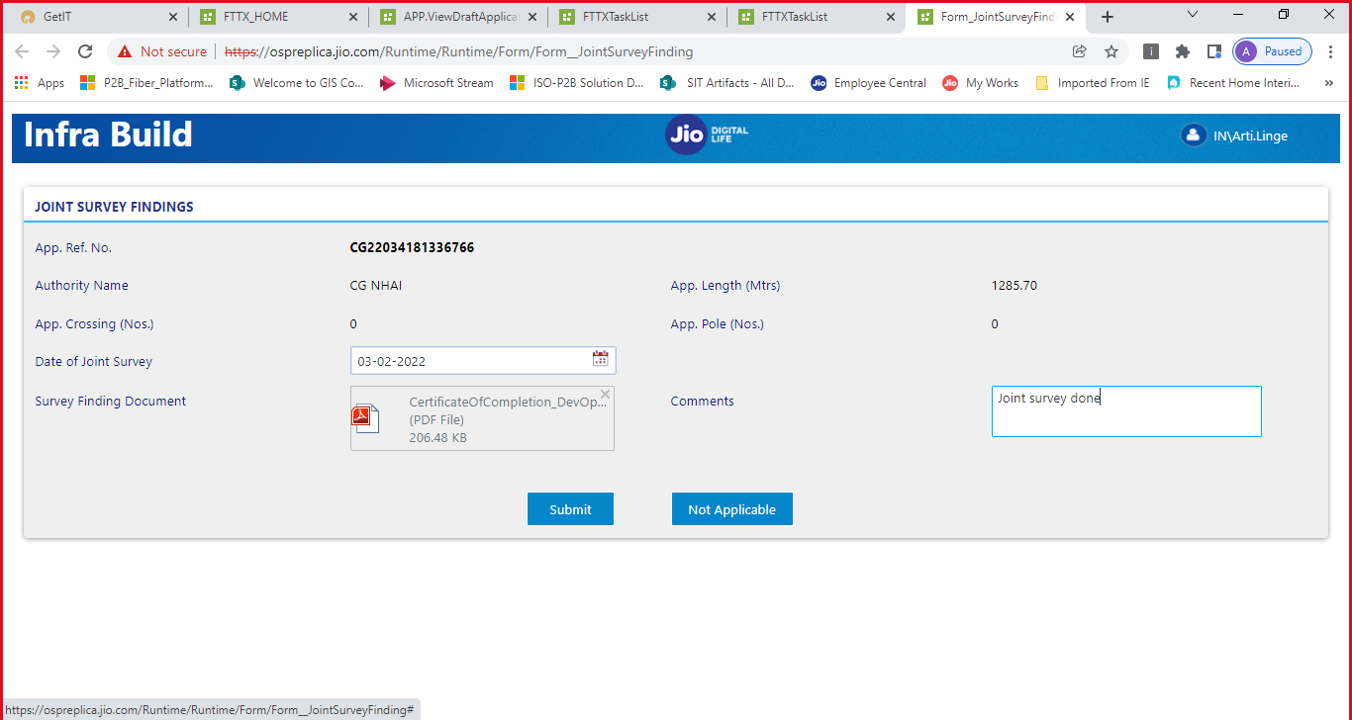
7. ROW Application (Cont’d)

Slide 26
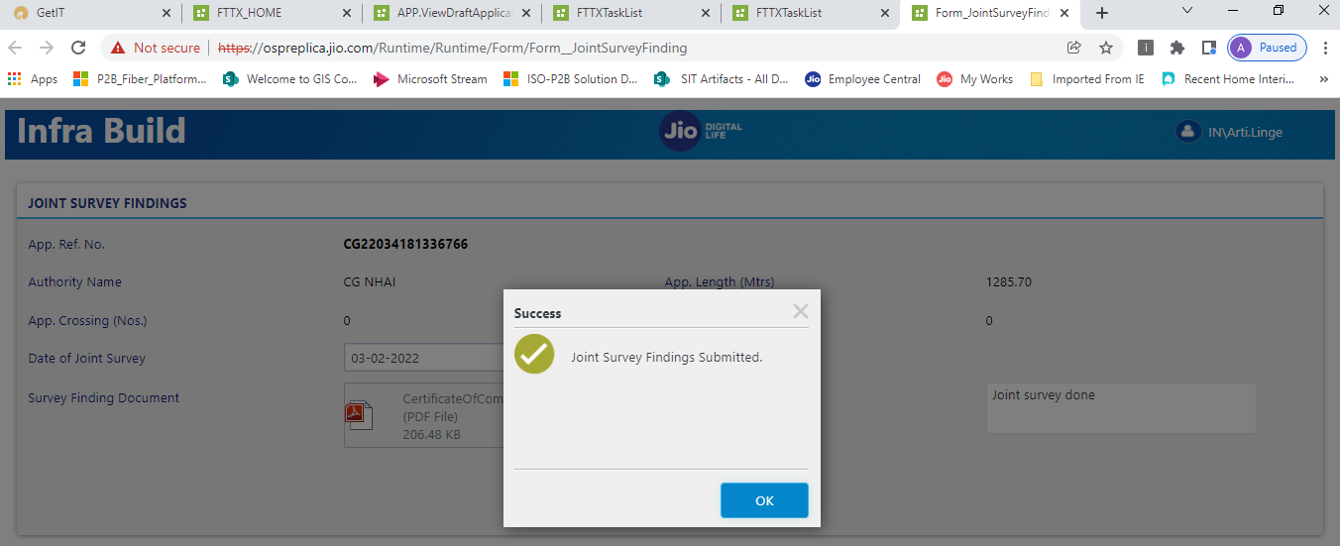
7. ROW Application (Cont’d)
Capture Application Processing Fee
Workflow | Task_Name | System | Application Type | Role | Location
ROW Application | Capture Application Processing Fee | K2,GIS | Web | ROW Executive | SHQ
ROW Application | Capture Application Processing Fee - Approval L1 | K2,GIS | Web | SCO | SHQ
ROW Application | Capture Application Processing Fee - Approval L2 | K2,GIS | Web | State FC&A | SHQ

