Slide 1
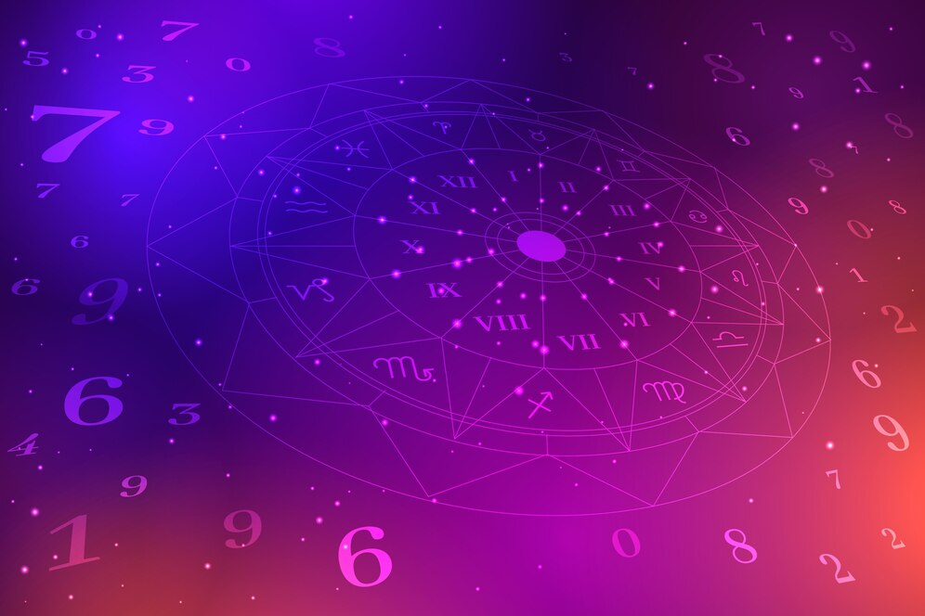
SUNSTONE
ASTROLOGY APPLICATION AND WEBSITE

Slide 2

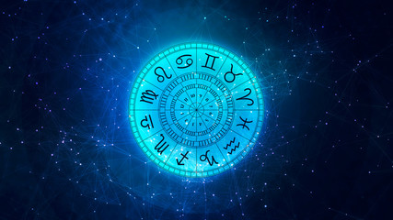
ASTROLOGY APPLICATION & WEBSITE
Introduction: General astrology studies the relationship of the significant celestial moments (e.g., the times of vernal equinoxes, eclipses, or planetary conjunctions) to social groups, nations, or all of humanity. It answers, by astrological means, questions formerly posed in Mesopotamia to the bāru.
LMS Username | Name | Batch
Ajitha Priyadharshini.P | Ajitha Priyadharshini.P | NM_15 CC3
Thorin Markarith.G | Thorin Markarith.G | NM_15 CC3
Charuhashini.R | Charuhashini.R | NM_15 CC3
Kaviya.P | Kaviya.P | NM_15 CC3
prathikasha.S | prathikasha.S | NM_15 CC3
Mahalakshmi.M | Mahalakshmi.M | NM_15 CC3

Slide 3

Task - 1
Creation of SRS & Github
Create SRS : “Your Project”
Creation & Set-up of Github account
Creation & Hands-on to various commands of Git Bash
Create SRS:”Astrology Application & Website”
Creation and setup of github account
Creation and hands-on to various commands of Git Bash
Evaluation Metric:
100% Completion of the above tasks
Learning Outcome
Get to know about different lifecycle models.
Understanding importance and how to create an SRS
Knowing various commands of Github
Understanding agile and scrum management techniques for efficient product development

Slide 4
Step-Wise Description
1. Plan & Design: Define your app and create the user interface.
2. Develop: Build the app, including authentication and messaging.
3. Test & Secure: Test for issues and ensure data security.
4. Deploy & Maintain: Launch the app and keep it updated.
5. Support & Grow: Assist users and promote app growth.
Summary of your task
The first step to getting to know your horoscope is to find out what your "big three" placements are - the sun, the moon and the ascendant.
These three planets describe different parts of you, and together they form a very truthful picture of your personality.

Slide 5
Assessment Parameter
Gather requirements for the project
add Readme.md file with description of the project
Prepare database design schemas
Check-List
Commit all changes with "first commit"
Get your initial project Structure ready
create a repository on github related to project
Initiate a git repository
Push your changes to github

Slide 6
Thanking you

