Slide 1


Business contract validation
Ajith kumar.S

Slide 2


Unique Idea Brief (Solution)
Lazy Loading with Caching Combining NER with User-Defined Labels Highlighting PDF with Custom Annotations Text Extraction from Multiple Formats

Slide 3

Features Offered
1
File Upload Support
5
Highlighting in PDF
2
Text Extraction
6
Summarization
Named Entity Recognition (NER)
Zero-Shot Text Classification
3
7
User-Defined Labels
Session State Management
4
8

Slide 4
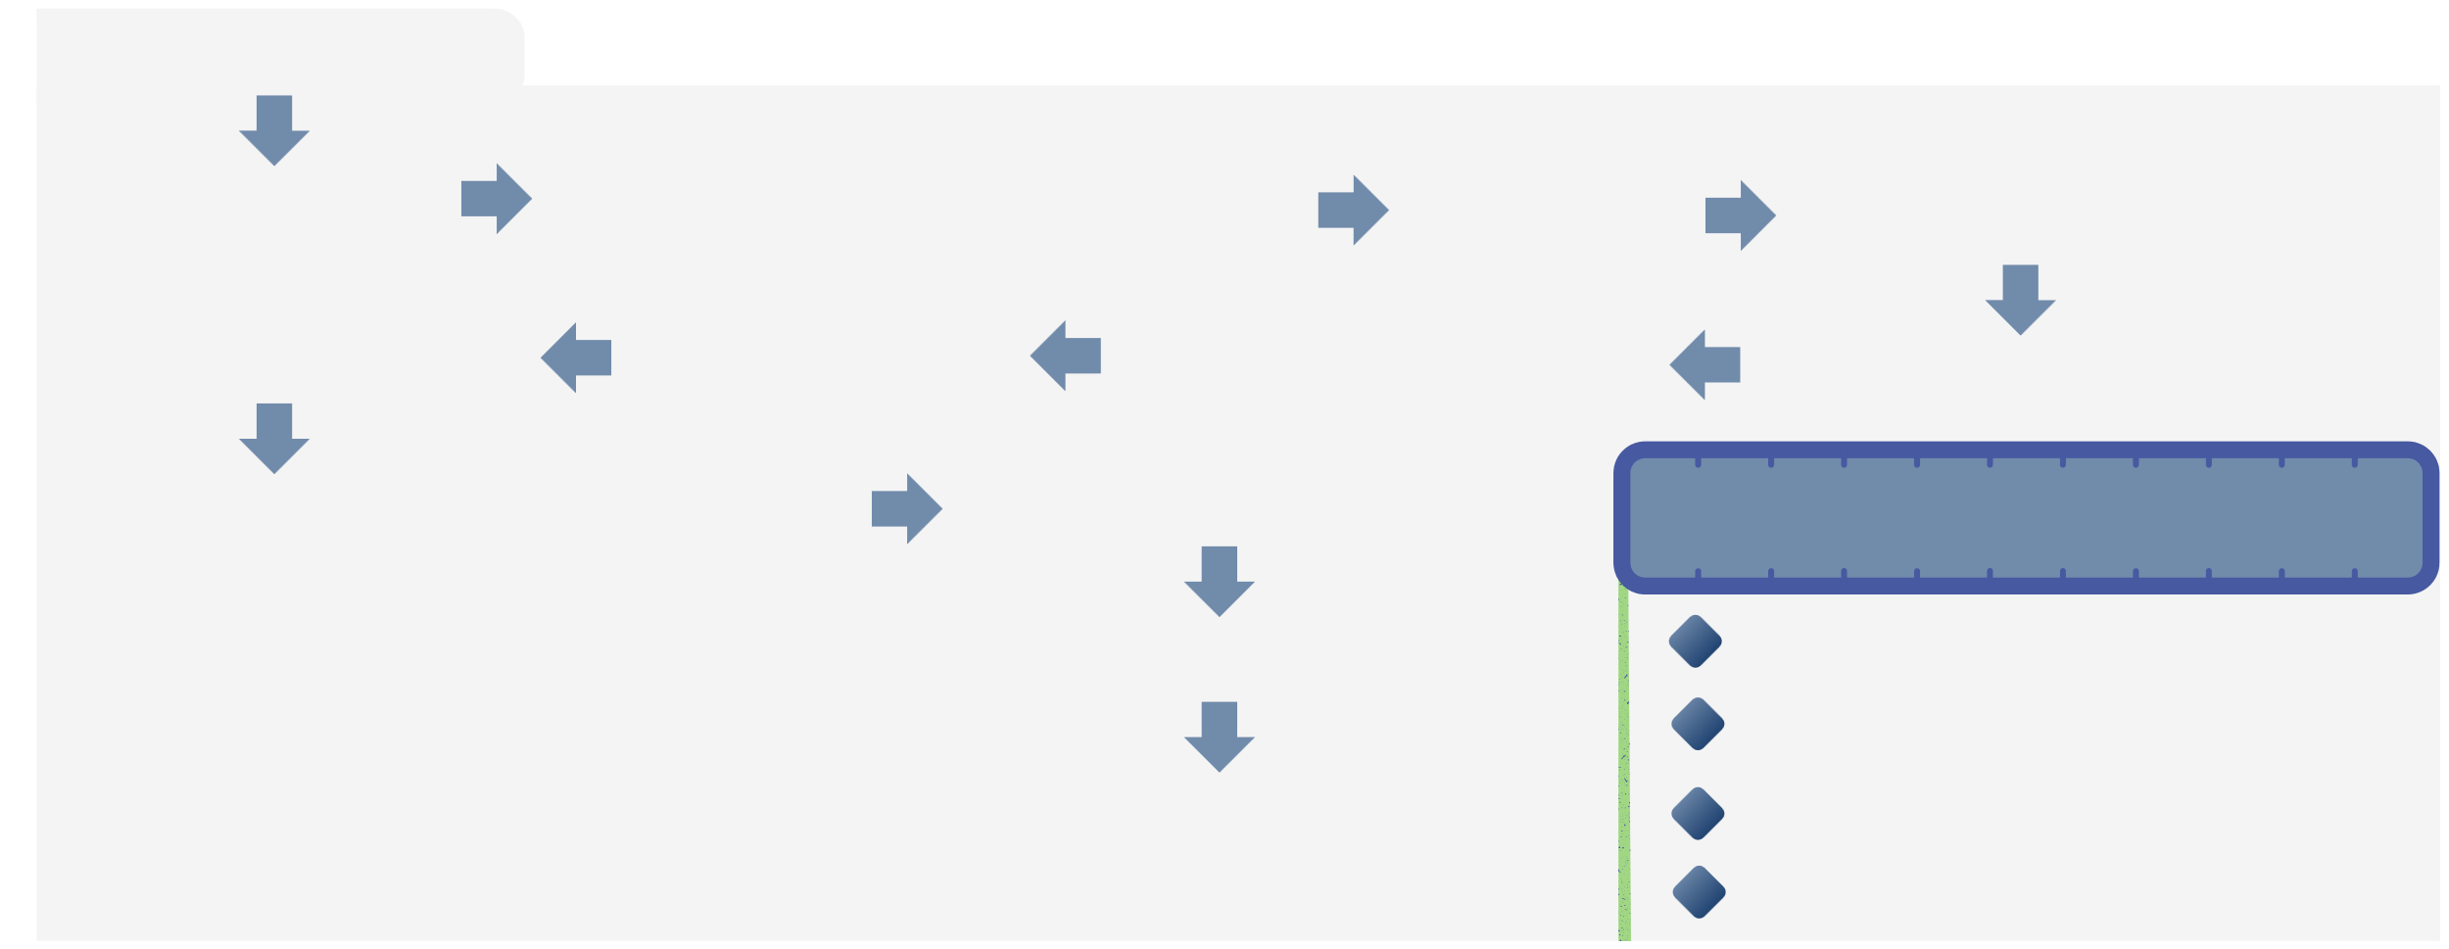
Process flow
START
Initialization
Loading Models and Pipelines
File Upload
Text Extraction
Analyze Button
User Input for Labels
PDF Highlighting
Displaying Extracted Text
Text Summarization
Named Entity Recognition (NER)
Displaying Results
Text Classification
Highlighted PDF Named Entities Summary
END
Classification Results

Slide 5







Architecture Diagram
Output Display
Classification
Highlighting
Pymupdf
(Text, Results, PDF)
(Hugging Face)
Upload Dir
File Processor
Summarization
(Temporary Storage)
(PDF/Text)
(Hugging Face)
File Uploader (PDF/Image)
Text Extractor
NER Module (spaCy)
(PyMuPDF,
Tesseract)
Streamlit App
user

Slide 6



Technologies used
Web Framework PDF Processing OCR Model NLP Models Data Encoding Text Processing
Filesystem Handling

Slide 7
Conclusion
Text Extraction: Handles both PDF and image files. Extracts text using PyMuPDF for PDFs and Pytesseract for images.
Text Analysis: Identifies named entities using Spacy. Summarizes the text with the Hugging Face Transformers library. Classifies text based on user-selected labels using zero-shot classification.
User Interface: Streamlit provides an easy-to-use web interface. Users can upload files, select predefined or custom labels, and view the results.
Highlighted Results:
Highlights entities and user-defined labels in the PDF. Displays extracted text, summaries, classifications, and the highlighted PDF on the web page.
Efficiency: Uses caching to improve performance and avoid redundant computations.

