Slide 1

PLAYWRIGHT
Master Class
Day 10
Playwright in CI/CD
GitHub Actions · pipelines · artifacts · sharding · parallelism

Slide 2
Today's Agenda
Five topics · take your tests off your laptop and into the pipeline
01
Playwright in CI Environments
15 min
Why CI matters · headless · containers · reporters
02
Clone the Repo from GitHub
10 min
Repo layout · branch strategy · checkout step
03
Add a GitHub Actions Workflow
25 min
.github/workflows/playwright.yml from scratch
04
Execute the E2E Pipeline
35 min
Triggers · matrix · artifacts · reading the report
Day 10 · Playwright Master Class
2

Slide 3

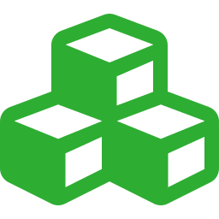



Why Run Playwright in CI?
Local runs prove your code works for YOU — CI proves it works for everyone.
Where tests fit in the lifecycle
Always headless
No display server — headless: true (or use xvfb if needed).
Commit
›
Push
›
CI runs
›
Merge
Use the official image
Block the merge if a test fails — bugs never reach main.
mcr.microsoft.com/playwright includes browsers + deps.
What CI gives you
Pin versions
• Clean environment, every run
• Same OS / browser everyone agrees on
• Tests run on every push & PR
• History & trend graphs over time
• Parallelism the laptop can't match
Same Playwright version locally and in CI — avoid drift.
Save the HTML report
Upload as an artifact so anyone can download & investigate.
Day 10 · Playwright Master Class
3

Slide 4

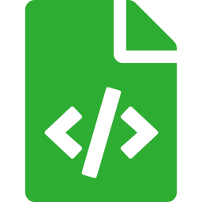
Set Up the Project Locally
From an empty folder to a green test run — six terminal commands.
In your terminal
Project scaffolded
package.json, playwright.config.ts, sample test, .gitignore — all created.
# 1) Create & open a project folder
mkdir my-playwright-tests
cd my-playwright-tests
# 2) Scaffold a Playwright project
npm init playwright@latest
# pick TypeScript · tests/ · GitHub Actions
# 3) Run the sample test
npx playwright test
# 4) Open the HTML report
npx playwright show-report
# 5) Write your own test under tests/
code tests/my-feature.spec.ts
Browsers installed
Chromium, Firefox, WebKit downloaded into the Playwright cache.
GitHub Actions ready
If you said 'yes', .github/workflows/playwright.yml is already there.
Verify with a test run
If 'npx playwright test' passes locally, you're ready to push to GitHub.
Day 10 · Playwright Master Class
4

Slide 5



Push Your Project to GitHub
Get the code off your laptop and onto github.com — three terminal steps + one click.
Initialize, commit, push
1. Create the repo on github.com
Click 'New' → name it → keep it empty (no README) so the push isn't rejected.
# 1) First, create an EMPTY repo on github.com
# (no README, no .gitignore — keep it empty)
# 2) Initialize git in your project
git init
git add .
git commit -m "initial commit"
# 3) Connect to GitHub & push
git branch -M main
git remote add origin \
https://github.com/<you>/<repo>.git
git push -u origin main
2. Authenticate
First push prompts for credentials — use a Personal Access Token or SSH key.
3. 'git push' uploads everything
Your tests, config, and the workflow YAML all land in the repo.
4. Watch Actions kick in
GitHub detects .github/workflows/ and runs your pipeline automatically.
Day 10 · Playwright Master Class
5

Slide 6
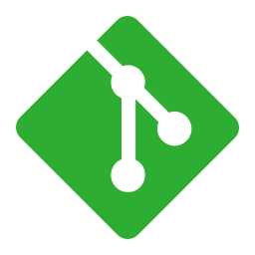
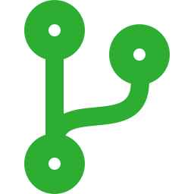

Clone the Repository from GitHub
Get your project on disk — locally for dev, automatically for CI.
Locally — manual clone
git clone is just step 1
Always follow with npm ci + browser install before tests can run.
# 1) Clone using HTTPS
git clone \
https://github.com/acme/playwright-tests.git
# 2) Move into the directory
cd playwright-tests
# 3) Install dependencies
npm ci
# 4) Install browsers (one-time)
npx playwright install --with-deps
# 5) Run the suite
npx playwright test
Branch per feature
Work on a feature branch; CI builds it and you merge via PR.
Use SSH or HTTPS+token
Personal access tokens for HTTPS; deploy keys for CI access.
CI does the clone for you
GitHub Actions has actions/checkout — no commands needed in YAML.
Day 10 · Playwright Master Class
6

Slide 7
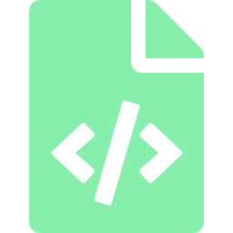


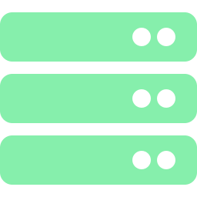


What is GitHub Actions?
Free CI built into every GitHub repo — describe the pipeline in a YAML file.
Workflow
Trigger (on:)
Job
A YAML file under .github/workflows/ that defines what to run.
What starts the workflow — push, pull_request, schedule, manual.
A set of steps that runs on a runner. Jobs can run in parallel.
playwright.yml
on: [push, pull_request]
jobs: test:
Runner
Step
Action
The VM/container the job runs on — ubuntu-latest is the default.
A command or reusable action. Steps run in order inside a job.
A reusable building block from the marketplace.
runs-on: ubuntu-latest
- run: npm ci
uses: actions/checkout@v4
Day 10 · Playwright Master Class
7

Slide 8
A Minimal Playwright Workflow
Drop this file in .github/workflows/ — tests run on every push & PR.
.github/workflows/playwright.yml
name: Playwright Tests
on:
push: { branches: [main] }
pull_request: { branches: [main] }
jobs:
test:
runs-on: ubuntu-latest
timeout-minutes: 30
steps:
- uses: actions/checkout@v4
- uses: actions/setup-node@v4
with: { node-version: 20 }
- run: npm ci
- run: npx playwright install --with-deps
- run: npx playwright test
- if: always()
uses: actions/upload-artifact@v4
with:
name: playwright-report
path: playwright-report/
Day 10 · Playwright Master Class
8

Slide 9
Workflow Walkthrough — Step by Step
What each block does, and why it's there.
1
on: push / pull_request
Triggers — run for every push to main and every PR targeting main.
2
runs-on: ubuntu-latest
Use GitHub's hosted Linux runner — fastest, cheapest, and works out of the box.
3
actions/checkout@v4
Clones the repo into the runner — without this, the next steps have nothing to run.
4
actions/setup-node@v4
Installs the Node version your project expects — keep it pinned.
5
npm ci + playwright install --with-deps
Lockfile-based install, then download browsers AND the Linux system libraries they need.
6
upload-artifact (if: always())
Save the HTML report even on failure — that's exactly when you need it most.
Day 10 · Playwright Master Class
9

Slide 10
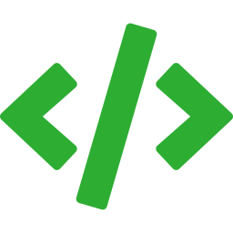
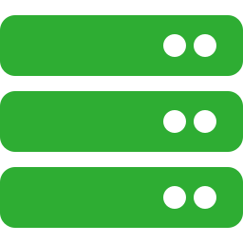




Executing the E2E Pipeline
From pushing code to reading the report — the full feedback loop.
›
›
›
›
1. Push
2. Trigger
3. Provision
4. Run tests
5. Artifacts
git push
Actions starts
Runner spins up
playwright test
Report uploaded
In the GitHub Actions UI you'll see…
Green check on the PR — merge unblocked
Red X with a link to the failed job logs
Per-step timing — find slow steps
Download report from the run's Artifacts section
Day 10 · Playwright Master Class
10

Slide 11
Triggers & Browser Matrix
Run on more events; run against more browsers in parallel.
Common triggers
Run on 3 browsers in parallel
on:
push:
branches: [main, develop]
pull_request:
branches: [main]
schedule:
# Nightly at 02:00 UTC
- cron: '0 2 * * *'
workflow_dispatch:
# Manual trigger from UI
jobs:
test:
strategy:
fail-fast: false
matrix:
browser: [chromium, firefox, webkit]
runs-on: ubuntu-latest
steps:
- run: |
npx playwright test \
--project=${{ matrix.browser }}
fail-fast: false
Keeps all matrix jobs running even if one fails — see which browsers are broken, not just the first.
Day 10 · Playwright Master Class
11

Slide 12

Secrets & Environment Variables
Never commit credentials — inject them as encrypted secrets at runtime.
playwright.yml
secrets vs vars
Use secrets for passwords / tokens, vars for non-sensitive config.
- run: npx playwright test
env:
BASE_URL: ${{ vars.BASE_URL }}
QA_USER: ${{ secrets.QA_USER }}
QA_PASSWORD: ${{ secrets.QA_PASSWORD }}
CI: true
Masked in logs
Secret values are auto-redacted from the workflow logs.
Per-environment values
Add them once in Settings → Secrets and variables → Actions.
Define environments (staging, prod) — each gets its own secrets.
Reference in code as process.env.QA_USER.
Never echo secrets
Don't log them; don't pass them as command-line args (visible in ps).
Day 10 · Playwright Master Class
12

Slide 13
CI/CD — Best Practices
1
Use npm ci, not npm install
Lockfile-strict and faster — guarantees the same dependency tree as locally.
2
Cache node_modules & browsers
actions/cache shaves minutes off every run — Playwright binaries are big.
3
retries: process.env.CI ? 2 : 0
Insurance against flakes in CI; instant truth on your laptop.
4
Always upload the HTML report
if: always() ensures it's saved on failure — that's the only time you really need it.
5
Shard, don't increase workers
Workers parallelise within a runner; sharding spreads across runners. Both help.
Day 10 · Playwright Master Class
15

Slide 14

✓
Day 10 — Recap
CI runs Playwright in a clean environment — same OS, same browsers, every time
Clone: git clone → npm ci → npx playwright install --with-deps → npx playwright test
Workflow lives in .github/workflows/playwright.yml — pipeline as code
Building blocks: on (trigger) · jobs · runs-on (runner) · steps · uses (actions)
Always upload the HTML report as an artifact — if: always() catches failures too
Browser matrix: strategy.matrix.browser runs chromium / firefox / webkit in parallel
Best practices: npm ci · cache · retries in CI only · upload reports · shard for scale
Master class complete
Ten days. You can now build, debug, scale and ship a real Playwright suite.
Day 10 · Playwright Master Class
16

Slide 15
Thank you!
10 days · a complete Playwright foundation
Now go ship the pipeline.
playwright.dev/docs/ci · docs.github.com/actions

