Slide 1
Bird Species Observation Analysis

Slide 2
Problem Statement:
This project aims to analyze the distribution and diversity of bird species in two distinct ecosystems: Forests and Grasslands.
By examining bird species observations across these habitats, the goal is to understand how environmental factors, such as vegetation type, climate, and terrain, influence bird populations and their behavior.
The study will involve working on the provided observational data of bird species present in both ecosystems, identifying patterns of habitat preference, and assessing the impact of these habitats on bird diversity.
The findings can provide valuable insights into habitat conservation, biodiversity management, and the effects of environmental changes on avian communities.

Slide 3
Exploratory Data Analysis (EDA)
The types of EDA performed below:-
Temporal Analysis
Spatial Analysis
Species Analysis
Environmental Conditions
Distance and Behaviour
Observer Trends
Conservation Insights

Slide 4
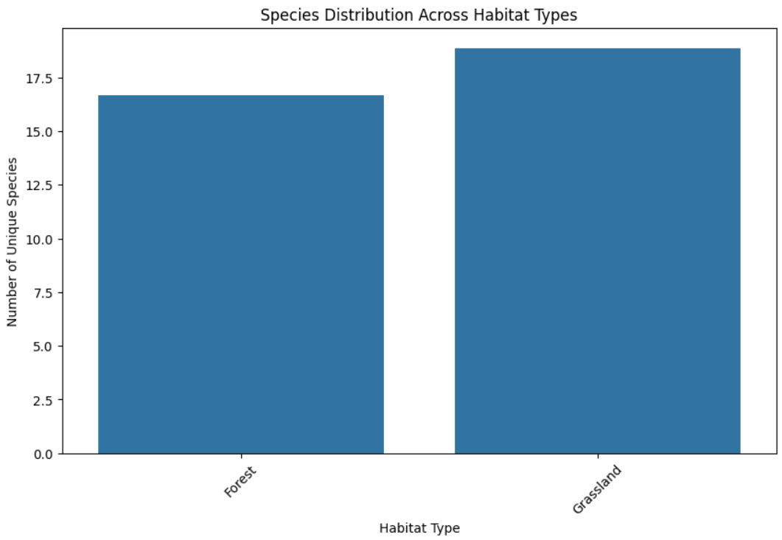
Distribution of Species Across Administrative Units and Habitat Types & Count species per administrative unit and habitat type
Species Distribution:
The Grassland habitat has the highest number of bird observations (3588 records).
Forest areas have fewer observations (333 records).

Slide 5
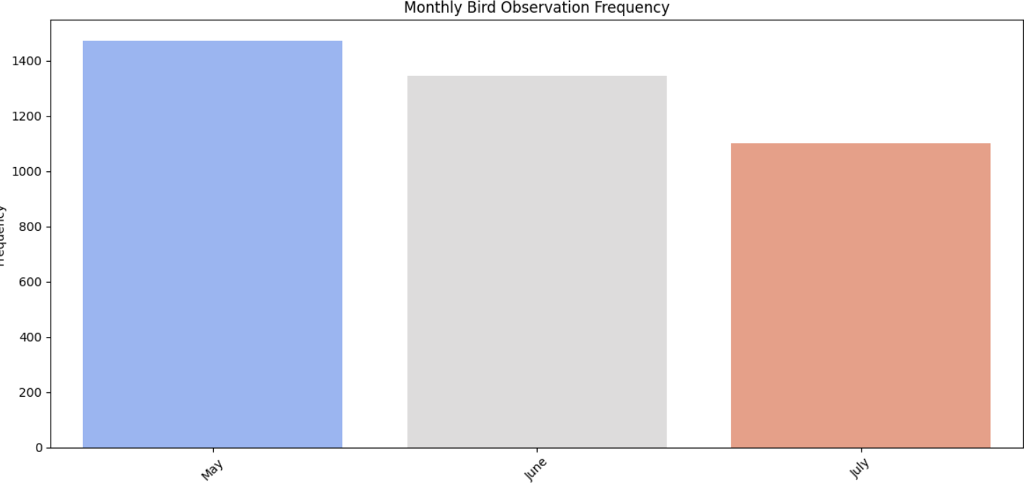
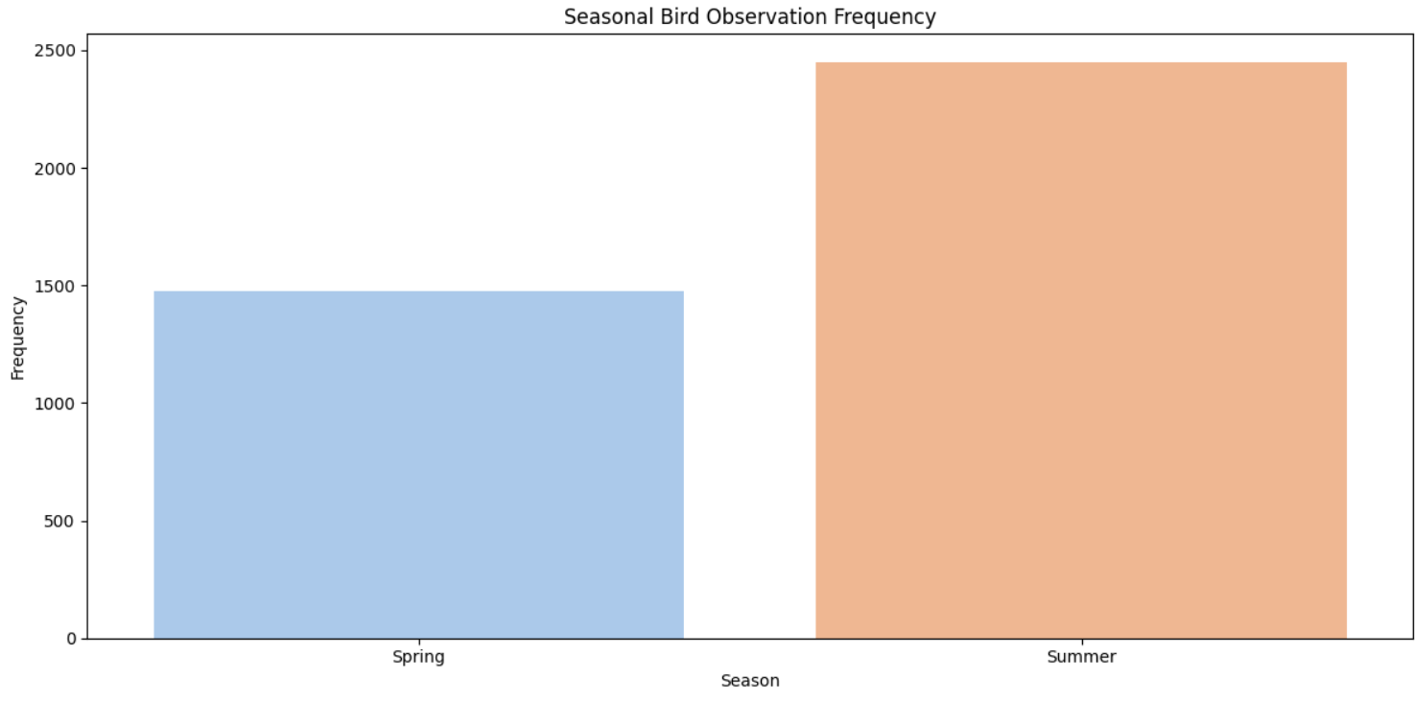
Distribution of Species Across Administrative Units and Habitat Types & Count species per administrative unit and habitat type
Observation Frequency:
All observations were recorded in 2018..
The highest number of observations occurred in May (1,474), followed by June (1,347) and July (1,100).Seasonally, Summer had the most observations (2,447 records), followed by Spring (1,474 records).

Slide 6
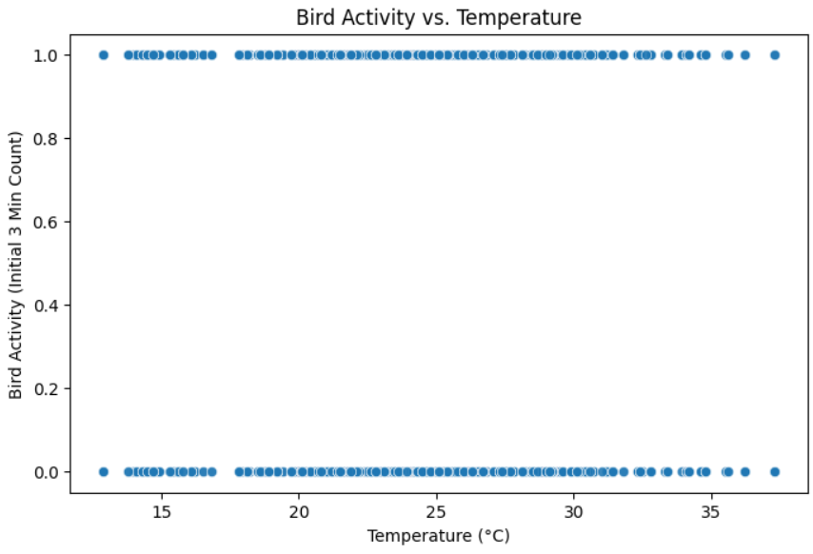
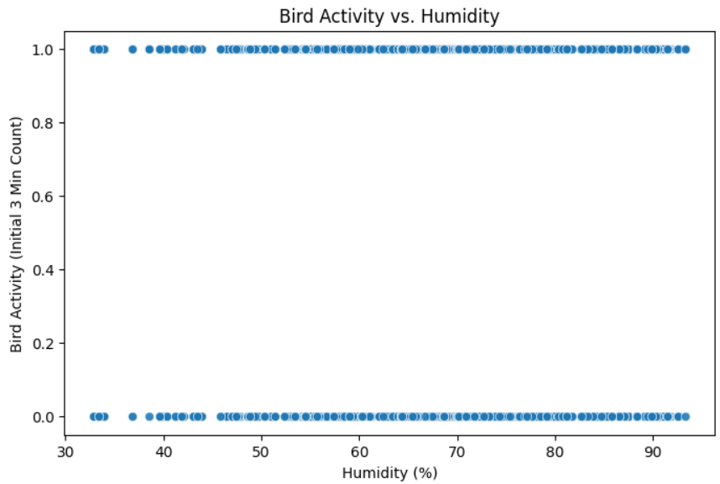
Environmental Conditions & Bird Activity:
There is a negative correlation between temperature and humidity (-0.72), meaning higher temperatures are associated with lower humidity.
This suggests that bird observations could be influenced by seasonal weather patterns.
Therefore, bird activity decreases when the temperature is high and increases when the humidity is high.

Slide 7
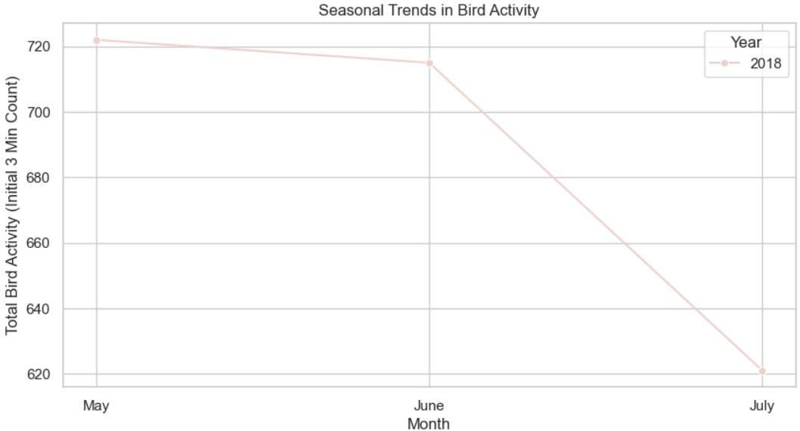
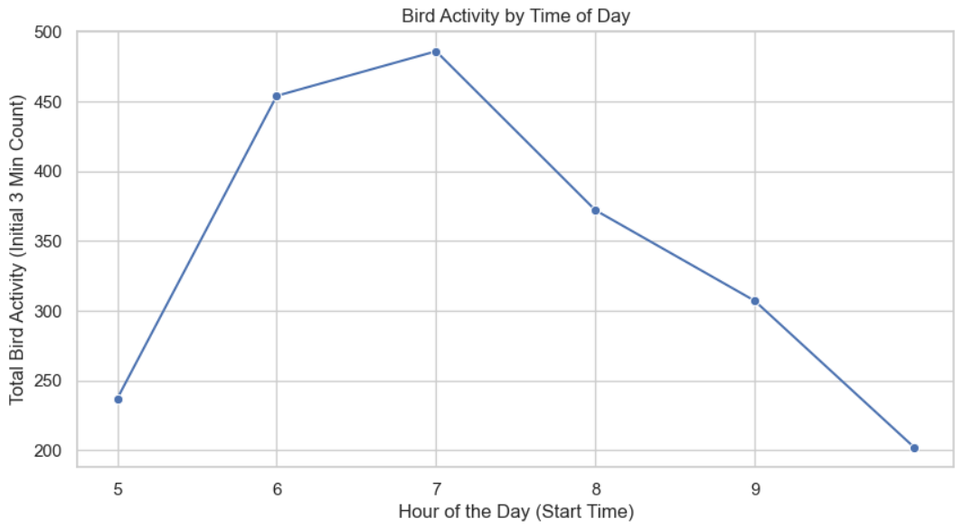
Temporal Analysis
Seasonal Trends:
Spring (1,474 observations) and Summer (2,447 observations) had the highest bird sightings in 2018.This suggests increased bird activity during warmer months, possibly linked to breeding or migration patterns.
Observation Time Analysis:
Bird observations peaked between 6 AM to 8 AM (868 at 6 AM, 902 at 7 AM, 719 at 8 AM).After 9 AM, sightings gradually declined. This indicates that early morning is the most active period for bird activity.

Slide 8
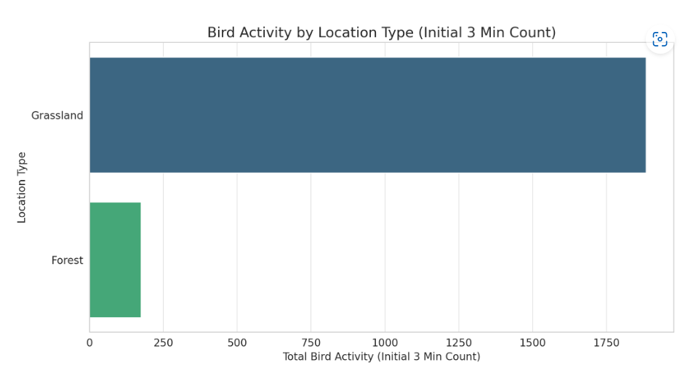
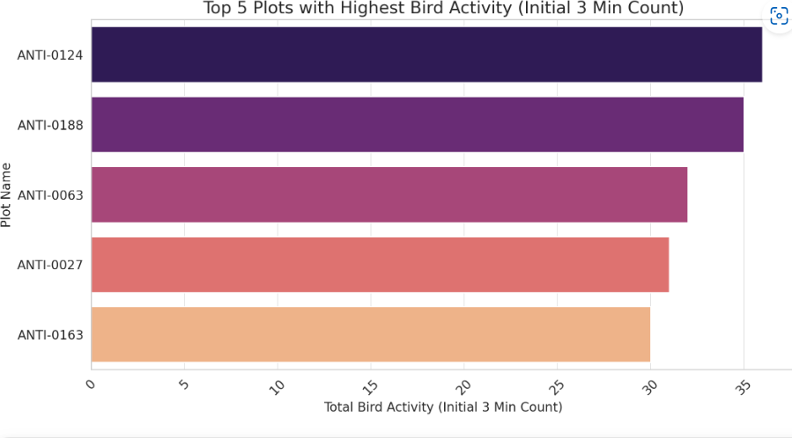
Spatial Analysis
Biodiversity Hotspots (Location Insights using Bird Activity Count):
Grasslands have the highest bird activity (1,884 total observations in the first 3 minutes).Forests have significantly lower bird activity (174 total observations), suggesting fewer species or lower detection rates.
Plot-Level Analysis:
ANTI-0124 has the highest bird activity (36 birds recorded in the first 3 minutes).Other high-activity plots include ANTI-0188 (35 birds), ANTI-0063 (32 birds), and ANTI-0027 (31 birds).

Slide 9
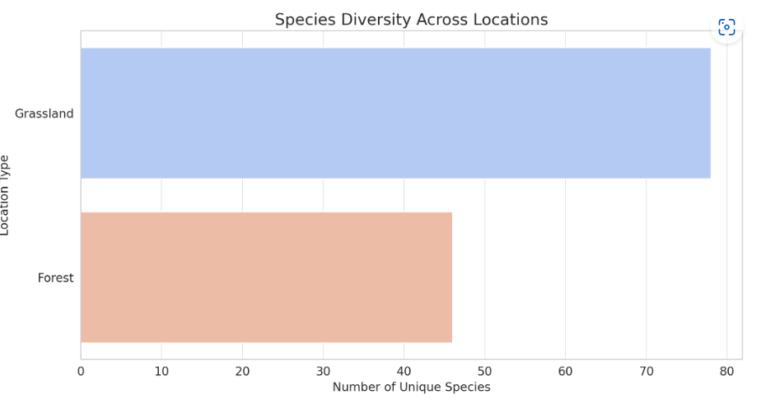
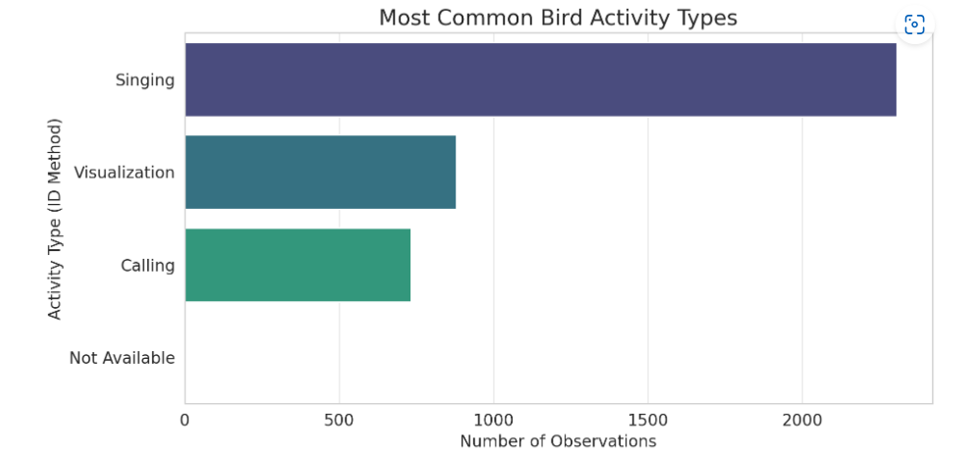
Species Analysis
Diversity Metrics:
A total of 81 unique bird species were observed. Grasslands (78 species) have the highest species diversity, while Forests (46 species) support fewer species.
Activity Patterns:
The most common bird activity is Singing (2,306 observations), followed by Visualization (880 observations) and Calling (734 observations).

Slide 10
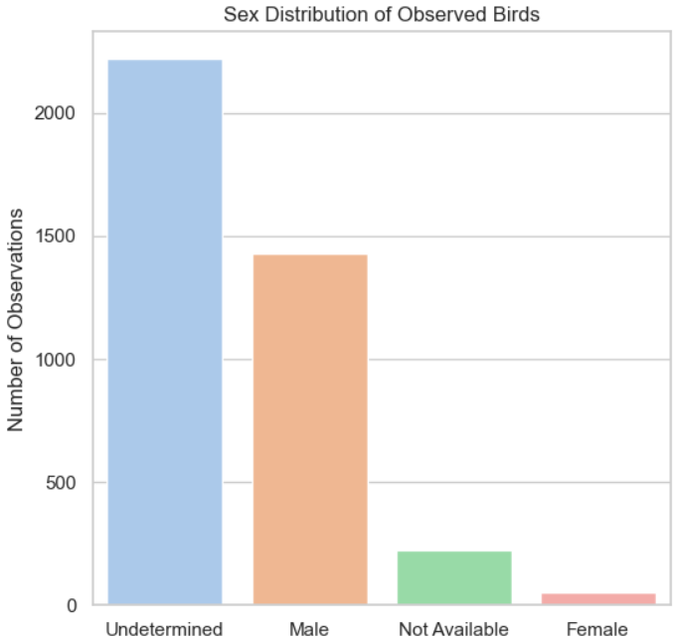
Sex Ratio Analysis:
Undetermined birds (64.5%) form the majority, indicating difficulty in identifying sex.
Males (41.6%) are significantly more observed than Females (1.5%).

Slide 11
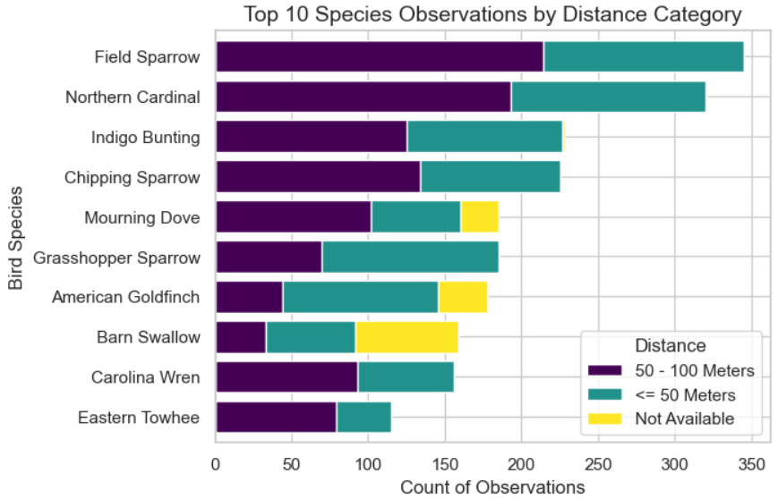
Species Analysis
Species-wise Distance Analysis:-
The top 10 most observed species exhibit varying distribution patterns across different distance categories.
Some species show a preference for closer distances, while others are more commonly spotted at a greater range.
This suggests species-specific behavior regarding how they interact with their environment and the observer.

Slide 12
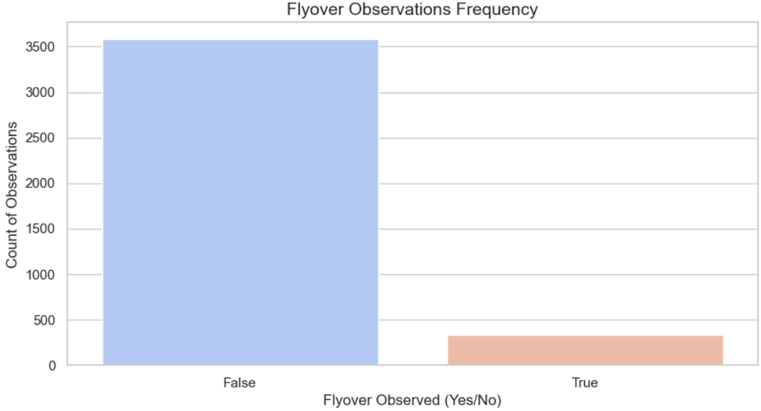
Flyover frequency Analysis:-
The Flyover Observations Frequency plot gives a quick view of how often flyovers are recorded.
A higher count of “Yes” observations likely indicates that certain monitoring locations intersect with flyways or open areas where birds are more likely to be seen flying overhead.

Slide 13
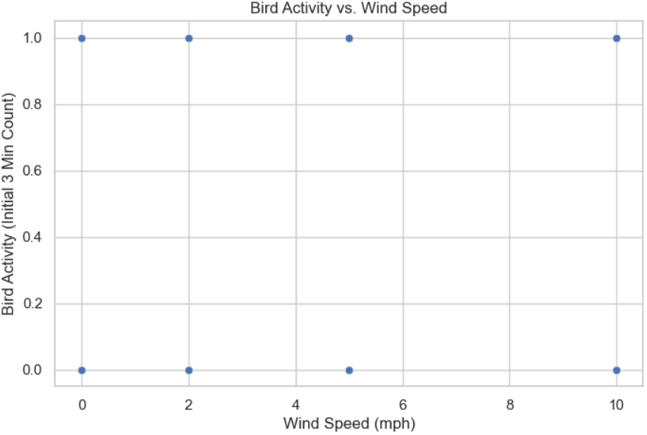
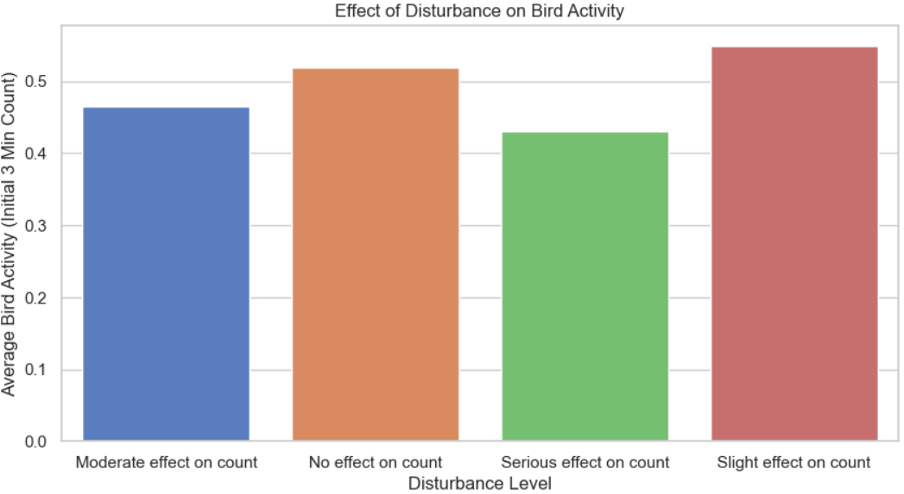
Environmental Conditions
Environmental Conditions Analysis
Weather Correlation:
Bird activity varies with temperature, humidity, and wind speed. Scatter plots show potential patterns between weather conditions and bird sightings.
Temperature vs. Bird Activity:
A moderate correlation is observed where bird activity increases at optimal temperatures but declines in extreme conditions.
Humidity vs. Bird Activity:
Higher humidity levels may slightly reduce bird activity, indicating potential discomfort or reduced visibility.
Wind Speed vs. Bird Activity:
Light to moderate breezes seem to support bird movement, while strong winds may deter activity.
Disturbance Effect:
The analysis of disturbance levels shows that higher disturbances generally reduce bird sightings.Bar plots highlight how different disturbance levels impact bird activity on average.

Slide 14
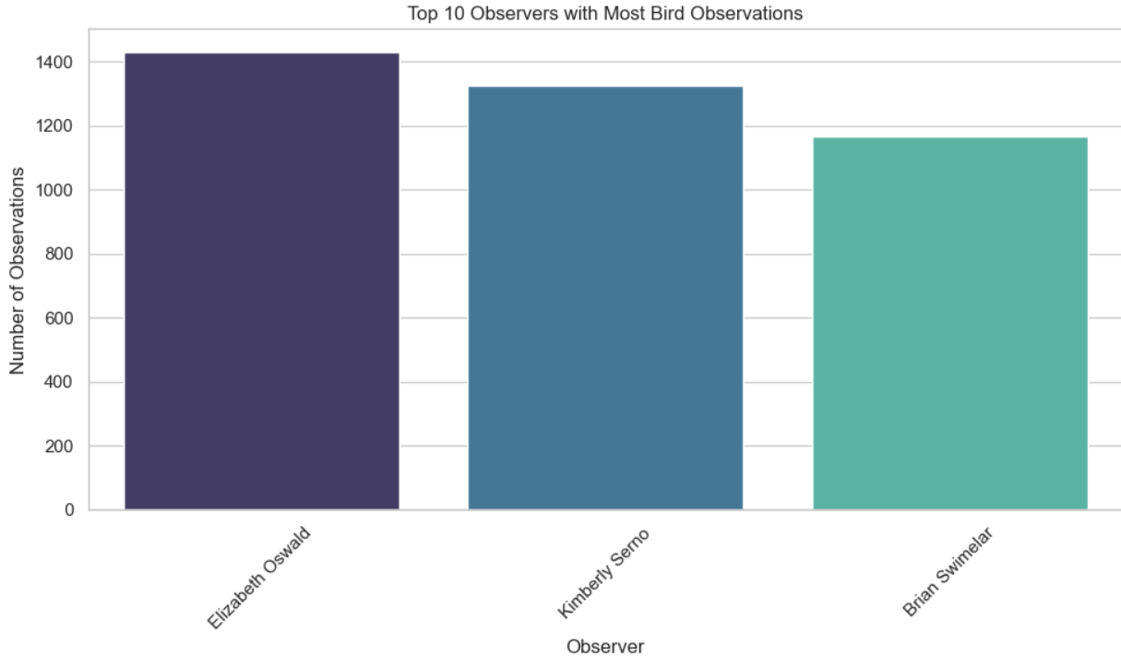
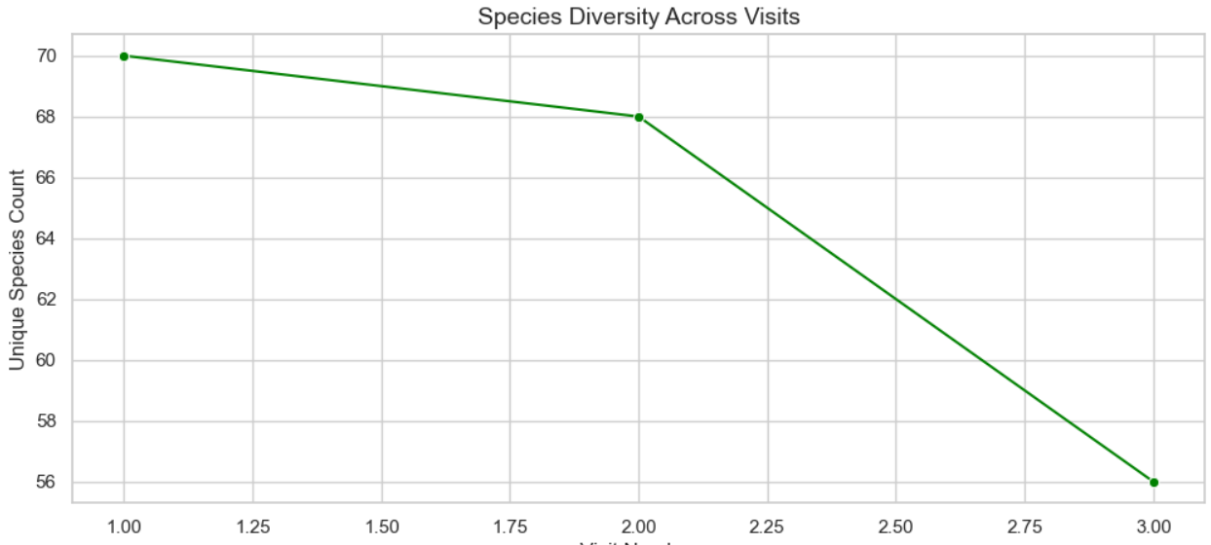
Observer Trends
Observer Bias:
Certain observers report significantly more bird observations than others, suggesting possible observer bias.
This could be due to varying levels of experience, observation effort, or frequency of visits.
The top 10 observers contribute a large proportion of the total data, which might influence species reporting trends.
Visit Patterns:
Species diversity fluctuates across visits, with some visits reporting a higher number of unique species.
This variation may be influenced by seasonal changes, environmental conditions, or differences in observation duration and effort.
A consistent number of species across visits could indicate stable bird populations, while fluctuations might suggest migration patterns or habitat changes.

Slide 15
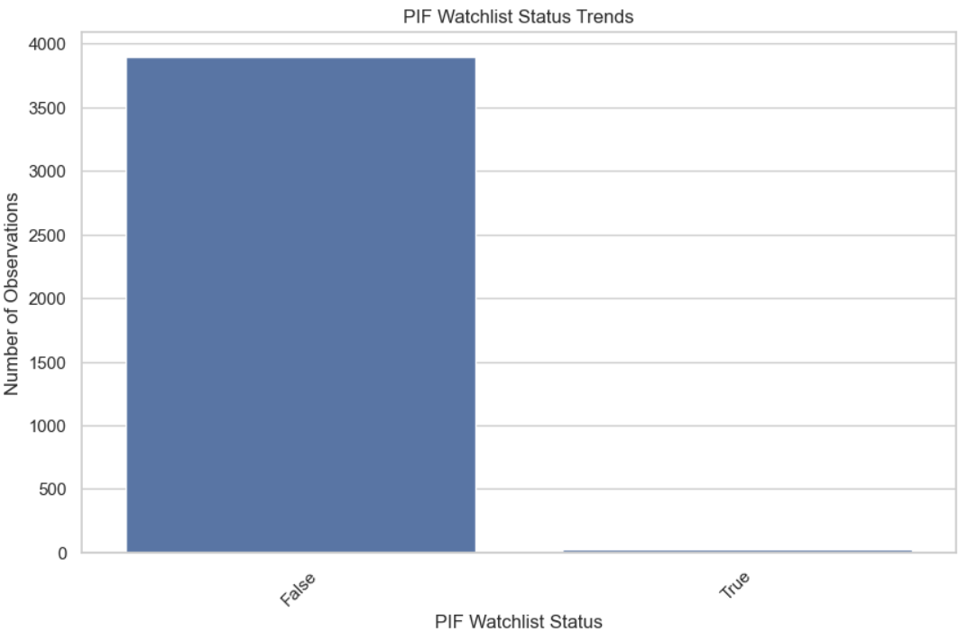
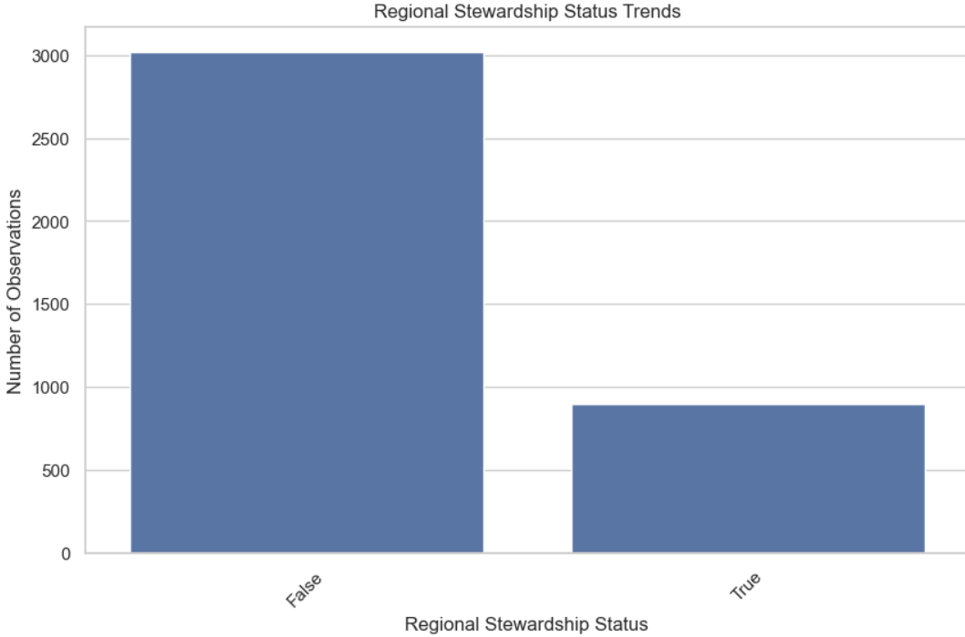
Conservation Insights
Watchlist Trends (PIF_Watchlist_Status)
The PIF Watchlist Status distribution shows which species are flagged as conservation concerns.
Certain at-risk categories have a higher frequency, indicating the need for habitat protection and conservation efforts.
This helps prioritize species that require urgent monitoring and intervention.
Regional Stewardship Status Trends
The Regional Stewardship Status highlights species that play a key role in local ecosystems.
Trends show which species are regionally significant, guiding conservation programs at a localized level.
Identifying stewardship trends ensures a more focused approach to species protection.

Slide 16
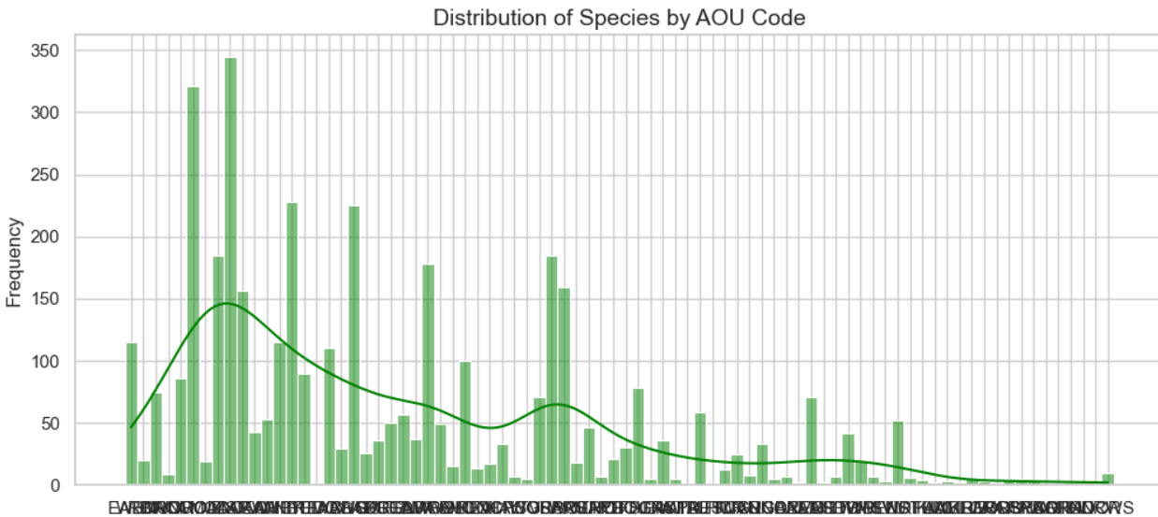
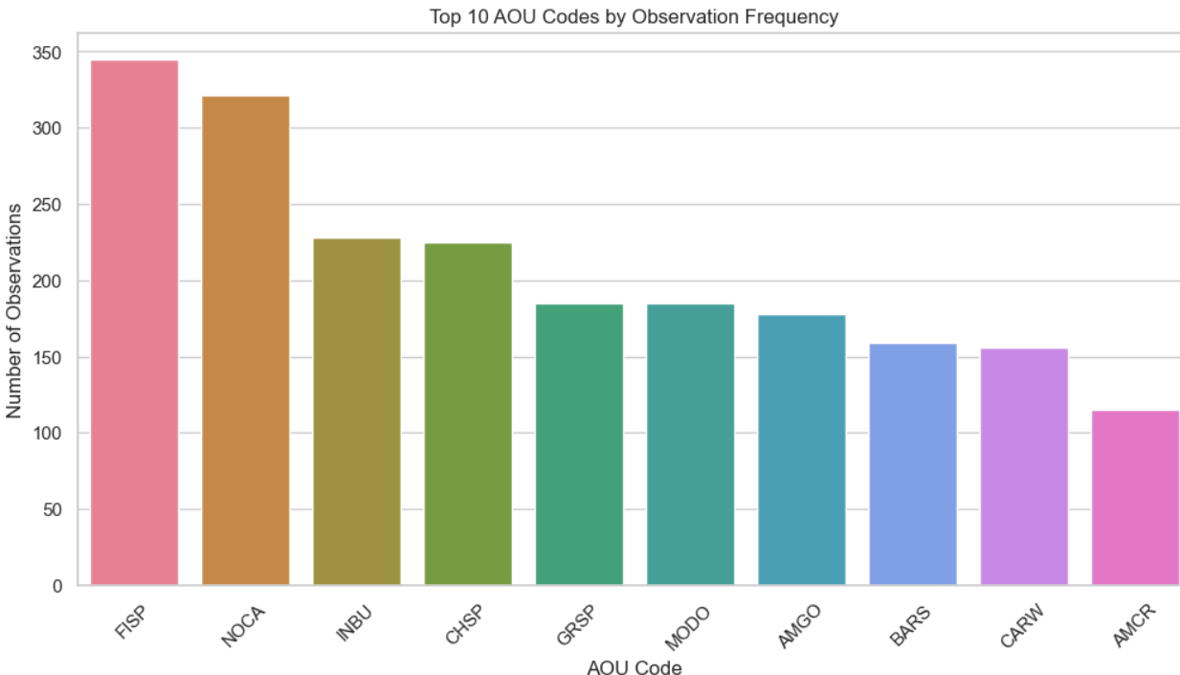
AOU Code Patterns
The AOU Code distribution reveals the diversity of observed species, with some codes appearing significantly more frequently.
High observation frequency of certain AOU codes suggests either common species or those under specific monitoring programs.
The top 10 most frequently recorded species provide insight into which birds dominate the observation dataset.

