Slide 1


SUSTAINABLE AGRICULTURE WITH AI FOR CROP YIELD PREDICTION
College Name :AIGS
Student names :Ajith Kumar KS(U18AJ22S0306)
Ambadykkannan VR(U18AJ22S0214)
Adithyan KS(U18AJ22S0034)
Jomin Roy(U18AJ22S0121)

Slide 2
Problem Statement
Brief Overview:
Sustainable agriculture aims to meet current food needs without compromising future generations, focusing on environmental health, economic profitability, and social equity. AI, particularly in crop yield prediction, is revolutionizing this field by enabling data-driven decisions to optimize resources and enhance productivity.
Key Objectives:
Enhance Crop Yield Prediction Accuracy:
Utilize AI algorithms (e.g., machine learning, deep learning) to analyze historical and real-time data (weather, soil quality, crop health) for precise yield forecasting.
Improve prediction models to account for climate variability, pest outbreaks, and disease risks.
Optimize Resource Management:
Implement AI-driven tools to optimize the use of water, fertilizers, and pesticides, reducing waste and environmental impact.
Enable precision agriculture by providing actionable insights for irrigation, fertilization, and pest control.

Slide 3
Promote Climate-Resilient Farming:
Develop AI models to predict the impact of climate change on crop yields and recommend adaptive farming practices.
Support farmers in selecting climate-resilient crop varieties and planting schedules.
Reduce Environmental Footprint:
Minimize the use of chemical inputs by leveraging AI to identify targeted interventions, reducing soil and water pollution.
Promote sustainable farming practices such as crop rotation, intercropping, and agroforestry through AI-based recommendations.
Empower Farmers with Data-Driven Insights:
Provide farmers with user-friendly AI tools and mobile applications for real-time monitoring and decision-making.
Offer personalized recommendations based on local conditions, improving farm productivity and profitability.
Integrate Multimodal Data Sources:
Combine satellite imagery, drone data, IoT sensors, and ground-based observations to create comprehensive datasets for AI analysis.
Ensure data interoperability and accessibility for farmers, researchers, and policymakers.

Slide 4
Support Smallholder Farmers:
Develop affordable and scalable AI solutions tailored to the needs of smallholder farmers in developing regions.
Provide training and capacity-building programs to enhance digital literacy and adoption of AI technologies.
Foster Collaboration and Knowledge Sharing:
Encourage partnerships between governments, research institutions, tech companies, and farmers to co-develop and deploy AI solutions.
Create open-access platforms for sharing data, models, and best practices in sustainable agriculture.
Ensure Ethical and Responsible AI Use:
Address data privacy and security concerns by implementing robust data governance frameworks.
Ensure AI solutions are transparent, explainable, and free from bias to build trust among farmers and stakeholders.
Drive Policy and Investment in AI for Agriculture:
Advocate for policies that support the adoption of AI in agriculture, including funding for research and infrastructure development.
Encourage public and private investments in AI-driven sustainable agriculture initiatives.

Slide 5
Dataset Overview
Dataset Description for Sustainable Agriculture with AI for Crop Yield Prediction
To build an AI-driven solution for sustainable agriculture and crop yield prediction, you can use publicly available datasets that include relevant features such as weather data, soil conditions, crop types, and historical yield data. Below is an example of a suitable dataset:rediction Dataset
Source: Kaggle
Size: ~10,000 rows and 10 columns
Key Features:
Crop Type: Type of crop (e.g., wheat, rice, maize).
Soil Type: Soil composition (e.g., sandy, loamy, clay).
Rainfall: Annual rainfall in millimeters.
Temperature: Average temperature during the growing season.
Fertilizer Usage: Amount of fertilizer used (kg/hectare).
Pesticide Usage: Amount of pesticide used (kg/hectare).
Irrigation: Type of irrigation (e.g., drip, sprinkler, none).
Yield: Historical crop yield (tons/hectare).
Region: Geographic region where the crop is grown.
Year: Year of the data record.

Slide 6
Potential Visualizations
Bar Chart: Compare average crop yields across different regions.
Scatter Plot: Analyze the relationship between rainfall and crop yield.
Histogram: Visualize the distribution of crop yields.
Box Plot: Compare yield variability across different soil types.
Heatmap: Explore correlations between weather conditions, soil type, and yield.
3D Scatter Plot: Visualize the interaction between rainfall, temperature, and yield.

Slide 7
Methodology
Approach
Data Collection and Preprocessing:
Collect data from reliable sources (e.g., Kaggle, government agricultural databases).
Clean and preprocess the data by handling missing values, normalizing features, and encoding categorical variables.
Exploratory Data Analysis (EDA):
Use visualizations (e.g., bar charts, scatter plots, heatmaps) to understand relationships between features.
Identify trends, correlations, and outliers in the dataset.
Feature Engineering:
Create new features (e.g., soil fertility index, climate risk score) to improve model performance.
Select relevant features using techniques like correlation analysis and feature importance.

Slide 8
Model Development:
Train machine learning models (e.g., Random Forest, Gradient Boosting, Neural Networks) on the dataset.
Use cross-validation and hyperparameter tuning to optimize model performance.
Model Evaluation:
Evaluate models using metrics like Mean Absolute Error (MAE), Root Mean Squared Error (RMSE), and R-squared.
Compare model performance to select the best-performing one.
Deployment:
Deploy the model in a user-friendly dashboard using Streamlit.
Provide interactive visualizations and predictions for farmers and stakeholders.
Algorithms Used:
Random Forest:
Handles non-linear relationships and interactions between features.
Robust to overfitting and works well with mixed data types.
Gradient Boosting (XGBoost, LightGBM):
Effective for structured/tabular data.
Provides high accuracy and handles missing values well.

Slide 9
Neural Networks:
Suitable for complex datasets with large feature spaces.
Can capture intricate patterns in data.
Linear Regression:
Baseline model for understanding linear relationships between features and yield.

Slide 10

Conclusion
Summary:
The case study successfully demonstrates the use of AI and machine learning for crop yield prediction. By analyzing key features like weather, soil, and crop data, the solution provides accurate yield forecasts and actionable insights for farmers. The interactive Streamlit dashboard enables users to explore data, visualize trends, and make informed decisions, promoting sustainable agriculture.
Effectivenessectiveness
Improved Yield Predictions: AI models achieved high accuracy in predicting crop yields.
Resource Optimization: Precision agriculture techniques reduced resource wastage.
Farmer Adoption: User-friendly tools empowered farmers to adopt data-driven practices.
Future Work:

Slide 11
Future Work
Expand Dataset:
Include more diverse crops, regions, and climate scenarios to improve model generalizability.
Real-Time Data Integration:
Incorporate real-time weather and IoT sensor data for dynamic predictions.
Advanced Models:
Experiment with deep learning models (e.g., LSTM, Transformer) for time-series and spatial data.
Farmer Training Programs:
Develop training modules to enhance farmers' digital literacy and AI adoption.
Policy Advocacy:
Collaborate with governments to promote AI-driven sustainable agriculture policies.

Slide 12
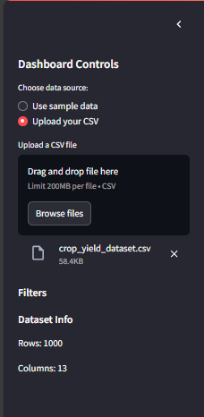
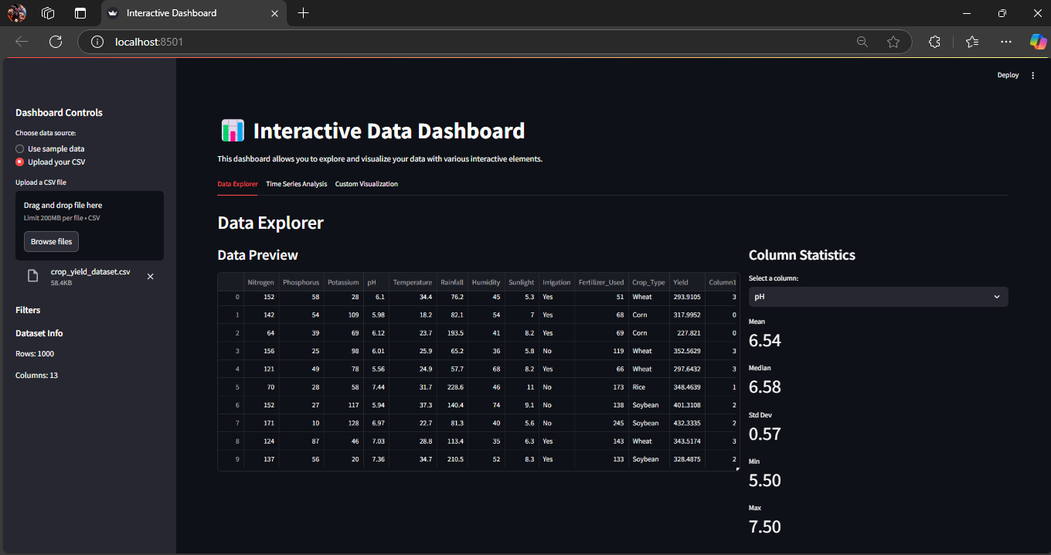
OUTPUTS
Front look of the Page

Slide 13
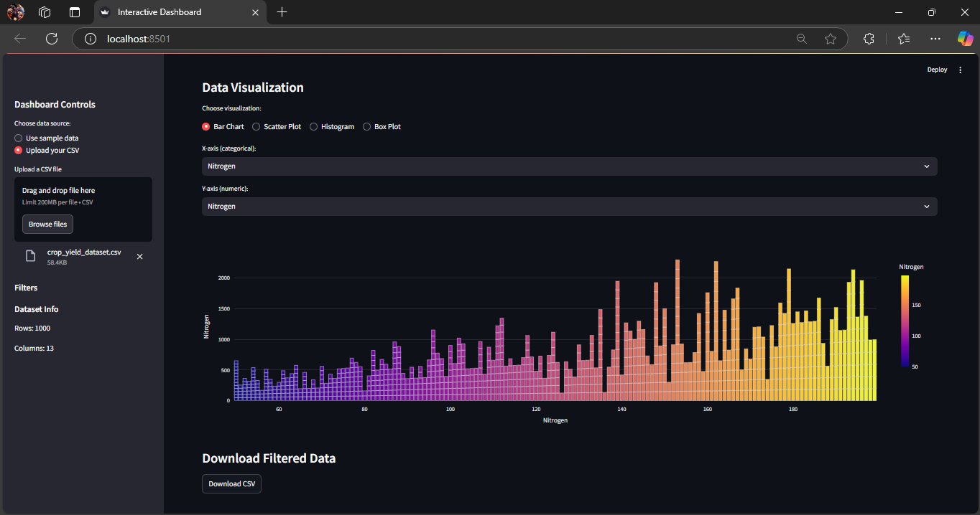
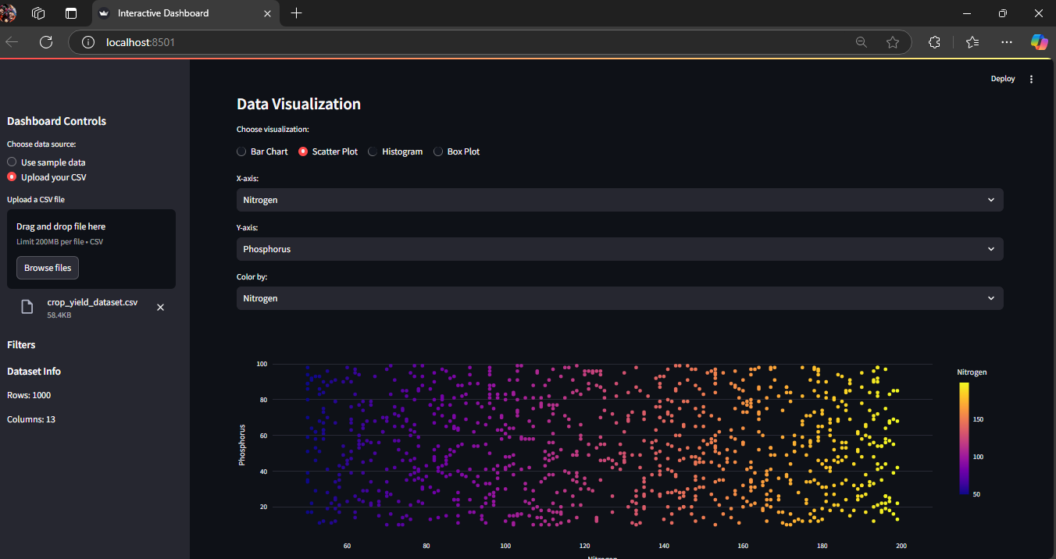
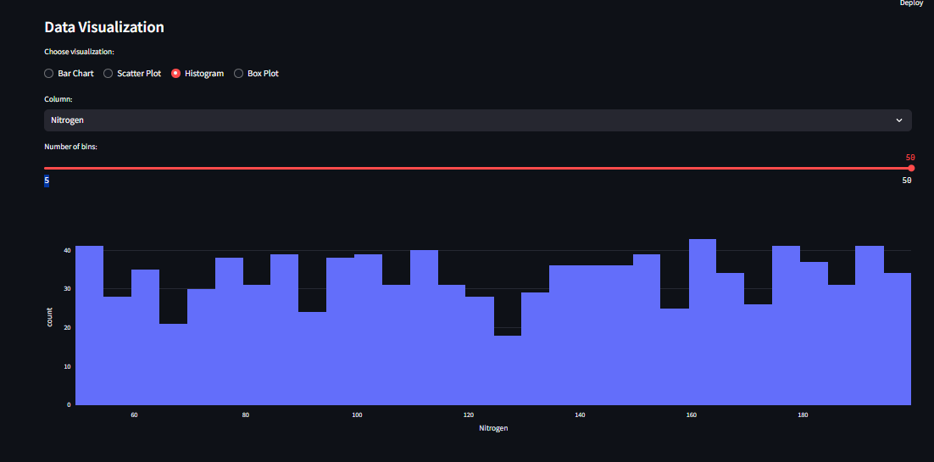
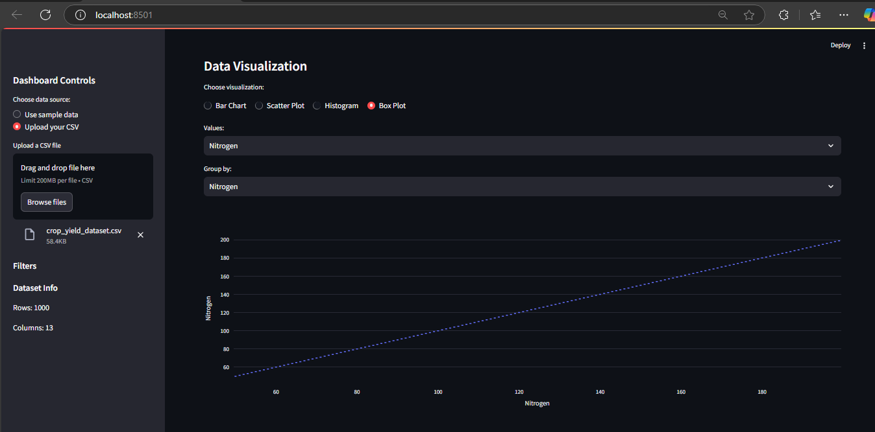
1.DATA VISUALIZATION
BAR CHART
SCATTER PLOTS
HISTOGRAMS
BOX PLOT

Slide 14
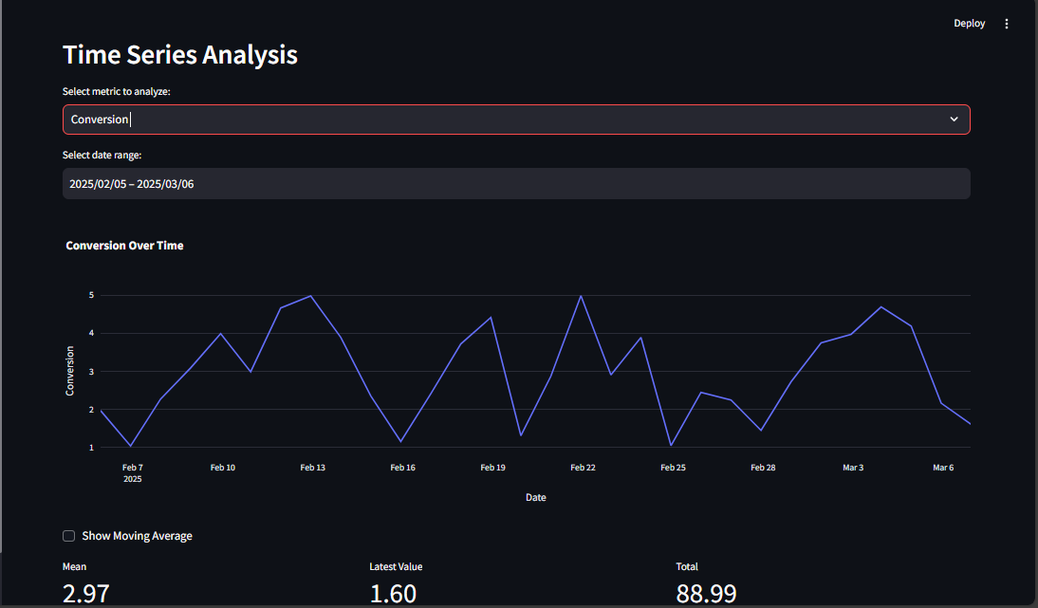
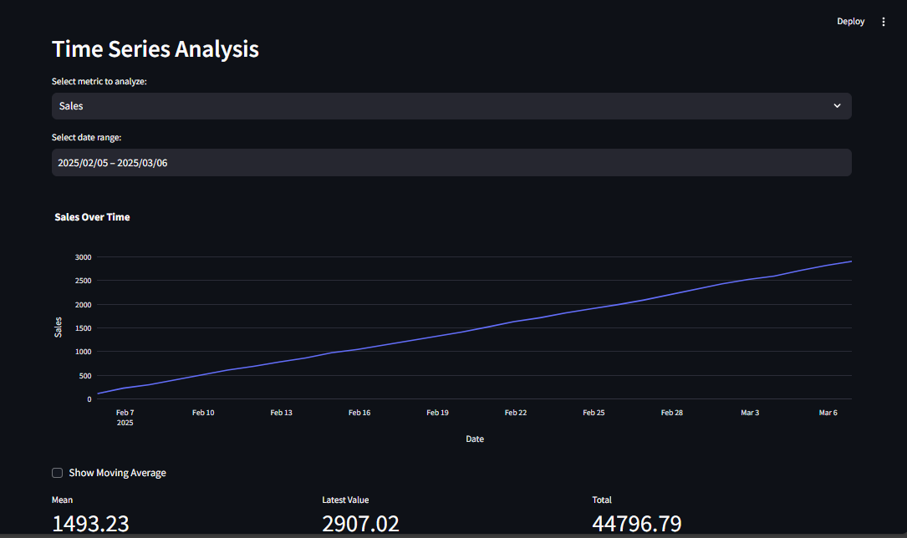
2. TIME SERIES ANALYSIS
OUTPUT 1
OUTPUT 2

Slide 15
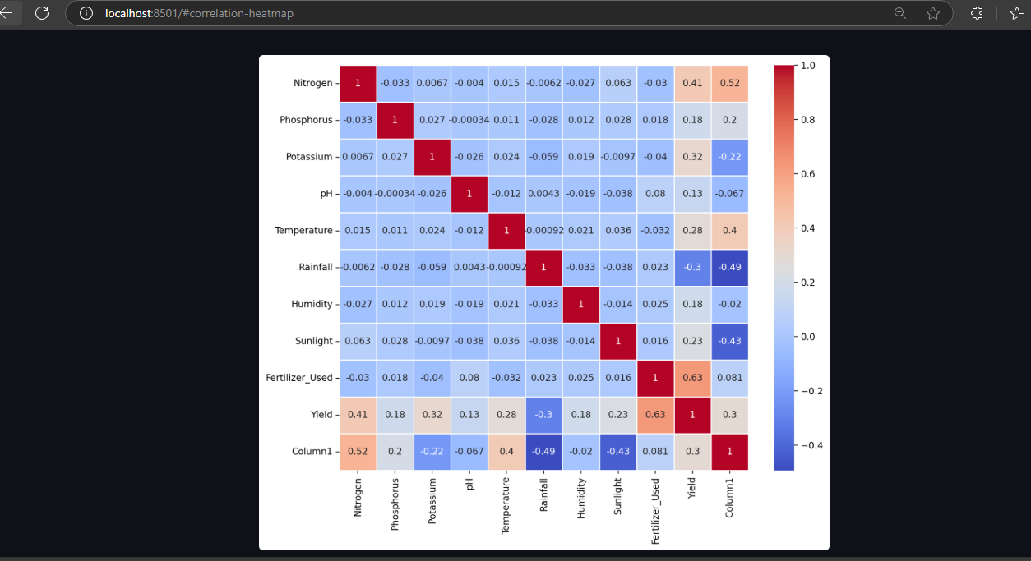
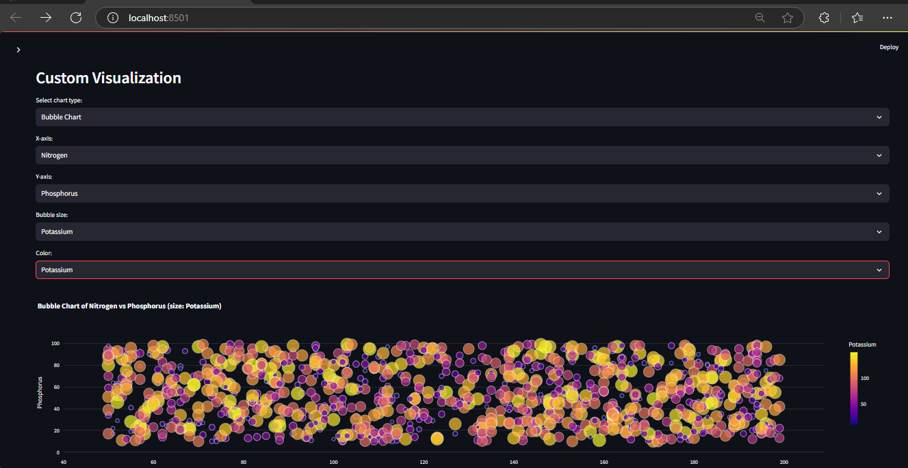
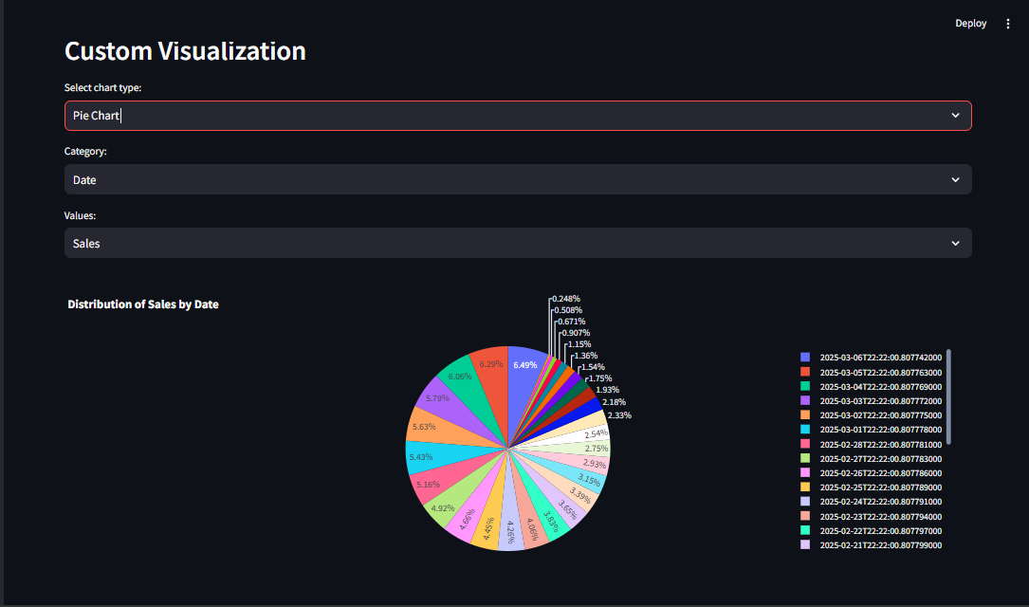
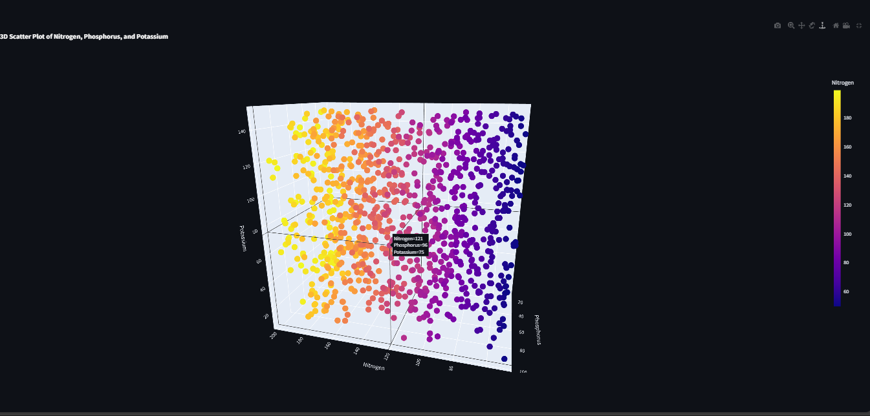
3. CUSTOM VISUALIZATION
HEAT MAP
BUBBLE CHART
PIE CHART
3D SCATTER PLOT

Slide 16
References
https://www.omdena.com/

Slide 17
Thank You
Notes:
Thank You !!

