Slide 1
CONTENT
ABSTRACT
EXISTING SYSTEM
PROPOSED SYSTEM
HARDWARE COMPONENTS
SOFTWARE TOOLS
BLOCK DIAGRAM
LOGIC FLOW
SIMULATION
HARDWARE RESULT
CONCLUSION

Slide 2
ABSTRACT
.
This project presents an innovative IoT-Based Smart Wheelchair with Obstacle Detection that seamlessly integrates multiple control mechanisms, safety features, and health monitoring capabilities within a unified mobility platform. The system features dual control through a traditional joystick and smartphone interface via Blynk, providing flexibility for users with varying abilities. Advanced safety is ensured through ultrasonic obstacle detection that automatically halts movement when hazards are within 25cm. The embedded heart rate monitoring system provides real-time health data to both onboard displays and caregiver smartphones. Testing demonstrates exceptional reliability in obstacle avoidance, smooth transitions between control modes, and accurate health monitoring. This cost-effective solution significantly enhances independence and safety for individuals with mobility challenges while providing caregivers with valuable remote monitoring capabilities.

Slide 3
EXISTING SYSTEM
Manual wheelchairs require considerable upper body strength and cause fatigue with prolonged use, limiting independence for many users.
Conventional powered wheelchairs typically offer only joystick control, creating barriers for users with limited hand dexterity or coordination.
Existing systems lack intelligent safety features, requiring constant vigilance from users to avoid collisions or accidents.
Current mobility solutions rarely incorporate health monitoring capabilities, missing opportunities to detect potential medical emergencies during wheelchair use.

Slide 4
PROPOSED SYSTEM
Dual Control System: Provides both traditional 2-axis analog joystick control and smartphone-based remote operation via Blynk application, ensuring accessibility across different user abilities.
Intelligent Safety Integration: Incorporates front-mounted ultrasonic sensor arrays for real-time obstacle detection with automatic stopping capability when obstacles are detected within 25cm distance.
Health Monitoring: Features an embedded heart rate pulse sensor in the seating surface for continuous vital sign monitoring during wheelchair operation.
IoT Remote Capability: Utilizes Wi-Fi connectivity through ESP8266 for real-time data sharing and remote control via a mobile app, enabling caregivers to monitor and assist users from any location.

Slide 5
HARDWARE COMPONENTS
PIC16F877A
DC MOTORS
L293D MOTOR DRIVER
2-AXIS JOYSTICK MODULE
HC-SR04 ULTRASONIC SENSOR
PULSE SENSOR
BI-DIRECTIONAL LEVEL CONVERSION MODULE
Wi-Fi MODULE
BUZZER
LCD

Slide 6




SOFTWARE TOOLS
PROTEUS SIMULATION SOFTWARE
MPLAB X IDE
XC8 COMPILER
BLYNK APPLICATION

Slide 7
BLOCK DIAGRAM
ULTRASONIC
SENSOR
PIC
16F877A
L293D MOTOR DRIVER
DC MOTORS
PULSE
SENSOR
BUZZER
2-AXIS JOYSTICK MODULE
16 X 2 LCD
ANDROID APPLICATION (BLYNK)
BI-DIRECTIONAL LEVEL CONVERSION
WI-FI MODULE

Slide 8
LOGIC FLOW
System Initialization:
The PIC16F877A microcontroller initializes all components: analog joystick, ultrasonic sensors, ESP8266 Wi-Fi module, heart rate sensor, L293D motor driver, and LCD display.
LCD displays "System Ready" and Blynk app shows connection status.
The system begins continuous heart rate monitoring.
Control Mode Selection:
System checks for active input source (joystick or Blynk remote control).
If joystick movement detected, system enters Joystick Control Mode. If Blynk command received, system enters Remote Control Mode.
LCD displays current active control mode ("JOYSTICK MODE" or "REMOTE MODE").
Joystick Control Operation:
The microcontroller continuously reads the 2-axis analog joystick position. In the neutral position, all motors stop.
Forward tilt rotates all four motors forward, while backward tilt rotates all four motors backward.
For a left turn, the left-side motors stop while the right-side motors rotate forward. For a right turn, the right-side motors stop while the left-side motors rotate forward.

Slide 9
Remote Control Operations:
The ESP8266 receives directional commands from Blynk app.
Movement commands translate to corresponding motor actions following same logic as joystick control.
Movement status updates sent to Blynk app in real-time.
Control can be overridden by joystick input for safety.
Obstacle Detection System:
Ultrasonic sensor array continuously measures distances to obstacles.
If obstacle detected within 50cm: LCD displays "OBSTACLE DETECTED" with distance. If obstacle detected within 25cm: System automatically halts motors regardless of control input, LCD displays "MOVEMENT HALTED," buzzer sounds alert, notification sent to Blynk app.
System resumes normal operation only when obstacle is cleared.
Heart Rate Monitoring:
Pulse sensor continuously monitors user's heart rate.
Heart rate displayed on LCD and updated to Blynk app every 5 seconds.
If heart rate exceeds user-defined thresholds: Alert displayed on LCD, notification sent to Blynk app, buzzer provides audible alert.

Slide 10
Wi-Fi Communication:
ESP8266 maintains connection with Blynk server. Transmits real-time data: heart rate readings, obstacle distances, wheelchair movement status.
Receives control commands from Blynk app.
If connection lost: System displays "CONNECTION LOST" on LCD, reverts to joystick-only control, attempts reconnection periodically.
Emergency Override:
Dedicated emergency stop button halts all motors immediately regardless of other inputs.
System requires manual reset after emergency stop activation.
Notification sent to predefined emergency contacts through Blynk.

Slide 11
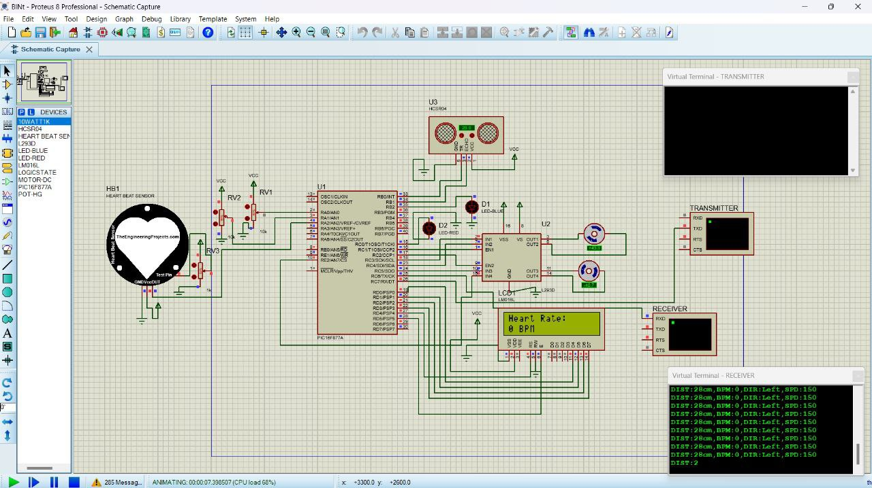
SIMULATION

Slide 12
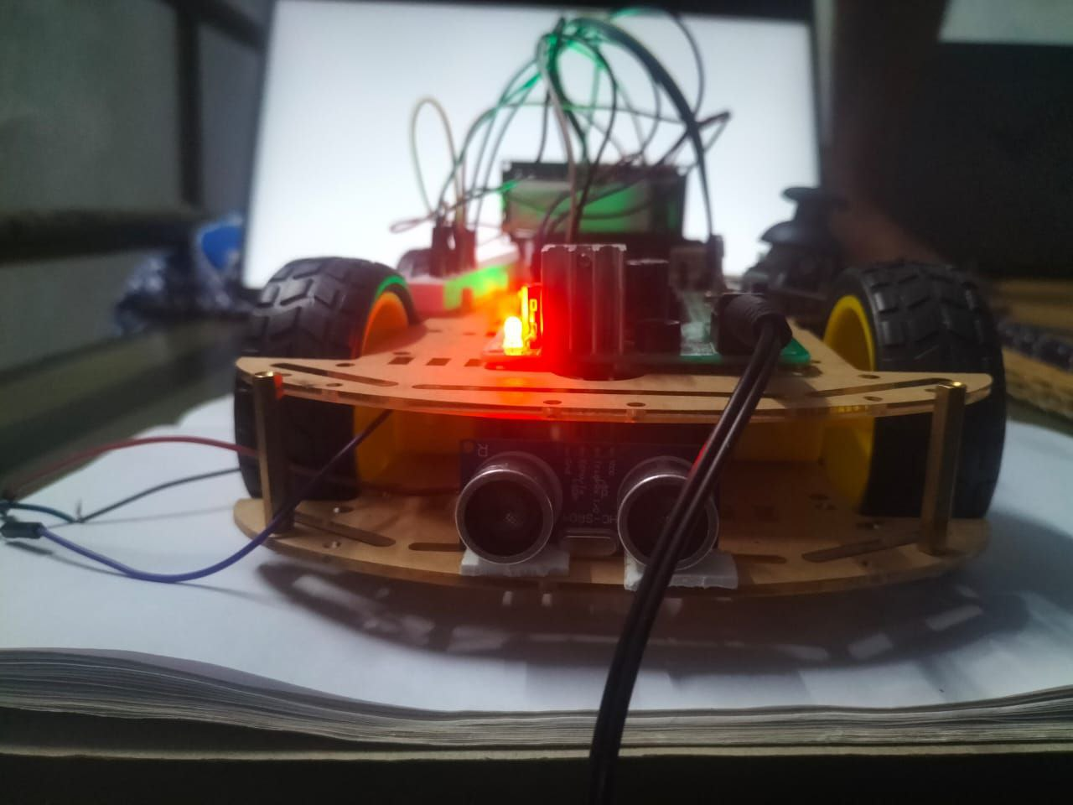
HARDWARE RESULT

Slide 13
CONCLUSION & FUTURE ENHANCEMENTS
The IoT-Based Smart Wheelchair with Obstacle Detection offers a reliable, safe, and user-friendly mobility solution by combining dual control modes, obstacle detection, and real-time health monitoring. It enhances independence for differently-abled individuals while ensuring continuous safety through intelligent sensors and IoT connectivity.
Autonomous Navigation with AI and Machine Learning
Advanced Sensor Suite and Predictive Data Analytics
Cloud-Based Health and System Monitoring
Voice Command and Gesture-Based Control Interfaces

Slide 14
THANK YOU

