Slide 1


Slide 2

1.Home page

Slide 3
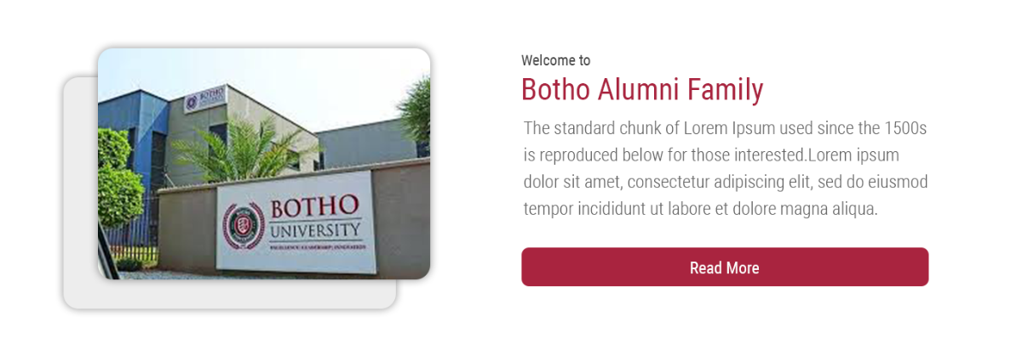
2.Welcome Page

Slide 4
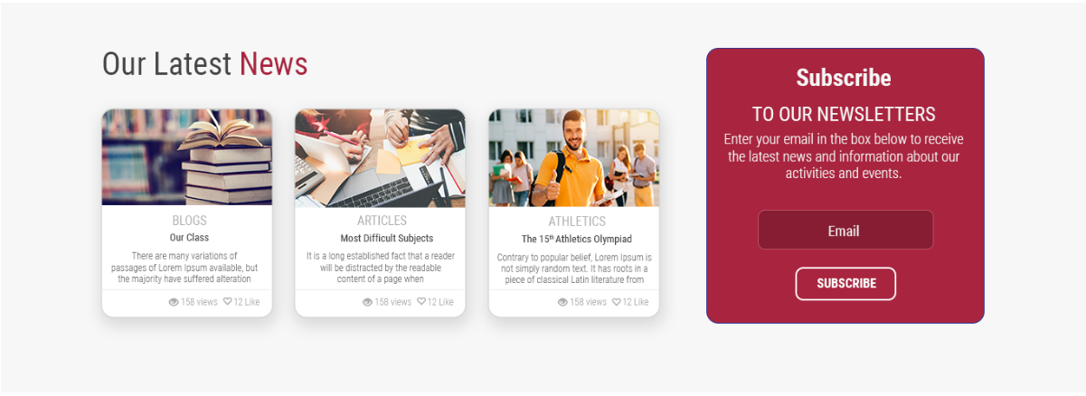
3.Latest News

Slide 5
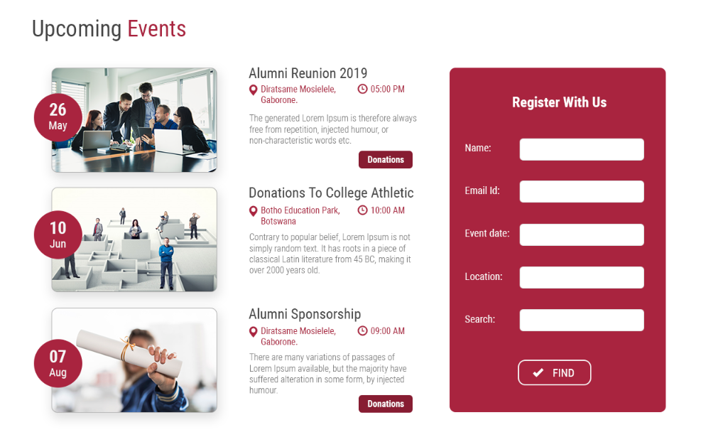
4.Events

Slide 6
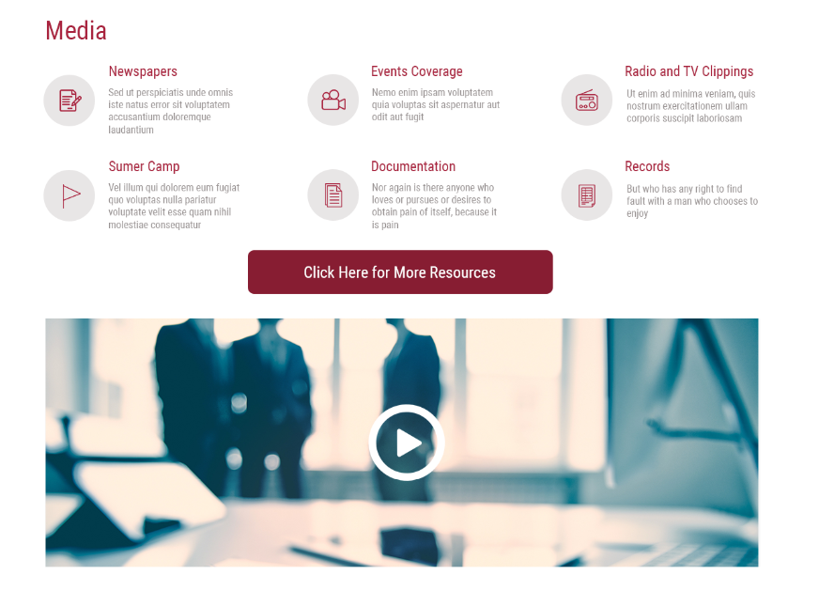
5.Media

Slide 7
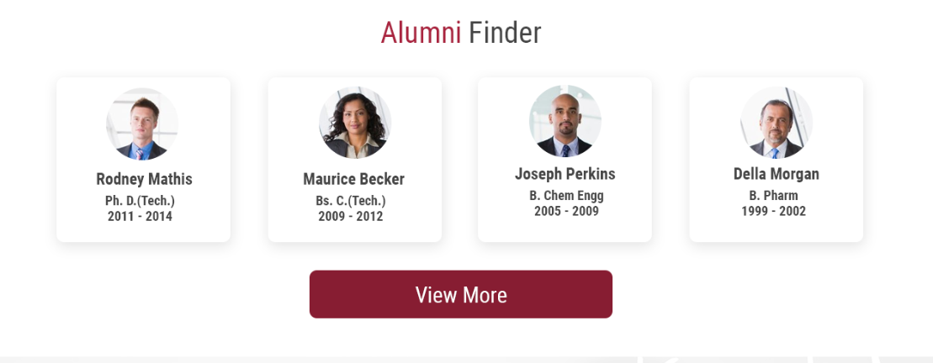
6.Alumni Finder

Slide 8

7.Careers

Slide 9

8.Botho Benefits Card

Slide 10
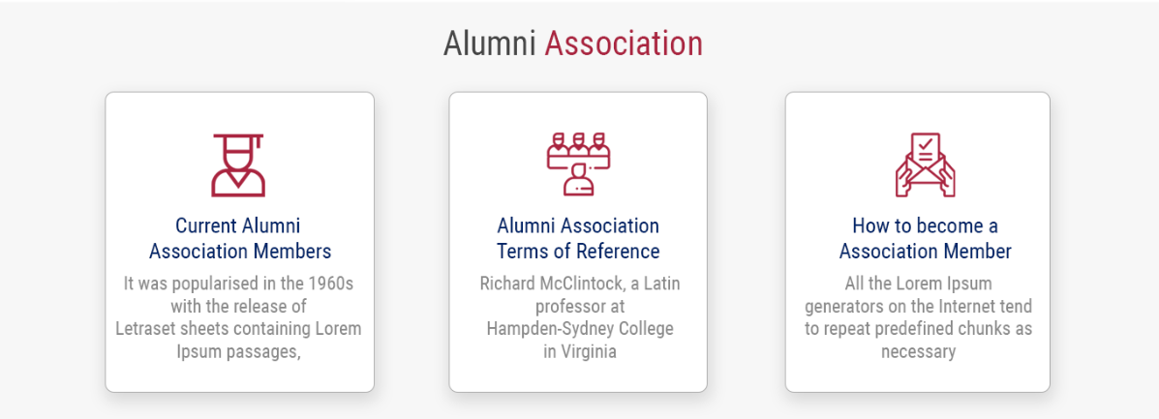
9.Alumni Association

Slide 11
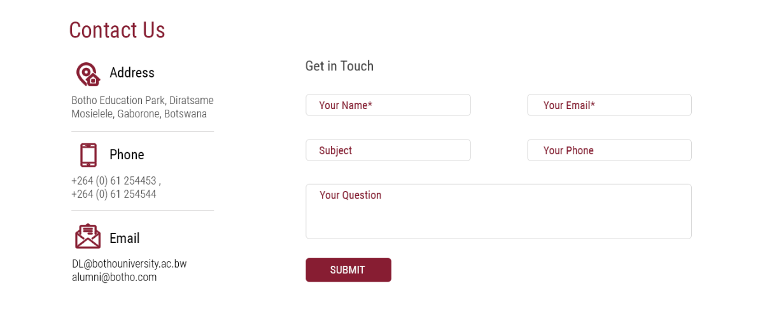
10.Contact Us

