Slide 1
Biometric based certificate verification and automation system
Presented By
Ajith venkadesh.K 962818104011
Ajith.S 962818104010
Jony.J 962818104045
Govindaraju.S 962818104035
IV year,
Computer Science and Engineering - A
University College Of Engineering
Nagercoil
Guided by
M.Ramadass M.tech,
Teaching fellow,
Computer Science and Engineering,
University College of Engineering,
Nagercoil.

Slide 2
OVERVIEW OF THE PRESENTATION
Abstract
Introduction
Literature Survey
Architecture of the Proposed system
Results obtained
Performance evaluation
Comparison with existing system
References

Slide 3
Introduction
In the field of certificate verification there is only manual certificate verification and no automation is present, our system overcome this difficulty using biometric authentication
This system is expected to compile the biometric data with the certificate
This biometric data are stored in database and retrieved by using API
This system completely run on Django web framework for security
This system uses biometric device named mantra 100 to collect the biometric data and verify

Slide 4
Abstract
Our project is a biometric based automated certificate verification system. The existing system consist of QR-code based verification or manual verification this system may have human error and forged edited document and require more human power to process, our system overcome this disadvantage by having biometric information linked to the particular document and can easily be verified, this is done by collecting the biometric information at the time of registration like SSLC,HSC and Degree certificate, government provided certificates linked with biometric information. This data is then used at the time of verification like college admission etc, this require certificate number and biometric information through this our system will confirm the genuinity of certificates in few steps and with more accuracy

Slide 5
LITERATURE SURVEY
Shahriar Karim Shawon,Hosnain Ahammad,Shumrose Zaman Shetu,Mahfujur Rahman & Syed Akhter Hossain “ DIUcerts DApp: A Blockchain-based Solution for Verification of Educational Certificates ” (2021) 12th International Conference on Computing Communication and Networking Technologies (ICCCNT)
Blockchain-based decentralized DIUcerts platform that offers an easy way to issue, check, and verify educational certificates.
Blockchain-based certificate verification system could be highly minimized as compared to building a similar application on a centralized database.
Features:
DIUcerts can lead to better security, cost savings, and a time-saving platform for educational certificate verification. Additionally, data doesn't have to be stored in one place as each certificate's information is kept in an individual file; entire issuance and verifications are done through the Ethereum platform

Slide 6
2. Nitima Malsa,Vaibhav Vyas,Jyoti Gautam ,Ankush Ghosh & Rabindra Nath Shaw ” CERTbchain: A Step by Step Approach Towards Building A Blockchain based Distributed Application for Certificate Verification System” (2021) IEEE 6th International Conference on Computing, Communication and Automation (ICCCA)
The proposed framework is based on blockchain technology that improves security, transparency, etc., and reduces the cost
The key component of this system is a smart contract. A Smart contract Certificate has been developed for storing certificates by using a text editor Sublime Text3 and an IDE Remix Ethereum
Features:
It overcomes the problem of fake certification by creating a chain of blocks for certificates that are immutable as well as transparent amongst all the nodes in the system.

Slide 7
3. GAYATHRI, A., JAYACHITRA, J, & MATILDA, S. (2020).” Certificate validation using blockchain” 2020 7th International Conference on Smart Structures and Systems (ICSSS).
The chaotic algorithm is used to generate the hash code value for the certificate
Then the certificates are stored in the blockchain. And these certificates are validated by using the mobile application
Features:
By using the unmodifiable property of blockchain provide more security. Confidentiality is transparent with each transaction visible to all the peers. Our application runs in offline mode. The certificate is validated rapidly. Provide accurate and reliable information.
Disadvantages:
More time consuming while validating huge blocks of data.
Complexity is high.

Slide 8
4. Raghav, Nitish Andola, Rakhi Verma, S. Venkatesan & Shekhar Verma ” Tamper-Proof Certificate Management System”(2019) IEEE Conference on Information and Communication Technology
Tamper-proof certificate management using hyperledger which provides secure anti-forge mechanism
Hyperledger has unmodifiablity and other suitable properties of the blockchain that helps to minimize the problem of forgery. We use IPFS (Inter Planetary File System) for storing the certificate.
Features:
It provides an unforgeable certificate based model based on hyperledger as hyperledger allows only authorized entities to generated certificate.
It provides integrity, privacy, transparency of certificate and anonymity of user.

Slide 9
5. Dongwei Liu & Xiaojin Guo ” Blockchain Based Storage and VerificatioScheme of Credible Degree Certificate ”(2019) 2nd International Conference on Safety Produce Informatization (IICSPI).
A storage and verification scheme of degree certificates is proposed which combines with the characteristics of blockchain.
The scheme is feasible and correct and can effectively avoid the problem of tampering and the single point of failure.
Features:
The results of tests show that the scheme has higher transaction processing speed than other blockchain-based schemes.

Slide 10
6. Jiin-Chiou Cheng, Narn-Yih Lee , Chien Chi & Yi-Hua Chen (2018)” Blockchain and smart contract for digital certificate” 2018 IEEE International Conference on Applied System Invention (ICASI).
. The system will create a related QR-code and inquiry string code to affix to the paper certificate.
It will provide the demand unit to verify the authenticity of the paper certificate through mobile phone scanning or website inquiries.
Features:
The system saves on paper, cuts management costs, prevents document forgery, and provides accurate and reliable information on digital certificates.
Disadvantages:
One of the notable weaknesses of blockchain is scalability,while blockchain is not indestructible .

Slide 11
7.Madala, D. S. V., Jhanwar, M. P., & Chattopadhyay, A. (2018)”Certificate Transparency Using Blockchain” 2018 IEEE International Conference on Data Mining Workshops (ICDMW).
In this paper, leveraging recent progress in blockchain technology, is proposed a novel system, called CTB, that makes it impossible for a CA to issue a certificate for a domain without obtaining consent from the domain owner
Features:
Implementation CTB using IBM’s Hyperledger Fabric blockchain platform.The security of these logics is bootstrapped by cryptography and allows domain owners to have absolute control over their certificates.
Disadvantages:
The existence of a certificate is necessary but not sufficient evidence for its validity, and a mechanism for determining whether a certificate was revoked is needed.

Slide 12
8. Mouad .M.H.Ali, Vivek H. Mahale,Pravin Yannawar & A. T. Gaikwad, “Overview of Fingerprint Recognition System” International Conference on Electrical, Electronics, and Optimization Techniques (ICEEOT) – 2016
The basic fingerprint recognition system consists of four stages: firstly, the sensor which is used for enrolment & recognition to capture the biometric data.
Secondly, the pre-processing stage which is used to remove unwanted data and increase the clarity of ridge structure by using enhancement techniques.
Thirdly, the feature extraction stage which takes the input from the output of the pre-processing stage to extract the fingerprint features.
Fourthly, the matching stage is to compare the acquired feature with the template in the database.
Features:
The aim of this paper is to review various recent work on fingerprint recognition systems and explain fingerprint recognition stages step by step and give summaries of fingerprint databases with characteristics.

Slide 13
9. Anas Abou El Kalam, Sana Ibjaoun &Abdellah Ait Ouahman “Biometric authentication systems based on hand pattern vein, digital certificates and smart cards” (2013) National Security Days (JNS3)
This paper describes and implements an authentication solution using biometrics, digital certificates and smartcards to solve the security problems in the authentication process.
Features:
Biometric authentication is extremely secure under a variety of attacks and can be used with a wide variety of biometric traits.
It provides better verification of both physical and virtual identities.
As the authentication can be done in real-time with the help of available hardware, the approach is also practical in many applications.

Slide 14
10. Chuchang Liu,M.A. Ozols, T. Cant & M. Henderson“Towards certificate verification in a certificate management system” Proceedings 23rd Australasian Computer Science Conference. ACSC (2000) (Cat. No.PR00518)
The certificate verification function performs the verification process and can store verified certificates in the local database for later use.
Focusing on the certificate verification function, this paper presents a state-based model for CMSs and discusses certificate verification issues.
Features:
It provides an unforgeable certificate based model based on hyperledger.
Disadvantages:
Joining Certificate Management System’s with cross-certificates or bridging Certificate Authorities, is another important issue.
Different distributions of trust points within a Certificate Management System .

Slide 15
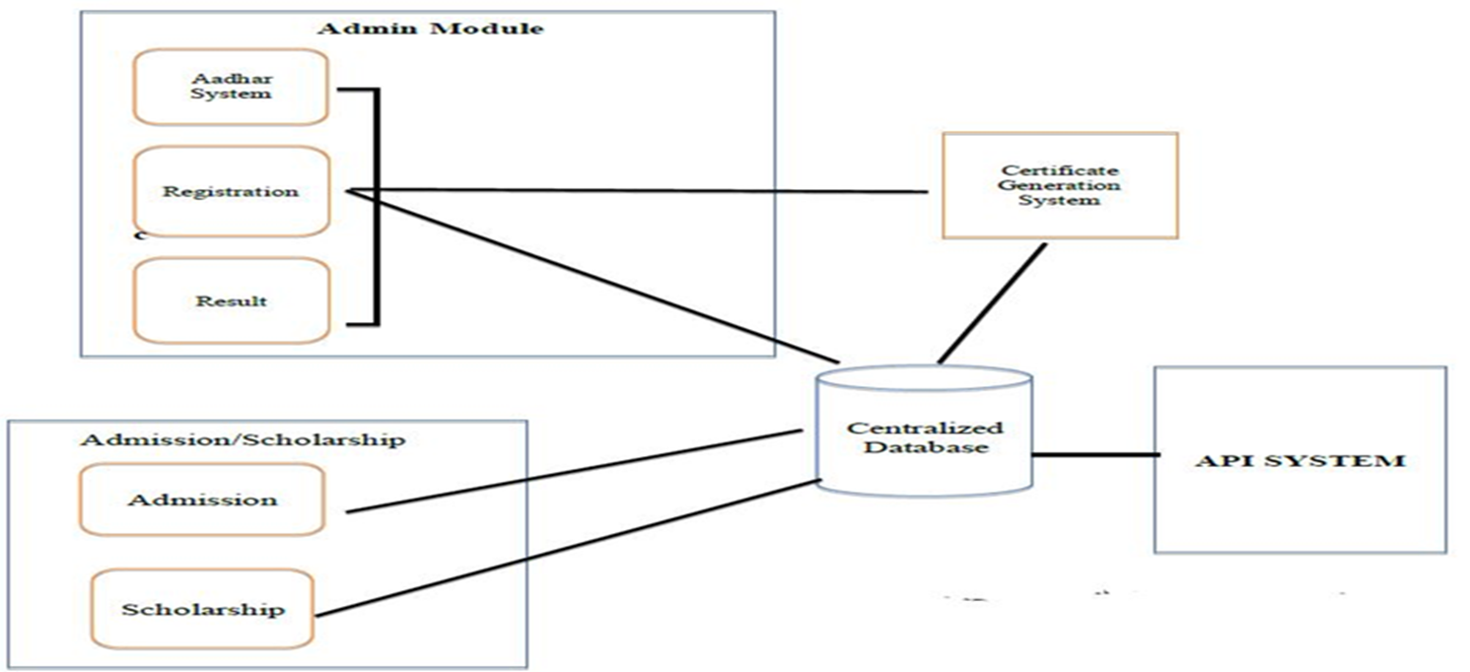
ARCHITECTURE DIAGRAM
continued

Slide 16
continued
Our system consists of three main modules.
Admin module is used for registering new students, registering aadhaar information, student information, generating certificates, registering staff information.
2.Admission and scholarship module is used to apply for admission and scholarship.
3.API module is used to retrieve information.

Slide 17
MODULES
ADMIN MODULE
SCHOLARSHIP / ADMISSION MODULE
API MODULE

Slide 18
ADMIN MODULE
In this module the admin creates new users .
By using this module the admin can add new students
This module provides functionality to create aadhaar record for Students
This module is used to generate certificates also.

Slide 19
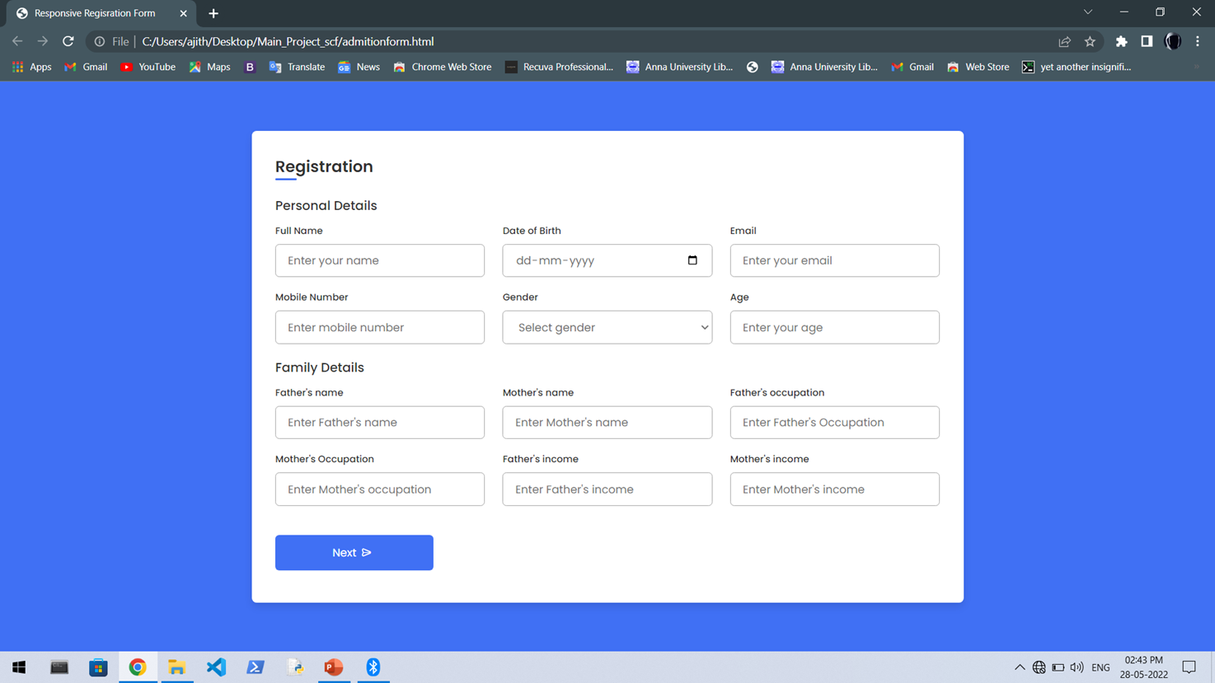

Slide 20
ADMISSION / SCHOLARSHIP MODULE
In this module the student can apply for admission
Also the student can apply for scholarship

Slide 21
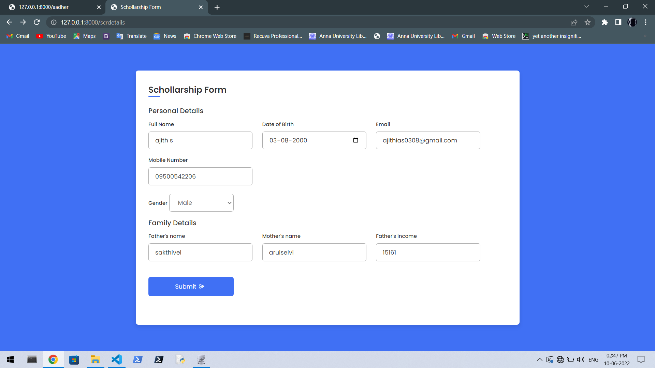

Slide 22
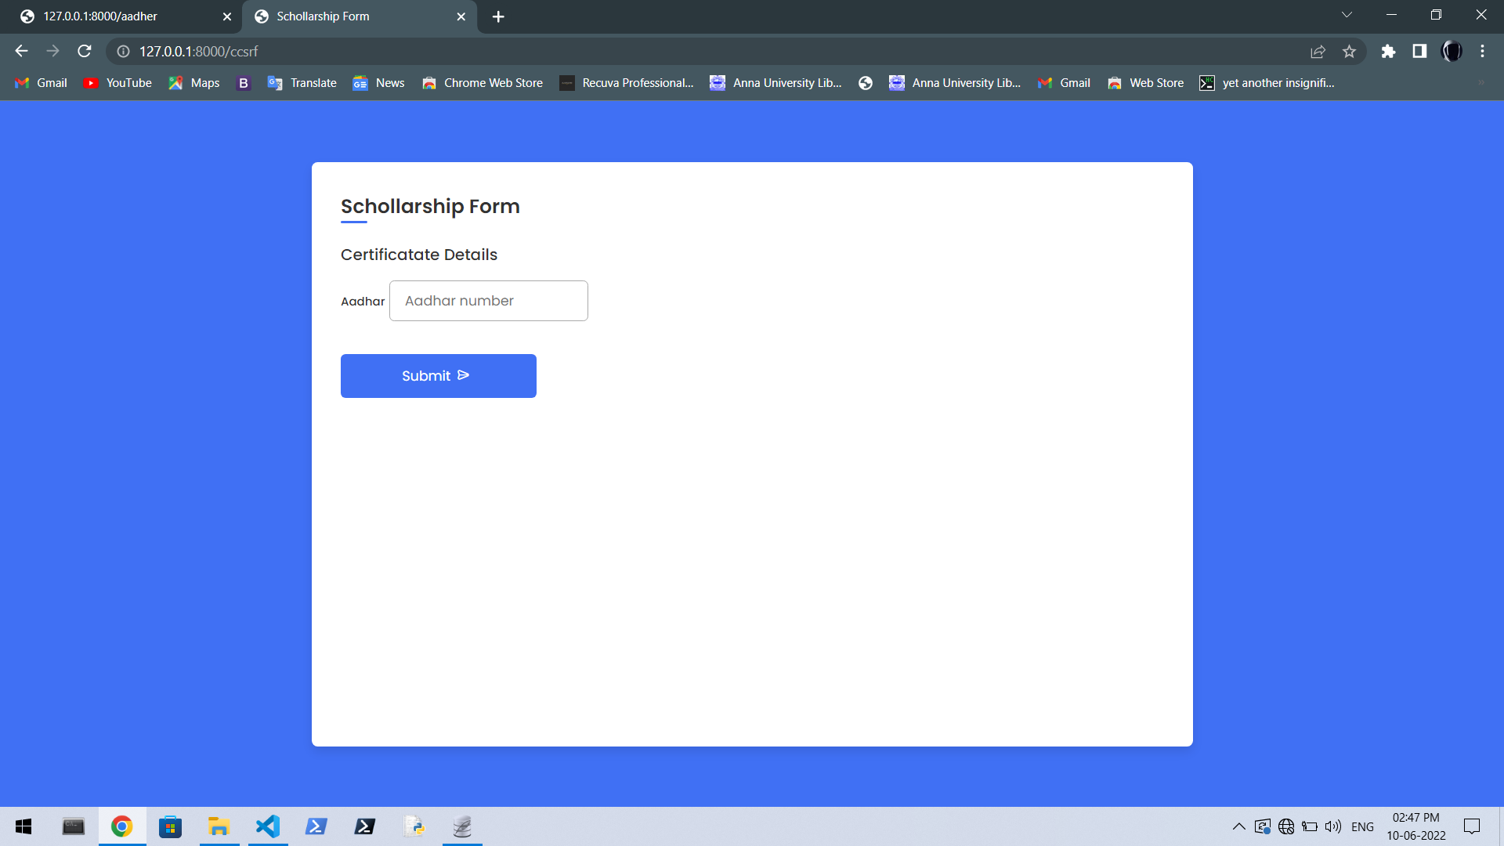

Slide 23
API MODULE
This module takes certificate number and biometric data as input
Then returns whether certificate is genunine or not.

Slide 24
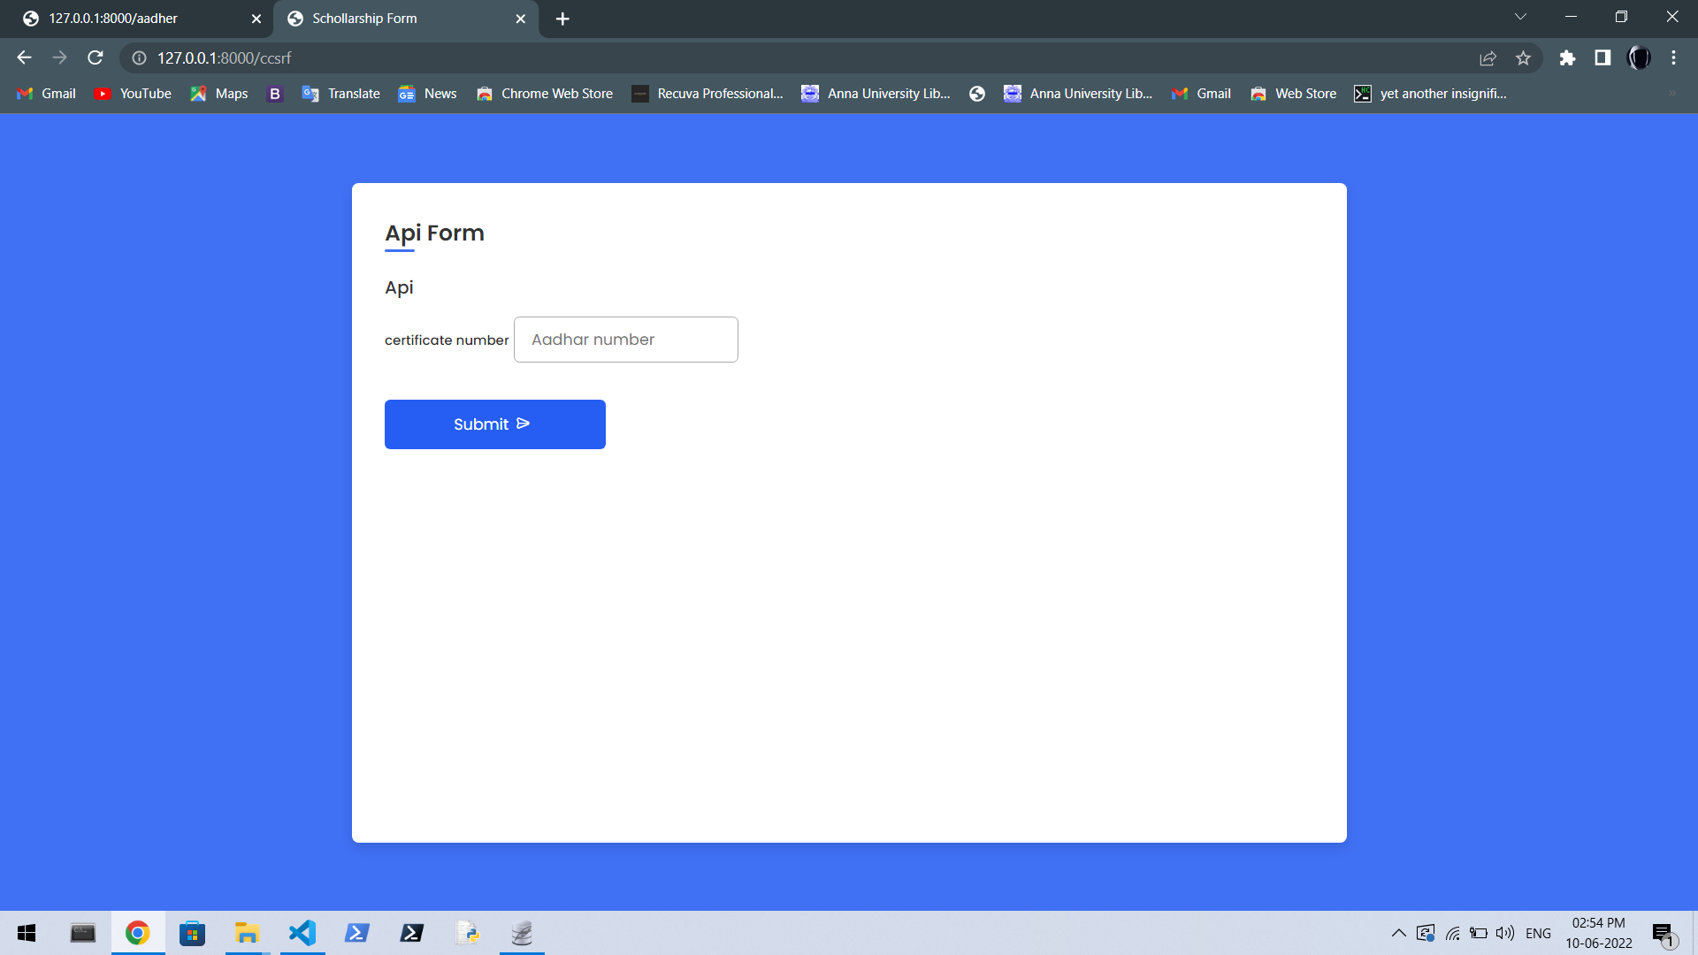

Slide 25
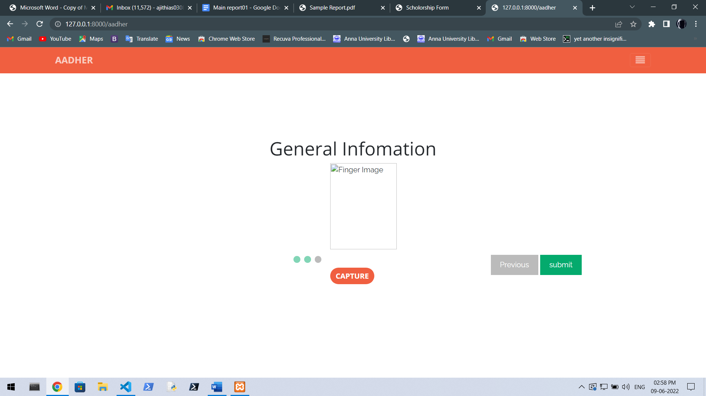

Slide 26
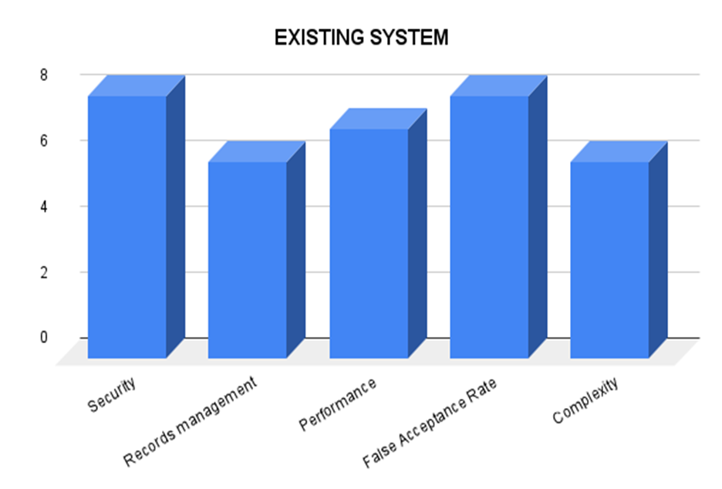
PERFORMANCE EVALUATION
EXISTING SYSTEM
The existing has some advantages over our proposed system because it uses block chain so the security is high here.

Slide 27
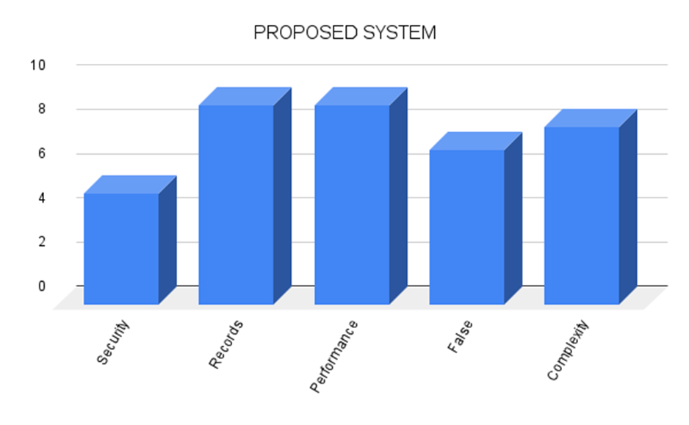
PROPOSED SYSTEM
Our proposed system has many advantages over the existing system it helps to keep track of efficiently when compared to existing system and the processing speed and performance is also high in our speed.

Slide 28
Comparison with existing system
EXISTING SYSTEM | PROPOSED SYSTEM
.In existing system the processing of information is time consuming as the technique of blockchain is employed. | Our system is tested for quick processing and its’s processing time is more efficient compared to the existing system
The energy consumption for the system processing is too high in the existing system | But , in our system as the processing is quicker , the energy required for processing of the information is less .
False acceptance ratio is high | Our system achieved a false acceptance ratio less than in the existing system

Slide 29
REFERENCES
Shahriar Karim Shawon,Hosnain Ahammad,Shumrose Zaman Shetu,Mahfujur Rahman & Syed Akhter Hossain “ DIUcerts DApp: A Blockchain-based Solution for Verification of Educational Certificates ” (2021) 12th International Conference on Computing Communication and Networking Technologies (ICCCNT).
Nitima Malsa,Vaibhav Vyas,Jyoti Gautam ,Ankush Ghosh & Rabindra Nath Shaw CERTbchain: A Step by Step Approach Towards Building A Blockchain based Distributed Application for Certificate Verification System” (2021) IEEE 6th International Conference on Computing, Communication and Automation (ICCCA) .
GAYATHRI, A., JAYACHITRA, J, & MATILDA, S. (2020).” Certificate validation using blockchain” 2020 7th International Conference on Smart Structures and Systems (ICSSS).

Slide 30
Raghav, Nitish Andola, Rakhi Verma, S. Venkatesan & Shekhar Verma Tamper-Proof Certificate Management System”(2019) IEEE Conference on Information and Communication Technology.
. Dongwei Liu & Xiaojin Guo ” Blockchain Based Storage and Verification Scheme of Credible Degree Certificate ”(2019) 2nd International Conference on Safety Produce Informatization (IICSPI).
Jiin-Chiou Cheng, Narn-Yih Lee , Chien Chi & Yi-Hua Chen (2018)” Blockchain and smart contract for digital certificate” 2018 IEEE International Conference on Applied System Invention (ICASI).
Madala, D. S. V., Jhanwar, M. P., & Chattopadhyay, A. (2018)”Certificate Transparency Using Blockchain” 2018 IEEE International Conference on Data Mining Workshops (ICDMW).

Slide 31
Mouad .M.H.Ali, Vivek H. Mahale,Pravin Yannawar & A. T. Gaikwad, “Overview of Fingerprint Recognition System” International Conference on Electrical, Electronics, and Optimization Techniques (ICEEOT) - (2016).
. Anas Abou El Kalam, Sana Ibjaoun &Abdellah Ait Ouahman “Biometric authentication systems based on hand pattern vein, digital certificates and smart cards” (2013) National Security Days (JNS3).
Chuchang Liu,M.A. Ozols, T. Cant & M. Henderson“Towards certificate verification in a certificate management system” Proceedings 23rd Australasian Computer Science Conference. ACSC (2000) (Cat. No.PR00518).

