Slide 1
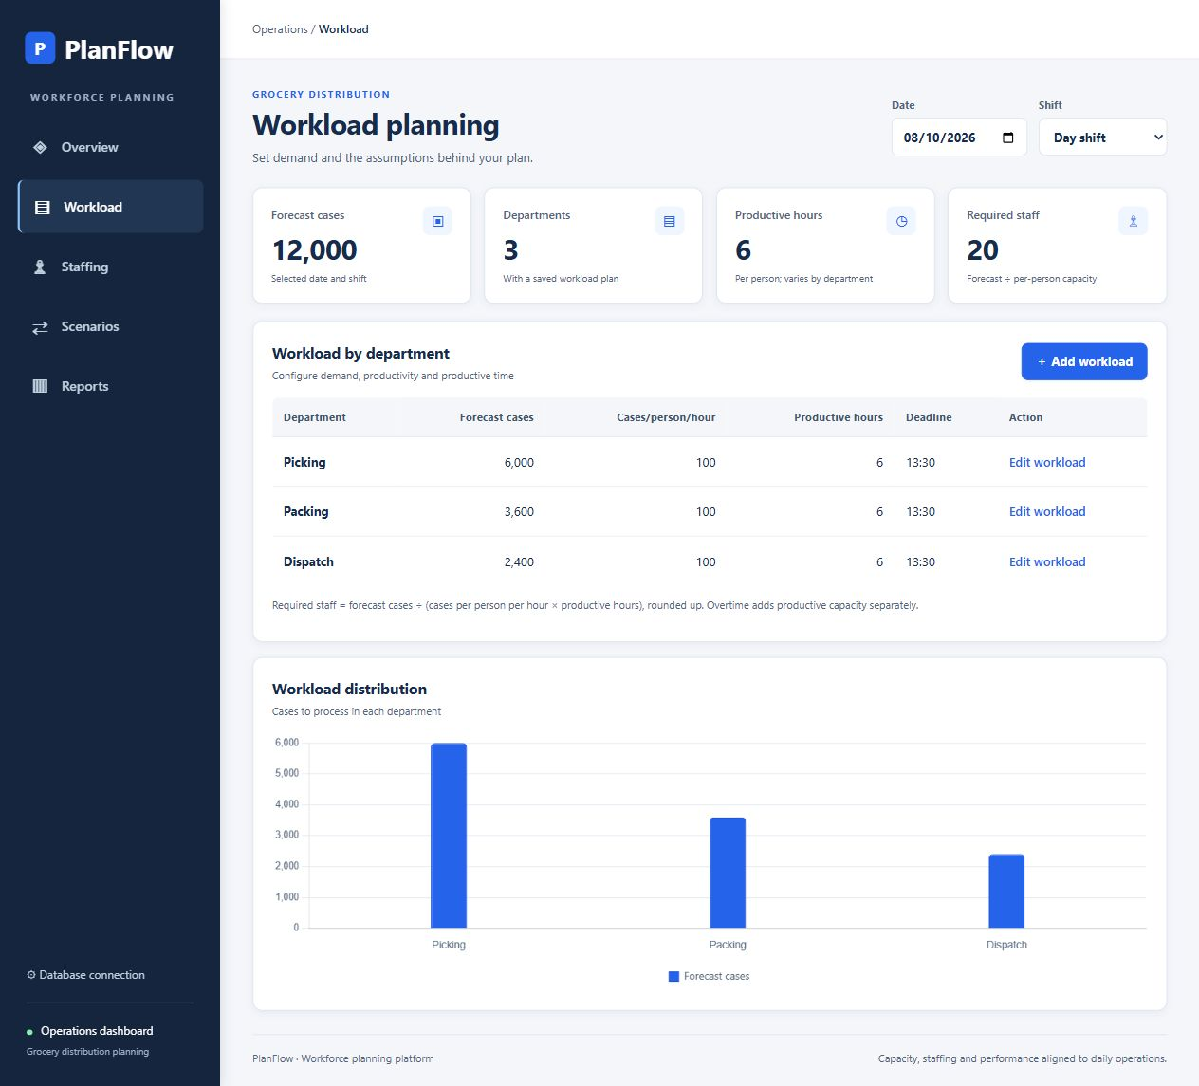
PlanFlow
Daily workload and
staffing planner
CPU4106-20C Group Project
Summative S1 group presentation
Ajiton Agnelo Estibeiro G216208
Newton Lobo G1407919
Ioan-Dragos Ghimboase G1408523
Marcos Rosa E Silva Brandao Pereira G1410839

Slide 2
The planning problem
Planners need to spot
departmental gaps early
01
Forecast volumes change between shifts
02
Absence changes available capacity
SDG 8
03
A total surplus can hide a local shortage
Target 8.2 connects productivity with
technological upgrading and innovation.
02

Slide 3
Aim objectives and scope
Support understandable and consistent
staffing decisions in a browser
01
Capture forecast workload and staffing assumptions
Current scope
02
Calculate required staff and departmental shortfalls
Local workstation prototype
Three departments
Two shifts
Fictional October–December data
03
Compare staffing or overtime proposals
04
Review saved plans and export filtered reports
03

Slide 4
Research and evidence
Research question
How can a browser application support
understandable and consistent staffing decisions?
Evidence available | Evaluation still required
Problem rationale and sample calculations | Interviews with relevant planners
Working interface and system models | Task-based usability observations
Automated tests and report checks | Authorised operational comparisons
04

Slide 5
Group responsibilities
Member | Allocated responsibility | Focus in the viva
Ajiton Agnelo Estibeiro G216208 | Scrum coordination and UX | Problem, planning and rationale
Newton Lobo G1407919 | Front end development | Models and interface behaviour
Ioan-Dragos Ghimboase G1408523 | Python and calculations | Architecture, scenarios and validation
Marcos Rosa E Silva Brandao Pereira G1410839 | Requirements, database and reports | Data, outputs and evaluation
05

Slide 6
Five-week development plan
Activity | W1 | W2 | W3 | W4 | W5
Requirements and research | ●
Design and database | ● | ●
Front end and calculations |  | ● | ●
Scenarios and reporting |  |  | ● | ●
Testing and fixes |  |  |  | ● | ●
Documentation and viva | ● | ● | ● | ● | ●
Weekly review and backlog refinement support iteration
06

Slide 7
UML Use Case diagram
PlanFlow workload and staffing planner
View workload and capacity
Add and edit workload plans
Configure database
connection
Update staffing and absences
Record simulated actuals
Review recent changes
Planner
Compare and save scenarios
Database
administrator
View and export reports
07

Slide 8
Level 0 Context DFD
Forecasts, staffing, actuals
Scenario inputs and filters
Connection settings
Database selection
0
PlanFlow
workload and
staffing planner
Planner
Database
administrator
Capacity and shortage results
Scenarios, reports and CSV
Connection status
Preparation results and changes
08

Slide 9
Application architecture
Browser
HTML, CSS, JavaScript
Chart.js
Flask routes
Input validation
JSON responses
SQL data access
SQLite demo
MySQL option
Local resources allow the configured demonstration to run offline.
The verified demo uses SQLite.
MySQL needs a separate integration check.
Calculation logic
Decimal arithmetic
Capacity, headcount and cost
09

Slide 10
Database and fictional sample data
departments
PK department_id
1 to many
1 to 1
plan_extras
PK/FK plan_id
Absence, cost and actuals
daily_plans
PK plan_id
FK department_id, shift_id
Date and planning inputs
shifts
PK shift_id
scenarios
FK shift_id
Baseline and proposed snapshots
552 plans
92 dates × 2 shifts × 3 departments
Excel sample records converted into SQL with AI assistance
10

Slide 11
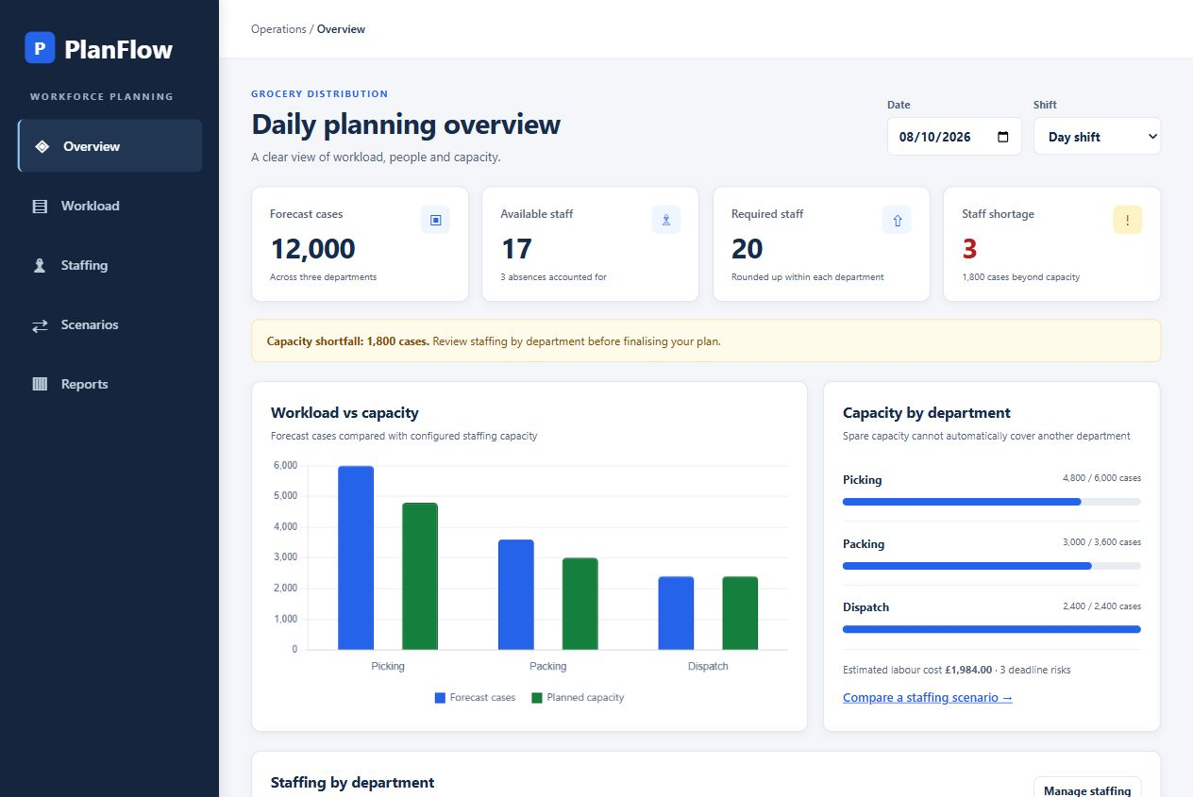
Planner interface and user journey
01
Identify the department with a gap
02
Inspect workload and staffing assumptions
03
Compare a response before saving
11

Slide 12
Staffing and capacity calculations
Required staff
ceil(forecast ÷
(productivity × productive hours))
Picking example
6,000 ÷ (100 × 6) = 10 staff
8 available gives a gap of 2
Shift total 17 available 20 required 1,800 cases short
12

Slide 13
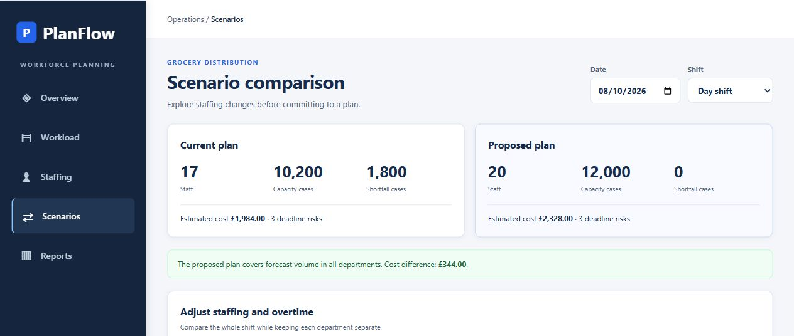
Staffing scenario comparison
Measure | Current | Proposed
Available staff | 17 | 20
Capacity cases | 10,200 | 12,000
Shortfall cases | 1,800 | 0
Illustrative cost | £1,984 | £2,328
Deadline risks | 3 | 3
Cover forecast
Picking 10, Packing 6, Dispatch 4
£344 additional planned cost
Volume covered
Deadline risks remain
13

Slide 14
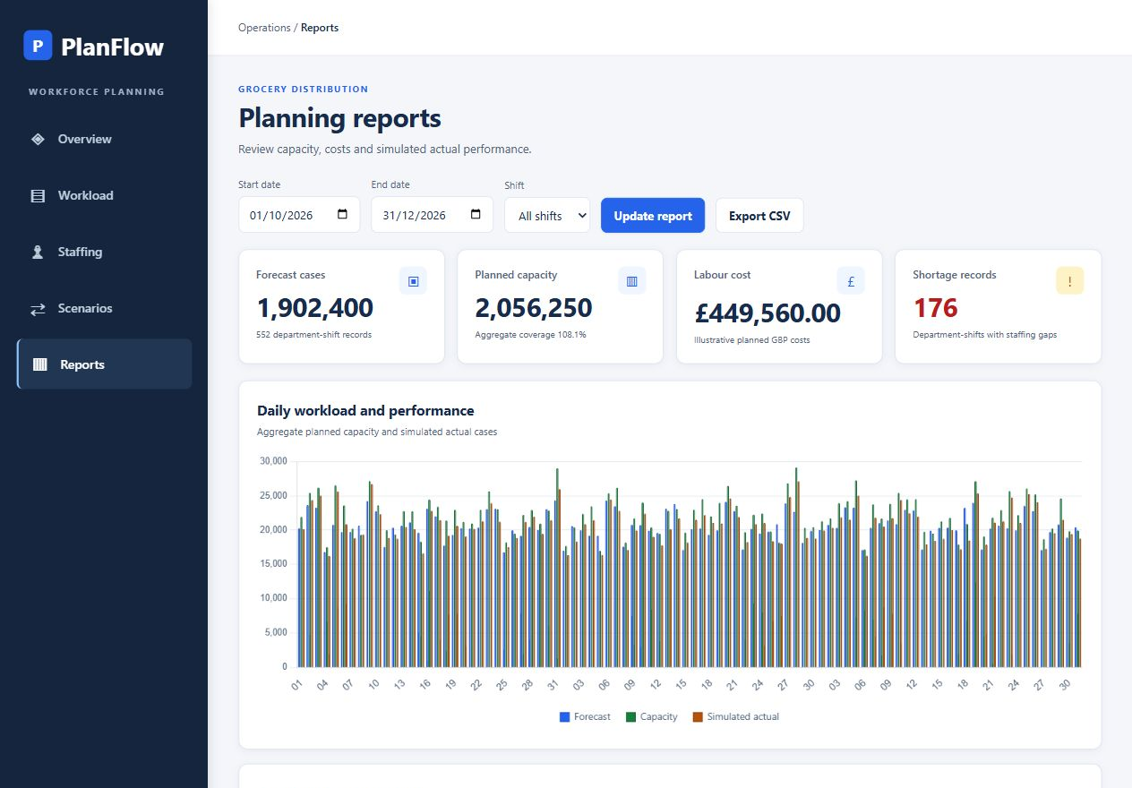
Reporting across the sample quarter
552 records
176 departmental shortage records
108.1% aggregate capacity coverage
14

Slide 15
Testing and validation results
19 / 19
automated tests passed
Check | Expected behaviour | Result
Reference shift | 12,000 forecast, 17 staff, 1,800 shortfall | Pass
Invalid dates and numeric inputs | Reject invalid requests without updates | Pass
Saved edits and stale versions | Persist valid edits and reject conflicts | Pass
Scenario isolation | Preserve baseline and saved snapshots | Pass
Quarter records and CSV reports | Keep record scope and totals consistent | Pass
15

Slide 16
Challenges and limitations
Issue | Current response | Remaining work
Totals hide local gaps | Shortages calculated per department | Validate transfer and skills assumptions
Proposals could alter plans | Independent scenario snapshots | Check users understand snapshot status
Database options need testing | Reproducible SQLite demo | PlanFlow-specific MySQL integration
Operational models simplify work | Visible rates, hours and deadlines | Planner and operational evaluation
No measured planning-time or workplace-productivity improvement is claimed.
16

Slide 17
Evaluation and next steps
A working local planning prototype
01
Workload, staffing, scenarios and reports form one inspectable flow
02
System models and 19 passing tests support the technical account
03
Next priorities are planner evaluation and verified MySQL integration
17

Slide 18
References and questions
References
Schwaber and Sutherland The Scrum Guide, 2020 scrumguides.org/scrum-guide.html
United Nations Goal 8 and Target 8.2 sdgs.un.org/goals/goal8
Questions
18

